Slide 1
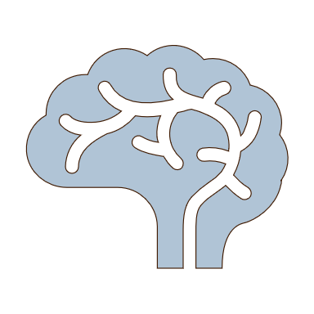
Summary
Neurobehavioural consequences of stroke – Overview of stroke
When a stroke occurs and blood stops flowing to any part of the brain, it is a medical emergency
Stroke has a high mortality rate
Strokes are either haemorrhagic or ischaemic
  In an ischaemic stroke, blood flow in a part of the brain is stopped by a blockage
  A haemorrhagic stroke involves a ruptured blood vessel in the brain
Modifiable risk factors for stroke account for roughly 90% of a person's stroke risk, and include hypertension, diabetes, high cholesterol, alcohol consumption, obesity, and smoking
The burden of stroke is rapidly rising in low- and middle-income countries, leading some to call for a global response to preventing stroke

