Slide 1
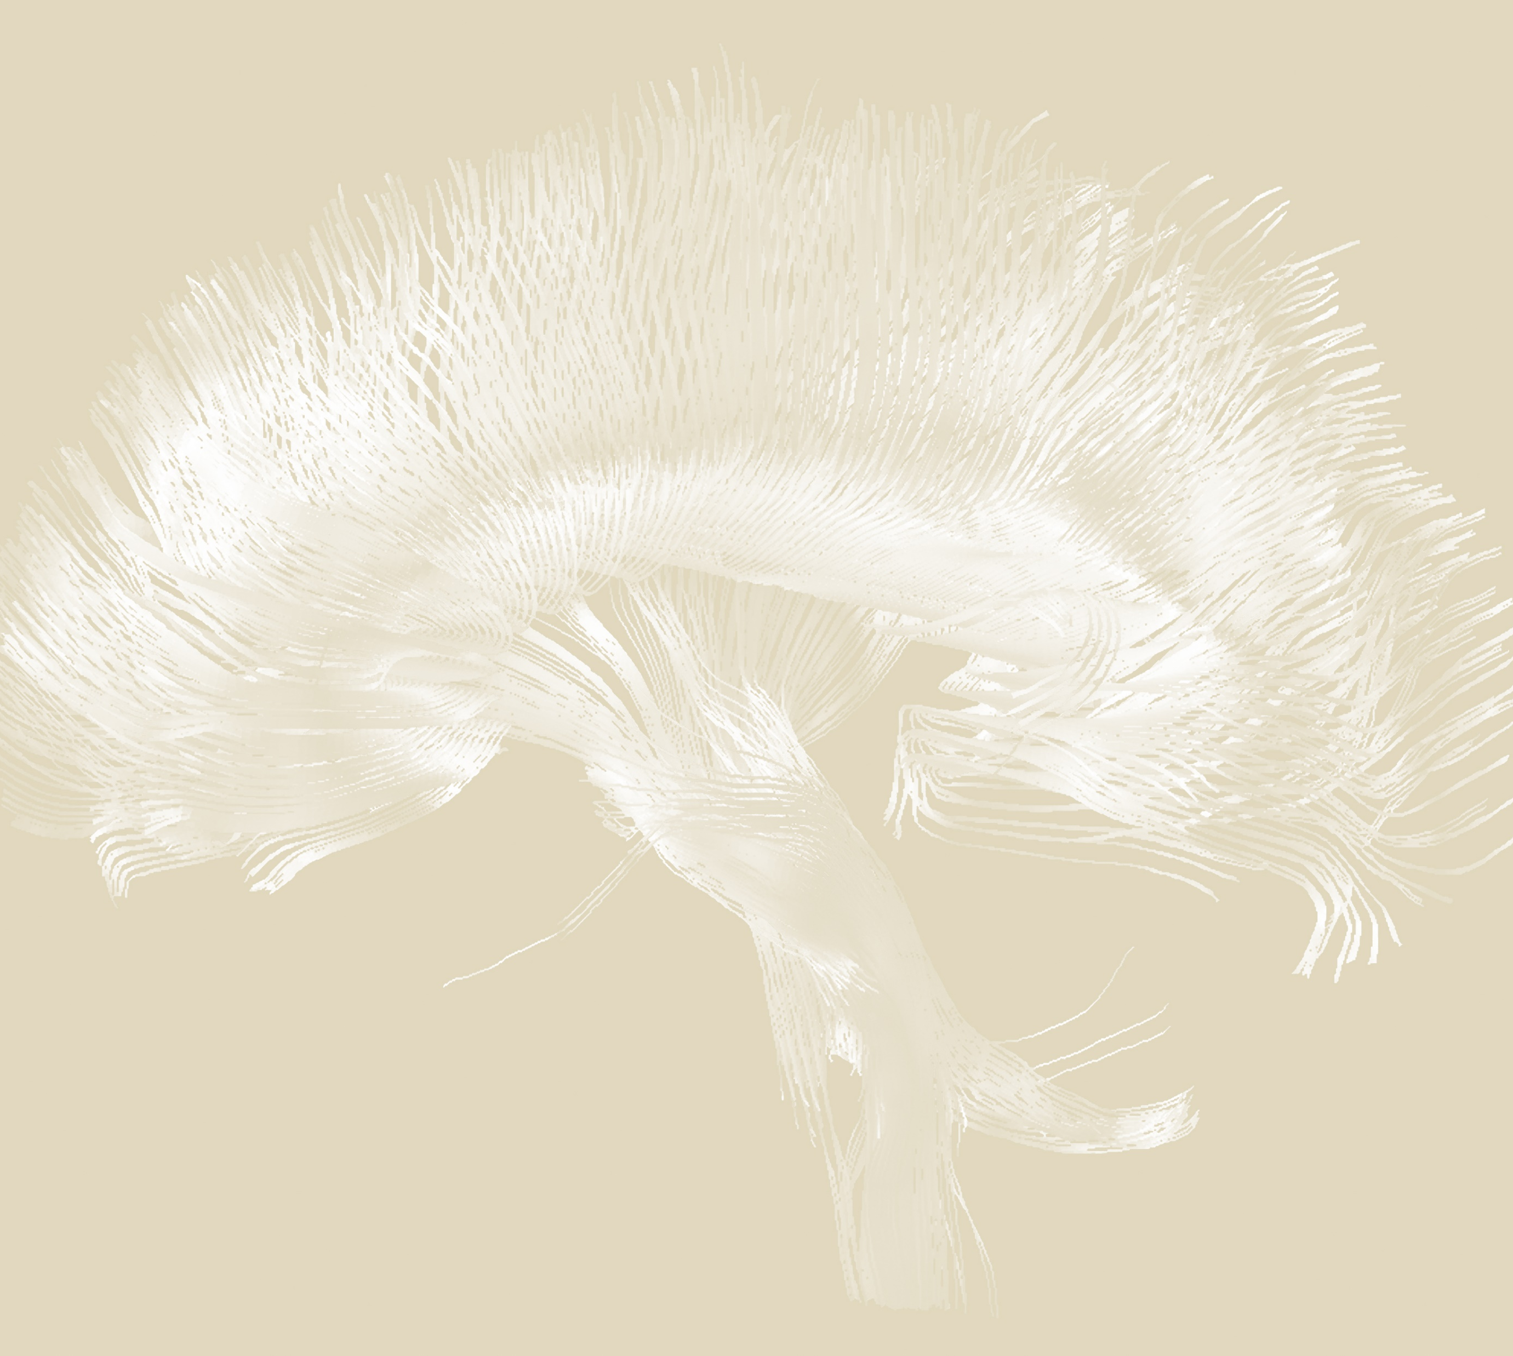
Neurobehavioural consequences of stroke
Post-stroke cognitive impairment and dementia

Slide 2

Case presentation
Neurobehavioural consequences of stroke – Post-stroke cognitive impairment and dementia
A 67-year-old man of South Asian origin with a long history of hypertension
He had a right hemisphere stroke ~5 years previously, and has been seen in the memory clinic with cognitive decline that had a sudden onset at the time of the previous stroke, but he initially presented with mild symptoms
He was experiencing problems with short term memory and managing his finances
  Blood pressure noted to be high
  Brain imaging showed the previous right hemisphere stroke, and moderate small vessel disease
  He was diagnosed with mild dementia of mixed Alzheimer’s type and vascular aetiology, and advised to begin treatment with donepezil
He re-presented to hospital with a further stroke, this time in the left hemisphere
  Noted to be non-compliant with medications
  A further decline in his cognition was noted
  He was discharged with his carers and his son supporting
Learning point: cognitive impairment resulted in medication non-compliance and contributed to further stroke hence the importance of screening for and diagnosing impairment and targeted interventions. The patient was at high risk of vascular disease also because of ethnicity and significant small vessel disease on scan
This case study is a hypothetical patient case, based on Prof. Sarah Pendlebury’s clinical experiences

Slide 3
Definitions
Neurobehavioural consequences of stroke – Post-stroke cognitive impairment and dementia
Vascular cognitive impairment (VCI) – cognitive impairment of any severity associated with cerebrovascular disease regardless of the occurrence of stroke symptoms
  Various injuries can lead to VCI, ranging from progressive microvascular pathologies to a stroke causing large damage to an area of the brain
Post-stroke cognitive impairment (PSCI) – any severity of cognitive impairment, regardless of cause, noted after an overt stroke
  Some degree of cognitive impairment after stroke is common
  PSCI can be seen as a spectrum from mild to severe
Post-stroke dementia (PSD) – all types of dementia after stroke
PSCI=post-stroke cognitive impairment; PSD=post-stroke dementia; VCI=vascular cognitive impairment
El Husseini et al. Stroke 2023;54(6):e272–e291
Notes:
The slide presents some key definitions of the cognitive impairment that can occur with stroke: vascular cognitive impairment (VCI), post-stroke cognitive impairment (PSCI), and post-stroke dementia (PSD), taken from a consensus statement from the American Heart Association and the American Stroke Association.¹
Reference:
El Husseini N, Katzan IL, Rost NS, et al.; American Heart Association Stroke Council; Council on Cardiovascular and Stroke Nursing; Council on Cardiovascular Radiology and Intervention; Council on Hypertension; and Council on Lifestyle and Cardiometabolic Health. Cognitive impairment after ischemic and hemorrhagic stroke: a scientific statement from the American Heart Association/American Stroke Association. Stroke 2023; 54 (6): e272–e291.

Slide 4
Epidemiology of post-stroke cognitive impairment and dementia

Slide 5
Prevalence of post-stroke cognitive impairment (PSCI)
Neurobehavioural consequences of stroke – Post-stroke cognitive impairment and dementia
The prevalence of PSCI differs according to the type of stroke, diagnostic criteria for cognitive impairment used, and the timing of cognitive assessment – resulting in substantial heterogeneity in reported estimates across different studies^{1,2}
Pooled prevalence of PSCI in the year after stroke
Meta-analysis of 21 studies, including patients with ischaemic stroke, or a mixture of ischaemic or haemorrhagic stroke or TIA
38%
of patients
(95% CI: 32, 43%)
In studies of patients with ischaemic stroke, the pooled prevalence of PSCI was higher:
45% (95% CI%: 41, 50%)
CI=confidence interval; PSCI=post-stroke cognitive impairment; TIA=transient ischaemic attack
1. Sexton et al. Eur Stroke J 2019;4(2):160–171; 2. Pendlebury & Rothwell. et al. Lancet Neurol 2009;8(11):1006–1018
Notes:
In this meta-analysis, which took data from 21 studies, the prevalence of cognitive impairment but not dementia in the year after stroke ranged from 17.5–54.9%.¹ The pooled prevalence in this study was 38%; in other words, approximately four patients out of every ten will experience some degree of cognitive impairment in the year after stroke.¹
References:
Sexton E, McLoughlin A, Williams DJ, et al. Systematic review and meta-analysis of the prevalence of cognitive impairment no dementia in the first year post-stroke. Eur Stroke J 2019; 4 (2): 160–171.
Pendlebury ST, Rothwell PM. Prevalence, incidence, and factors associated with pre-stroke and post-stroke dementia: a systematic review and meta-analysis. Lancet Neurol 2009; 8 (11): 1006–1018.

Slide 6
Prevalence of post-stroke dementia (PSD)
Neurobehavioural consequences of stroke – Post-stroke cognitive impairment and dementia
Approximately 1 in 10 patients have dementia before their first stroke, another 1 in 10 will develop dementia after their first stroke, and more than one-third have dementia after recurrent stroke
Rates of PSD in different clinical settings
 | Rate of PSD (%) | 95% CI
Hospital-based, recurrent stroke, including pre-stroke dementia | 41.3 | 29.6, 53.1
Hospital-based, any stroke, including pre-stroke dementia | 26.5 | 24.3, 28.7
Hospital-based, first ever stroke, including pre-stroke dementia | 23.0 | 21.4, 24.7
Hospital-based, any stroke, excluding pre-stroke dementia | 20.3 | 18.2, 22.5
Hospital-based, first ever stroke, excluding pre-stroke dementia | 12.0 | 9.6, 14.4
CI=confidence interval; PSD=post-stroke dementia
Pendlebury et al. Int J Stroke 2012;7(7):570–581
Notes:
As shown on the slide, the rates of dementia in the first year after stroke ranged as high as 41.3% (in hospital-based studies of recurrent stroke in which pre-stroke dementia was included).¹ The factors associated with dementia after stroke are similar to those associated with dementia before stroke, and include older age, and female sex.¹
Reference:
Pendlebury ST. Dementia in patients hospitalized with stroke: rates, time course, and clinico-pathologic factors. Int J Stroke 2012; 7 (7): 570–581.

Slide 7
Effect of stroke severity on post-stroke dementia (PSD)
Neurobehavioural consequences of stroke – Post-stroke cognitive impairment and dementia
The incidence of dementia is nearly 50 times higher in people the year after a major stroke compared with that of the general population
The risk of PSD is much higher in the first year after stroke compared with anytime thereafter, particularly after severe stroke
Cumulative incidence of PSD stratified by stroke event severity
NIHSS >10
NIHSS 6–10
Incidence
NIHSS 3–5
NIHSS <3
TIA
0
5
Years after stroke
This work is adapted from ‘Incidence and prevalence of dementia associated with transient ischaemic attack and stroke: analysis of the population-based Oxford Vascular Study' by Pendlebury et al., used under CC-BY-4.0. This work is licensed under Creative Commons license CC-BY-SA by The Lundbeck Foundation.
NIHSS=US National Institutes of Health Stroke Scale; PSD=post-stroke dementia; TIA=transient ischaemic attack
Pendlebury et al. Lancet Neurol 2019;18(3):248–258
Notes:
The Oxford Vascular Study was a prospective study which recruited 92,728 people between 2002–2012, living in Oxford, UK, and followed them for up to 10 years.¹ Among the sample, 1,617 experienced a stroke and 688 experienced transient ischaemic attack, and were included in the analysis.¹ As shown on the slide, the incidence of dementia after stroke appeared to increase according to the severity of the stroke.¹
Reference:
Pendlebury ST, Rothwell PM; Oxford Vascular Study. Incidence and prevalence of dementia associated with transient ischaemic attack and stroke: analysis of the population-based Oxford Vascular Study. Lancet Neurol 2019; 18 (3): 248–258.

Slide 8
Post-stroke dementia after haemorrhagic stroke
Neurobehavioural consequences of stroke – Post-stroke cognitive impairment and dementia
This prospective observational study included patients from the PITCH cohort in France, following patients after haemorrhagic stroke for 6 years for the occurrence of dementia
There were 560 people who experienced spontaneous cerebral haemorrhage, of whom 218 had no dementia at baseline
After 1 year, 14.2% had developed dementia
After 4 years, 28.3% had developed dementia
Risk factors for dementia after stroke included:
  Disseminated superficial siderosis
  Higher cortical atrophy score
  Higher number of cerebral microbleeds
  Older age
In this study, the incidence of new-onset dementia was more than two-times higher in patients with lobar intracerebral haemorrhage compared with patients with non-lobar intracerebral haemorrhage
28.3%
PITCH=prognosis of intracerebral haemorrhage
Moulin et al. Lancet Neurol 2016;15(8):820–829
Notes:
This study was undertaken because there was a lack of good evidence about the risk of dementia after haemorrhagic stroke.¹ Patients from the Prognosis of Intracerebral Haemorrhage (PITCH) cohort were included in the study if they were aged ≥18 years and older and had a parenchymal haemorrhage on their first CT scan.¹ Patients were followed for a median of six years, and monitored for the development of dementia, based on the National Institute on Aging – Alzheimer’s Association criteria.¹ In this group of patients who experienced haemorrhagic stroke there was a substantial risk of developing dementia.¹
Reference:
Moulin S, Labreuche J, Bombois S, et al. Dementia risk after spontaneous intracerebral haemorrhage: a prospective cohort study. Lancet Neurol 2016; 15 (8): 820–829.

Slide 9

Rates of PSD compared with the background population
Neurobehavioural consequences of stroke – Post-stroke cognitive impairment and dementia
In the population-based observational Framingham Study, incident stroke doubled the risk of dementia:¹
  HR: 2.0 (95% CI: 1.5, 3.1)
  At 10 years post stroke, the cumulative incidence of dementia was estimated to be ~35% in people with stroke compared with ~20% for the general population
The prevalence of dementia is brought forward by:²
  2 years for TIA
  4 years for minor stroke
  25 years for severe stroke
Prevalence of dementia in patients 1 year after stroke compared with the general population²
60
TIA
50
Major stroke
General population
40
Prevalence (%)
30
20
10
0
<65
65–69
70–74
75–79
80–84
85–89
>90
Age (years)
This work is adapted from ‘Incidence and prevalence of dementia associated with transient ischaemic attack and stroke: analysis of the population-based Oxford Vascular Study' by Pendlebury et al., used under CC-BY-4.0. This work is licensed under Creative Commons license CC-BY-SA by The Lundbeck Foundation.
CI=confidence interval; HR=hazard ratio; PSD=post-stroke dementia; TIA=transient ischaemic attack
1. Ivan et al. Stroke 2004;35(6):1264–1268; 2. Pendlebury et al. Lancet Neurol 2019;18(3):248–258
Notes:
The Framingham study is an observational study that began monitoring people for incident stroke in the 1950s.¹ The subset of patients used for the analysis presented on the slide included 212 people who were dementia free in 1982, experienced a stroke after this date, and their risk of developing dementia thereafter was compared with 1,060 control individuals.¹ Stroke doubled the risk of developing dementia, after adjustment for age, sex, education, and exposure to certain risk factors.¹
References:
Ivan CS, Seshadri S, Beiser A, et al. Dementia after stroke: the Framingham Study. Stroke 2004; 35 (6): 1264–1268.
Pendlebury ST, Rothwell PM; Oxford Vascular Study. Incidence and prevalence of dementia associated with transient ischaemic attack and stroke: analysis of the population-based Oxford Vascular Study. Lancet Neurol 2019; 18 (3): 248–258.

Slide 10
Stroke accelerates cognitive decline
Neurobehavioural consequences of stroke – Post-stroke cognitive impairment and dementia
An analysis using the STROKOG collaboration data found that, after stroke, people experience cognitive decline that is significantly faster than people without stroke¹
In the REGARDS study, stroke was associated with a stepwise immediate decline in cognitive function, followed by an accelerated risk for future cognitive decline – greater than would be expected for age²
Rate of cognitive decline in different domains after stroke¹
 | Patients in study for <1 year: Effect size | Patients in study for ≥1 year: Effect size
Global cognition | 0.14 | -0.056
Attention and processing speed | 0.11 | -0.032
Memory | 0.25 | -0.061
Language | -0.002 | -0.097
Language (outlier excluded) | 0.10 | -0.046
Perceptual motor | 0.17 | -0.051
Executive function | 0.051 | -0.013
REGARDS=Reasons for Geographical and Racial Differences in Stroke; STROKOG=Stroke and Cognition Collaboration
1. Lo et al. Stroke 2022;53(4):1318–1327; 2. Levine et al. Stroke 2018;49(4):987–994
Notes:
Stroke appears to accelerate the rate of cognitive decline.^{1,2} In the ‘reasons for geographic and racial differences in stroke’ (REGARDS) study, 22,875 people without baseline cognitive impairment were followed, and stroke was associated with declines in global cognition, as well as declines in new learning, verbal memory, and executive function.² Faster declines were seen in patients who were Black, male, and who experienced cardioembolic or large artery stroke.²
References:
Lo JW, Crawford JD, Desmond DW, et al.; Stroke and Cognition (STROKOG) Collaboration. Long-term cognitive decline after stroke: an individual participant data meta-analysis. Stroke 2022; 53 (4): 1318–1327.
Levine DA, Wadley VG, Langa KM, et al. Risk factors for poststroke cognitive decline: the REGARDS study (reasons for geographic and racial differences in stroke). Stroke 2018; 49 (4): 987–994.

Slide 11

Cognitive trajectories after stroke
Neurobehavioural consequences of stroke – Post-stroke cognitive impairment and dementia
Some patients show cognitive recovery, evident in the months following a stroke^{1,2}
However, some patients develop dementia with delayed onset after stroke – years after²
The risk factors associated with
delayed-onset versus early-onset post-stroke dementia are only partly understood²
Cognitive trajectories after stroke³
Varying baseline cognition and pre-stroke cognitive decline
Varying recovery and cognitive trajectories
Stroke
Cognitive function
Initial recovery and early cognitive issues
Time
Increased decline with further insult
This work is adapted from ‘Post-stroke dementia – a comprehensive review' by Mijajlović et al., used under CC-BY-4.0. This work is licensed under Creative Commons license CC-BY-SA by The Lundbeck Foundation.
1. Rost et al. Circ Res 2022;130(8):1252–1271; 2. Mok et al. Nat Rev Neurol 2017;13(3):148–159; 3. Mijajlović et al. BMC Med 2017;15(1):11
Notes:
As shown on the slide, there are different paths of recovery that a patient can take after a stroke, which range from some degree of cognitive recovery to a steep decline and recurrent strokes.^{1,3} Patients can show some early recovery,¹⁻³ but this is reduced in patients with:
greater small vessel disease burden⁴
diabetes mellitus, older age⁵
early executive dysfunction.⁶
References:
Rost NS, Brodtmann A, Pase MP, et al. Post-stroke cognitive impairment and dementia. Circ Res 2022; 130 (8): 1252–1271.
Mok VCT, Lam BYK, Wong A, et al. Early-onset and delayed-onset poststroke dementia – revisiting the mechanisms. Nat Rev Neurol 2017; 13 (3): 148–159.
Mijajlović MD, Pavlović A, Brainin M, et al. Post-stroke dementia – a comprehensive review. BMC Med 2017; 15 (1): 11.
Sagnier S, Catheline G, Munsch F, et al. Severity of small vessel disease biomarkers reduces the magnitude of cognitive recovery after ischemic stroke. Cerebrovasc Dis 2021; 50 (4): 456–463.
Nys GMS, van Zandvoort MJE, De Kort PLM, et al. Domain-specific cognitive recovery after first-ever stroke: a follow-up study of 111 cases. J Int Neuropsychol Soc 2005; 11 (7): 795–806.
Nys GMS, van Zandvoort MJE, de Kort PLM, et al. The prognostic value of domain-specific cognitive abilities in acute first-ever stroke. Neurology 2005; 64 (5): 821–827.

Slide 12
Pathology of post-stroke cognitive impairment and dementia

Slide 13
Pathophysiology of post-stroke cognitive impairment
Neurobehavioural consequences of stroke – Post-stroke cognitive impairment and dementia
In the general population, small-vessel disease is the biggest contributor to VCI and dementia
In the post-stroke population, there is a relatively greater contribution from larger, more destructive embolic infarcts
In post-stroke cognitive impairment, there are variable contributions from:
  The severity of the injury
  The lesion location
  The interaction between pre-existing brain pathology and the acute stroke lesion
…all of which can accelerate cognitive decline in a vulnerable brain
Susceptibility to PSCI and PSD
Preexisting
pathology
Genetic factors
Acute stroke lesion
Environmental exposure, vascular and sociodemographic risk
Cognitive
function
Cognitive reserve and brain resilience
The development of cognitive impairment or dementia after stroke
can be conceptualized as a balance between the impact of stroke lesions and preexisting pathology against the protective elements
of cognitive reserve and brain resilience
PSCI=post-stroke cognitive impairment; PSD=post-stroke dementia; VCI=vascular cognitive impairment
El Husseini et al. Stroke 2023;54(6):e272–e291
Notes:
An individual’s brain reserve/resilience are important factors in determining the risk of cognitive impairment after stroke.¹
Brain reserve is the difference between the degree of brain damage observed in an individual and the clinical manifestation of that damage.
Brain resilience is a combination of the capacity of the brain to mitigate the effects of damage accumulated over time.
Reference:
El Husseini N, Katzan IL, Rost NS, et al.; American Heart Association Stroke Council; Council on Cardiovascular and Stroke Nursing; Council on Cardiovascular Radiology and Intervention; Council on Hypertension; and Council on Lifestyle and Cardiometabolic Health. Cognitive impairment after ischemic and hemorrhagic stroke: a scientific statement from the American Heart Association/American Stroke Association. Stroke 2023; 54 (6): e272–e291.

Slide 14
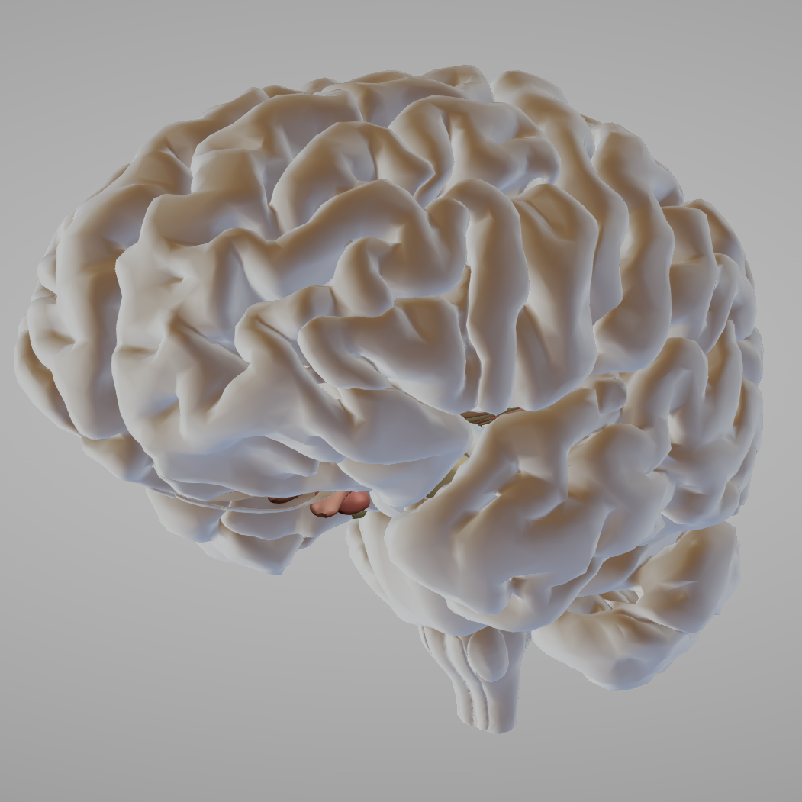
Risk factors for post-stroke cognitive impairment
Neurobehavioural consequences of stroke – Post-stroke cognitive impairment and dementia
Risk factors
Older age
At-risk ethnicity
Stroke location
Stroke severity
Pre-existing cognitive impairment
Vascular comorbidity
Multiple strokes
Comorbid neurodegeneration
Diabetes
Protective factors
(brain reserve)
Education
Genetic factors
Structure of the brain
Function of the brain
Cognitive impairment
El Husseini et al. Stroke 2023;54(6):e272–e291
Notes:
Some of the risk factors for cognitive impairment after stroke are general, imitating risk of cognitive impairment pre-stroke, and others are partly stroke specific.¹ As shown on the slide, the risk factors for post-stroke cognitive impairment can be visualised as a collection of risks balanced against factors that protect the brain, i.e., the concept of brain reserve.¹
Reference:
El Husseini N, Katzan IL, Rost NS, et al.; American Heart Association Stroke Council; Council on Cardiovascular and Stroke Nursing; Council on Cardiovascular Radiology and Intervention; Council on Hypertension; and Council on Lifestyle and Cardiometabolic Health. Cognitive impairment after ischemic and hemorrhagic stroke: a scientific statement from the American Heart Association/American Stroke Association. Stroke 2023; 54 (6): e272–e291.

Slide 15
Risk factors for post-stroke dementia
Neurobehavioural consequences of stroke – Post-stroke cognitive impairment and dementia
This systematic review identified many different factors associated with PSD
Demographic factors
  Female sex
  Non-white
  Low education
Vascular risk factors
  Diabetes
  Atrial fibrillation
  Hypertension
  Moderate alcohol reduced risk
Brain imaging factors
  Leukoaraiosis
  Atrophy
  Medial temporal lobe atrophy
Stroke factors
  Haemorrhagic
  Dysphasia
  Left hemisphere
  Previous stroke
  Multiple strokes
  Recurrent strokes
  Silent strokes
Stroke complications
  Incontinence
  Hypoxic–ischaemic episodes
  Acute confusion
  Early seizures
  Abnormal EEG
EEG=electroencephalogram; PSD=post-stroke dementia
Pendlebury & Rothwell. Lancet Neurol 2009;8(11):1006–1018
Notes:
This systematic literature review and meta-analysis included data from 22 hospital-based cohorts, and 8 population-based cohorts, amounting to a total of 8,705 patients, described across 73 publications.¹ Many different factors were identified as risk factors for dementia after stroke, as shown on the slide.¹ Dementia appeared to be strongly associated with multiple strokes, reinforcing the importance of good management and patient care to reduce the later burden of dementia.¹
Reference:
Pendlebury ST, Rothwell PM. Prevalence, incidence, and factors associated with pre-stroke and post-stroke dementia: a systematic review and meta-analysis. Lancet Neurol 2009; 8 (11): 1006–1018.

Slide 16
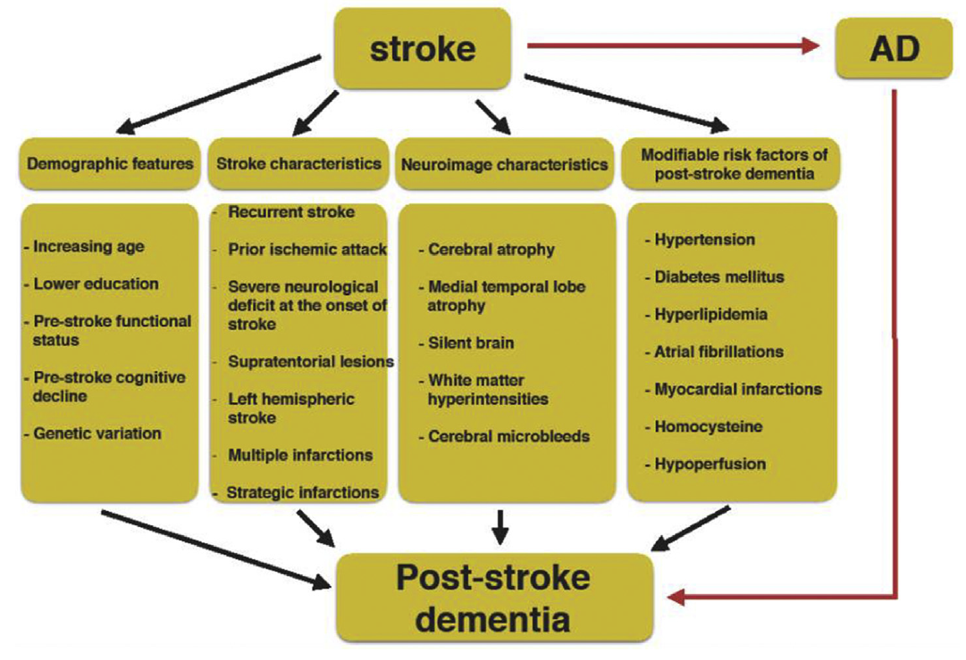
Risk factors for PSCI & PSD: stroke characteristics
Neurobehavioural consequences of stroke – Post-stroke cognitive impairment and dementia
In the OxVasc study, PSD was associated with:¹
  The severity of stroke (as measured by NIHSS) –
  dementia occurred in 34.4% of patients with severe stroke compared with 8.2% of those with minor stroke, and 5.2% in patients with TIA
  Multiple strokes – including having had previous stroke, and recurrent stroke on follow-up
  The presence of multiple lesions in the brain
Characteristics of stroke and risk factors for dementia²
Severe stroke:
34.4%
Minor stroke:
8.2%
TIA:
5.2%
This work is from Hu & Chen. Int J Gerontol 2017, licensed under CC BY-NC-ND. Published by Elsevier Taiwan LLC. The work cannot be changed in any way or used commercially without permission from the journal. https://creativecommons.org/licenses/by-nc-nd/4.0/
NIHSS=US National Institutes of Health Stroke Scale; OxVasc=Oxford Vascular Study;
PSCI=post-stroke cognitive impairment; PSD=post-stroke dementia; TIA=transient ischaemic attack
1. Pendlebury et al. Lancet Neurol 2019;18(3):248–258; 2. Hu & Chen. Int J Gerontol 2017;11(4):210–214
Notes:
Several factors relating to the characteristics of stroke can be grouped together, and form part of a person’s risk of dementia after stroke alongside their demographic and genetic makeup, and various modifiable risk factors (e.g., hypertension, diabetes).^{1,2}
References:
Pendlebury ST, Rothwell PM; Oxford Vascular Study. Incidence and prevalence of dementia associated with transient ischaemic attack and stroke: analysis of the population-based Oxford Vascular Study. Lancet Neurol 2019; 18 (3): 248–258.
Hu GC, Chen YM. Post-stroke dementia: epidemiology, mechanisms and management. Int J Gerontol 2017; 11 (4): 210–214.

Slide 17
Risk factors for PSCI & PSD: lesion location
Neurobehavioural consequences of stroke – Post-stroke cognitive impairment and dementia
The location of the stroke, the number of infarcts, and the effect of functional pathways of the brain may all have an effect on cognitive impairment¹⁻³
According to a pooled analysis of patient-level data across 12 studies (including 2,950 patients), the key brain locations associated with cognitive impairment were:¹
  Left frontotemporal lobes
  Left thalamus
  Right parietal lobe
In the Reykjavik study (including 4,030 patients), patients who experienced infarcts in multiple locations in the brain showed greater cognitive impairment than patients with no infarcts or infarcts within single locations²
A matched case–control study (including 38 cases matched to 66 controls) found that, rather than specific areas of the brain, cognitive impairment was associated with disruption of cholinergic pathways within the brain³
PSCI=post-stroke cognitive impairment; PSD=post-stroke dementia
1. Weaver et al. Lancet Neurol 2021;20(6):448–459; 2. Saczynski et al. Stroke 2009;40(3):677–682; 3. Lim et al. Stroke 2014;45(4):1069–1076
Notes:
The location of post-stroke lesions appear to be linked to the risk of cognitive impairment after stroke.¹ However, different studies have highlighted that, more than the exact location of the lesion, the number of different areas of the brain affected and the brain networks affected also play a role in the development of cognitive impairment and dementia after stroke.^{2,3}
References:
Weaver NA, Kuijf HJ, Aben HP, et al. Strategic infarct locations for post-stroke cognitive impairment: a pooled analysis of individual patient data from 12 acute ischaemic stroke cohorts. Lancet Neurol 2021; 20 (6): 448–459.
Saczynski JS, Sigurdsson S, Jonsdottir MK, et al. Cerebral infarcts and cognitive performance: importance of location and number of infarcts. Stroke 2009; 40 (3): 677–682.
Lim JS, Kim N, Jang MU, et al. Cortical hubs and subcortical cholinergic pathways as neural substrates of poststroke dementia. Stroke 2014; 45 (4): 1069–1076.

Slide 18
Risk factors for PSCI & PSD: diabetes
Neurobehavioural consequences of stroke – Post-stroke cognitive impairment and dementia
Studies investigating the effect of diabetes on the risk of cognitive decline have generated conflicting results¹
Whilst there appears to be no association between diabetes and AD pathology, there does appear to be an association between diabetes and vascular disease¹
After stroke, diabetes increases the risk of cognitive impairment:
  In a cohort study of 982 patients after stroke, a higher cumulative mean glucose level was significantly associated with a faster decline in global cognition²
  In the OxVasc study, which included 2,305 patients after stroke or TIA, diabetes was significantly associated with 5-year risk of dementia³
Modelled relationship between fasting glucose
and decline in global cognition after stroke²
Cognition
Mean cumulative fasting glucose level:
86 mg/dl
106 mg/dl
126 mg/dl
146 mg/dl
166 mg/dl
0
2
4
6
8
10
12
Time since stroke (years)
This work is adapted from ‘Associations between vascular risk factor levels and cognitive decline among stroke survivors' by Levine et al., used under CC-BY. This work is licensed under Creative Commons license CC-BY-SA by The Lundbeck Foundation.
AD=Alzheimer’s disease; OxVasc=Oxford Vascular Study;
PSCI=post-stroke cognitive impairment; PSD=post-stroke dementia TIA=transient ischaemic attack
1. Hadley et al. J Neurol Neurosurg Psychiatry 2022;93(3):246–253; 2. Levine et al. JAMA Netw Open 2023;6(5):e2313879; 3. Pendlebury et al. Lancet Neurol 2019;18(3):248–258
Notes:
As detailed on the slide, diabetes and higher cumulative glucose levels in the blood appear to contribute to greater risk of cognitive decline and dementia in patients after stroke.¹⁻³ This association represents a point of intervention for healthcare professionals, to help patients to preserve cognitive functions after stroke.²
References:
Hadley G, Zhang J, Harris-Skillman E, et al. Cognitive decline and diabetes: a systematic review of the neuropathological correlates accounting for cognition at death. J Neurol Neurosurg Psychiatry 2022; 93 (3): 246–253.
Levine DA, Chen B, Galecki AT, et al. Associations between vascular risk factor levels and cognitive decline among stroke survivors. JAMA Netw Open 2023; 6 (5): e2313879.
Pendlebury ST, Rothwell PM; Oxford Vascular Study. Incidence and prevalence of dementia associated with transient ischaemic attack and stroke: analysis of the population-based Oxford Vascular Study. Lancet Neurol 2019; 18 (3): 248–258.

Slide 19


Risk factors PSCI & PSD: low baseline cognitive score and delirium
Neurobehavioural consequences of stroke – Post-stroke cognitive impairment and dementia
The level of a patient’s cognitive functioning before stroke and at the acute stroke stage can predict their cognitive impairment and functional disability after stroke¹⁻³
A prospective observational study measured the neurocognitive status (MoCA and MMSE) of 400 people who had experienced TIA or mild ischaemic stroke¹
  80% of recruited patients had experienced a stroke and 20% had experienced TIA
  For patients who experienced a mild stroke (NIHSS ~2), baseline MMSE scores predicted functional disability
  For patients who experienced a severe stroke (NIHSS >2), both the baseline MMSE and MoCA scores predicted functional disability after stroke
In the acute stroke phase, MoCA scores have been shown to correlate with later functional disability and risk of mortality after stroke^{2,3}
Post-stroke delirium and dementia⁴
This study followed 50 people with stroke, split into two groups:
22 with delirium
28 without delirium
2 years
The chance of developing dementia at 2-years for those with delirium was 5–7 times greater than those who did not experience delirium
MMSE=Mini-Mental State Examination; MoCA=Montreal Cognitive Assessment;
NIHSS=US National Institutes of Health Stroke Scale; PSCI=post-stroke cognitive impairment; PSD=post-stroke dementia; TIA=transient ischaemic attack
1. Dong et al. BMJ Open 2013;3(9):e003105; 2. Dong et al. J Neurol Neurosurg Psychiatry 2012;83(6):580–585;
3. Zietemann et al. Neurology 2018;91(20):e1838–e1850; 4. van Rijsbergen et al. J Neurol Sci 2011;306(1–2):138–142
Notes:
Many people experience cognitive impairment of some degree after stroke, making assessment of cognition after stroke a clinically valuable goal.⁵ One such tool, which has been studied extensively, is the Montreal Cognitive Assessment (MoCA).⁵ The MoCA is a quick test that includes executive function, word recall, memory, attention, and language skills.⁵ In patients with stroke, the MoCA can be used as a brief cognitive tool in both the acute phase and the chronic post-stroke phase.⁵
References:
Dong Y, Slavin MJ, Chan BP, et al. Cognitive screening improves the predictive value of stroke severity scores for functional outcome 3–6 months after mild stroke and transient ischaemic attack: an observational study. BMJ Open 2013; 3 (9): e003105.
Dong Y, Venketasubramanian N, Chan BP, et al. Brief screening tests during acute admission in patients with mild stroke are predictive of vascular cognitive impairment 3–6 months after stroke. J Neurol Neurosurg Psychiatry 2012; 83 (6): 580–585.
Zietemann V, Georgakis MK, Dondaine T, et al. Early MoCA predicts long-term cognitive and functional outcome and mortality after stroke. Neurology 2018; 91 (20): e1838–e1850.
van Rijsbergen MWA, Oldenbeuving AW, Nieuwenhuis-Mark RE, et al. Delirium in acute stroke: a predictor of subsequent cognitive impairment? A two-year follow-up study. J Neurol Sci 2011; 306 (1–2): 138–142.
Chiti G, Pantoni L. Use of Montreal Cognitive Assessment in patients with stroke. Stroke 2014; 45 (10): 3135–3140.

Slide 20
Risk factors PSCI & PSD: APOE-ε4 genotype
Neurobehavioural consequences of stroke – Post-stroke cognitive impairment and dementia
The apolipoprotein E ε4 genotype is associated with pre-stroke dementia and the development of post-stroke dementia
Risk of dementia 5 years after stroke according to APOE status
 | HR (95% CI) | p | HR (95% CI) | p | HR (95% CI) | p | HR (95% CI) | p
All patients, n=1,657
≥1ε2 | 1.36 (1.02, 1.83) | 0.04 | 1.12 (0.83, 1.51) | 0.45 | 1.18 (0.87,1.61) | 0.28 | 1.12 (0.81, 1.56) | 0.49
ε4/ε3 | 0.92 (0.70, 1.20) | 0.52 | 0.91 (0.69, 1.19) | 0.49 | 1.02 (0.77, 1.13) | 0.91 | 1.11 (0.84, 1.48) | 0.47
ε4/ε4 | 2.05 (1.09, 3.87) | 0.03 | 2.94 (1.55, 5.57) | 0.001 | 3.64 (1.90, 7.00) | <0.0001 | 2.41 (1.19, 4.89) | 0.01
TIA and minor stroke only, n=1,199
≥1ε2 | 1.52 (1.00, 2.32) | 0.05 | 1.24 (0.89, 1.90) | 0.33 | 1.30 (0.84, 2.00) | 0.24 | 1.38 (0.87, 2.18) | 0.17
ε4/ε3 | 1.12 (0.78, 1.62) | 0.52 | 1.07 (0.74, 1.55) | 0.71 | 1.05 (0.72, 1.52) | 0.80 | 1.10 (0.75, 1.61) | 0.62
ε4/ε4 | 2.34 (1.02, 5.33) | 0.04 | 3.49 (1.52, 8.01) | 0.003 | 3.46 (1.49, 8.00) | 0.004 | 1.82 (0.69, 4.82) | 0.23
Major stroke (NIHSS ≥3) only, n=458
≥1ε2 | 1.14 (0.75, 1.71) | 0.55 | 1.01 (0.67, 1.53) | 0.96 | 1.07 (0.69, 1.66) | 0.77 | 1.02 (0.62, 1.66) | 0.95
ε4/ε3 | 0.75 (0.51, 1.12) | 0.17 | 0.81 (0.54, 1.20) | 0.29 | 0.94 (0.63, 1.42) | 0.78 | 1.14 (0.73, 1.77) | 0.57
ε4/ε4 | 3.04 (1.11, 8.28) | 0.03 | 4.21 (1.51, 11.74) | 0.006 | 6.38 (2.15, 18.62) | 0.001 | 5.44 (1.78, 16.67) | 0.003
Unadjusted
Model 1
Model 2
Model 3
Adjusted for: age, sex, education
Adjusted for: age, sex, education, stroke severity, prior stroke, white matter disease, diabetes mellitus, dysphasia
Adjusted for: baseline cognitive score
APOE=apolipoprotein E gene; CI=confidence interval; HR=hazard ratio; NIHSS=National Institutes of Health Stroke Scale;
PSCI=post-stroke cognitive impairment; PSD=post-stroke dementia; TIA=transient ischaemic attack
Pendlebury et al. Stroke 2020;51(3):751–758
This work is adapted from ‘APOE-ε4 genotype and dementia before and after transient ischemic attack and stroke: population-based cohort study' by Pendlebury et al., used under CC-BY. This work is licensed under Creative Commons license CC-BY-SA by The Lundbeck Foundation.
Notes:
Apolipoprotein E is a lipoprotein used in the brain, found in several isoforms coded by different alleles of the APOE gene.¹ The APOE-ε4 allele is a known risk factor for dementia, and as detailed on the slide, it is a risk factor for post-stroke dementia.¹ Whilst this association has been seen, the mechanism(s) underlying the effect are unclear, and more research is needed to determine what extent the pathology of post-stroke dementia interacts with pre-existing dementia risk.²
References:
Pendlebury ST, Poole D, Burgess A, et al.; Oxford Vascular Study. APOE-ε4 genotype and dementia before and after transient ischemic attack and stroke: population-based cohort study. Stroke 2020; 51 (3): 751–758.
Montagne A, Nation DA, Zlokovic BV. APOE4 accelerates development of dementia after stroke: is there a role for cerebrovascular dysfunction? Stroke 2020; 51 (3): 699–700.

Slide 21
Transient cognitive impairment after stroke
Neurobehavioural consequences of stroke – Post-stroke cognitive impairment and dementia
After stroke, a temporary, transient cognitive impairment is common¹⁻³
The OxVasc study was a population-based study of the incidence and outcome of all acute vascular events in a population of 92,728 individuals in Oxford, UK¹
Data from the OxVasc cohort showed transient cognitive impairment is common after stroke¹
One study followed 100 people after TIA or ischaemic stroke and administered cognitive tests (MoCA and MMSE) at Days 1, 7, 30, and 90²
Whereas the MoCA was sensitive to temporary cognitive impairment, the MMSE was not²
MoCA scores improved from baseline at Day 7, 30, and 90²
These findings underscore the importance of screening for cognitive impairment after stroke, and monitoring transient cognitive impairment, using a tool that is sensitive to these changes¹⁻³
Patients experiencing cognitive impairment after stroke¹
Persistent MCI:
14.1%
Transient cognitive impairment:
30.1%
No cognitive impairment:
55.8%
MCI=mild cognitive impairment; MMSE=Mini-Mental State Examination; MoCA=Montreal Cognitive Assessment; OxVasc=Oxford Vascular study; TIA=transient ischaemic attack
1. Mazzucco et al. Int J Stroke 2016;11(9):978–986; 2. Sivakumar et al. Stroke 2014;45(6):1709–1715; 3. Pendlebury et al. Stroke 2011;42(11):3116–3121
Notes:
The frequency with which patients experience transient cognitive impairment, as well as persistent cognitive impairment after stroke reinforces the importance of routine cognitive testing after cerebrovascular events,^{1,3} using a tool such as the MoCA (Montreal Cognitive Assessment).²
References:
Mazzucco S, Li L, Tuna MA, et al.; Oxford Vascular Study. Hemodynamic correlates of transient cognitive impairment after transient ischemic attack and minor stroke: a transcranial Doppler study. Int J Stroke 2016; 11 (9): 978–986.
Sivakumar L, Kate M, Jeerakathil T, et al. Serial Montreal Cognitive Assessments demonstrate reversible cognitive impairment in patients with acute transient ischemic attack and minor stroke. Stroke 2014; 45 (6): 1709–1715.
Pendlebury ST, Wadling S, Silver LE, et al. Transient cognitive impairment in TIA and minor stroke. Stroke 2011; 42 (11): 3116–3121.

Slide 22
Clinical management of post-stroke cognitive impairment and dementia

Slide 23
The impact of post-stroke cognitive impairment on patients
Neurobehavioural consequences of stroke – Post-stroke cognitive impairment and dementia
The NBCS and comorbidities of stroke can impact
on a patient’s quality of life¹
Depression
Anxiety
Post-stroke apathy
Post-stroke fatigue
Post-stroke cognitive impairment and dementia
Physical and functional disability
Sleep disorders
Multimorbidity – co-occurring disorders add complexity to the management of a person’s health
Correlations between QoL states and NBCS²
Baseline | NIHSS admission | NIHSS discharge | mRS discharge | MoCA | HADS Anxiety | HADS Depression
Health state | -0.2280.007 | -0.511 <0.0001 | -0.532 <0.0001 | 0.1630.056 | -0.387 <0.0001 | -0.469 <0.0001
Health index | −0.1800.036 | -0.398 <0.0001 | -0.456 <0.0001 | 0.1230.151 | -0.417 <0.0001 | -0.466 <0.0001
Follow-up | NIHSS admission | NIHSS | mRS | MoCA | HADS Anxiety | HADS Depression
Health state | 0.360 <0.0001 | -0.517 <0.0001 | -0.603 <0.0001 | 0.2680.007 | -0.467 <0.0001 | -0.624 <0.0001
Health index | 0.478 <0.0001 | -0.534 <0.0001 | -0.657 <0.0001 | 0.0700.491 | -0.428 <0.0001 | -0.478 <0.0001
In this cohort study, many patients reported cognitive impairment, and emotional problems, that were associated with QoL, but not routinely screened for²
This work is adapted from ‘Relevance of cognition and emotion for patient-reported quality of life after stroke in working age: an observational cohort study' by Pinter et al., used under CC-BY. This work is licensed under Creative Commons license CC-BY-SA by The Lundbeck Foundation.
HADS=Hospital Anxiety and Depression Scale; MoCA=Montreal Cognitive Assessment; mRS=Modified Rankin Scale;
NBCS=neurobehavioural consequences of stroke; NIHSS=National Institutes of Health Stroke Scale; QoL=quality of life
1. El Husseini et al. Stroke 2023;54(6):e272–e291; 2. Pinter et al. Front Neurol 2022;13:869550
Notes:
Cognitive impairment after stroke is common, and can impact a patient’s quality of life.¹⁻³ A systematic review aimed to investigate to what extent post-stroke cognitive impairment impacts on patients’ activities and participation outcomes.³ Data were extracted from 62 publications, including a total of 7,817 patients.³ Small but significant associations were seen between multiple different domains of cognitive functioning and domains of quality of life or functioning.³ This association reinforces the importance of cognitive screening after stroke, and helping patients deal with any cognitive consequences that they experience.³
References:
El Husseini N, Katzan IL, Rost NS, et al.; American Heart Association Stroke Council; Council on Cardiovascular and Stroke Nursing; Council on Cardiovascular Radiology and Intervention; Council on Hypertension; and Council on Lifestyle and Cardiometabolic Health. Cognitive impairment after ischemic and hemorrhagic stroke: a scientific statement from the American Heart Association/American Stroke Association. Stroke 2023; 54 (6): e272–e291.
Pinter D, Fandler-Höfler S, Fruhwirth V, et al. Relevance of cognition and emotion for patient-reported quality of life after stroke in working age: an observational cohort study. Front Neurol 2022; 13: 869550.
Stolwyk RJ, Mihaljcic T, Wong DK, et al. Poststroke cognitive impairment negatively impacts activity and participation outcomes: a systematic review and meta-analysis. Stroke 2021; 52 (2): 748–760.

Slide 24
Association with other neuropsychiatric post-stroke outcomes
Neurobehavioural consequences of stroke – Post-stroke cognitive impairment and dementia
Post-stroke cognitive impairment is associated with many of the other neurobehavioural consequences of stroke (NBCS):^{1,2}
This multi-morbidity can complicate treatment, and reduce a patient’s functioning and quality of life
– e.g., the presence of cognitive impairment after stroke could delay or obstruct the diagnosis of depression or vice versa¹
NBCS are interlinked in many patients; apathy and depression are commonly comorbid, and the presence of apathy in a patient can be associated with reduced cognitive function³
Depression
Anxiety
Apathy
Fatigue
NBCS=neurobehavioural consequences of stroke
1. El Husseini et al. Stroke 2023;54(6):e272–e291; 2. Lanctôt et al. Int J Stroke 2020;15(6):668–688; 3. van Dalen et al. Stroke 2013;44(3):851–860
Notes:
Despite the impact of post-stroke cognitive impairment on the patient, and the additional impact of multi-morbidity, there is a poor evidence base for making clinical decisions about treatment in this patient group.¹ Indeed, more research is needed to understand the interaction of these symptoms, how best to treat them, and how treatment of post-stroke cognitive impairment may affect the treatment of other neurobehavioural consequences of stroke and vice versa.¹
References:
El Husseini N, Katzan IL, Rost NS, et al.; American Heart Association Stroke Council; Council on Cardiovascular and Stroke Nursing; Council on Cardiovascular Radiology and Intervention; Council on Hypertension; and Council on Lifestyle and Cardiometabolic Health. Cognitive impairment after ischemic and hemorrhagic stroke: a scientific statement from the American Heart Association/American Stroke Association. Stroke 2023; 54 (6): e272–e291.
Lanctôt KL, Lindsay MP, Smith EE, et al.; Management of Mood, Cognition and Fatigue Following Stroke Best Practice Writing Group, the Heart & Stroke Canadian Stroke Best Practices and Quality Advisory Committee; in collaboration with the Canadian Stroke Consortium. Canadian stroke best practice recommendations: mood, cognition and fatigue following stroke, 6th edition update 2019. Int J Stroke 2020; 15 (6): 668–688.
van Dalen JW, Moll van Charante EP, Nederkoorn PJ, et al. Poststroke apathy. Stroke 2013; 44 (3): 851–860.

Slide 25
Post-stroke cognitive assessment
Neurobehavioural consequences of stroke – Post-stroke cognitive impairment and dementia
Clinical assessment depends on the time and resources available
Cognitive assessment can include testing in many core domains:¹
  Executive function
  Attention
  Memory
  Language
  Visuospatial function
Short screening tests of cognitive function include:¹
  Montreal Cognitive Assessment (MoCA)
  Mini-Mental State Examination (MMSE)
Studies have shown the MoCA to be more sensitive to milder cognitive impairments seen after stroke, and is generally preferred over the MMSE¹⁻³
Longer, more in-depth assessment tools include the National Institute of Neurological Disorders and Stroke – Canadian Stroke Network Vascular Cognitive Impairment
(NINDS-CSN VCI)⁴
The NINDS-CSN VCI is available in 30-minute and 60-minute protocols⁴
Other tools can be used to question an informant, to provide more information on a patient’s cognitive function and their functioning before stroke, e.g., the Informant Questionnaire on Cognitive Decline in the Elderly (IQCODE)⁵
IQCODE=Informant Questionnaire on Cognitive Decline in the Elderly; MMSE=Mini-Mental State Examination; MoCA=Montreal Cognitive Assessment;
NINDS-CSN VCI=National Institute of Neurological Disorders and Stroke – Canadian Stroke Network Vascular Cognitive Impairment
1. Pendlebury et al. Stroke 2012;43(2):464–469; 2. Pendlebury et al. Stroke 2010;41(6):1290–1293;
3. Lees et al. Stroke 2014;45(10):3008–3018; 4. Hachinski et al. Stroke 2006;37(9):2220–2241; 5. McGovern et al. Stroke 2016;47(2):329–335
Notes:
In order to compare the Mini-Mental State Examination (MMSE) and the Montreal Cognitive Assessment (MoCA), one study administered both tests to 413 patients and compared the results.² Scores on both tests were correlated.² However, in patients who scored relatively normally on the MMSE, scores on the MoCA were correlated with higher Rankin scores, and deficits in delayed recall, abstraction, visuospatial/executive function, and sustained attention, suggesting that the MoCA was more sensitive to cognitive dysfunction after stroke in these patients.²
References:
Pendlebury ST, Mariz J, Bull L, et al. MoCA, ACE-R, and MMSE versus the National Institute of Neurological Disorders and Stroke – Canadian Stroke Network Vascular Cognitive Impairment Harmonization Standards Neuropsychological Battery after TIA and stroke. Stroke 2012; 43 (2): 464–469.
Pendlebury ST, Cuthbertson FC, Welch SJV, et al. Underestimation of cognitive impairment by Mini-Mental State Examination versus the Montreal Cognitive Assessment in patients with transient ischemic attack and stroke: a population-based study. Stroke 2010; 41 (6): 1290–1293.
Lees R, Selvarajah J, Fenton C, et al. Test accuracy of cognitive screening tests for diagnosis of dementia and multidomain cognitive impairment in stroke. Stroke 2014; 45 (10): 3008–3018.
Hachinski V, Iadecola C, Petersen RC, et al. National Institute of Neurological Disorders and Stroke – Canadian Stroke Network vascular cognitive impairment harmonization standards. Stroke 2006; 37 (9): 2220–2241.
McGovern A, Pendlebury ST, Mishra NK, et al. Test accuracy of informant-based cognitive screening tests for diagnosis of dementia and multidomain cognitive impairment in stroke. Stroke 2016; 47 (2): 329–335.

Slide 26
Management of patients with PSCI
Neurobehavioural consequences of stroke – Post-stroke cognitive impairment and dementia
Good collaboration among different healthcare professionals is important during the post-stroke phase, to ensure the best management and treatment of cognitive problems after stroke
No
Further cognitive evaluation probably not indicated
Evidence of cognitive impairment (from screening or an informant)?
Yes
Is there evidence of communication deficits?
Further neuropsychological evaluation
Is there evidence of cognitive impairment?
Does cognitive impairment impact on functioning?
Speech language pathology
Refer to appropriate health professional
Occupational therapy
PSCI=post-stroke cognitive impairment
El Husseini et al. Stroke 2023;54(6):e272–e291
Notes:
The slide outlines some factors that should be considered during assessment of a patient after stroke, and the multidisciplinary evaluation of post-stroke cognitive impairment.¹
Reference:
El Husseini N, Katzan IL, Rost NS, et al.; American Heart Association Stroke Council; Council on Cardiovascular and Stroke Nursing; Council on Cardiovascular Radiology and Intervention; Council on Hypertension; and Council on Lifestyle and Cardiometabolic Health. Cognitive impairment after ischemic and hemorrhagic stroke: a scientific statement from the American Heart Association/American Stroke Association. Stroke 2023; 54 (6): e272–e291.

Slide 27
Treatments for cognitive impairment after stroke
Neurobehavioural consequences of stroke – Post-stroke cognitive impairment and dementia
Some studies have suggested that IV thrombolysis or thrombectomy may improve cognitive outcomes in patients after stroke¹⁻³
A study using data from 6,268 patients from the Virtual International Stroke Trials archive compared cognitive outcomes in patients treated with thrombolysis versus those who were treated conservatively¹
  Thrombolysis improved the chance of higher cognitive scores 90 days after therapy – OR: 1.31, 95% CI: 1.18, 1.47, p<0.01¹
Another study found that patients with acute stroke who received thrombectomy plus intravenous thrombolysis, versus those who received just thrombolysis, performed significantly better at various neuropsychological tests
6 months after stroke²
Secondary stroke prevention and management⁴
Multidisciplinary team management can help to identify patient and caregiver needs
Physical activity – there is some evidence of a cognitive benefit, possibly greater with aerobic exercise
Cognitive rehabilitation – some techniques
(e.g., cognitive training) appear to result in small but sustained improvements in cognition
Pharmacological treatments – cholinesterase inhibitors and/or memantine are sometimes prescribed for patients with dementia after stroke
IV=intravenous; REVASCAT=endovascular revascularization with solitaire device versus best medical therapy in anterior circulation stroke within 8 hours
1. Hajjar et al. Int J Stroke 2013;8(8):652–656; 2. Lattanzi et al. Sci Rep 2020;10(1):18524;
3. López-Cancio E, et al. Neurology 2017;88(3):245–251; 4. El Husseini et al. Stroke 2023;54(6):e272–e291
Notes:
As outlined on the slide, part of the management of post-stroke cognitive impairment involves optimizing a patient’s cognition alongside helping the patient to manage symptoms and safely return to their life.⁴ Some treatment approaches appear to provide some benefit to cognitive function, however, many studies in stroke do not consider cognition as an endpoint.⁴
References:
Hajjar K, Fulton RL, Diener HC, et al. Does the cognitive measure Cog-4 show improvement among patients treated with thrombolysis after acute stroke? Int J Stroke 2013; 8 (8): 652–656.
Lattanzi S, Coccia M, Pulcini A, et al. Endovascular treatment and cognitive outcome after anterior circulation ischemic stroke. Sci Rep 2020; 10 (1): 18524.
López-Cancio E, Jovin TG, Cobo E, et al. Endovascular treatment improves cognition after stroke: a secondary analysis of REVASCAT trial. Neurology 2017; 88 (3): 245–251.
El Husseini N, Katzan IL, Rost NS, et al.; American Heart Association Stroke Council; Council on Cardiovascular and Stroke Nursing; Council on Cardiovascular Radiology and Intervention; Council on Hypertension; and Council on Lifestyle and Cardiometabolic Health. Cognitive impairment after ischemic and hemorrhagic stroke: a scientific statement from the American Heart Association/American Stroke Association. Stroke 2023; 54 (6): e272–e291.

Slide 28
Trials to prevent cognitive decline after stroke
Neurobehavioural consequences of stroke – Post-stroke cognitive impairment and dementia
Multifactorial risk factor management¹
Patients after first stroke/TIA were randomized to either intensive vascular risk factor intervention or care as usual
After 1 year, the difference between groups in TMT-A was in favour of intervention but was not significant
  3.8 seconds (p=0.35)
Multidomain lifestyle interventions²
Patients with stroke were randomized to a 2-year lifestyle intervention or care as usual
After 2 years, fewer patients in the intervention group showed cognitive decline:
  10.5% versus 12.0%
  (a risk reduction of 0.874)
Intensive blood pressure
and lipid reduction³
Patients with stroke and high BP (SBP 125–170 mmHg) were randomized to aggressive BP management, with lipid lowering where indicated, or care as usual
Patients who received BP and lipid-lowering treatment showed significantly improved ACE-R scores at 6 months, as well as other cognitive indicators
ACE-R=Addenbrooke’s Cognitive Examination – Revised; BP=blood pressure; SBP=systolic blood pressure; TIA=transient ischaemic attack; TMT-A=Trail Making Test – Part A
1. Ihle-Hansen et al. Int J Stroke 2014;9(7):932–938; 2. Matz et al. Stroke 2015;46(10):2874–2880; 3. Bath et al. PLoS One 2017;12(1):e0164608
Notes:
Several studies have undertaken to investigate the efficacy of different multicomponent interventions on cognition after stroke, with varying results as outlined on the slide.¹⁻³ Moreover, despite recent advances in the understanding of small vessel disease – a major cause of vascular cognitive impairment – there are few proven treatments to help improve cognition in these patients.⁴
References:
Ihle-Hansen H, Thommessen B, Fagerland MW, et al. Multifactorial vascular risk factor intervention to prevent cognitive impairment after stroke and TIA: a 12-month randomized controlled trial. Int J Stroke 2014; 9 (7): 932–938.
Matz K, Teuschl Y, Firlinger B, et al.; ASPIS Study Group. Multidomain lifestyle interventions for the prevention of cognitive decline after ischemic stroke: randomized trial. Stroke 2015; 46 (10): 2874–2880.
Bath PM, Scutt P, Blackburn DJ, et al.; PODCAST Trial Investigators. Intensive versus guideline blood pressure and lipid lowering in patients with previous stroke: main results from the pilot ‘prevention of decline in cognition after stroke trial’ (PODCAST) randomised controlled trial. PLoS One 2017; 12 (1): e0164608.
Markus HS, de Leeuw FE. Cerebral small vessel disease: recent advances and future directions. Int J Stroke 2023; 18 (1): 4–14.

Slide 29
Ongoing studies of treatments for PSCI
Neurobehavioural consequences of stroke – Post-stroke cognitive impairment and dementia
Many studies into
post-stroke cognitive impairment are planned
or underway¹
Many studies of treatments for post-stroke cognitive impairment are currently underway or planned, as at the end of 2023, including the use of acupuncture, stimulation therapy, transcranial stimulation, and various pharmacological approaches¹
There is ongoing research identifying and validating biomarkers, to better be able to predict patients at risk of cognitive impairment or dementia after stroke²
The DISCOVERY study is a prospective, multi-centre, observational, nested-cohort study of ~8,000 patients with ischaemic and haemorrhagic stroke without a history of dementia, followed for a minimum of 2 years with serial cognitive evaluations and assessments of functional outcomes across the length of the study³
Consortia have been assembled to study post-stroke vascular cognitive impairment, for instance the STROKOG collaboration⁴
DISCOVERY=Determinants of Incident Stroke Cognitive Outcomes and Vascular Effects on Recovery; STROKOG=Stroke and Cognition Collaboration
1. ClinicalTrials.gov. Accessed Dec 2023; 2. Wilcock et al. Alzheimers Dement 2021;17(4):704–715;
3. Rost et al. Stroke 2021;52(8):e499–e516; 4. Lo et al. Neurology 2019;93(24):e2257–e2271
Notes:
Many studies into treating and managing post-stroke cognitive impairment are ongoing or are planned, to help address the lack of firm evidence base for clinical decision making in this complex patient population.
References:
ClinicalTrials.gov. Accessed Dec 2023.
Wilcock D, Jicha G, Blacker D, et al.; MarkVCID Consortium. MarkVCID cerebral small vessel consortium: I. Enrollment, clinical, fluid protocols. Alzheimers Dement 2021; 17 (4): 704–715.
Rost NS, Meschia JF, Gottesman R, et al.; DISCOVERY Investigators. Cognitive impairment and dementia after stroke: design and rationale for the DISCOVERY study. Stroke 2021; 52 (8): e499–e516.
Lo JW, Crawford JD, Desmond DW, et al.; Stroke and cognition (STROKOG) collaboration. Profile of and risk factors for poststroke cognitive impairment in diverse ethnoregional groups. Neurology 2019; 93 (24): e2257–e2271.

Slide 30
Summary

Slide 31
Summary
Neurobehavioural consequences of stroke – Post-stroke cognitive impairment and dementia
Cognitive impairment and dementia are common after stroke – approximately 1 in 10 patients will develop dementia after their first stroke, and more than one-third have dementia after recurrent stroke
Approximately 1 in 10 patients have dementia at the point of their first stroke, and the stroke appears to accelerate the rate of any already existing cognitive decline
There are many risk factors for post-stroke cognitive impairment, including:
  The severity of the stroke
  The location of lesions
  Diabetes
  Low baseline cognitive functioning
  APOE-ε4 genotype
Good collaboration among different healthcare professionals is important during the post-stroke phase, to ensure the best management and treatment of cognitive problems after stroke
APOE=apolipoprotein E gene

Slide 32
…there are multiple unanswered questions about the pathophysiology, diagnosis, and treatment of PSCI. More studies are needed on the exact mechanisms of PSCI, the effects of specific stroke subtypes, and the interaction among the preexisting brain pathology, sociocultural factors, and the acute stroke event
El Husseini et al. Stroke 2023;54(6):e272–e291
Notes:
Reference:
El Husseini N, Katzan IL, Rost NS, et al.; American Heart Association Stroke Council; Council on Cardiovascular and Stroke Nursing; Council on Cardiovascular Radiology and Intervention; Council on Hypertension; and Council on Lifestyle and Cardiometabolic Health. Cognitive impairment after ischemic and hemorrhagic stroke: a scientific statement from the American Heart Association/American Stroke Association. Stroke 2023; 54 (6): e272–e291.

