Slide 1
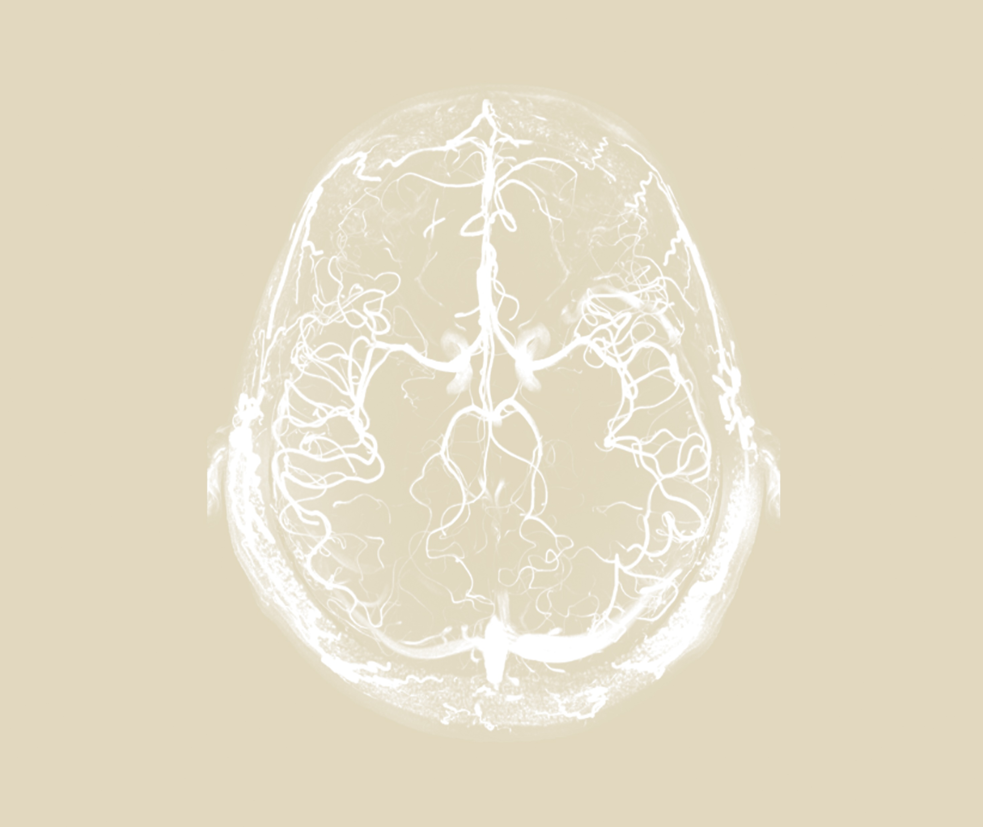
Neurobehavioural consequences of stroke
Stroke syndromes

