Slide 1
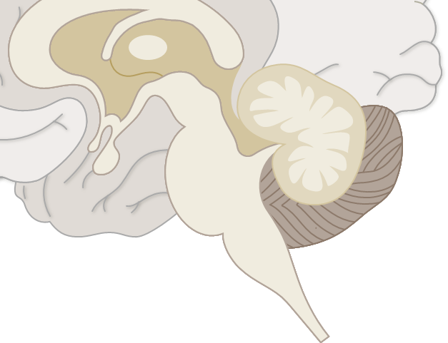
Cerebellar infarction
Neurobehavioural consequences of stroke – Stroke syndromes
The cerebellum is supplied with blood via three branches of the basilar artery – the posterior inferior cerebellar artery (PICA), the anterior inferior cerebellar artery (AICA), and the superior cerebellar artery (SCA)¹
Cerebellar infarction typically presents with symptoms of nausea, vomiting, and dizziness, and therefore can mimic other common more benign conditions²
Symptoms of PICA infarction can include:^{3,4}
  Truncal ataxia and vertigo
  Limb ataxia may occur, especially if the inferior cerebellar peduncle is affected
Symptoms of AICA infarction can include:³
  Vertigo with vomiting and nystagmus
Cerebellar arteries¹
SCA
AICA
PICA
Basilar artery
Vertebral artery
AICA=anterior inferior cerebellar artery; PICA=posterior inferior cerebellar artery; SCA=superior cerebellar artery
1. Muller Ewald et al. Front Neurosci 2023;17:1203488; 2. Datar & Rabinstein. Neurol Clin 2014;32(4):979–991;
3. Odier & Michel. In: Brainin & Heiss (eds). Textbook of Stroke Medicine. 2010; 4. Merwick & Werring. BMJ 2014;348:g3175
Notes:
References:
Muller Ewald VA, Deifelt Streese C, Bruss JE, et al. Neuropsychiatric outcomes following strokes involving the cerebellum: a retrospective cohort study. Front Neurosci 2023; 17: 1203488.
Datar S, Rabinstein AA. Cerebellar infarction. Neurol Clin 2014; 32 (4): 979–991.
Odier C, Michel P. Common stroke syndromes. In: Brainin M, Heiss WD (eds). Textbook of Stroke Medicine. Cambridge University Press, 2010. Pg. 121–134.
Merwick Á, Werring D. Posterior circulation ischaemic stroke. BMJ 2014; 348: g3175.

