Slide 1
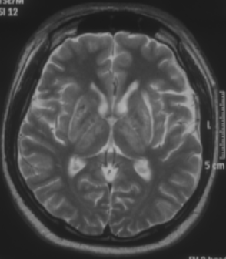
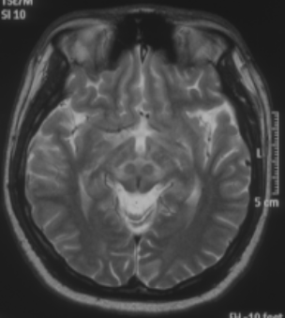
Example differential diagnosis – Wilson’s disease
Parkinson’s disease – History, definitions and diagnosis
Young man with Wilson’s disease
Left panel: Abnormal T2 hyperintensities in the lentiform nucleus (left arrow) and thalamus (right arrow), bilaterally
Right panel: ‘Face of the giant panda sign’ of the midbrain (arrow)
The patient also had
Kayser–Fleischer rings, and a very low level of serum caeruloplasmin, 0.02 g/l (reference range 0.17–0.35 g/l)
Images courtesy of Shen-Yang Lim
Notes:
Wilson’s disease (WD) is a disorder of copper metabolism, and was first identified in 1912.¹ Clinically, WD can cause neurologic, psychiatric, and hepatic problems.¹ The symptoms can include tremor, dystonia and/or parkinsonism, which makes confirmation of the diagnosis of WD, and therefore ruling out PD, important.¹ The main tests for diagnosis of neurologic/neuropsychiatric WD are: slit lamp examination by an ophthalmologist, plasma levels of ceruloplasmin, 24-hour urine copper assay, and brain MRI scan.² Diagnosis of WD is increasingly done by genetic testing for mutations in the ATP7B gene.¹
References:
Bandmann O, Weiss KH, Kaler SG. Wilson’s disease and other neurological copper disorders. Lancet Neurol 2015; 14 (1): 103–113.
Hedera. Update on the clinical management of Wilson’s disease. Appl Clin Genet 2017; 10: 9–19.

