Slide 1
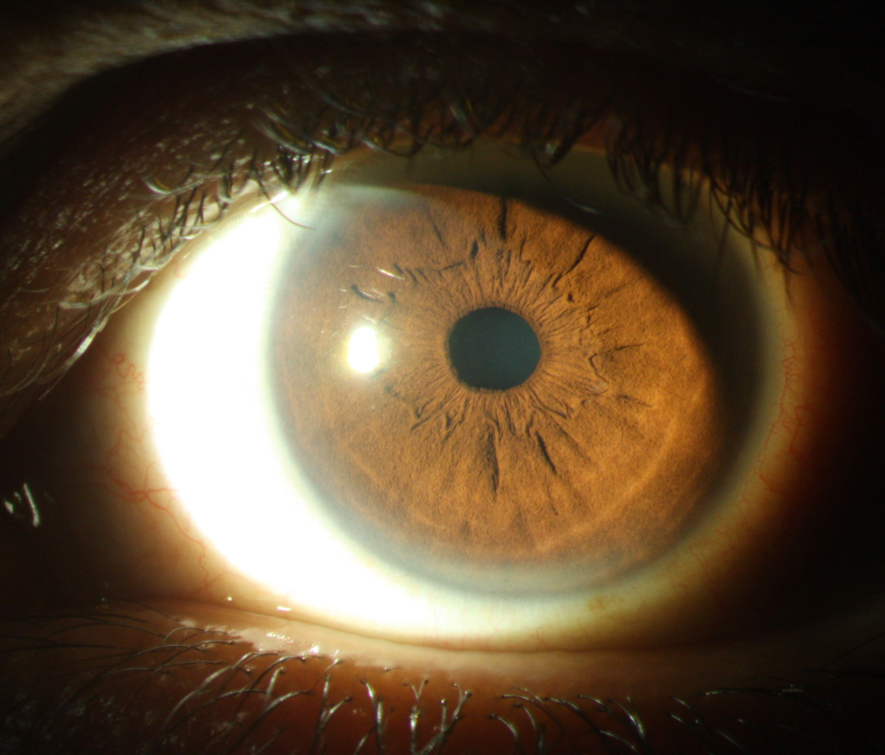
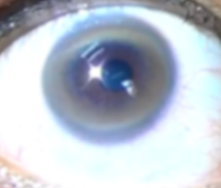
Example differential diagnosis – Wilson’s disease Kayser–Fleischer rings
Parkinson’s disease – History, definitions and diagnosis
Kayser-Fleischer ring
in Wilson’s disease
Images courtesy of Shen-Yang Lim
Notes:
In Wilson’s disease (WD), the presence of Kayser–Fleischer rings and reduced serum ceruloplasmin can be sufficient to confirm a diagnosis of WD.¹ However, Kayser–Fleischer rings are not present in every patient with WD (even those with a neurologic/neuropsychiatric presentation), so their absence cannot be used to rule out a diagnosis.¹
Reference:
Bandmann O, Weiss KH, Kaler SG. Wilson’s disease and other neurological copper disorders. Lancet Neurol 2015; 14 (1): 103–113.

