Slide 1
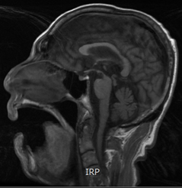
Example differential diagnosis – progressive supranuclear palsy (PSP)
Parkinson’s disease – History, definitions and diagnosis
T1 mid-sagittal image shows the ‘hummingbird sign’ (i.e., concavity of the upper border of the midbrain) (arrow)
Case of progressive supranuclear palsy (PSP)
Image courtesy of Shen-Yang Lim
Notes:
Progressive supranuclear palsy (PSP) is a fatal neurodegenerative condition, with a typical survival time of seven years.^{1,2} PSP can present with parkinsonism symptoms.¹ Pathologically, PSP is characterised by accumulation of tau proteins (four-repeat tau) that form filaments and neurofibrillary tangles within the brains of affected individuals.^{1,3}
References:
Niccolini F, Politis M. A systematic review of lessons learned from PET molecular imaging research in atypical parkinsonism. Eur J Nucl Med Mol Imaging 2016; 43 (12): 2244–2254.
Golbe LI. Progressive supranuclear palsy. Semin Neurol 2014; 34 (2): 151–159.
Spillantini MG, Goedert M. Tau pathology and neurodegeneration. Lancet Neurol 2013; 12: 609–622.

