Slide 1
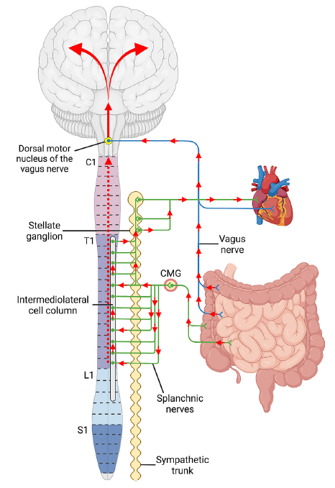
Aggregation of misfolded proteins
Parkinson’s disease – Neurobiology and aetiology
The autonomic nervous system in the spreading of α-synuclein³
At the heart of the PD disease process is the misfolding and propagation of the protein α-synuclein¹
The pathology typical of PD is first seen, within the brain, in the dorsal motor nucleus, and spreads upwards from there²
A milestone in understanding came in 2008, when Lewy body-like inclusions were observed in neurons that had been grafted (from foetal tissue) into the brains of patients with PD, 11–16 years after the grafts were performed¹
This observation was ground-breaking, because it suggested host-to-graft transmission of PD pathology¹
PD=Parkinson’s disease
1. Hauser. Lancet Neurol 2015;14(8):785–786;
2. Braak et al. Cell Tissue Res 2004;318(1):121–134;
3. Woerman & Tamgüney. Neurobiol Dis 2022;164:105625
This work is from Woerman & Tamgüney. Neurobiol Dis 2022, licensed under CC BY-NC-ND. Published by Elsevier. The work cannot be changed in any way or used commercially without permission from the journal. https://doi.org/10.1016/j.nbd.2022.105625
Notes:
According to the staging scheme of Braak and colleagues, the accumulation of aggregated α-synuclein that forms Lewy pathology is first seen in the lower parts of the brainstem during early PD, and then spreads over time in a relatively predictable way through different regions of the brain.² This phenomenon has been observed in the brain tissue of deceased patients with PD, yet the mechanisms by which this spreading occurs are not entirely certain.¹ However, a growing body of evidence has suggested that the α-synuclein proteins themselves may be responsible for the transmission of PD pathology from one area of the brain to another.⁴ This is known as the ‘prion model’ of disease transmission.⁴
References:
Hauser RA. α-Synuclein in Parkinson’s disease: getting to the core of the matter. Lancet Neurol 2015; 14 (8): 785–786.
Braak H, Ghebremedhin E, Rüb U, et al. Stages in the development of Parkinson’s disease-related pathology. Cell Tissue Res 2004; 318 (1): 121–134.
Woerman AL, Tamgüney G. Body-first Parkinson’s disease and variant Creutzfeldt-Jakob disease - similar or different? Neurobiol Dis 2022; 164: 105625.
Stopschinski BE, Diamond MI. The prion model for progression and diversity of neurodegenerative diseases. Lancet Neurol 2017; 16 (4): 323–332.

