Slide 1
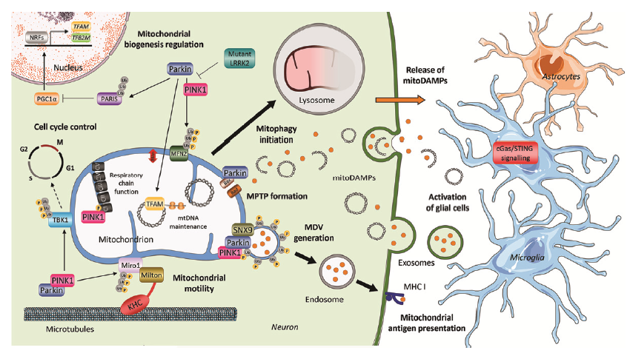

The importance of mitochondria in Parkinson’s disease
Parkinson’s disease – Neurobiology and aetiology
The genetic causes of PD reinforce the importance of the mitochondria–oxidative stress–proteasomal dysfunction axis in the pathogenesis of PD
Nucleus
TFAM
Mitochondrial
biogenesis regulation
NRFs
TFB2M
Nucleus
Mutant
LRRK2
Parkin
Release of
mitoDAMPs
Ub
Ub
PINK1
Astrocytes
PGC1 α
Ub
Lysosome
PARIS
Cell cycle control
Mitophagy
initiation
G2
M
P
Ub
P
Ub
cGas/STING
signalling
P
Ub
G1
MFN2
S
CV
Respiratory
chain
function
Parkin
mitoDAMPs
CIV
Bax
CIII
Rad
MPTP formation
Activation
of glial cells
Microglia
P
Ub
CII
TFAM
P
Ub
P
CI
mtDNA
maintenance
P
Ub
PINK1
TBK1
P
P
MDV
generation
Mitochondrion
SNX9
Ub
Ub
Ub
P
Mitochondrion
Parkin
Ub
PINK1
Ub
Ub
P
Exosomes
Miro1
P
Ub
P
P
Ub
Milton
Mitochondrial
motility
P
PINK1
P
Ub
MHC I
Parkin
P
Ub
Endosome
KHC
Mitochondrial
antigen presentation
Microtubules
Neuron
PD=Parkinson’s disease; PINK1=PTEN-induced putative kinase 1; PRKN=Parkin (not all abbreviations shown here)
Adapted from: Borsche et al. J Parkinsons Dis 2021;11(1):45-60; Grünewald et al. Prog Neurobiol 2019;177:73–93; Schapira. Lancet Neurol 2008;7:97–109
Notes:
Mitochondria are known as the ‘power plants of the cell’. They use metabolic fuels such as glucose to produce the high-energy molecule, adenosine triphosphate (ATP), which drives many important physiological processes.
A toxic by-product of normal mitochondrial function is the generation of free radicals, which cause oxidative stress.⁴ The cellular responses to this oxidative stress are regulated by the genes DJ-1, PINK1, PRKN, and UCH-L1, all of which have genetic variations associated with PD.¹⁻³ Taken together, the evidence strongly suggests that mitochondrial dysfunction plays an important role in the pathogenesis of PD.^{1,2} This opens the potential for novel treatments that may correct this dysfunction in people with PD.¹
References:
Borsche M, Pereira SL, Klein C, Grünewald A. Mitochondria and Parkinson’s disease: clinical, molecular, and translational aspects. J Parkinsons Dis 2021; 11 (1): 45-60.
Grünewald A, Kumar KR, Sue CM. New insights into the complex role of mitochondria in Parkinson’s disease. Prog Neurobiol 2019; 177: 73–93.
Schapira AHV. Mitochondria in the aetiology and pathogenesis of Parkinson’s disease. Lancet Neurol 2008; 7 (1): 97–109.
Moore DJ, West AB, Dawson VL, Dawson TM. Molecular pathophysiology of Parkinson’s disease. Annu Rev Neurosci 2005; 28: 57–87.

