Slide 1
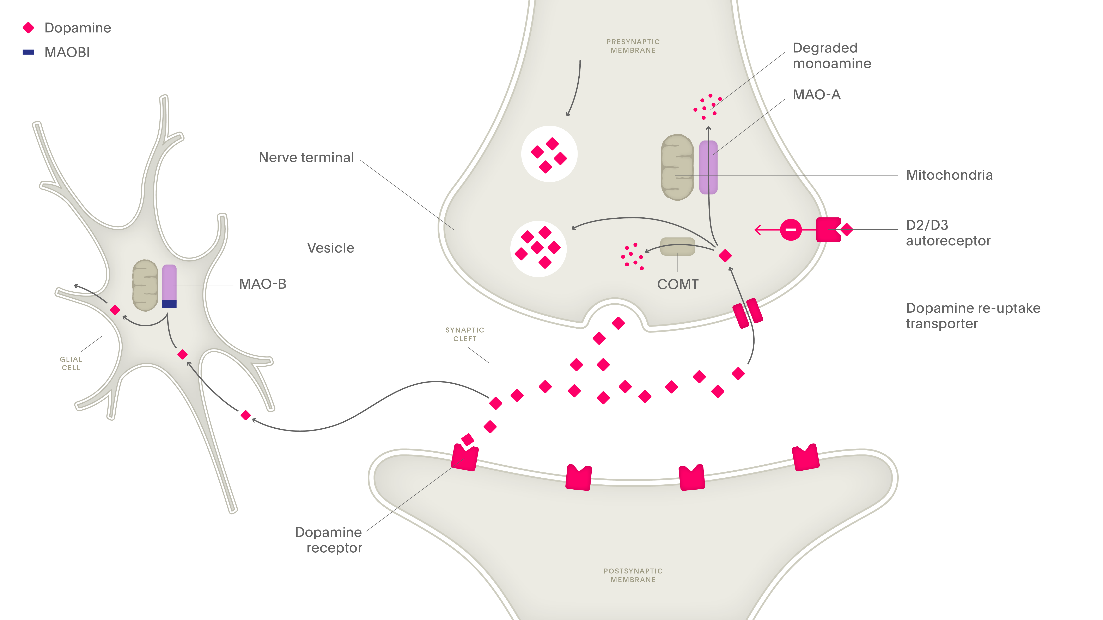
Other medications used in the treatment of Parkinson’s disease (II)
Parkinson’s disease – Treatment principles
Monoamine oxidase type B
(MAO-B) inhibitors^{1,2}
MAO breaks down dopamine^{1,2}
MAO-B inhibitors have shown efficacy in patients with PD as monotherapy³ or as adjunct therapy^{4,5}
Additionally, both rasagiline and safinamide were shown to increase the ‘ON’ time duration without troublesome dyskinesia⁵
MAO-B inhibitor mechanism of action at the synapse
COMT=catechol-O-methyltransferase; MAO-A=monoamine oxidase type A; MAO-B=monoamine oxidase type B;
MAOBI=monoamine oxidase type B inhibitor; PD=Parkinson’s disease
1. Stocchi. Conventional treatment-related motor complications: their prevention and treatment. In: Wolters & Baumann (eds). Parkinson Disease and Other Movement Disorders. 2014;
2. Fox et al. Mov Disord 2018;33(8):1248–1266; 3. Tan et al. J Parkinsons Dis 2022;12(2):477–493; 4. Schapira et al. JAMA Neurol 2017;74(2):216–224; 5. de Bie et al. Mov Disord 2025;doi:10.1002/mds.30162
Notes:
Patients who are experiencing ‘wearing-off’ may benefit from taking a monoamine oxidase type B inhibitor (MAO-B inhibitor).^{5,6} MAO-B inhibitors inhibit the breakdown of either dopamine or levodopa in the body, thus prolonging their therapeutic effect and time spent in ‘ON’ states.⁷ MAO-B inhibitors may be used during early PD, before the patient moves on to more potent treatments, such as dopamine agonists or levodopa.⁷
References:
1. Stocchi F. Conventional treatment-related motor complications: their prevention and treatment. In: Wolters & Baumann (eds). Parkinson Disease and Other Movement Disorders. VU University Press, 2014.
2. Fox SH, Katzenschlager R, Lim S-Y, et al. International Parkinson and Movement Disorder Society evidence-based medicine review: update on treatments for the motor symptoms of Parkinson’s disease. Mov Disord 2018; 33 (8): 1248–1266.
3. Tan Y-Y, Jenner P, Chen S-D. Monoamine oxidase-B inhibitors for the treatment of Parkinson’s disease: past, present, and future. J Parkinsons Dis 2022; 12 (2): 477–493.
4. Schapira AH, Fox SH, Hauser RA, et al. Assessment of safety and efficacy of safinamide as a levodopa adjunct in patients with Parkinson disease and motor fluctuations: a randomized clinical trial. JAMA Neurol 2017; 74 (2): 216–224.
5. de Bie RMA, Katzenschlager R, Swinnen BEKS, et al. Update on treatments for Parkinson’s disease motor fluctuations - An International Parkinson and Movement Disorder society evidence-based medicine review. Mov Disord 2025; doi: 10.1002/mds.30162.
6. Factor SA. Current status of symptomatic medical therapy in Parkinson’s disease. Neurotherapeutics 2008; 5 (2): 164–180.
7. Connolly BS, Lang AE. Pharmacological treatment of Parkinson disease: a review. JAMA 2014; 311 (16): 1670–1683.
De Bie et al. 2025 Pg. 5 (AA, AB), 8 (AC), 9 (G)

