Slide 1
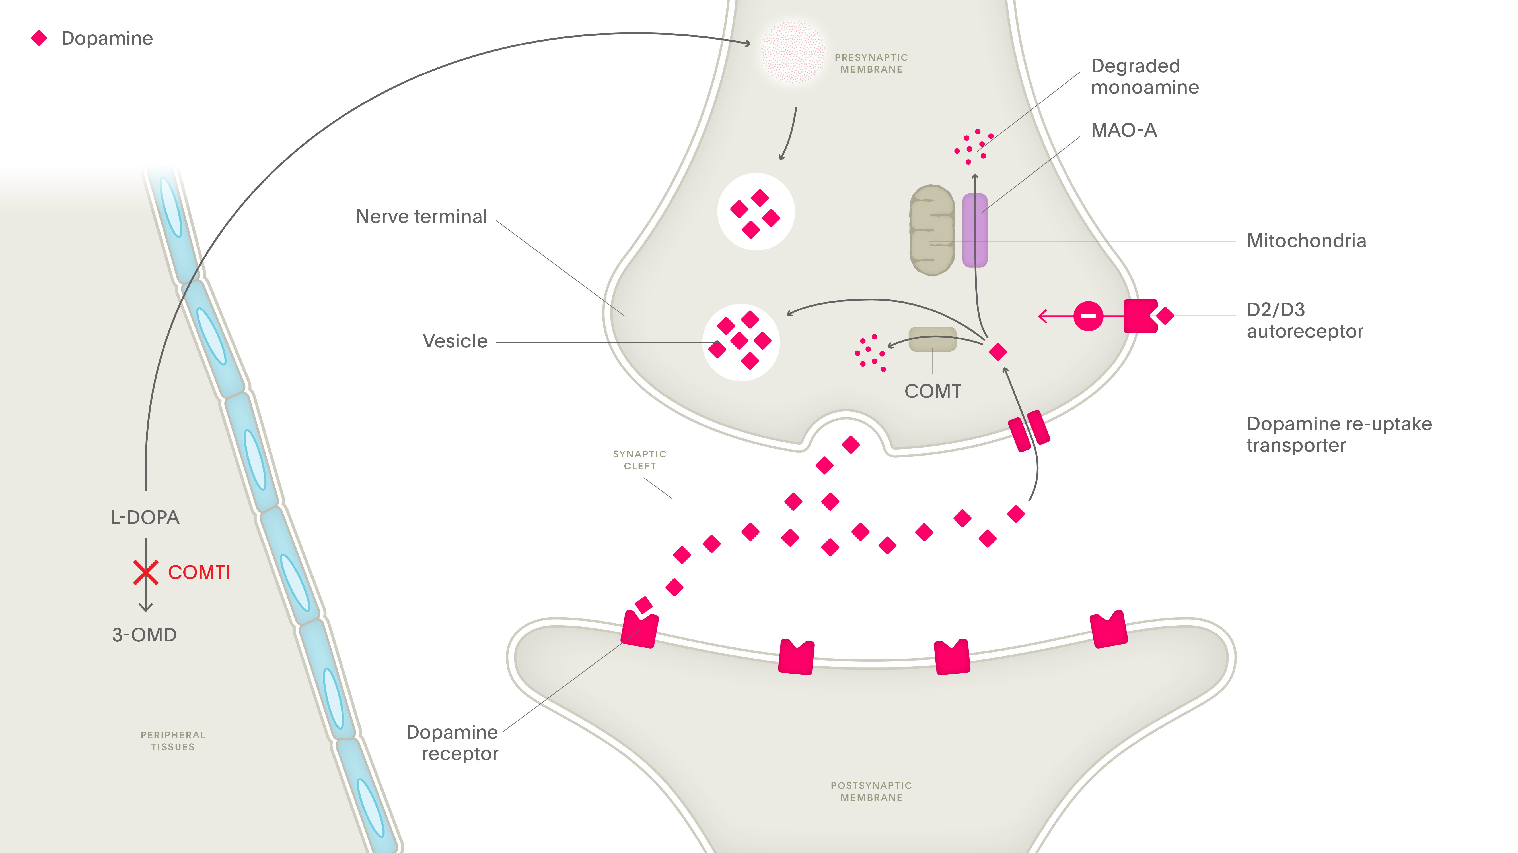
Other medications used in the treatment of Parkinson’s disease (III)
Parkinson’s disease – Treatment principles
Catechol-O-methyltransferase (COMT) inhibitors
COMT breaks down levodopa¹
To increase the amount of levodopa that gets to the brain, COMT inhibitors are used to decrease the metabolism of levodopa¹
COMT inhibitors increase the half-life of levodopa by up to about 50%^{1,2}
In some countries, a COMT inhibitor is available with levodopa/decarboxylase inhibitor as a combination tablet, easing the patient’s pill burden¹
COMT inhibitors mechanism of action
3-OMD=3-O-methyldopa; COMT=catechol-O-methyltransferase; COMTI=catechol-O-methyltransferase inhibitor; L-DOPA=levodopa; MAO-A=monoamine oxidase type A
1. Stocchi. Conventional treatment-related motor complications: their prevention and treatment. In: Wolters & Baumann (eds). Parkinson Disease and Other Movement Disorders. 2014;
2. van Gerpen. Conventional treatment in Parkinson’s disease. In: Wolters & Baumann (eds). Parkinson Disease and Other Movement Disorders. 2014
Notes:
Patients who are experiencing ‘wearing-off’ may benefit from taking a catechol-O-methyltransferase inhibitor (COMT inhibitor).^{3,4} COMT inhibitors inhibit the breakdown of dopamine and of levodopa in the body, thus prolonging their therapeutic effect and time spent in ‘ON’ states.⁵
References:
1. Stocchi F. Conventional treatment-related motor complications: their prevention and treatment. In: Wolters & Baumann (eds). Parkinson Disease and Other Movement Disorders. VU University Press, 2014.
2. van Gerpen JA. Conventional treatment in Parkinson’s disease. In: Wolters & Baumann (eds). Parkinson Disease and Other Movement Disorders. VU University Press, 2014.
3. de Bie RMA, Katzenschlager R, Swinnen BEKS, et al. Update on treatments for Parkinson’s disease motor fluctuations - An International Parkinson and Movement Disorder society evidence-based medicine review. Mov Disord 2025; doi: 10.1002/mds.30162.
4. Factor SA. Current status of symptomatic medical therapy in Parkinson’s disease. Neurotherapeutics 2008; 5 (2): 164–180.
5. Connolly BS, Lang AE. Pharmacological treatment of Parkinson disease: a review. JAMA 2014; 311 (16): 1670–1683.

