Slide 1
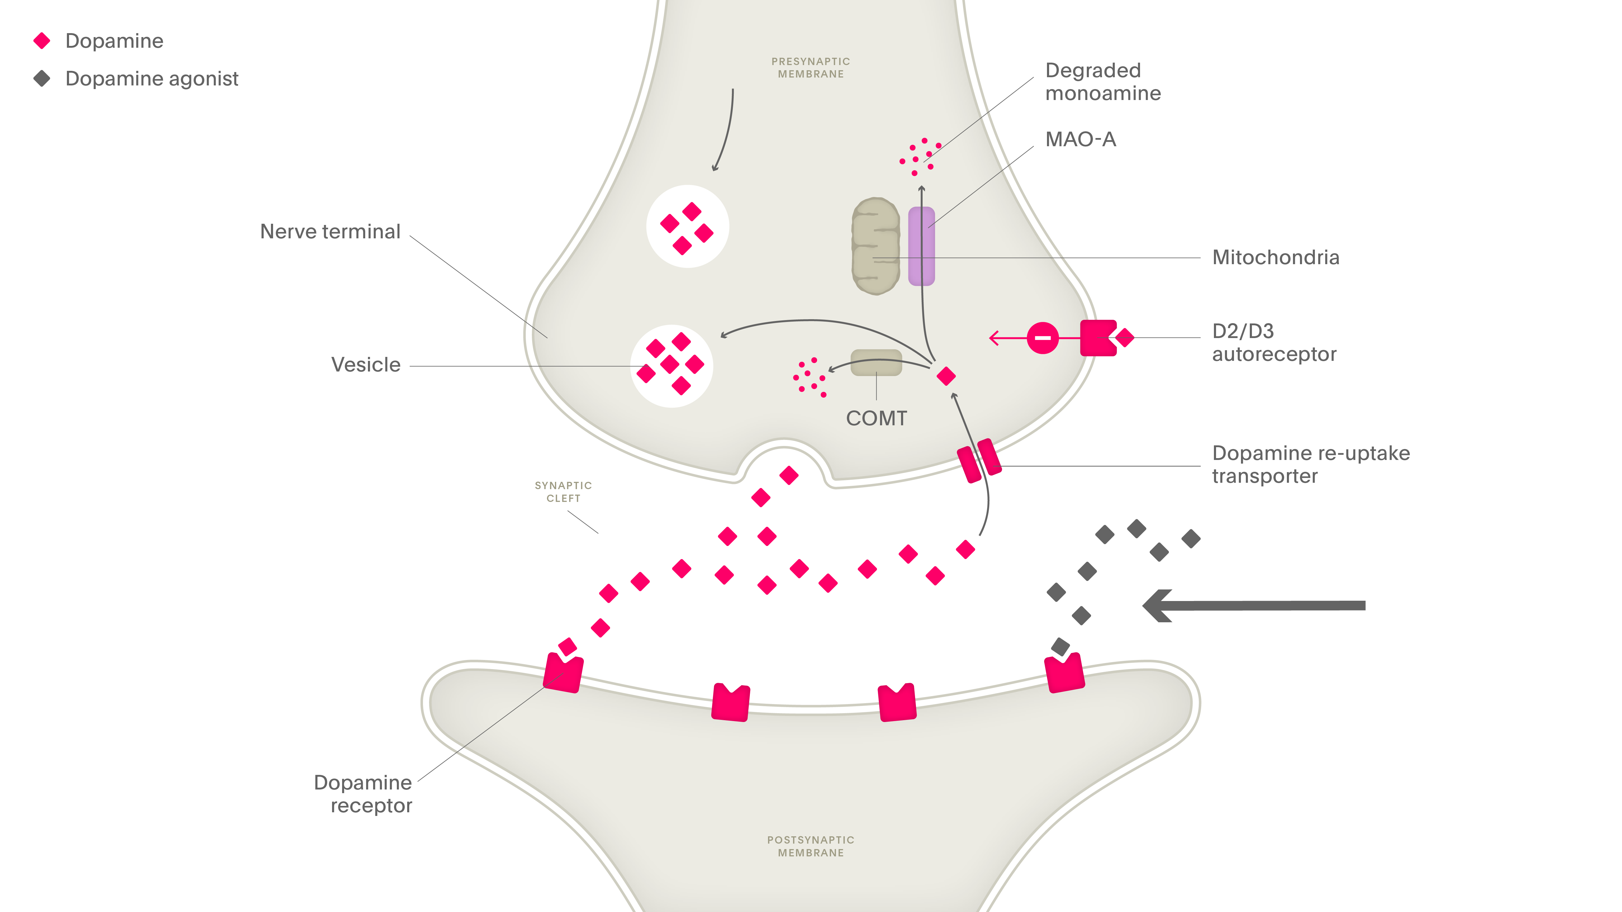
Other medications used in the treatment of Parkinson’s disease (I)
Parkinson’s disease – Treatment principles
Dopamine agonists (DAs)
DAs mimic the action of dopamine by activating dopamine receptors¹
DAs are useful as monotherapy in earlier stages of PD, and are also useful as adjunctive treatment in patients experiencing motor fluctuations^{2,3}
DAs have shown antidepressant effects in people with PD⁴
DAs can cause/contribute to a variety of side effects, including nausea, psychosis and ‘impulse control disorders’ (e.g., hypersexuality, pathological gambling, binge eating, and compulsive buying)⁵
Dopamine and DAs at the synapse
COMT=catechol-O-methyltransferase; DA=dopamine agonist; MAO-A=monoamine oxidase type A; PD=Parkinson’s disease
1. Isaacson et al. Clin Park Relat Disord 2023;9:100212; 2. Fox et al. Mov Disord 2018;33(8):1248–1266; 3. de Bie et al. Mov Disord 2025;doi:10.1002/mds.30162;
4. Picillo et al. Parkinsonism Relat Disord 2009;15(Suppl 4):S81–S84; 5. Weintraub et al. Arch Neurol 2010;67(5):589–595
Notes:
Dopamine agonists play a major role in the treatment of PD.⁶ They act by directly stimulating intact postsynaptic receptors in the brain linked to motor control.⁶ Although they tend to be less potent than levodopa in reducing parkinsonian motor symptoms, dopamine agonists are much less likely to cause dyskinesias.⁶ This characteristic can make dopamine agonists a useful tool for the management of early and fluctuating PD.⁶
Dopamine agonists have several key advantages over levodopa: they tend to have a longer half-life, which allows for a more prolonged action; their absorption in the gut is not inhibited by dietary protein; and they are easily absorbed across the blood–brain barrier.⁶ Dopamine agonists may therefore allow the patient to reduce their levodopa usage without worsening their parkinsonian symptoms.⁷
References:
1. Isaacson SH, Hauser RA, Pahwa R, et al. Dopamine agonists in Parkinson’s disease: Impact of D1-like or D2-like dopamine receptor subtype selectivity and avenues for future treatment. Clin Park Relat Disord 2023; 9: 100212.
2. Fox SH, Katzenschlager R, Lim S-Y, et al. International Parkinson and Movement Disorder Society evidence-based medicine review: update on treatments for the motor symptoms of Parkinson’s disease. Mov Disord 2018; 33 (8): 1248–1266.
3. de Bie RMA, Katzenschlager R, Swinnen BEKS, et al. Update on treatments for Parkinson’s disease motor fluctuations - An International Parkinson and Movement Disorder Society evidence-based medicine review. Mov Disord 2025; doi: 10.1002/mds.30162.
4. Picillo M, Rocco M, Barone P. Dopamine receptor agonists and depression in Parkinson's disease. Parkinsonism Relat Disord 2009; 15 (Suppl 4): S81–S84.
5. Weintraub D, Koester J, Potenza MN. Impulse control disorders in Parkinson disease: A cross-sectional study of 3090 patients. Arch Neurol 2010; 67 (5): 589–595.
6. Factor SA. Current status of symptomatic medical therapy in Parkinson’s disease. Neurotherapeutics 2008; 5 (2): 164–180.
7. Stocchi F. Conventional treatment-related motor complications: their prevention and treatment. In: Wolters & Baumann (eds). Parkinson Disease and Other Movement Disorders. VU University Press, 2014.
Picillo et al. 2009 Pg. 582, 583

