Slide 1
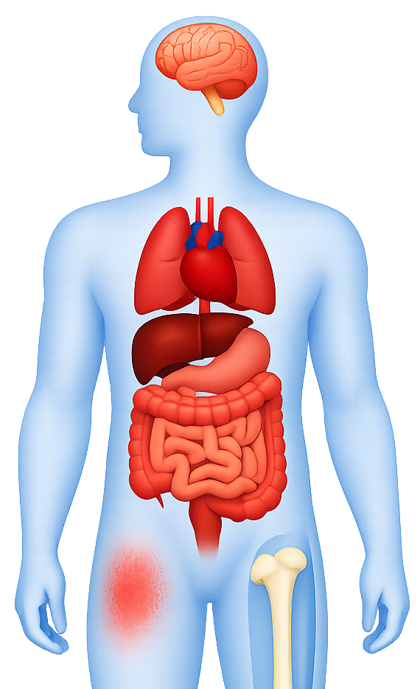
Somatic comorbidities in schizophrenia
Schizophrenia – Comorbidity
Neurological¹
Nine meta-analyses encompassing ~66 million participants examined 21 distinct health outcomes¹
Thirteen outcomes demonstrated statistically significant associations with schizophrenia, indicating a substantial link between schizophrenia and multiple adverse health conditions¹
  Population cohort data similarly demonstrate schizophrenia is associated with a broadly elevated risk of most physical health conditions (HR >1)^{2,d}
Adjusting for prior mental disorders attenuated some associations, but the pattern of comorbidity
is consistent^{1,2}
  The strength of supporting evidence is fragile due to heterogeneity, publication bias, and methodological variation in underlying meta-analyses¹
Dementiaª
Respiratory¹
COPD,ª pneumonia,ª asthma^{b}
Cardiovascular¹
CVD,ª CHF,ª strokeª
Oncological¹
Breast cancer (women)ª
Dermatological¹
Psoriasisª
Sexual¹
Sexual dysfunction^{a,c}
Musculoskeletal¹
Fractureª
ªCE=weak (remaining significant associations; p value<0.05); ^{b}CE=NS (NS associations; p value<0.05); ^{c}Male, female, and overall populations; ^{d}Data are from a nationwide population‑based cohort of 5,940,299 individuals born in Denmark between 1900 and 2015 who were residing in the country at the start of follow‑up (1 January 2000, or their first birthday thereafter). Among included individuals, 698,874 (11.8%) had received a diagnosis of a mental disorder and 5,241,425 (88.2%) had not
CE=class and quality of evidence; CHF=congestive heart failure; COPD=chronic obstructive pulmonary disease; CVD=cardiovascular disease; HR=hazard ratio; NS=non-significant
1. Lee et al. Mol Psychiatry 2025;30:1127–1137; 2. Momen et al. N Engl J Med 2020;382:1721–1731
Notes:
References:
Lee H, Lee JH, Lee S, et al. Comorbid health outcomes in patients with schizophrenia: an umbrella review of systematic reviews and meta-analyses. Mol Psychiatry 2025; 30: 1127–1137.
Momen NC, Plana-Ripoll O, Agerbo E, et al. Association between mental disorders and subsequent medical conditions. N Engl J Med 2020; 382: 1721–1731.

