Slide 1
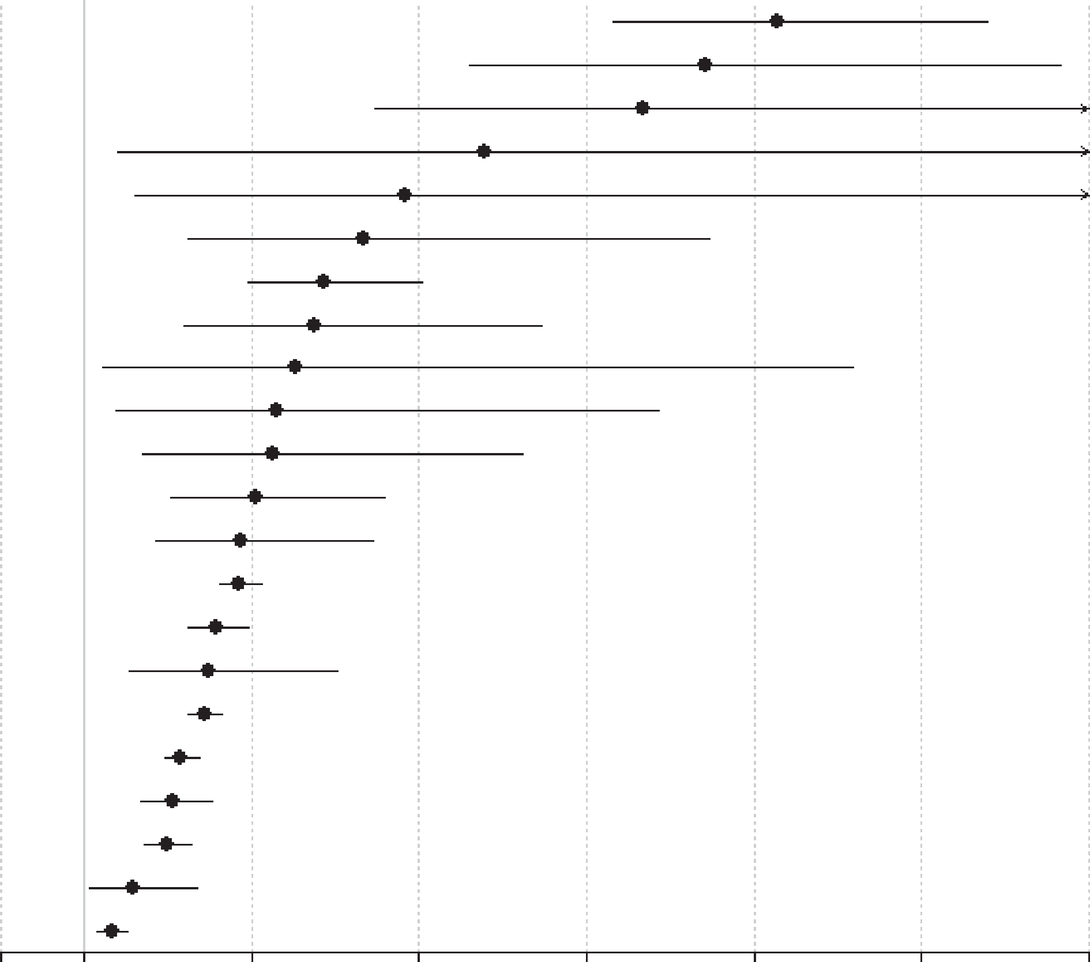
Mortality rates in schizophrenia
Schizophrenia – Comorbidity
Mortality risk in people with prevalent schizophrenia versus the general population
Schizophrenia was found to be associated with markedly elevated mortality across nearly all causes of death, with risk magnitude varying substantially by cause
Highest relative risks for incident and prevalent schizophreniaª included suicide, injury/poisoning and undetermined non‑natural causes, and pneumonia
Schizophrenia was linked to broad, multi‑system increases in natural‑cause mortality, including infectious diseases, endocrine diseases, respiratory diseases (overall), urogenital diseases, diabetes mellitus, gastrointestinal diseases, neurological diseases, liver diseases, and cerebrovascular diseases
Outcome
Risk ratio (95% CI)
Suicide (n=23)
Undetermined non-natural (n=9)
Infectious-pneumonia (n=2)
Skin/subcutaneous (n=2)
Musculoskeletal/connective (n=2)
Infectious, any (n=8)
Respiratory, any (n=11)
Urogenital, any (n=7)
Endocrine (n=6)
Injury-accidents (n=4)
Injury-any (n=5)
Gastrointestinal (n=8)
Diabetes (n=4)
All-cause (n=50)
Natural (study-defined) (n=16)
Other not specified (n=4)
Nervous-any (n=4)
Natural (n=38)
Cardiovascular (n=14)
Cardio-cerebrovascular (n=24)
Cerebrovascular (n=8)
Cancer, any (n=20)
9.28 (7.31, 11.78)
8.42 (5.60, 12.70)
7.67 (4.48, 13.10)
5.79 (1.40, 23.90)
4.83 (1.60, 14.60)
4.34 (2.23, 8.47)
3.86 (2.96, 5.03)
3.75 (2.18, 6.45)
3.52 (1.22, 10.18)
3.31 (1.39, 7.87)
3.26 (1.70, 6.23)
3.06 (2.05, 4.58)
2.88 (1.86, 4.46)
2.86 (2.62, 3.12)
2.58 (2.25, 2.96)
2.49 (1.53, 4.02)
2.43 (2.24, 2.64)
2.15 (1.96, 2.37)
2.06 (1.68, 2.52)
1.98 (1.73, 2.28)
1.58 (1.06, 2.36)
1.33 (1.16, 1.52)
0
1
3
5
7
9
11
13
Risk ratio (95% CI)
This work is from ‘Mortality in people with schizophrenia: a systematic review and meta-analysis of relative risk and aggravating or attenuating factors' by Correll et al. World Psychiatry 2022; Copyright © 2022, with permission from the authors. This work is licensed under Creative Commons license CC-BY-SA by The Lundbeck Foundation.
Data are from a systematic review and random‑effects meta‑analysis of 135 studies (1957–2021), including ~4.5 million people with schizophrenia and ~1.1 billion controls
ªPrevalent cases include all individuals living with schizophrenia within a specified timeframe, regardless of when the person was diagnosed with or developed the condition; incident cases encompass all individuals who are newly identified within the period of observation as having schizophrenia, or all new cases of schizophrenia
CI=confidence interval
Correll et al. World Psychiatry 2022;21:248–271
Notes:
Reference:
Correll CU, Solmi M, Croatto G, et al. Mortality in people with schizophrenia: a systematic review and meta-analysis of relative risk and aggravating or attenuating factors. World Psychiatry 2022; 21: 248–271.

