Slide 1
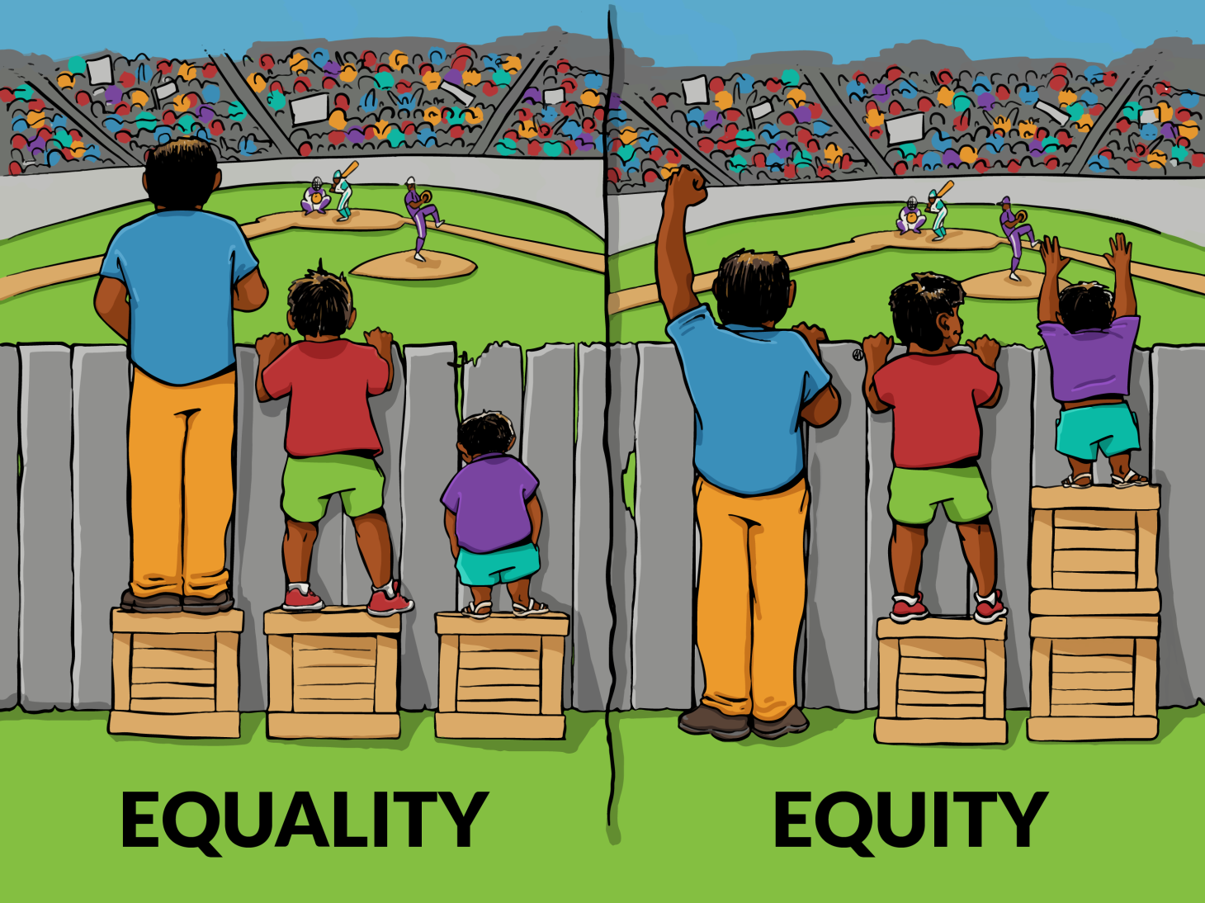
Health disparities in mental disorders
Schizophrenia – Comorbidity
Mental illness is associated with higher physical disease risk, poorer access to care, and inadequate management of physical comorbidity across diagnoses and
income settings
Premature mortality in mental illness reflects cumulative health inequalities across the
life course
Reducing physical health inequalities in people with mental illness requires attention to both the prevention of chronic conditions and the reduction of their long‑term impact across the life course
This work is from Interaction Institute for Social Change (https://interactioninstitute.org/illustrating-equality-vs-equity/); | Artist: Angus Maguire (madewithangus.com). This work is licensed under Creative Commons license CC-BY-SA by The Lundbeck Foundation.
Firth et al. Lancet Psychiatry 2019;6:675–712
Notes:
Reference:
Firth J, Siddiqi N, Koyanagi A, et al. The Lancet Psychiatry Commission: a blueprint for protecting physical health in people with mental illness. Lancet Psychiatry 2019; 6: 675–712.

