Slide 1
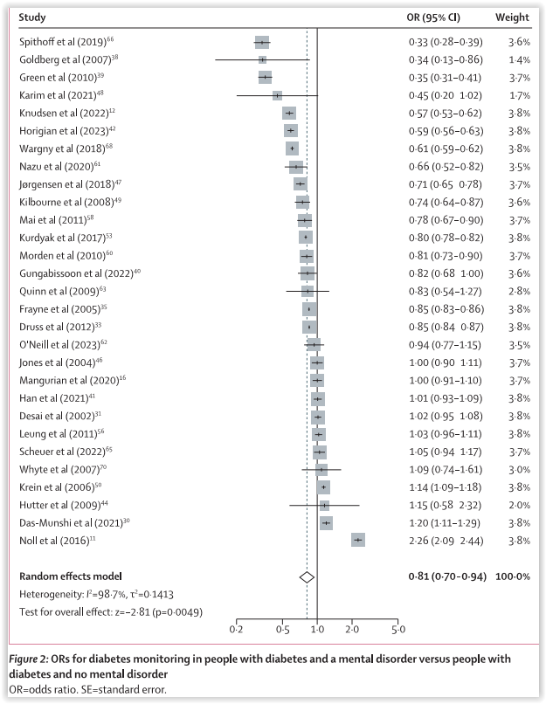
Disparities in diabetes management in mental disorders
Schizophrenia – Comorbidity
Diabetes monitoring in individuals
with versus without mental disorders
Significant negative associations were observed between having any mental disorder and the likelihood of receiving any recommended diabetes monitoring
(29 studies, OR=0.81 [95% CI: 0.70, 0.94]; p=0.0049)
Negative associations were observed for:
  HbA1c measurement
  (24 studies; OR=0.81 [95% CI: 0.68, 0.97]; p=0.024)
  Retinal screening
  (21 studies; OR=0.77 [95% CI: 0.63, 0.95]; p=0.013)
  Lipid and cholesterol measurement
  (20 studies; OR=0.83 [95% CI: 0.69, 0.99]; p=0.043)
  Foot examination
  (11 studies; OR=0.85 [95% CI: 0.76, 0.95]; p=0.0044)
  Renal investigation
  (16 studies; OR=0.78 [95% CI: 0.63, 0.96]; p=0.022)
  Receiving GLP-1 receptor agonist treatment
  (2 studies; OR=0.26 [95% CI: 0.13, 0.49]; p<0.0001)
Study |  | OR (95% CI) | Weight (%)
Spithoff et al. 2019 |  | 0.33 (0.28, 0.39) | 3.6
Goldberg et al. 2007 |  | 0.34 (0.13, 0.86) | 1.4
Green et al. 2010 |  | 0.35 (0.31, 0.41) | 3.7
Karim et al. 2021 |  | 0.45 (0.20, 1.02) | 1.7
Knudsen et al. 2022 |  | 0.57 (0.53, 0.62) | 3.8
Horigian et al. 2023 |  | 0.59 (0.56, 0.63) | 3.8
Wargny et al. 2018 |  | 0.61 (0.59, 0.62) | 3.8
Nazu et al. 2020 |  | 0.66 (0.52, 0.82) | 3.5
Jørgensen et al. 2018 |  | 0.71 (0.65, 0.78) | 3.7
Kilbourne et al. 2008 |  | 0.74 (0.64, 0.87) | 3.6
Mai et al. 2011 |  | 0.78 (0.67, 0.90) | 3.7
Kurdyak et al. 2017 |  | 0.80 (0.78, 0.82) | 3.8
Morden et al. 2010 |  | 0.81 (0.73, 0.90) | 3.7
Gungabissoon et al. 2022 |  | 0.82 (0.68, 1.00) | 3.6
Quinn et al. 2009 |  | 0.83 (0.54, 1.27) | 2.8
Frayne et al. 2005 |  | 0.85 (0.83, 0.86) | 3.8
Druss et al. 2012 |  | 0.85 (0.84, 0.87) | 3.8
O'Neill et al. 2023 |  | 0.94 (0.77, 1.15) | 3.5
Jones et al. 2004 |  | 1.00 (0.90, 1.11) | 3.7
Mangurian et al. 2020 |  | 1.00 (0.91, 1.10) | 3.7
Han et al. 2021 |  | 1.01 (0.93, 1.09) | 3.8
Desai et al. 2002 |  | 1.02 (0.95, 1.08) | 3.8
Leung et al. 2011 |  | 1.03 (0.96, 1.11) | 3.8
Scheuer et al. 2022 |  | 1.05 (0.94, 1.17) | 3.7
Whyte et al. 2007 |  | 1.09 (0.74, 1.61) | 3.0
Krein et al. 2006 |  | 1.14 (1.09, 1.18) | 3.8
Hutter et al. 2009 |  | 1.15 (0.58, 2.32) | 2.0
Das-Munshi et al. 2021 |  | 1.20 (1.11, 1.29) | 3.8
Noll et al. 2016 |  | 2.26 (2.09, 2.44) | 3.8
Random effects model |  | 0.81 (0.70, 0.94) | 100.0
Heterogeneity: I²=98.7%, τ²=0.1413
Test for overall effect: z=−2.81 (p=0.0049)
0.2
0.5
1.0
2.0
5.0
This work is adapted from ‘Disparities in diabetes treatment and monitoring for people with and without mental disorders: a systematic review and meta-analysis' by Wagner et al. Lancet Psychiatry 2026, used under
CC-BY 4.0. This work is licensed under Creative Commons license CC-BY-SA by The Lundbeck Foundation.
Data are derived from a systematic review and random‑effects meta‑analysis of studies published from database inception to February 2025, including 49 studies (42 cohort and seven case‑control) and a total of 5,503,712 individuals with diabetes, of whom 838,366 (15.2%) had a diagnosed mental disorder
CI=confidence interval; GLP-1=glucagon-like peptide-1; HbA1c=glycated haemoglobin; OR=odds ratio
Wagner et al. Lancet Psychiatry 2026;13:112–124
Notes:
Reference:
Wagner E, Højlund M, Fiedorowicz JG, et al. ECNP PAN-Health Group. Disparities in diabetes treatment and monitoring for people with and without mental disorders: a systematic review and meta-analysis. Lancet Psychiatry 2026; 13: 112–124.

