Slide 1
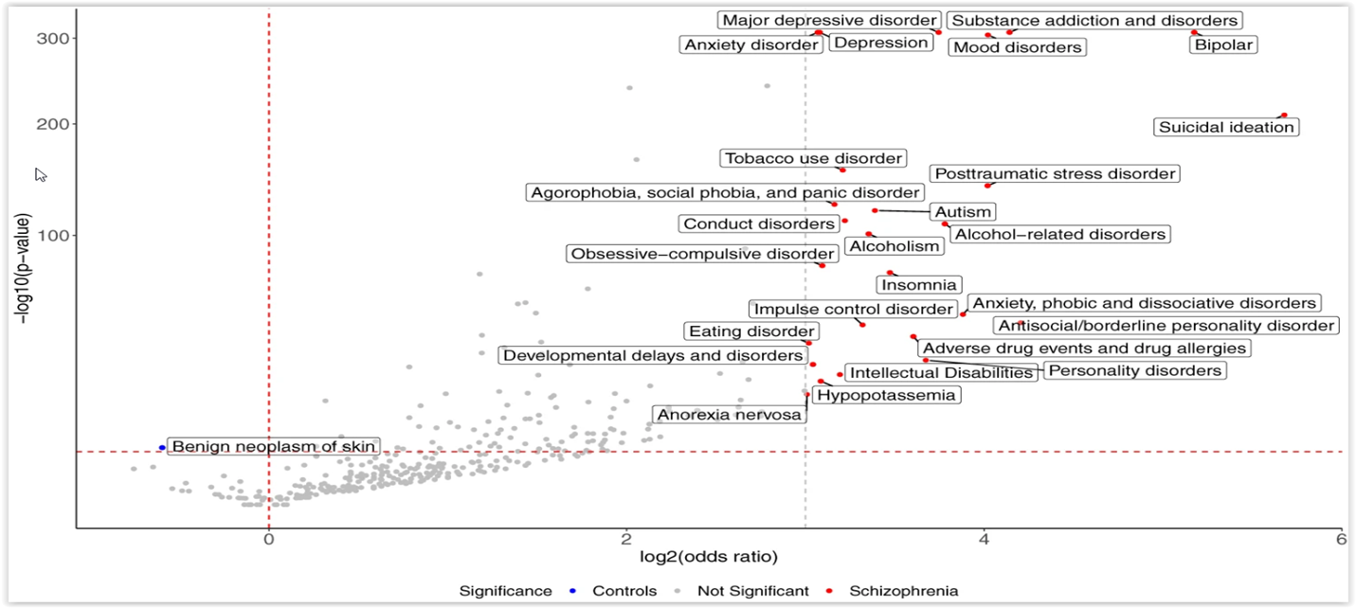
Enriched phenotypes preceding a diagnosis of schizophrenia
Schizophrenia – Comorbidity
Systematic analysis of phenotypes preceding schizophrenia diagnosesª
Top ten significantly enriched phenotypes preceding schizophrenia diagnoses
Suicidal ideation
Bipolar disorder
Antisocial/borderline personality disorder
Substance addiction and disorders
Mood disorders
PTSD
Anxiety, phobic, and dissociative disorders
Alcohol-related disorders
MDD
Personality disorders
300
Significance
Controls
Not significant
Schizophrenia
MDD
Substance addiction and disorders
Anxiety disorder
Depression
Mood disorders
Bipolar disorder
200
Suicidal ideation
Tobacco use disorder
PTSD
Agoraphobia, social phobia, and panic disorder
ASD
100
Conduct disorders
Alcoholism
Alcohol-related disorders
−Log₁₀ (p value)
Obsessive-compulsive disorder
Insomnia
Anxiety, phobic, and dissociative disorders
Impulse control disorder
Antisocial/borderline personality disorder
Eating disorder
Adverse drug events and drug allergies
Developmental delays and disorders
Intellectual disabilities
Personality disorders
Benign neoplasm of skin
Anorexia nervosa
Hypopotassaemia
0
2
4
6
Log₂ (OR)
This work is adapted from ‘Large-scale real-world data analysis identifies comorbidity patterns in schizophrenia' by Lu et al. Transl Psychiatry 2022, used under CC-BY 4.0. This work is licensed under Creative Commons license CC-BY-SA by The Lundbeck Foundation.
Phenotype mapping revealed 144 significantly^{b} enriched phecodes before schizophrenia diagnosis
in adolescents and young adults (15–29 years; n=13,828) versus matched controls
ªThe volcano plot displays both ORs (log₂ scale) and statistical significance (−log₁₀ p value). The red horizontal dashed line indicates the same Bonferroni-corrected p value threshold, the red vertical dashed line designates OR=1, and the grey vertical dashed line indicates an OR=8 threshold, above which phenotypes enriched in the schizophrenic group are annotated; ^{b}Bonferroni-corrected p value<0.05
ASD=autism spectrum disorder; MDD=major depressive disorder; OR=odds ratio; PTSD=post-traumatic stress disorder
Lu et al. Transl Psychiatry 2022;12:154
Notes:
Reference:
Lu C, Jin D, Palmer N, et al. Large-scale real-world data analysis identifies comorbidity patterns in schizophrenia. Transl Psychiatry 2022; 12: 154.

