Slide 1
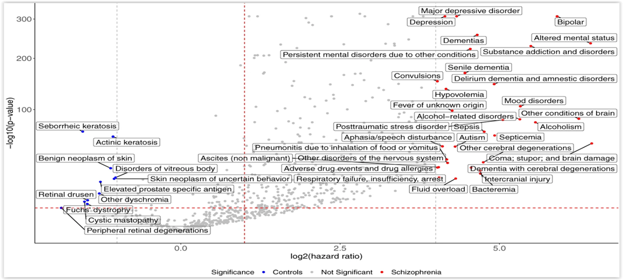
Enriched phenotypes succeeding a diagnosis of schizophrenia
Schizophrenia – Comorbidity
Systematic analysis of phenotypes succeeding schizophrenia diagnosesª
Top ten significantly enriched phenotypes succeeding schizophrenia diagnoses
Coma; stupor; and brain damage
Altered mental state
Other conditions of brain
Bipolar disorder
Alcoholism
Substance addiction and disorders
Mood disorders
Alcohol-related disorders
PTSD
Septicaemia
Depression
MDD
Bipolar disorder
300
Significance
Controls
Not significant
Schizophrenia
Dementias
Altered mental status
Persistent mental disorders due to other conditions
200
Senile dementia
Substance addiction and disorders
Convulsions
Delirium dementia and amnestic disorders
Hypovolemia
Mood disorders
100
Fever of unknown origin
PTSD
Alcohol-related disorders
Seborrheic keratosis
Aphasia/speech disturbance
−Log₁₀ (p value)
Actinic keratosis
Pneumonitis due to inhalation of food or vomitus
Sepsis
Alcoholism
Other conditions of brain
Benign neoplasm of skin
Other disorders of the nervous system
ASD
Septicaemia
Disorders of vitreous body
Ascites (non-malignant)
Coma; stupor; and brain damage
Retinal drusen
Skin neoplasm of uncertain behaviour
Adverse drug events and drug allergies
Other cerebral degenerations
Elevated prostate-specific antigen
Respiratory failure, insufficiency, arrest
Intercranial injury
Other dyschromia
Fluid overload
Bacteraemia
Cystic mastopathy
Fuchs’ dystrophy
Dementia with cerebral degenerations
Peripheral retinal degenerations
0.0
2.5
5.0
Log₂ (HR)
This work is adapted from ‘Large-scale real-world data analysis identifies comorbidity patterns in schizophrenia' by Lu et al. Transl Psychiatry 2022, used under CC-BY 4.0. This work is licensed under Creative Commons license CC-BY-SA by The Lundbeck Foundation.
Phenotype mapping after schizophrenia diagnosis (n=61,453) revealed
402 significantly^{b} enriched phecodes versus matched controls
ªThe volcano plot displays both HRs (log₂ scale) and statistical significance (−log₁₀ p value). The red horizontal dashed line indicates the same Bonferroni-corrected p value threshold, the red vertical dashed line designates an HR=1 threshold, and the grey vertical dashed lines indicate HR=16 and HR=0.5. Phenotypes with more extreme HRs are labeled in the figure; ^{b}Bonferroni-corrected p value<0.05
ASD=autism spectrum disorder; HR=hazard ratio; MDD=major depressive disorder; PTSD=post-traumatic stress disorder
Lu et al. Transl Psychiatry 2022;12:154
Notes:
Reference:
Lu C, Jin D, Palmer N, et al. Large-scale real-world data analysis identifies comorbidity patterns in schizophrenia. Transl Psychiatry 2022; 12: 154.

