Slide 1
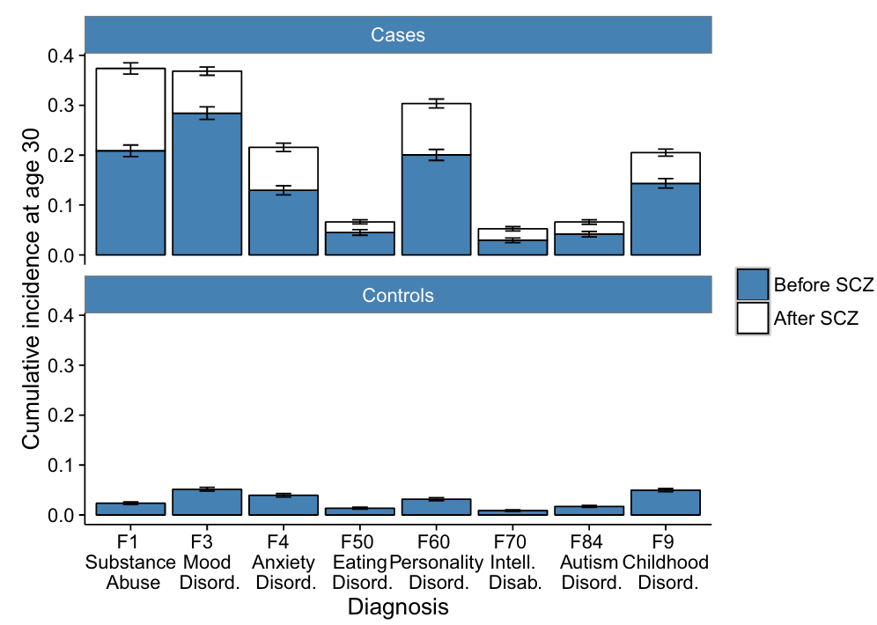
Incidence and timing of psychiatric comorbidities in schizophrenia
Schizophrenia – Comorbidity
Cumulative incidence at age 30 of comorbid psychiatric disorders before and after schizophrenia diagnosisª
By age 30, individuals with schizophrenia showed substantially higher cumulative incidence across eight comorbid psychiatric disorder categories compared with population controls
82% of individuals with schizophrenia had at least one additional psychiatric diagnosis prior to, concurrent with, or following their schizophrenia diagnosis
70% had already received another psychiatric diagnosis before their schizophrenia diagnosis
0.4
Cases
0.3
0.2
0.1
0.0
Cumulative incidence at age 30
0.4
0.3
Controls
0.2
0.1
0.0
F1
Substance
abuse
F3
Mood
disord.
F4
Anxiety
disord.
F50
Eating
disord.
F60
Personality
disord.
F70
Intell.
disab.
F84
Autism
disord.
F9
Childhood
disord.
Diagnosis
Before schizophrenia
After schizophrenia
Data are from the Danish national patient registers, including individuals born between 1981 and 2002 diagnosed with
schizophrenia (ICD‑10 F20.0–F20.9; n=5,432) and matched population controls (n=10,864), followed until 31 December 2016
ªError bars show 95% confidence intervals
Disab.=disability; Disord.=disorder; Intell.=intellectual
Krebs et al. Nat Commun 2021;12:6617
This work is adapted from ‘Associations between patterns in comorbid diagnostic trajectories of individuals with schizophrenia and etiological factors' by Krebs et al. Nat Commun 2021, used under CC-BY 4.0. This work is licensed under Creative Commons license CC-BY-SA by The Lundbeck Foundation.
Notes:
Reference:
Krebs MD, Themudo GE, Benros ME, et al. Associations between patterns in comorbid diagnostic trajectories of individuals with schizophrenia and etiological factors. Nat Commun 2021; 12: 6617.

