Slide 1
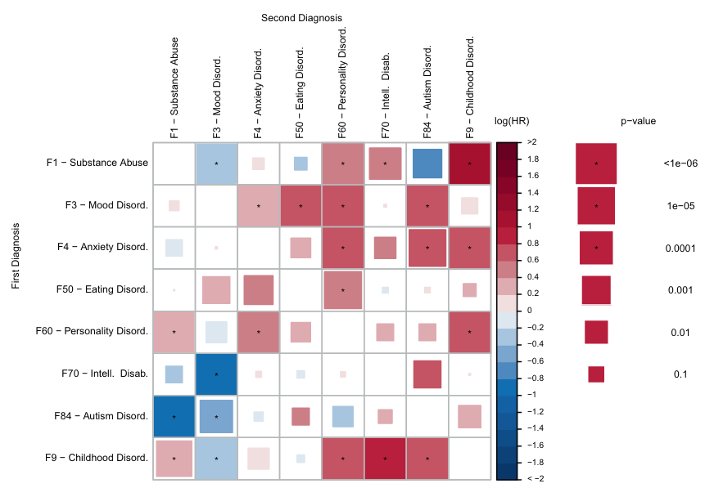
Timing of psychiatric comorbidities in schizophrenia
Schizophrenia – Comorbidity
Adjusted HRs for comorbid psychiatric disorders in individuals with schizophrenia (n=5,432)ª
Among individuals with schizophrenia, HRs for
22 of 56 non‑schizophrenia comorbidity pairs were significant (p<0.00089), suggesting a temporally structured ordering of comorbidities from adolescence into adulthood
The results indicate that comorbidities in schizophrenia follow distinct, time‑dependent patterns and may reflect underlying multi‑outcome structures operating across the full follow‑up period
 |  | Second diagnosis
 |  | F1 – Substance abuse | F3 – Mood disord. | F4 – Anxiety disord. | F50 – Eating disord. | F60 – Personality disord. | F70 – Intell. disab. | F84 – Autism disord. | F9 – Childhood disord.
First diagnosis | F1 – Substance abuse |  | * |  |  | * |  |  | *
 | F3 – Mood disord. |  |  | * | * | * |  | *
 | F4 – Anxiety disord. |  |  |  |  | * |  | * | *
 | F50 – Eating disord.
 | F60 – Personality disord. | * |  | * |  |  |  |  | *
 | F70 – Intell. disab. |  | *
 | F84 – Autism disord. | *
 | F9 – Childhood disord. |  | * |  |  | * | * | *
Log(HR)
p value
*
>2
*
1.8
<1e-06
1.6
1.4
*
1e-05
1.2
1.0
*
0.8
0.0001
0.6
*
0.4
0.001
0.2
0
−0.2
0.01
−0.4
−0.6
0.1
−0.8
*
−1.0
−1.2
−1.4
*
−1.6
−1.8
< −2.0
This work is adapted from ‘Associations between patterns in comorbid diagnostic trajectories of individuals with schizophrenia and etiological factors' by Krebs et al. Nat Commun 2021, used under CC-BY 4.0. This work is licensed under Creative Commons license CC-BY-SA by The Lundbeck Foundation.
ªCox Proportional Hazard model. For each of the eight categories of psychiatric disorders (second diagnosis), the colour indicates how the hazard depends on a previous diagnosis of each of the seven other categories (first diagnosis). All models are adjusted for age and sex. Square size indicates the uncorrected p value of a two-sided Wald test with one degree of freedom. Asterisks indicate significance after a Bonferroni correction for 56 tests. p values are unadjusted
Disab.=disability; Disord.=disorder; HR=hazard ratio; Intell.=intellectual
Krebs et al. Nat Commun 2021;12:6617
Notes:
The figure presents a matrix of HRs showing how receiving one psychiatric diagnosis affects the risk of subsequently receiving another among 5,432 individuals with schizophrenia.¹ This analysis captures temporal ordering, that is, which comorbidities tend to appear before others in the clinical trajectory.¹
Abbreviation:
HR=hazard ratio
Reference:
Krebs MD, Themudo GE, Benros ME, et al. Associations between patterns in comorbid diagnostic trajectories of individuals with schizophrenia and etiological factors. Nat Commun 2021; 12: 6617.

