Slide 1
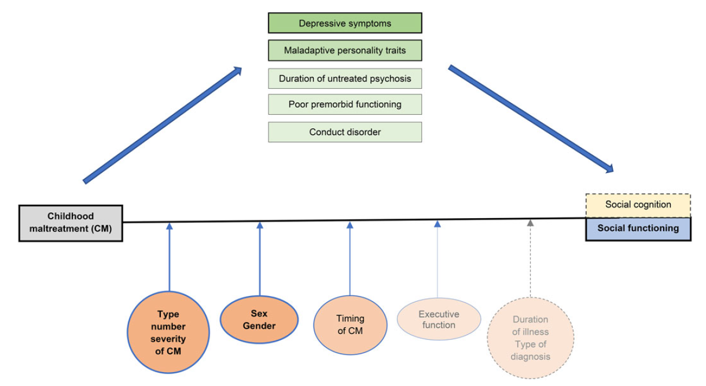
Trauma, social cognition, and functioning
Schizophrenia – Course, natural history, and prognosis
Childhood adversities, such as emotional abuse, neglect, and bullying, are associated with more severe positive, negative, and affective symptom dimensions in psychosis¹
Exposure to trauma is linked to reduced social functioning and impaired social cognition, which may partly contribute to poorer long-term functional outcomes²
Associations between maltreatment and symptoms are modulated by type of adversity, developmental timing and cumulative burden of traumatic events²
Childhood abuse or neglect may negatively affect neurocognitive and mentalizing abilities, which could contribute to psychotic symptoms, particularly in males³
Moderators and mediators between childhood maltreatment and social outcomes in psychotic disorders²
This work is from Fares-Otero, et al., ‘Examining associations, moderators and mediators between childhood maltreatment, social functioning, and social cognition in psychotic disorders: a systematic review and meta-analysis’ 2023, licensed under CC-BY-NC-ND-4.0. Published by Cambridge University Press on behalf of Psychological Medicine. The work cannot be changed in any way or used commercially without permission from the journal.
1. Alameda et al. Schizophr Bull 2021;47:975–985; 2. Fares-Otero et al. Psychol Med 2023;53:5909–5932; 3. Mansueto et al. Schizophrenia Research 2019;206:183–193
Notes:
The colour and thickness of the lines indicate the strength of the evidence: darker, thicker lines represent strong evidence (n ≥ 5), while lighter, thinner lines represent emerging evidence (n = 1).² Dotted lines and grey text indicate areas where evidence is lacking and further research is needed.²
References:
Alameda L, Christy A, Rodriguez V, et al. Association between specific childhood adversities and symptom dimensions in people with psychosis: systematic review and meta-analysis. Schizophr Bull 2021; 47: 975–985.
Fares-Otero N, Alameda L, Paltz, et al. Examining associations, moderators and mediators between childhood maltreatment, social functioning, and social cognition in psychotic disorders: a systematic review and meta-analysis. Psychol Med 2023; 53: 5909–5932.
Mansueto G, Schruers K, Cosci F, et al. Childhood adversities and psychotic symptoms: The potential mediating or moderating role of neurocognition and social cognition. Schizophrenia Research 2019; 206: 183–193.

