Slide 1
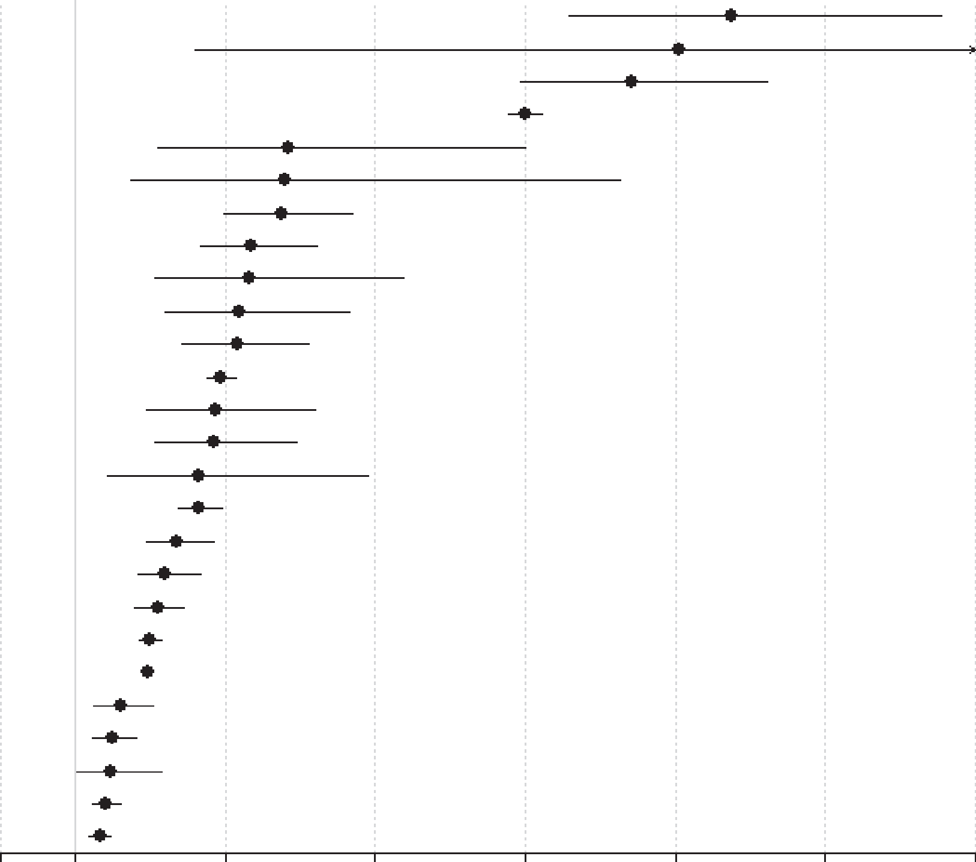
Physical health outcomes in schizophrenia
Schizophrenia – Course, natural history, and prognosis
People with schizophrenia face increased mortality risk from suicide and from multiple physical health conditions
All-cause and cause-specific mortality risk in schizophrenia versus the general population^{2a}
Patients with schizophrenia experience increased burden of physical multimorbidity compared with the general population, and are four times more likely to have at least two physical conditions¹
This excess is often evident at younger ages and highlights the need for early, integrated prevention and care¹
Outcome
Suicide (n=28)
Injury-poisoning (n=2) Undetermined non-natural (n=14)
Infectious-pneumonia (n=3)
Infectious-any (n=10)
Endocrine (n=9)
Respiratory-any (n=15)
Injury-accidents (n=9)
Urogenital-any (n=9)
Risk ratio (95% CI)
9.76 (7.60, 12.55)
9.06 (2.60, 31.50)
8.42 (6.94, 10.20)
7.00 (6.79, 7.23)
3.84 (2.10, 7.01)
3.80 (1.75, 8.26)
3.75 (2.99, 4.70)
3.35 (2.66, 4.22)
3.33 (2.06, 5.37)
Other not specified (n=7)
Diabetes (n=5)
All-cause (n=57)
Alcohol (n=2)
Gastrointestinal (n=12)
Urogenital-renal failure (n=2)
Natural (study-defined) (n=21)
3.19 (2.19, 4.64)
3.16 (2.42, 4.12)
2.94 (2.75, 3.13)
2.86 (1.95, 4.21)
2.86 (2.07, 3.95)
2.65 (1.43, 4.90)
2.65 (2.38, 2.95)
Nervous-any (n=8)
Cardiovascular (n=19)
Cardio-cerebrovascular (n=28)
Natural (n=59)
Liver (n=2)
Cerebrovascular (n=13)
Cancer-breast (n=2)
Cancer-colon (n=3)
Cancer-pancreas (n=2)
Cancer-any (n=25)
2.35 (1.94, 2.84)
2.21 (1.82, 2.67)
2.10 (1.80, 2.45)
2.00 (1.85, 2.15)
1.96 (1.90, 2.03)
1.60 (1.25, 2.04)
1.49 (1.22, 1.82)
1.48 (1.01, 2.16)
1.40 (1.21, 1.62)
1.33 (1.19, 1.48)
0
1
3
5
7
9
11
13
Risk ratio (95% CI)
ªIncident plus prevalent schizophrenia
CI=confidence interval
1. Stubbs et al. BMC Med 2016;14:189; 2. Correll et al. World Psychiatry 2022;21:248–271
This work is from ‘Mortality in people with schizophrenia: a systematic review and meta-analysis of relative risk and aggravating or attenuating factors’ by Correll et al. World Psychiatry 2022. Reproduced with permission from the authors; copyright © 2022 World Psychiatric Association.
Notes:
References:
Stubbs Koyanagi AI, Veronese N, et al. Physical multimorbidity and psychosis: comprehensive cross sectional analysis including 242,952 people across 48 low- and middle-income countries. BMC Med 2016; 14: 189.
Correll CU, Solmi M, Croatto G, et al. Mortality in people with schizophrenia: a systematic review and meta-analysis of relative risk and aggravating or attenuating factors. World Psychiatry 2022; 21: 248–271.

