Slide 1
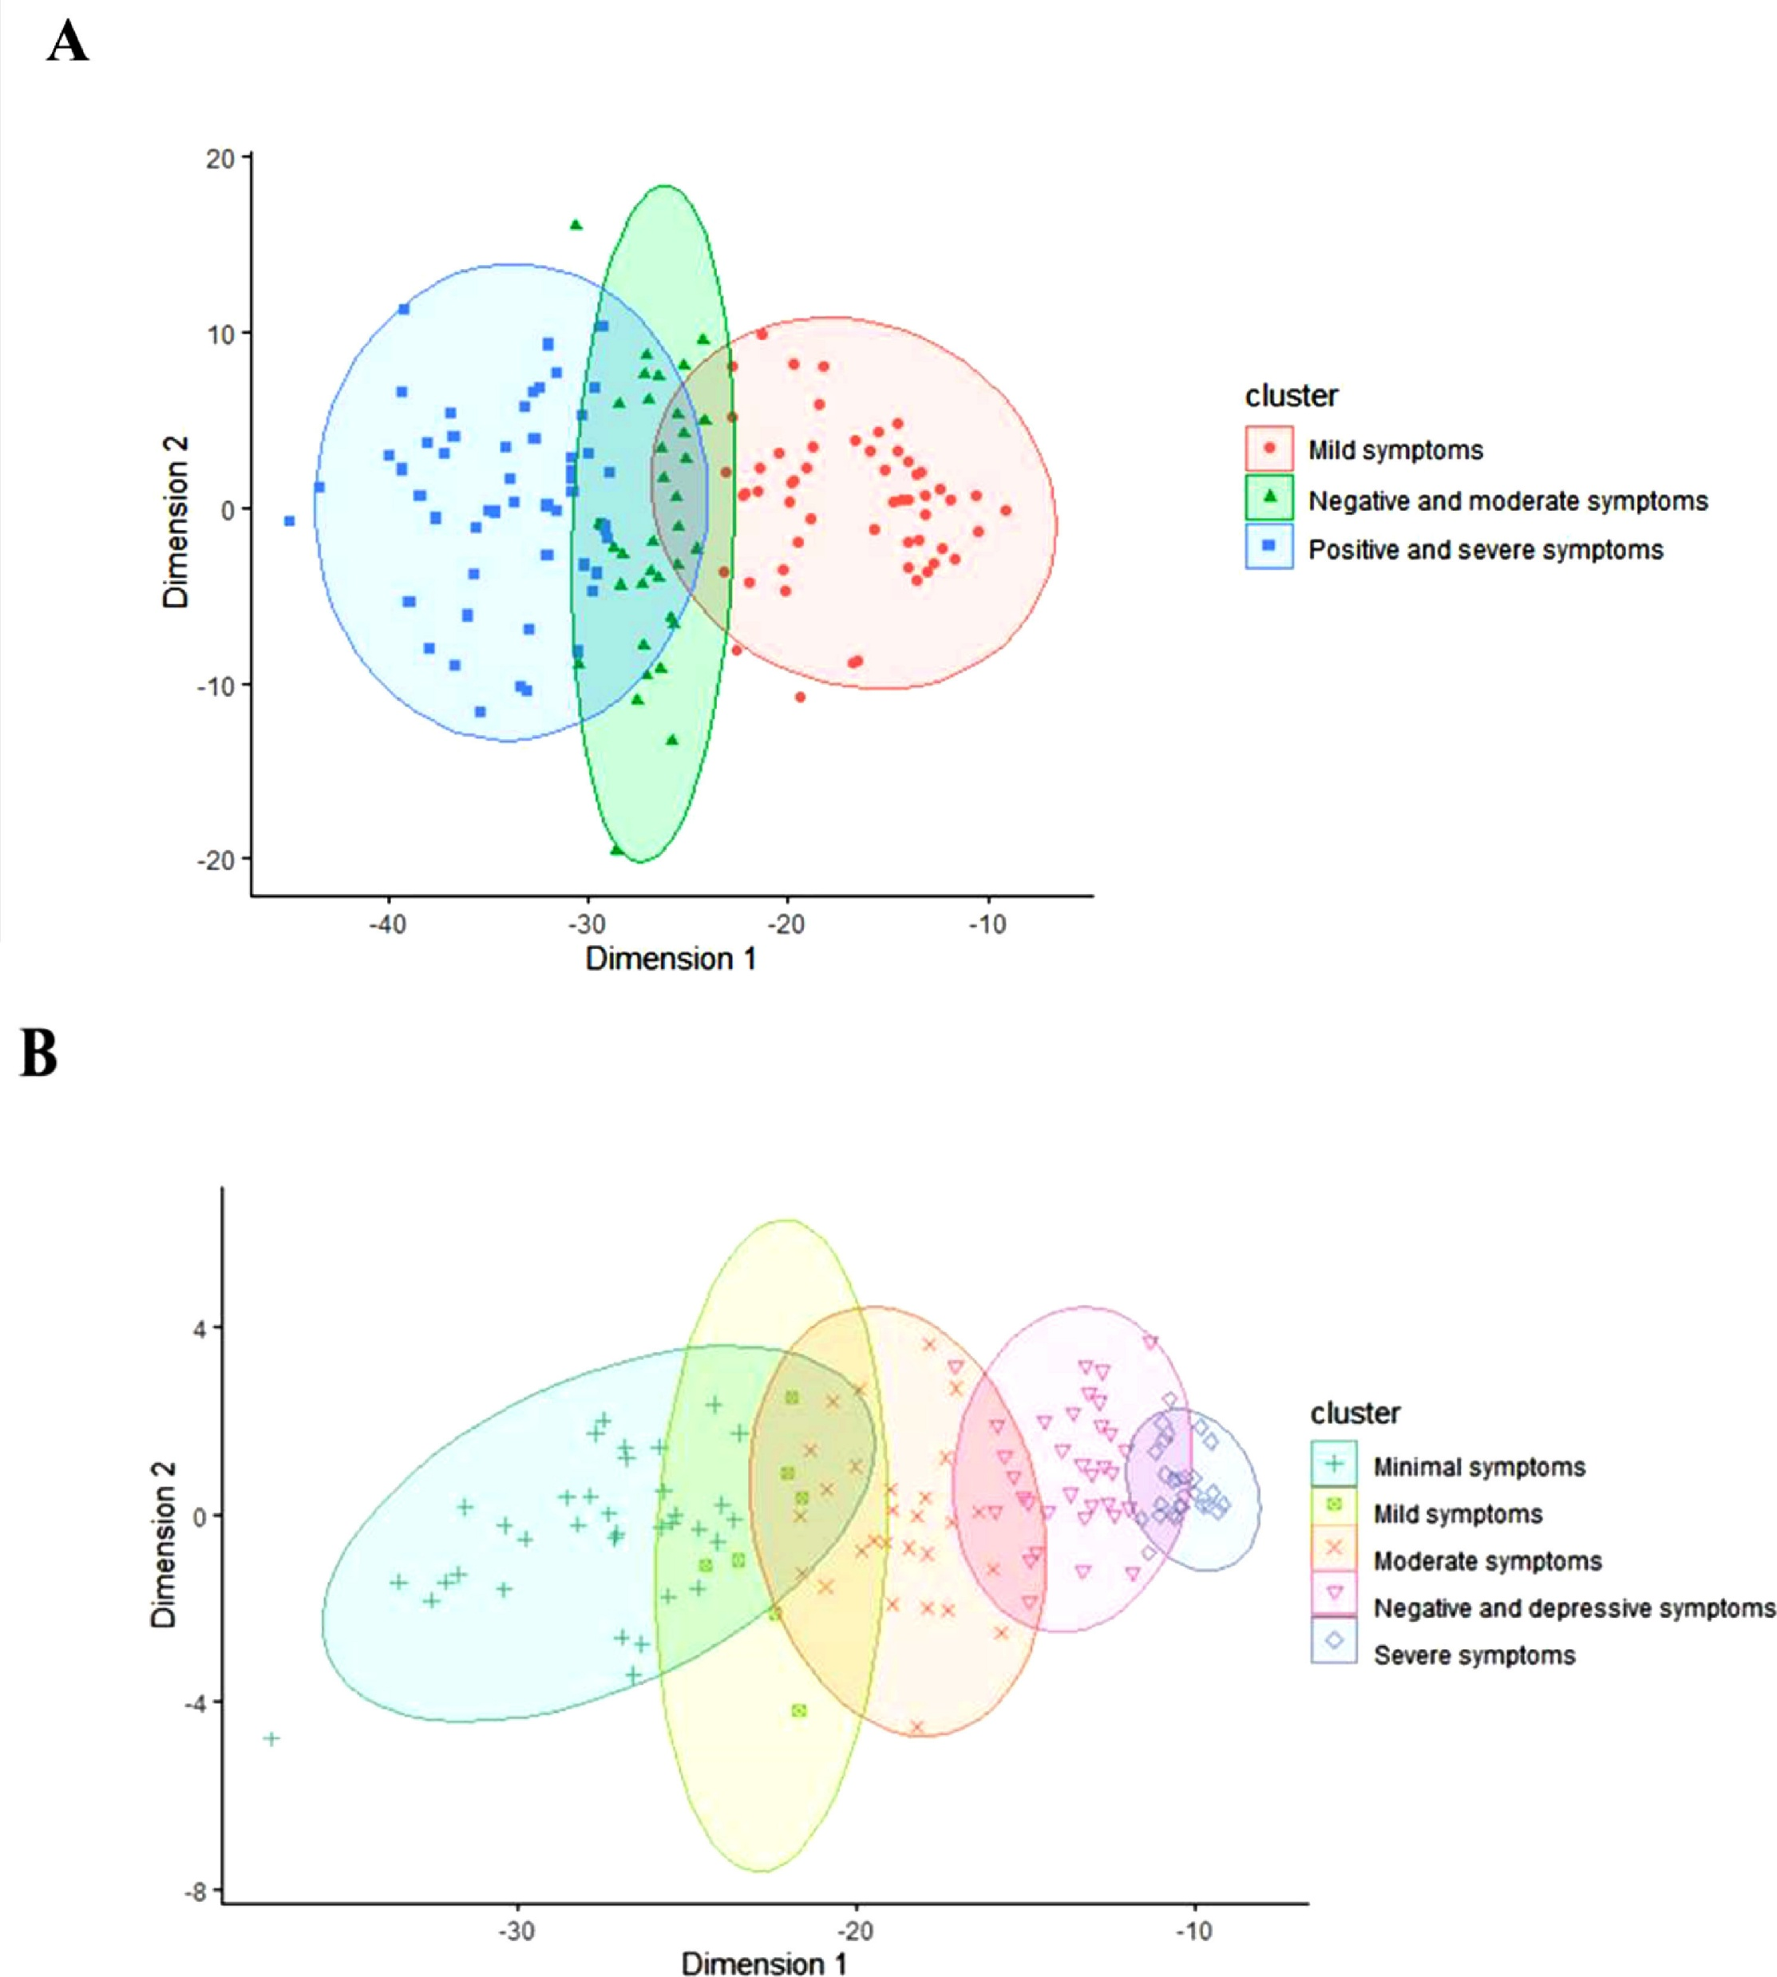
Premorbid functioning and prognosis
Schizophrenia – Course, natural history, and prognosis
Premorbid functioning in schizophrenia is heterogeneous, with studies identifying distinct latent or cluster-based profiles across patient populations¹
Cluster analyses have identified transdiagnostic premorbid trajectories, such as ‘normal overall’, ‘normal social/impaired declining academic’, and ‘impaired stable social/impaired declining academic’²
Poorer premorbid adjustment, particularly in social and academic domains, has consistently been associated with worse clinical and functional outcomes^{2,3}
Distribution of clinical subgroups in patients with FEP¹
Cluster distribution at baselineª
Cluster distribution at 2-year follow-upª
20
10
4
0
0
Dimension 2
Dimension 2
–10
–4
–20
–8
–40
–30
–20
–10
–30
–20
–10
Dimension 1
Dimension 1
Cluster
Cluster
●
Mild symptoms
+
Minimal symptoms
Negative and depressive symptoms
Negative and moderate symptoms
Mild symptoms
◊
Severe symptoms
■
Positive and severe symptoms
x
Moderate symptoms
Premorbid profiles may serve as early prognostic markers and could guide stratification efforts in early psychosis³
ªEach axis represents a reduction of a symptomatology domain, and each point is a subject
FEP=first-episode psychosis
1. Amoretti et al. Eur Neuropsychopharmacol 2021;47:112–129; 2. Chan et al. Psychiatry Res 2019;272:655–662;
3. Caqueo-Urízar et al. J Clin Med 2022;11:3840
This work is adapted from ‘Identifying clinical clusters with distinct trajectories in first-episode psychosis through an unsupervised machine learning technique’, by Amoretti et al. Eur Neuropsychopharmacol 2021, used under license CC-BY-4.0, This work is licensed under Creative Commons license CC-BY-SA by
The Lundbeck Foundation.
Notes:
References:
Amoretti S, Verdolini N, Mezquida G, et al. Identifying clinical clusters with distinct trajectories in first-episode psychosis through an unsupervised machine learning technique. Eur Neuropsychopharmacol 2021; 47: 112–129.
Chan CC, Shanahan M, Ospina LH, et al. Premorbid adjustment trajectories in schizophrenia and bipolar disorder: a transdiagnostic cluster analysis. Psychiatry Res 2019; 272: 655–662.
Caqueo-Urízar A, Ponce-Correa F, Semir-González C, Urzúa A. Latent profiles of premorbid adjustment in schizophrenia and their correlation with measures of recovery. J Clin Med 2022; 11: 3840.

