Slide 1
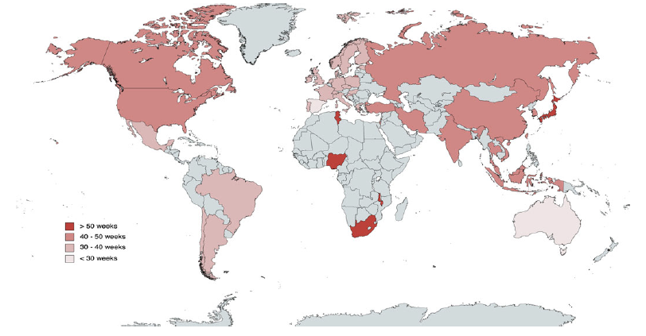
Global mean duration of untreated psychosis
Schizophrenia – Course, natural history, and prognosis
The duration of untreated psychosis varies worldwide, with a mean duration of
42.6 weeks across countries
Data suggest gaps in care exist between and within geographical regions, highlighting the need to address factors such as health literacy, stigma, and inequality
Countries and regions reporting mean duration of untreated psychosisª
48.7 weeks in North America
38.6 weeks in Europe
48.8 weeks in Asia
34.9 weeks in South America
>50 weeks
70.0 weeks in Africa
28.0 weeks
in Australasia
40–50 weeks
30–40 weeks
<30 weeks
ªThe duration of untreated psychosis for countries with at least 10 independent samples was individually calculated and the rest are represented according to the meta-analytical results in their continent
Salazar de Pablo et al. Psychol Med 2024;54:652–662
This work is adapted from ‘What is the duration of untreated psychosis worldwide? - A meta-analysis of pooled mean and median time and regional trends and other correlates across 369 studies’ by Salazar de Pablo et al. Psychol Med 2024, used under license CC-BY-4.0, This work is licensed under Creative Commons license CC-BY-SA by
The Lundbeck Foundation.
Notes:
References:
Salazar de Pablo G, Aymerich C, Guinart D. What is the duration of untreated psychosis worldwide? - A meta-analysis of pooled mean and median time and regional trends and other correlates across 369 studies. Psychol Med 2024; 54: 652–662.

