Slide 1
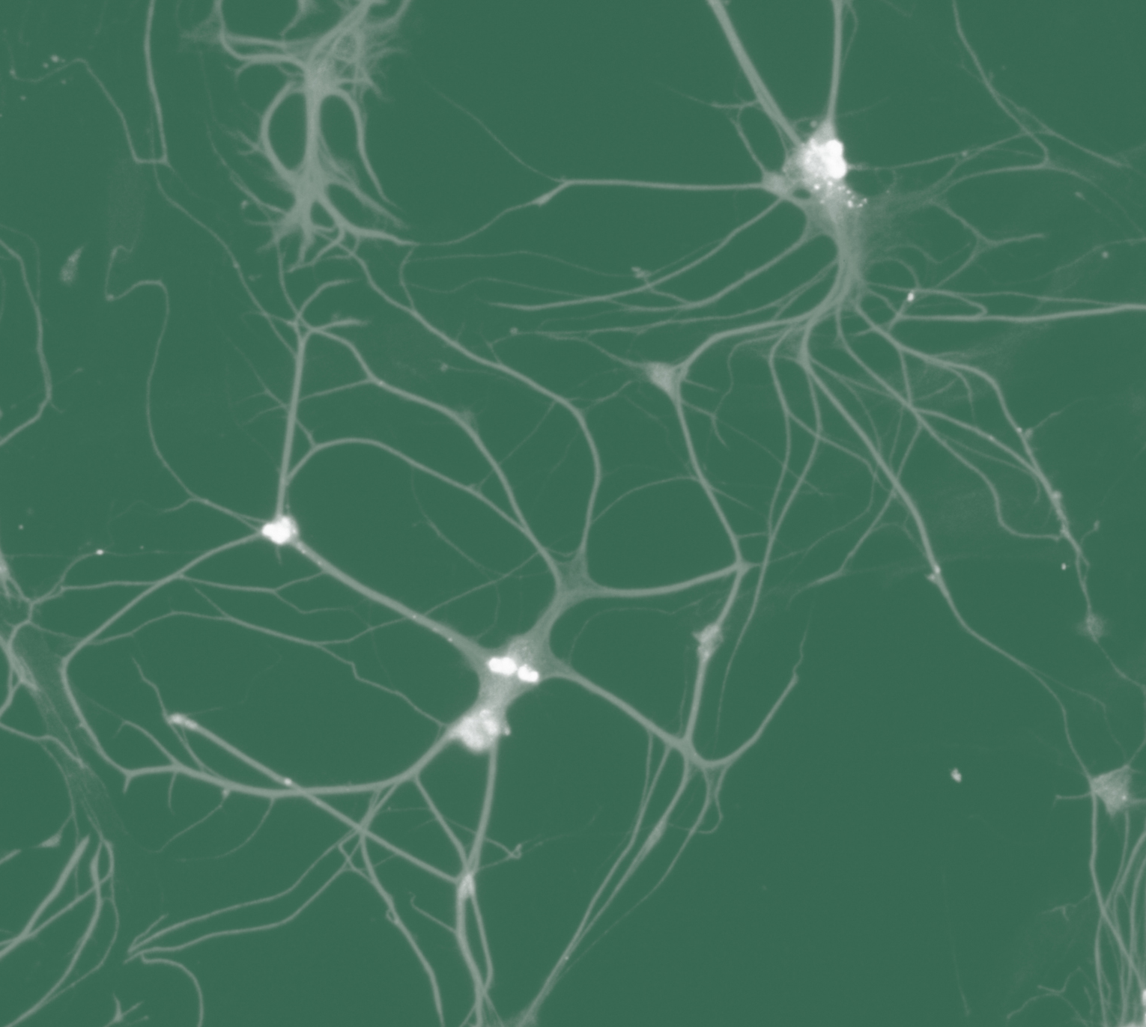
Schizophrenia
Aetiology and neurobiology

