Slide 1
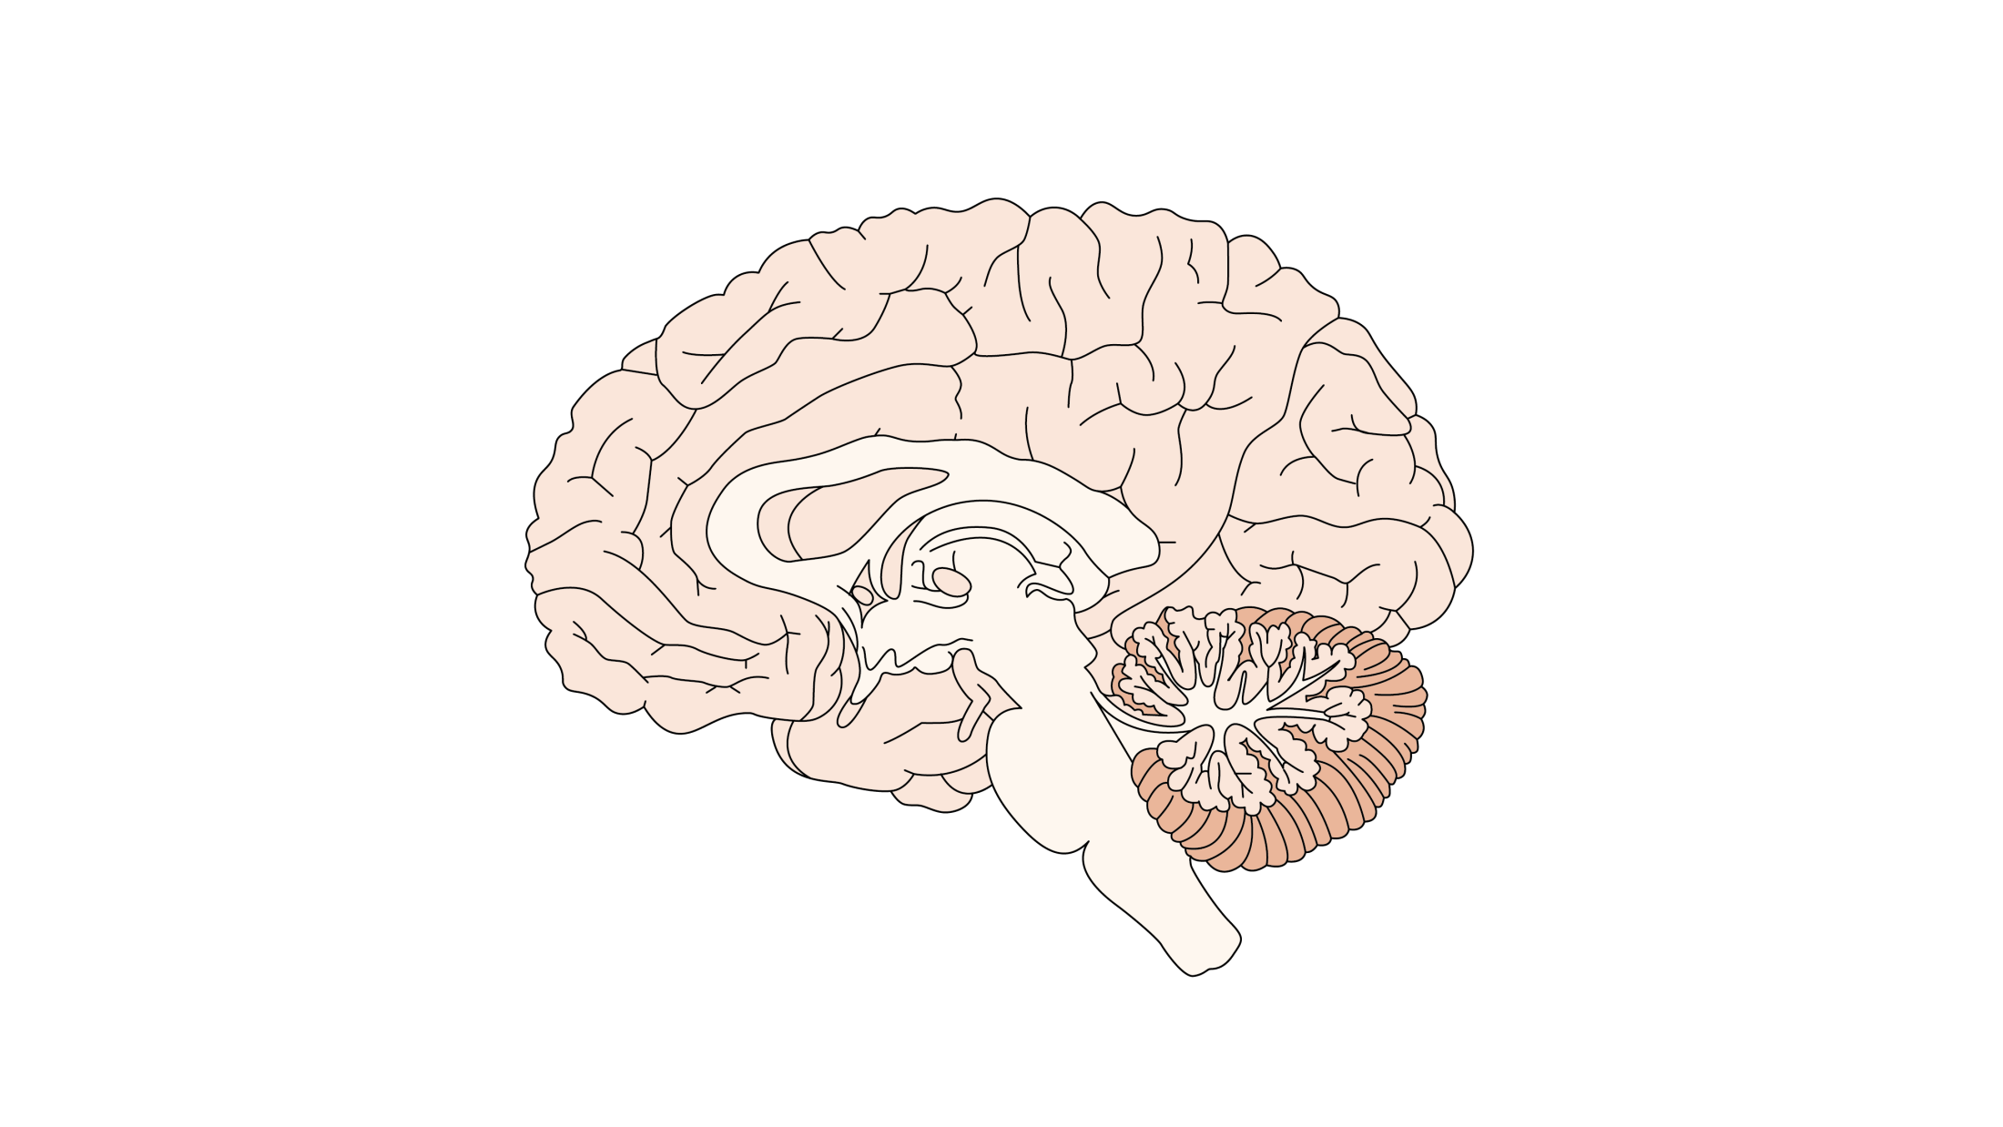
Structural brain findings in schizophrenia
Schizophrenia – Aetiology and neurobiology
Neuroimaging findings consistently show brain structure abnormalities in schizophrenia
Enlarged ventricles are reported in individuals with schizophrenia and are hypothesized to reflect surrounding tissue loss
Lower grey matter volumes and reduced cortical thickness across multiple brain regions in individuals with schizophrenia versus controls
Some evidence of increased volumes in striatal brain regions, in individuals with schizophrenia, including the left and right putamen and right caudate
Howes et al. Neuropsychopharmacology 2023;48:151–167
Notes:
References:
Howes OD, Cummings C, Chapman GE et al. Neuroimaging in schizophrenia: an overview of findings and their implications for synaptic changes. Neuropsychopharmacology 2023; 48: 151–167.

