Slide 1
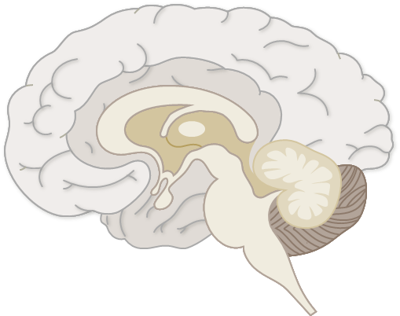
Muscarinic neurotransmission in schizophrenia
Schizophrenia – Aetiology and neurobiology
Various studies highlight the potential role of muscarinic systems in schizophrenia
Muscarinic system and schizophrenia
The muscarinic system projects from the basal forebrain and brainstem regions to multiple brain regions implicated in the neurobiology of schizophrenia, including the basal ganglia and frontal and temporal cortices¹⁻³
Meta-analytic findings show reduced cortical and subcortical muscarinic receptors, particularly M₁/M₄ subtypes in the striatum, hippocampus, and fronto-cingulate cortex post-mortem⁴
Studies in healthy volunteers show that centrally acting antimuscarinic drugs can induce psychotic and negative symptoms as well as cognitive impairments, providing evidence that perturbations in the muscarinic system could lead to symptoms similar to schizophrenia¹
A medicine combining xanomeline and trospium chloride (called KarXT or Cobenfy™) has been shown to be effective for acute schizophrenia and has recently been approved in some countries.⁵ As xanomeline is a centrally acting muscarinic M1 and M4 agonist, this provides evidence that targeting the muscarinic system is a viable therapeutic strategy⁵
Trospium is a peripherally restricted antimuscarinic designed to reduce the peripheral pro-cholinergic side effects of xanomeline⁵
Cholinergic projections in the central nervous system³
Thalamus
Anterior
cingulate
Ventral
tegmental area
Amygdala
Hippocampus
Basal forebrain cholinergic system
Brainstem cholinergic system
Ch1 medial septal nucleus
Ch5 pedunculopontine tegmental nucleus
Ch2 diagonal band of Broca
Ch6 laterodorsal tegmental nucleus
Ch4 nucleus basalis of Meynert
Ch=cholinergic
1. McCutcheon et al. Lancet Psychiatry 2024;11:554–565; 2. Wang et al. Schizophr Bull 2024;50:545–556; 3. Luo et al. Schizophr Bull 2023;49:1554–1567;
4. Saint-Georges et al. Mol Psychiatry 2025;30:3301–3315; 5. Paul & Yohn. Neurotherapeutics 2026; 23:e00839
Notes:
References:
McCutcheon RA, Weber LAE, Nour MM, et al. Psychosis as a disorder of muscarinic signalling: psychopathology and pharmacology. Lancet Psychiatry 2024; 11: 554–565.
Wang Y, Yang Y, Xu W, et al. Heterogeneous brain abnormalities in schizophrenia converge on a common network associated with symptom remission. Schizophr Bull 2024; 50: 545–556.
Luo Y, Dong D, Huang H, et al. Associating multimodal neuroimaging abnormalities with the transcriptome and neurotransmitter signatures in schizophrenia. Schizophr Bull 2023; 49: 1554–1567.
Saint-Georges Z, MacDonald J, Al-Khalili R, et al. Cholinergic system in schizophrenia: a systematic review and meta-analysis. Mol Psychiatry 2025; 30: 3301–3315.
Paul SM, Yohn SE. Targeting muscarinic receptors for treating schizophrenia. Neurotherapeutics 2026; 23: e00839.

