Slide 1
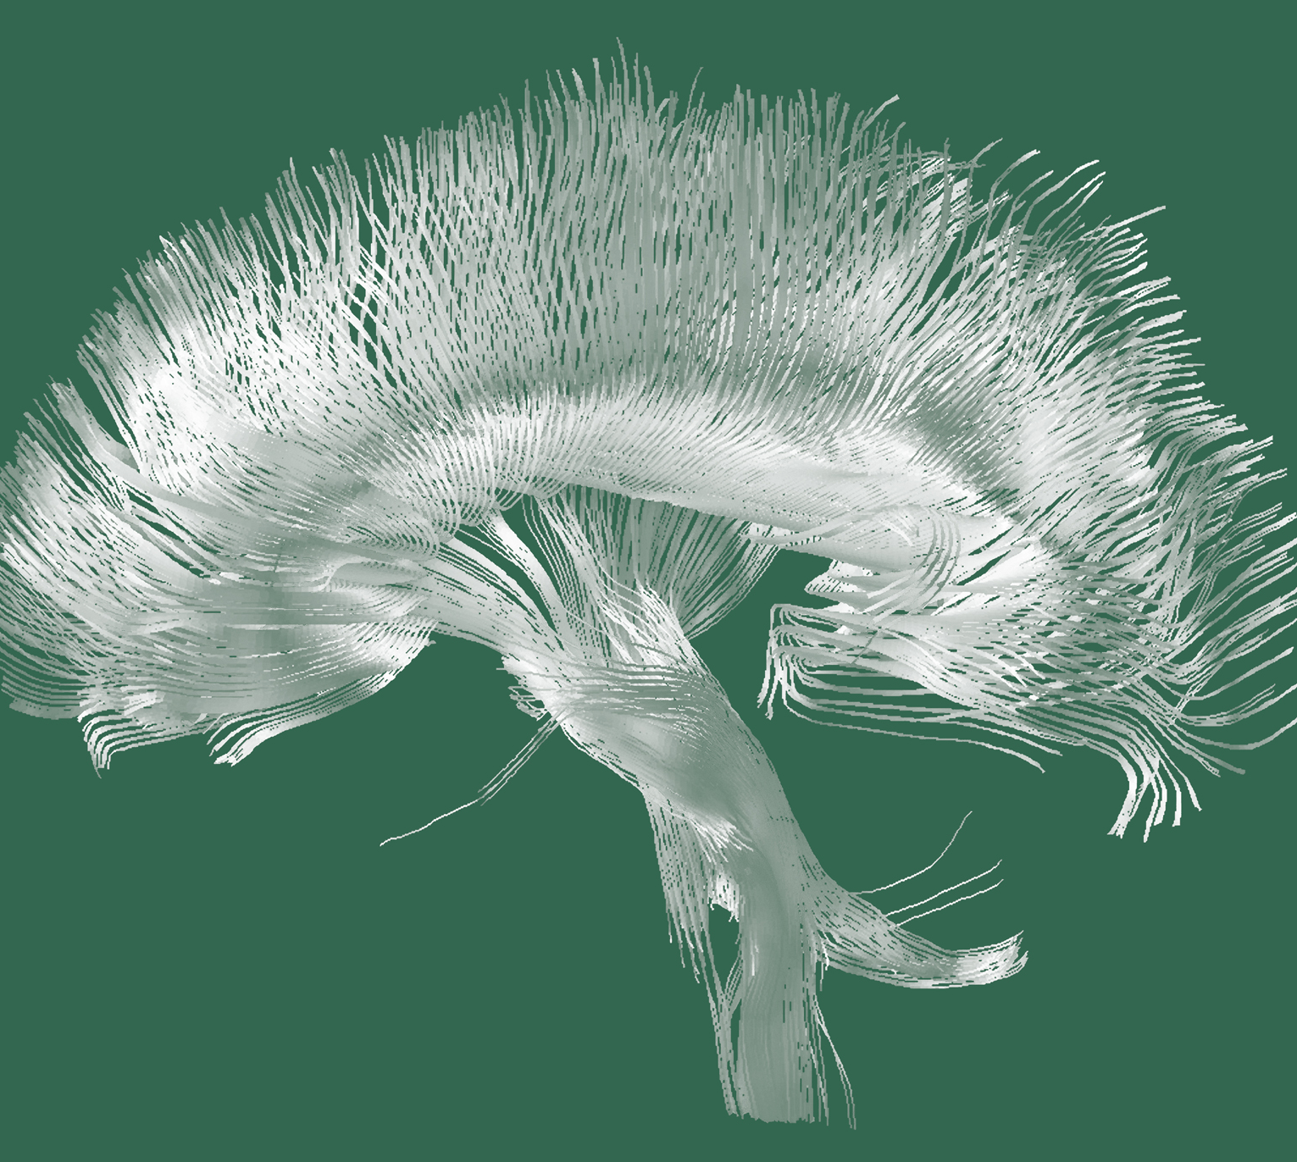
Schizophrenia
Comorbidity

Slide 2






Overview of comorbidities in schizophrenia
Schizophrenia – Comorbidity
Schizophrenia is a chronic mental health condition that comprises positive symptoms, negative symptoms, motor symptoms, and a global cognitive deficit¹
In 2019, schizophrenia ranked as the 20th leading cause of disability globally;² affected individuals experience a reduction in life expectancy of >15 years³
Alongside disease burden, individuals with schizophrenia experience a range of psychiatric and somatic comorbidities^{4,5}
Schizophrenia is reportedly associated with >1.5 times the odds of comorbidities across multiple disease categories,⁶ and is linked to broad, multi‑system increases in natural‑cause mortality⁷
FEP is associated with pronounced alterations in non‑CNS systems, which are broadly comparable in magnitude to those observed in the CNS⁸
Relative to healthy controls, individuals with FEP exhibited alterations across CNS and non-CNS systems:^{8,a}
CNS systems | Non-CNS systems
Brain structure (g=0.40) | Immune parameters (g=1.19)
Neurophysiological (g=0.80) | Cardiometabolic markers (g=0.23)^{b}
Neurochemical (g=0.43) | HPA‑axis measures (g=0.68)
ªSystematic meta-review summarizing effect size (g) magnitudes for CNS and non-CNS alterations in FEP (case-control data from 165 studies [N=13,440; 6,806 individuals with FEP and 6,634 healthy control individuals]);⁸ ^{b}Summary effect size in antipsychotic-naïve FEP⁸
CNS=central nervous system; FEP=first-episode psychosis; HPA=hypothalamic pituitary adrenal
1. Leucht et al. Nat Rev Dis Primers 2025;11:83; 2. GBD 2019 Mental Disorders Collaborators. Lancet Psychiatry. 2022;9:137–150; 3. Chan et al. EClinicalMedicine 2023;65:102294;
4. Lu et al. Transl Psychiatry 2022;12:154; 5. Lee et al. Mol Psychiatry 2025;30:1127–1137; 6. Bahorik et al. J Psychosom Res 2017;100:35–45; 7. Correll et al. World Psychiatry 2022;21:248–271;
8. Pillinger et al. Mol Psychiatry 2019;24:776–794
Notes:
References:
Leucht S, Siafis S, McGrath JJ, et al. Schizophrenia. Nat Rev Dis Primers 2025; 11: 83.
GBD 2019 Mental Disorders Collaborators. Global, regional, and national burden of 12 mental disorders in 204 countries and territories, 1990-2019: a systematic analysis for the Global Burden of Disease Study 2019. Lancet Psychiatry 2022; 9: 137–150.
Chan JKN, Correll CU, Wong CSM, et al. Life expectancy and years of potential life lost in people with mental disorders: a systematic review and meta-analysis. EClinicalMedicine 2023; 65: 102294.
Lu C, Jin D, Palmer N, et al. Large-scale real-world data analysis identifies comorbidity patterns in schizophrenia. Transl Psychiatry 2022; 12: 154.
Lee H, Lee JH, Lee S, et al. Comorbid health outcomes in patients with schizophrenia: an umbrella review of systematic reviews and meta-analyses. Mol Psychiatry 2025; 30: 1127–1137.
Bahorik AL, Satre DD, Kline-Simon AH, et al. Serious mental illness and medical comorbidities: findings from an integrated health care system. J Psychosom Res 2017; 100: 35–45.
Correll CU, Solmi M, Croatto G, et al. Mortality in people with schizophrenia: a systematic review and meta-analysis of relative risk and aggravating or attenuating factors. World Psychiatry 2022; 21: 248–271.
Pillinger T, D'Ambrosio E, McCutcheon R, et al. Is psychosis a multisystem disorder? A meta-review of central nervous system, immune, cardiometabolic, and endocrine alterations in first-episode psychosis and perspective on potential models. Mol Psychiatry 2019; 24: 776–794.

Slide 3
The burden of schizophrenia
Schizophrenia – Comorbidity
Rank ordered estimates of YLD per 100,000
person-years for the Danish population (2000–2015)^{1,b}
Schizophrenia was found to be the single largest contributor to YLDs (36%) among all 18 mental and substance use disorders examined in the entire Danish population between 2000 and 2015¹
The novel HeLPª metric showed that schizophrenia was associated with the greatest individual health loss, with affected individuals losing ~73% of a healthy year annually (HeLP = 0.73; 95% CI: 0.63, 0.83)¹
Schizophrenia, while considered a disabling condition in itself, is frequently accompanied by multiple psychiatric and physical comorbidities,² which substantially increase the overall burden on affected individuals
Females
Males
Schizophrenia
Personality disorders
Anxiety disorders
Major depressive disorder
Bipolar disorder
Alcohol use disorder
Anorexia
Autism spectrum disorders
Opioid use disorder
Intellectual disability
Bulimia
Dysthymia
ADHD
Cannabis use disorder
Amphetamine use disorder
Cocaine use disorder
Other drug use disorders
Conduct disorder
Schizophrenia
Personality disorders
Alcohol use disorder
Anxiety disorders
Autism spectrum disorders
Major depressive disorder
Bipolar disorder
Opioid use disorder
ADHD
Intellectual disability
Cannabis use disorder
Amphetamine use disorder
Cocaine use disorder
Dysthymia
Conduct disorder
Anorexia
Other drug use disorders
Bulimia
350
300
250
200
150
100
50
0
50
100
150
200
250
300
350
YLD per 100,000 person-years
This work is adapted from ‘Register-based metrics of years lived with disability associated with mental and substance use disorders: a register-based cohort study in Denmark' by Weye et al. Lancet Psychiatry 2021, used under
CC-BY 4.0. This work is licensed under Creative Commons license CC-BY-SA by The Lundbeck Foundation.
ªThe HeLP quantifies the average individual disability associated with each index mental or substance use disorder and can be decomposed into disability attributable to the index disorder itself and to non‑index disorder comorbidity; ^{b}Adjusted for observed comorbidity of mental and substance use disorders¹
Data are from a prospective population‑based cohort including all individuals living in Denmark between 1 January 2000, and 31 December 2015. Participants were followed from 1 January 2000, birth, or immigration (whichever occurred last) until death, age 95 years, emigration, or 31 December 2015, whichever came first. Diagnoses were based on the Danish modification of ICD‑10¹
ADHD=attention-deficit/hyperactivity disorder; CI=confidence interval; HeLP=Health Loss Proportion; ICD-10=International Classification of Diseases, 10th revision; YLD=years lived with disability
1. Weye et al. Lancet Psychiatry 2021;8:310–319; 2. Leucht et al. Nat Rev Dis Primers 2025;11:83
Notes:
Reference:
Weye N, Santomauro DF, Agerbo E, et al. Register-based metrics of years lived with disability associated with mental and substance use disorders: a register-based cohort study in Denmark. Lancet Psychiatry 2021; 8: 310–319.
Leucht S, Siafis S, McGrath JJ, et al. Schizophrenia. Nat Rev Dis Primers 2025; 11: 83.

Slide 4
Schizophrenia and psychiatric comorbidities

Slide 5
Schizophrenia’s hidden genetic relationships
Schizophrenia – Comorbidity
Schizophrenia shares genetic variants with most other psychiatric disorders^{1,2}
A large GWAS meta-analysis showed that schizophrenia shares extensive common genetic risk with other psychiatric disorders, including bipolar disorder, MDD, ADHD, OCD, anorexia nervosa, and ASD²
The findings support the idea of overlapping biological mechanisms and a highly interconnected psychiatric spectrum²
Genetic correlations (SE) between schizophrenia and other psychiatric disorders^{2,a}
Bipolar disorder
0.6808 (−0.021)
p=2.1×10⁻²³⁰
MDD
0.3377 (−0.0282)
p=5.45×10⁻³³
OCD
0.3273 (−0.0588)
p=2.58×10⁻⁸
Anxiety disorder
0.2582 (−0.0898)
p=0.004
ADHD
0.2226 (−0.0459)
p=1.22×10⁻⁶
Anorexia nervosa
0.2194 (−0.0543)
p=5.35×10⁻⁵
ASD
0.2082 (−0.0577)
p=0.0003
PTSD
0.1471 (−0.088)
p=0.0945
Tourette syndrome
0.0627 (−0.0416)
p=0.1313
ªData are from the Brainstorm Consortium GWAS meta-analysis of 265,218 cases and 784,643 controls across 25 common brain disorders
ADHD=attention-deficit/hyperactivity disorder; ASD=autism spectrum disorder; GWAS=genome-wide association study; MDD=major depressive disorder;
OCD=obsessive–compulsive disorder; PTSD=post-traumatic stress disorder; SE=standard error
1. Marshall. Nature 2020;581:19–21; 2. Brainstorm Consortium. Science 2018;360:eaap8757
Notes:
The authors of this study concluded that the current clinical boundaries between major psychiatric disorders do not reflect distinct underlying genetic aetiologies; many psychiatric disorders, including schizophrenia, share large portions of common variant risk.¹ The observed positive genetic correlations are consistent with several hypothetical explanations. For example, they may reflect shared genetic risk factors that increase susceptibility to multiple psychiatric disorders, alongside additional disorder‑specific genetic and non‑genetic influences that shape the eventual clinical presentation.¹
References:
Marshall M. The hidden links between mental disorders. Nature 2020; 581: 19–21.
Brainstorm Consortium. Analysis of shared heritability in common disorders of the brain. Science 2018; 360: eaap8757.

Slide 6
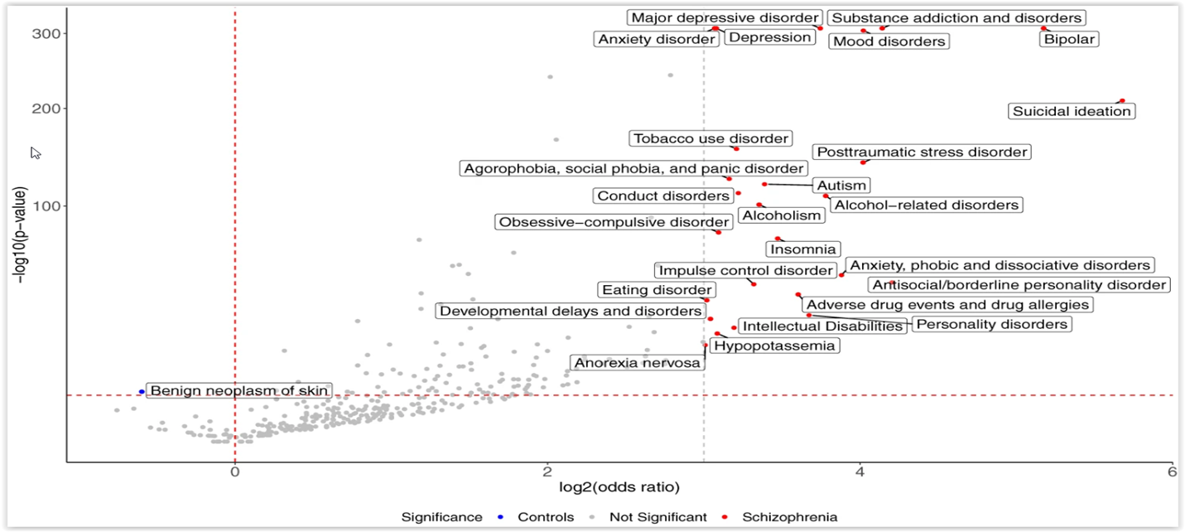
Enriched phenotypes preceding a diagnosis of schizophrenia
Schizophrenia – Comorbidity
Systematic analysis of phenotypes preceding schizophrenia diagnosesª
Top ten significantly enriched phenotypes preceding schizophrenia diagnoses
Suicidal ideation
Bipolar disorder
Antisocial/borderline personality disorder
Substance addiction and disorders
Mood disorders
PTSD
Anxiety, phobic, and dissociative disorders
Alcohol-related disorders
MDD
Personality disorders
300
Significance
Controls
Not significant
Schizophrenia
MDD
Substance addiction and disorders
Anxiety disorder
Depression
Mood disorders
Bipolar disorder
200
Suicidal ideation
Tobacco use disorder
PTSD
Agoraphobia, social phobia, and panic disorder
ASD
100
Conduct disorders
Alcoholism
Alcohol-related disorders
−Log₁₀ (p value)
Obsessive-compulsive disorder
Insomnia
Anxiety, phobic, and dissociative disorders
Impulse control disorder
Antisocial/borderline personality disorder
Eating disorder
Adverse drug events and drug allergies
Developmental delays and disorders
Intellectual disabilities
Personality disorders
Benign neoplasm of skin
Anorexia nervosa
Hypopotassaemia
0
2
4
6
Log₂ (OR)
This work is adapted from ‘Large-scale real-world data analysis identifies comorbidity patterns in schizophrenia' by Lu et al. Transl Psychiatry 2022, used under CC-BY 4.0. This work is licensed under Creative Commons license CC-BY-SA by The Lundbeck Foundation.
Phenotype mapping revealed 144 significantly^{b} enriched phecodes before schizophrenia diagnosis
in adolescents and young adults (15–29 years; n=13,828) versus matched controls
ªThe volcano plot displays both ORs (log₂ scale) and statistical significance (−log₁₀ p value). The red horizontal dashed line indicates the same Bonferroni-corrected p value threshold, the red vertical dashed line designates OR=1, and the grey vertical dashed line indicates an OR=8 threshold, above which phenotypes enriched in the schizophrenic group are annotated; ^{b}Bonferroni-corrected p value<0.05
ASD=autism spectrum disorder; MDD=major depressive disorder; OR=odds ratio; PTSD=post-traumatic stress disorder
Lu et al. Transl Psychiatry 2022;12:154
Notes:
Reference:
Lu C, Jin D, Palmer N, et al. Large-scale real-world data analysis identifies comorbidity patterns in schizophrenia. Transl Psychiatry 2022; 12: 154.

Slide 7
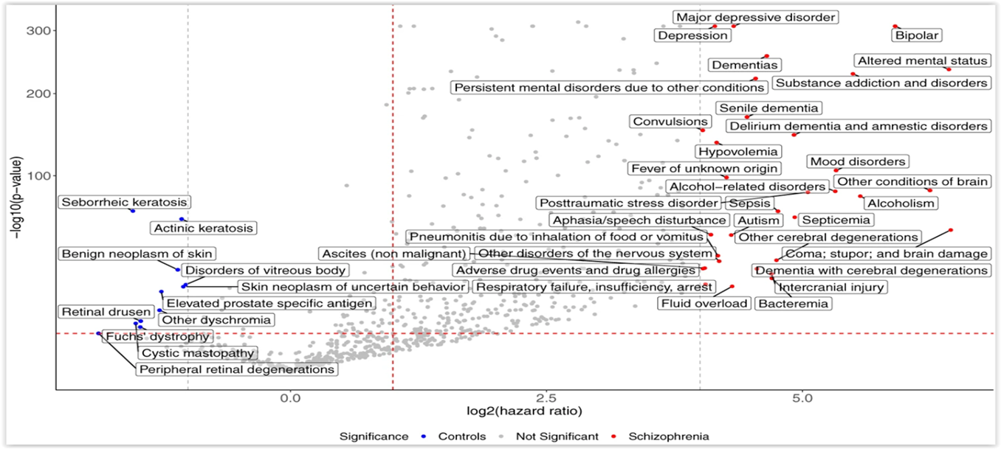
Enriched phenotypes succeeding a diagnosis of schizophrenia
Schizophrenia – Comorbidity
Systematic analysis of phenotypes succeeding schizophrenia diagnosesª
Top ten significantly enriched phenotypes succeeding schizophrenia diagnoses
Coma; stupor; and brain damage
Altered mental state
Other conditions of brain
Bipolar disorder
Alcoholism
Substance addiction and disorders
Mood disorders
Alcohol-related disorders
PTSD
Septicaemia
Depression
MDD
Bipolar disorder
300
Significance
Controls
Not significant
Schizophrenia
Dementias
Altered mental status
Persistent mental disorders due to other conditions
200
Senile dementia
Substance addiction and disorders
Convulsions
Delirium dementia and amnestic disorders
Hypovolemia
Mood disorders
100
Fever of unknown origin
PTSD
Alcohol-related disorders
Seborrheic keratosis
Aphasia/speech disturbance
−Log₁₀ (p value)
Actinic keratosis
Pneumonitis due to inhalation of food or vomitus
Sepsis
Alcoholism
Other conditions of brain
Benign neoplasm of skin
Other disorders of the nervous system
ASD
Septicaemia
Disorders of vitreous body
Ascites (non-malignant)
Coma; stupor; and brain damage
Retinal drusen
Skin neoplasm of uncertain behaviour
Adverse drug events and drug allergies
Other cerebral degenerations
Elevated prostate-specific antigen
Respiratory failure, insufficiency, arrest
Intercranial injury
Other dyschromia
Fluid overload
Bacteraemia
Cystic mastopathy
Fuchs’ dystrophy
Dementia with cerebral degenerations
Peripheral retinal degenerations
0.0
2.5
5.0
Log₂ (HR)
This work is adapted from ‘Large-scale real-world data analysis identifies comorbidity patterns in schizophrenia' by Lu et al. Transl Psychiatry 2022, used under CC-BY 4.0. This work is licensed under Creative Commons license CC-BY-SA by The Lundbeck Foundation.
Phenotype mapping after schizophrenia diagnosis (n=61,453) revealed
402 significantly^{b} enriched phecodes versus matched controls
ªThe volcano plot displays both HRs (log₂ scale) and statistical significance (−log₁₀ p value). The red horizontal dashed line indicates the same Bonferroni-corrected p value threshold, the red vertical dashed line designates an HR=1 threshold, and the grey vertical dashed lines indicate HR=16 and HR=0.5. Phenotypes with more extreme HRs are labeled in the figure; ^{b}Bonferroni-corrected p value<0.05
ASD=autism spectrum disorder; HR=hazard ratio; MDD=major depressive disorder; PTSD=post-traumatic stress disorder
Lu et al. Transl Psychiatry 2022;12:154
Notes:
Reference:
Lu C, Jin D, Palmer N, et al. Large-scale real-world data analysis identifies comorbidity patterns in schizophrenia. Transl Psychiatry 2022; 12: 154.

Slide 8
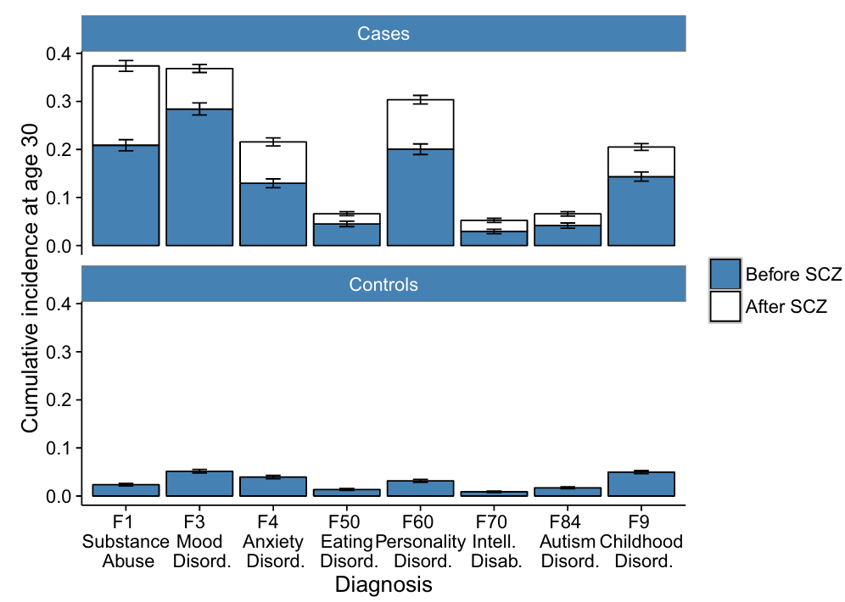
Incidence and timing of psychiatric comorbidities in schizophrenia
Schizophrenia – Comorbidity
Cumulative incidence at age 30 of comorbid psychiatric disorders before and after schizophrenia diagnosisª
By age 30, individuals with schizophrenia showed substantially higher cumulative incidence across eight comorbid psychiatric disorder categories compared with population controls
82% of individuals with schizophrenia had at least one additional psychiatric diagnosis prior to, concurrent with, or following their schizophrenia diagnosis
70% had already received another psychiatric diagnosis before their schizophrenia diagnosis
0.4
Cases
0.3
0.2
0.1
0.0
Cumulative incidence at age 30
0.4
0.3
Controls
0.2
0.1
0.0
F1
Substance
abuse
F3
Mood
disord.
F4
Anxiety
disord.
F50
Eating
disord.
F60
Personality
disord.
F70
Intell.
disab.
F84
Autism
disord.
F9
Childhood
disord.
Diagnosis
Before schizophrenia
After schizophrenia
Data are from the Danish national patient registers, including individuals born between 1981 and 2002 diagnosed with
schizophrenia (ICD‑10 F20.0–F20.9; n=5,432) and matched population controls (n=10,864), followed until 31 December 2016
ªError bars show 95% confidence intervals
Disab.=disability; Disord.=disorder; Intell.=intellectual
Krebs et al. Nat Commun 2021;12:6617
This work is adapted from ‘Associations between patterns in comorbid diagnostic trajectories of individuals with schizophrenia and etiological factors' by Krebs et al. Nat Commun 2021, used under CC-BY 4.0. This work is licensed under Creative Commons license CC-BY-SA by The Lundbeck Foundation.
Notes:
Reference:
Krebs MD, Themudo GE, Benros ME, et al. Associations between patterns in comorbid diagnostic trajectories of individuals with schizophrenia and etiological factors. Nat Commun 2021; 12: 6617.

Slide 9
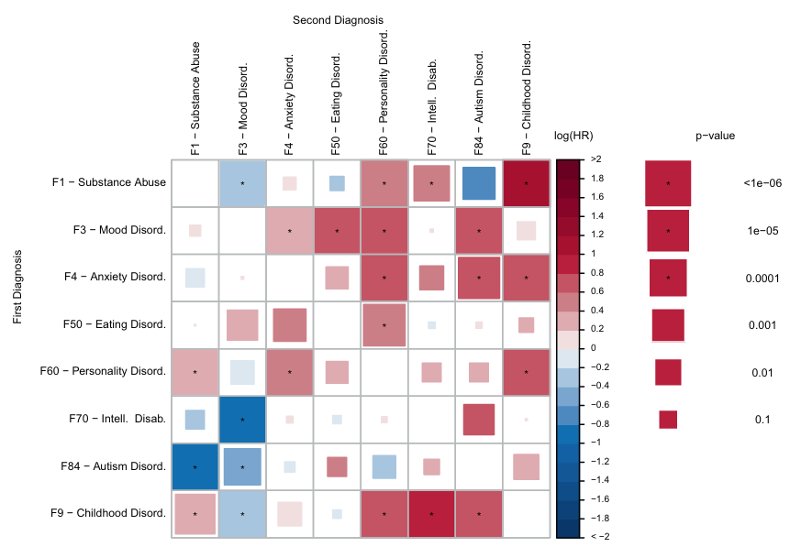
Timing of psychiatric comorbidities in schizophrenia
Schizophrenia – Comorbidity
Adjusted HRs for comorbid psychiatric disorders in individuals with schizophrenia (n=5,432)ª
Among individuals with schizophrenia, HRs for
22 of 56 non‑schizophrenia comorbidity pairs were significant (p<0.00089), suggesting a temporally structured ordering of comorbidities from adolescence into adulthood
The results indicate that comorbidities in schizophrenia follow distinct, time‑dependent patterns and may reflect underlying multi‑outcome structures operating across the full follow‑up period
 |  | Second diagnosis
 |  | F1 – Substance abuse | F3 – Mood disord. | F4 – Anxiety disord. | F50 – Eating disord. | F60 – Personality disord. | F70 – Intell. disab. | F84 – Autism disord. | F9 – Childhood disord.
First diagnosis | F1 – Substance abuse |  | * |  |  | * |  |  | *
 | F3 – Mood disord. |  |  | * | * | * |  | *
 | F4 – Anxiety disord. |  |  |  |  | * |  | * | *
 | F50 – Eating disord.
 | F60 – Personality disord. | * |  | * |  |  |  |  | *
 | F70 – Intell. disab. |  | *
 | F84 – Autism disord. | *
 | F9 – Childhood disord. |  | * |  |  | * | * | *
Log(HR)
p value
*
>2
*
1.8
<1e-06
1.6
1.4
*
1e-05
1.2
1.0
*
0.8
0.0001
0.6
*
0.4
0.001
0.2
0
−0.2
0.01
−0.4
−0.6
0.1
−0.8
*
−1.0
−1.2
−1.4
*
−1.6
−1.8
< −2.0
This work is adapted from ‘Associations between patterns in comorbid diagnostic trajectories of individuals with schizophrenia and etiological factors' by Krebs et al. Nat Commun 2021, used under CC-BY 4.0. This work is licensed under Creative Commons license CC-BY-SA by The Lundbeck Foundation.
ªCox Proportional Hazard model. For each of the eight categories of psychiatric disorders (second diagnosis), the colour indicates how the hazard depends on a previous diagnosis of each of the seven other categories (first diagnosis). All models are adjusted for age and sex. Square size indicates the uncorrected p value of a two-sided Wald test with one degree of freedom. Asterisks indicate significance after a Bonferroni correction for 56 tests. p values are unadjusted
Disab.=disability; Disord.=disorder; HR=hazard ratio; Intell.=intellectual
Krebs et al. Nat Commun 2021;12:6617
Notes:
The figure presents a matrix of HRs showing how receiving one psychiatric diagnosis affects the risk of subsequently receiving another among 5,432 individuals with schizophrenia.¹ This analysis captures temporal ordering, that is, which comorbidities tend to appear before others in the clinical trajectory.¹
Abbreviation:
HR=hazard ratio
Reference:
Krebs MD, Themudo GE, Benros ME, et al. Associations between patterns in comorbid diagnostic trajectories of individuals with schizophrenia and etiological factors. Nat Commun 2021; 12: 6617.

Slide 10
The interconnected spectrum of psychiatric disorders
Schizophrenia – Comorbidity
A population‑based cohort study showed that experiencing any mental disorder increased the likelihood of developing other mental disorders, even after accounting for sex, age, and calendar time
The risk was highest within the first 6 months after the onset of the first disorder, but it remained consistently elevated throughout the entire follow‑up period
The authors developed an interactive data visualization tool that allows HCPs to explore diagnosis‑, age‑, and sex‑specific absolute risks of emerging comorbidity, supporting more tailored prevention and self‑management
Data are from a population‑based cohort including all individuals born in Denmark between 1900 and 2015 who resided in the country during 2000–2016 (n=5,940,778). Diagnoses of mental disorders were obtained from the Danish Psychiatric Central Research Register using ICD‑8 and ICD‑10 codes
HCP=healthcare professional; ICD-8=International Classification of Diseases, 8th revision; ICD-10= International Classification of Diseases, 10th revision
Plana-Ripoll et al. JAMA Psychiatry 2019;76:259–270
Notes:
Reference:
Plana-Ripoll O, Pedersen CB, Holtz Y, et al. Exploring comorbidity within mental disorders among a Danish national population. JAMA Psychiatry 2019; 76: 259–270.

Slide 11
Schizophrenia and somatic comorbidities

Slide 12
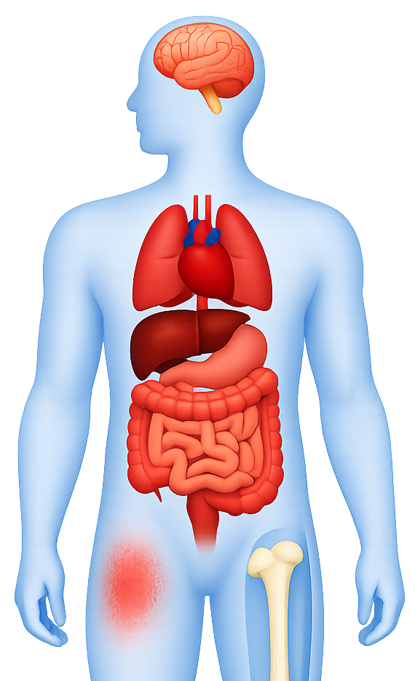
Somatic comorbidities in schizophrenia
Schizophrenia – Comorbidity
Neurological¹
Nine meta-analyses encompassing ~66 million participants examined 21 distinct health outcomes¹
Thirteen outcomes demonstrated statistically significant associations with schizophrenia, indicating a substantial link between schizophrenia and multiple adverse health conditions¹
  Population cohort data similarly demonstrate schizophrenia is associated with a broadly elevated risk of most physical health conditions (HR >1)^{2,d}
Adjusting for prior mental disorders attenuated some associations, but the pattern of comorbidity
is consistent^{1,2}
  The strength of supporting evidence is fragile due to heterogeneity, publication bias, and methodological variation in underlying meta-analyses¹
Dementiaª
Respiratory¹
COPD,ª pneumonia,ª asthma^{b}
Cardiovascular¹
CVD,ª CHF,ª strokeª
Oncological¹
Breast cancer (women)ª
Dermatological¹
Psoriasisª
Sexual¹
Sexual dysfunction^{a,c}
Musculoskeletal¹
Fractureª
ªCE=weak (remaining significant associations; p value<0.05); ^{b}CE=NS (NS associations; p value<0.05); ^{c}Male, female, and overall populations; ^{d}Data are from a nationwide population‑based cohort of 5,940,299 individuals born in Denmark between 1900 and 2015 who were residing in the country at the start of follow‑up (1 January 2000, or their first birthday thereafter). Among included individuals, 698,874 (11.8%) had received a diagnosis of a mental disorder and 5,241,425 (88.2%) had not
CE=class and quality of evidence; CHF=congestive heart failure; COPD=chronic obstructive pulmonary disease; CVD=cardiovascular disease; HR=hazard ratio; NS=non-significant
1. Lee et al. Mol Psychiatry 2025;30:1127–1137; 2. Momen et al. N Engl J Med 2020;382:1721–1731
Notes:
References:
Lee H, Lee JH, Lee S, et al. Comorbid health outcomes in patients with schizophrenia: an umbrella review of systematic reviews and meta-analyses. Mol Psychiatry 2025; 30: 1127–1137.
Momen NC, Plana-Ripoll O, Agerbo E, et al. Association between mental disorders and subsequent medical conditions. N Engl J Med 2020; 382: 1721–1731.

Slide 13
Mortality rates in schizophrenia

Slide 14
Mortality rates in mental health disorders
Schizophrenia – Comorbidity
Cause-specific mortality ratios associated with schizophreniaª
In a nationwide Danish cohort including all residents younger than 95 years (1995–2015), mental disorders across the diagnostic spectrum were consistently associated with higher rates of all-cause mortality compared with the general population
Schizophrenia was associated with substantial increases in mortality across all cause‑of‑death categories
Cause of death | Mortality rate ratios (95% CI)
 | Male | Female
All causes of death | 2.96 (2.91, 3.02) | 2.32 (2.28, 2.36)
External causes | 7.59 (7.23, 7.96) | 6.04 (5.69, 6.40)
Suicide | 9.12 (8.47, 9.82) | 14.85 (13.52, 16.32)
Accidents | 6.68 (6.26, 7.12) | 4.17 (3.86, 4.51)
Homicide | 5.02 (3.35, 7.50) | 3.34 (1.77, 6.29)
Natural causes | 2.65 (2.59, 2.70) | 2.19 (2.15, 2.23)
Infectious diseases | 4.06 (3.51, 4.71) | 2.40 (2.07, 2.78)
Neoplasms | 1.41 (1.34, 1·48) | 1.36 (1.31, 1.42)
Diabetes | 3.54 (3.17, 3.94) | 2.79 (2.50, 3.10)
Circulatory system diseases | 2.47 (2.38, 2.57) | 2.08 (2.01, 2.14)
Respiratory diseases | 3.50 (3.30, 3.72) | 2.98 (2.84, 3.12)
Digestive diseases | 3.60 (3.25, 3.98) | 2.25 (2.06, 2.45)
Alcohol misuse | 3.89 (3.62, 4.19) | 4.21 (3.78, 4.69)
Other causes | 4.44 (4.25, 4.64) | 3.33 (3.20, 3.46)
ªMortality rate ratios are for people with a diagnosis of schizophrenia compared with those without schizophrenia. Mortality rate ratios and 95% CIs are reported. All estimates and 95% CIs were obtained with Poisson regression models with an interaction term for sex, adjusting for age, and calendar time. Estimates based on fewer than three cases are not shown
CI=confidence interval
Plana-Ripoll et al. Lancet 2019;394:1827–1835
Notes:
Reference:
Plana-Ripoll O, Pedersen CB, Agerbo E, et al. A comprehensive analysis of mortality-related health metrics associated with mental disorders: a nationwide, register-based cohort study. Lancet 2019; 394: 1827–1835.

Slide 15
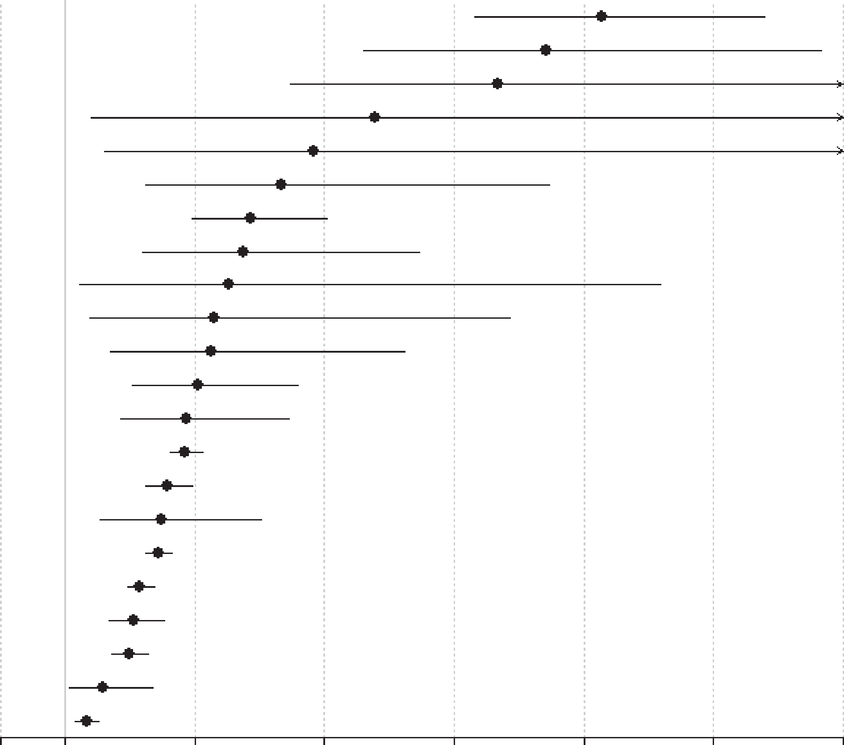
Mortality rates in schizophrenia
Schizophrenia – Comorbidity
Mortality risk in people with prevalent schizophrenia versus the general population
Schizophrenia was found to be associated with markedly elevated mortality across nearly all causes of death, with risk magnitude varying substantially by cause
Highest relative risks for incident and prevalent schizophreniaª included suicide, injury/poisoning and undetermined non‑natural causes, and pneumonia
Schizophrenia was linked to broad, multi‑system increases in natural‑cause mortality, including infectious diseases, endocrine diseases, respiratory diseases (overall), urogenital diseases, diabetes mellitus, gastrointestinal diseases, neurological diseases, liver diseases, and cerebrovascular diseases
Outcome
Risk ratio (95% CI)
Suicide (n=23)
Undetermined non-natural (n=9)
Infectious-pneumonia (n=2)
Skin/subcutaneous (n=2)
Musculoskeletal/connective (n=2)
Infectious, any (n=8)
Respiratory, any (n=11)
Urogenital, any (n=7)
Endocrine (n=6)
Injury-accidents (n=4)
Injury-any (n=5)
Gastrointestinal (n=8)
Diabetes (n=4)
All-cause (n=50)
Natural (study-defined) (n=16)
Other not specified (n=4)
Nervous-any (n=4)
Natural (n=38)
Cardiovascular (n=14)
Cardio-cerebrovascular (n=24)
Cerebrovascular (n=8)
Cancer, any (n=20)
9.28 (7.31, 11.78)
8.42 (5.60, 12.70)
7.67 (4.48, 13.10)
5.79 (1.40, 23.90)
4.83 (1.60, 14.60)
4.34 (2.23, 8.47)
3.86 (2.96, 5.03)
3.75 (2.18, 6.45)
3.52 (1.22, 10.18)
3.31 (1.39, 7.87)
3.26 (1.70, 6.23)
3.06 (2.05, 4.58)
2.88 (1.86, 4.46)
2.86 (2.62, 3.12)
2.58 (2.25, 2.96)
2.49 (1.53, 4.02)
2.43 (2.24, 2.64)
2.15 (1.96, 2.37)
2.06 (1.68, 2.52)
1.98 (1.73, 2.28)
1.58 (1.06, 2.36)
1.33 (1.16, 1.52)
0
1
3
5
7
9
11
13
Risk ratio (95% CI)
This work is from ‘Mortality in people with schizophrenia: a systematic review and meta-analysis of relative risk and aggravating or attenuating factors' by Correll et al. World Psychiatry 2022; Copyright © 2022, with permission from the authors. This work is licensed under Creative Commons license CC-BY-SA by The Lundbeck Foundation.
Data are from a systematic review and random‑effects meta‑analysis of 135 studies (1957–2021), including ~4.5 million people with schizophrenia and ~1.1 billion controls
ªPrevalent cases include all individuals living with schizophrenia within a specified timeframe, regardless of when the person was diagnosed with or developed the condition; incident cases encompass all individuals who are newly identified within the period of observation as having schizophrenia, or all new cases of schizophrenia
CI=confidence interval
Correll et al. World Psychiatry 2022;21:248–271
Notes:
Reference:
Correll CU, Solmi M, Croatto G, et al. Mortality in people with schizophrenia: a systematic review and meta-analysis of relative risk and aggravating or attenuating factors. World Psychiatry 2022; 21: 248–271.

Slide 16
Mortality from respiratory diseases in schizophrenia
Schizophrenia – Comorbidity
In a large meta‑analysis, SSD showed the highest, or among the highest, mortality risks across nearly all respiratory categories compared with other severe mental illnesses
The findings revealed that people with SSD have ~2.6‑fold higher risk of dying from any respiratory disease than the general population
Relative risk of respiratory‑related mortality in individuals with SSD
Respiratory illness | Studies, n | Patients, n | Relative risk (95% CI)
Overall | 57 | 2,979,972 | 2.60 (2.28, 2.96)
Asthma | 4 | 465,923 | 2.17 (1.75, 2.68)
COPD | 12 | 1,484,170 | 3.86 (3.37, 4.42)
Any infection | 28 | 1,998,038 | 3.20 (2.81, 3.66)
Pneumonia | 15 | 1,409,599 | 3.21 (2.81, 3.67)
COVID-19 | 11 | 68,023 | 3.12 (2.65, 3.66)
Tuberculosis | 2 | 464,898 | 5.34 (4.56, 6.25)
Other respiratory infection | 3 | 519,936 | 2.90 (2.52, 3.33)
Unspecified respiratory infection | 26 | 964,783 | 2.42 (2.11, 2.76)
Lung cancer | 16 | 1,524,134 | 1.02 (0.89, 1.16)
Data are from a random‑effects meta‑analysis of 57 cohort studies (through April 2025), comprising 2,979,972 individuals with SSD and 785,538,236 control individuals from the general population
CI=confidence interval; COPD=chronic obstructive pulmonary disease; COVID-19=coronavirus disease 2019; SSD=schizophrenia-spectrum disorders
Laguna-Muñoz et al. Lancet Psychiatry 2025;12:768–779
Notes:
Reference:
Laguna-Muñoz D, Pata MP, Jiménez-Peinado A, et al. Mortality from respiratory diseases in individuals with severe mental illness: a large-scale systematic review and meta-analysis of pooled and specific diagnoses. Lancet Psychiatry 2025; 12: 768–779.

Slide 17
Mortality from SUD in schizophrenia
Schizophrenia – Comorbidity
Impact of SUD on SMRs in schizophrenia,
bipolar disorder, and depression (1990–2012)
Schizophrenia already carries a high mortality burden, with an SMR of ~3–4 in individuals without comorbid SUD
Comorbid SUD more than doubles this excess mortality, with SMRs of >8
Across the three disorders shown, schizophrenia shows the highest SMRs both with and without SUD, indicating the largest mortality burden
Standardized mortality ratio
Data are derived from a prospective, register‑based nationwide Danish cohort study; the study included all individuals born in Denmark on or after 1 January 1955, and included individuals with schizophrenia (n=41,470), bipolar disorder (n=11,739), and depression (n=88,270). Mortality in the study population was compared with the background population using age‑ and sex‑specific SMRs,
defined as the ratio of observed to expected deaths. Expected deaths were estimated using aggregate background population data from Statistics Denmark (1990–2012)
SMR=standardized mortality ratio; SUD=substance use disorder
Hjorthøj et al. Lancet Psychiatry 2015;2:801–808
Notes:
In the study, 10,286 (24.8%) people with schizophrenia had one type of substance use disorder and 8,275 (20.0%) had two or more types.¹ Substance use disorders were recorded in more than one register in 10,528 (56.7%) of 18,561 individuals with schizophrenia.¹
Reference:
Hjorthøj C, Østergaard ML, Benros ME, et al. Association between alcohol and substance use disorders and all-cause and cause-specific mortality in schizophrenia, bipolar disorder, and unipolar depression: a nationwide, prospective, register-based study. Lancet Psychiatry 2015; 2: 801–808.

Slide 18
Health inequities and preventive care gaps in schizophrenia

Slide 19

Health disparities in mental disorders
Schizophrenia – Comorbidity
Mental illness is associated with higher physical disease risk, poorer access to care, and inadequate management of physical comorbidity across diagnoses and
income settings
Premature mortality in mental illness reflects cumulative health inequalities across the
life course
Reducing physical health inequalities in people with mental illness requires attention to both the prevention of chronic conditions and the reduction of their long‑term impact across the life course
This work is from Interaction Institute for Social Change (https://interactioninstitute.org/illustrating-equality-vs-equity/); | Artist: Angus Maguire (madewithangus.com). This work is licensed under Creative Commons license CC-BY-SA by The Lundbeck Foundation.
Firth et al. Lancet Psychiatry 2019;6:675–712
Notes:
Reference:
Firth J, Siddiqi N, Koyanagi A, et al. The Lancet Psychiatry Commission: a blueprint for protecting physical health in people with mental illness. Lancet Psychiatry 2019; 6: 675–712.

Slide 20
Socioeconomic stratification of mortality risk in schizophrenia
Schizophrenia – Comorbidity
Mortality rates related to schizophrenia according to baseline income categories
People with schizophrenia have a shorter life expectancy than even the most socioeconomically disadvantaged groups in the general population
Socioeconomic gradients in mortality from natural causes underscore the need for better coordinated physical healthcare for people with schizophrenia, particularly those with low SEP
People without schizophrenia
People with schizophrenia and related disorders
All-cause mortality rate per
1,000 person-years
Baseline income categories
Data are from a population‑based cohort including all individuals living in Denmark on 1 January 2000, who were followed until 31 December 2020. SEP was proxied using income data and defined as household annual equivalized disposable income (post‑tax and interest, adjusted for household size). Income was averaged over the 3 years preceding baseline (1997–1999). For individuals aged ≤30 years, SEP was defined as the higher of the individual’s household income or the parental household income. Income was ranked into age‑ and sex‑specific percentiles within the Danish general population and categorized as low (<20th percentile), medium (20th–79th percentile), or high (≥80th percentile)
SEP=socioeconomic position
Chen et al. World Psychiatry 2025;24:92–102
Notes:
Reference:
Chen D, Momen NC, Ejlskov L, et al. Socioeconomic inequalities in mortality associated with mental disorders: a population-based cohort study. World Psychiatry 2025; 24: 92–102.

Slide 21
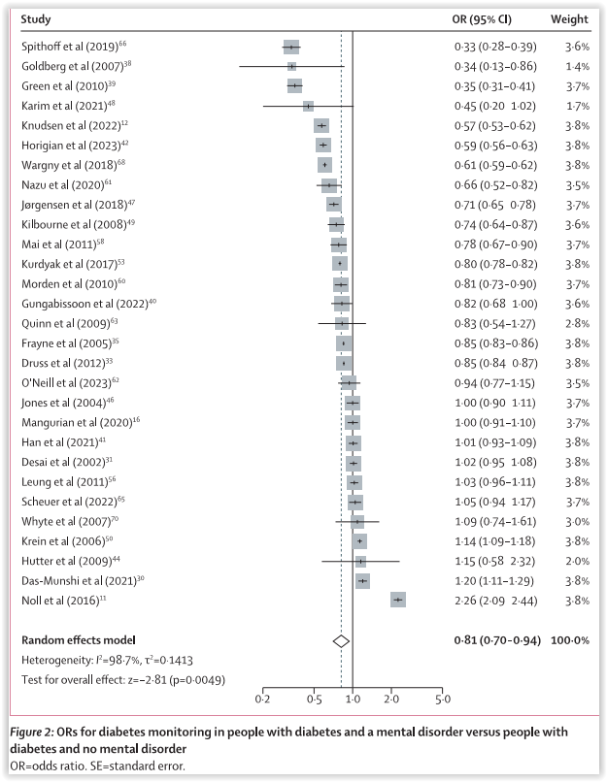
Disparities in diabetes management in mental disorders
Schizophrenia – Comorbidity
Diabetes monitoring in individuals
with versus without mental disorders
Significant negative associations were observed between having any mental disorder and the likelihood of receiving any recommended diabetes monitoring
(29 studies, OR=0.81 [95% CI: 0.70, 0.94]; p=0.0049)
Negative associations were observed for:
  HbA1c measurement
  (24 studies; OR=0.81 [95% CI: 0.68, 0.97]; p=0.024)
  Retinal screening
  (21 studies; OR=0.77 [95% CI: 0.63, 0.95]; p=0.013)
  Lipid and cholesterol measurement
  (20 studies; OR=0.83 [95% CI: 0.69, 0.99]; p=0.043)
  Foot examination
  (11 studies; OR=0.85 [95% CI: 0.76, 0.95]; p=0.0044)
  Renal investigation
  (16 studies; OR=0.78 [95% CI: 0.63, 0.96]; p=0.022)
  Receiving GLP-1 receptor agonist treatment
  (2 studies; OR=0.26 [95% CI: 0.13, 0.49]; p<0.0001)
Study |  | OR (95% CI) | Weight (%)
Spithoff et al. 2019 |  | 0.33 (0.28, 0.39) | 3.6
Goldberg et al. 2007 |  | 0.34 (0.13, 0.86) | 1.4
Green et al. 2010 |  | 0.35 (0.31, 0.41) | 3.7
Karim et al. 2021 |  | 0.45 (0.20, 1.02) | 1.7
Knudsen et al. 2022 |  | 0.57 (0.53, 0.62) | 3.8
Horigian et al. 2023 |  | 0.59 (0.56, 0.63) | 3.8
Wargny et al. 2018 |  | 0.61 (0.59, 0.62) | 3.8
Nazu et al. 2020 |  | 0.66 (0.52, 0.82) | 3.5
Jørgensen et al. 2018 |  | 0.71 (0.65, 0.78) | 3.7
Kilbourne et al. 2008 |  | 0.74 (0.64, 0.87) | 3.6
Mai et al. 2011 |  | 0.78 (0.67, 0.90) | 3.7
Kurdyak et al. 2017 |  | 0.80 (0.78, 0.82) | 3.8
Morden et al. 2010 |  | 0.81 (0.73, 0.90) | 3.7
Gungabissoon et al. 2022 |  | 0.82 (0.68, 1.00) | 3.6
Quinn et al. 2009 |  | 0.83 (0.54, 1.27) | 2.8
Frayne et al. 2005 |  | 0.85 (0.83, 0.86) | 3.8
Druss et al. 2012 |  | 0.85 (0.84, 0.87) | 3.8
O'Neill et al. 2023 |  | 0.94 (0.77, 1.15) | 3.5
Jones et al. 2004 |  | 1.00 (0.90, 1.11) | 3.7
Mangurian et al. 2020 |  | 1.00 (0.91, 1.10) | 3.7
Han et al. 2021 |  | 1.01 (0.93, 1.09) | 3.8
Desai et al. 2002 |  | 1.02 (0.95, 1.08) | 3.8
Leung et al. 2011 |  | 1.03 (0.96, 1.11) | 3.8
Scheuer et al. 2022 |  | 1.05 (0.94, 1.17) | 3.7
Whyte et al. 2007 |  | 1.09 (0.74, 1.61) | 3.0
Krein et al. 2006 |  | 1.14 (1.09, 1.18) | 3.8
Hutter et al. 2009 |  | 1.15 (0.58, 2.32) | 2.0
Das-Munshi et al. 2021 |  | 1.20 (1.11, 1.29) | 3.8
Noll et al. 2016 |  | 2.26 (2.09, 2.44) | 3.8
Random effects model |  | 0.81 (0.70, 0.94) | 100.0
Heterogeneity: I²=98.7%, τ²=0.1413
Test for overall effect: z=−2.81 (p=0.0049)
0.2
0.5
1.0
2.0
5.0
This work is adapted from ‘Disparities in diabetes treatment and monitoring for people with and without mental disorders: a systematic review and meta-analysis' by Wagner et al. Lancet Psychiatry 2026, used under
CC-BY 4.0. This work is licensed under Creative Commons license CC-BY-SA by The Lundbeck Foundation.
Data are derived from a systematic review and random‑effects meta‑analysis of studies published from database inception to February 2025, including 49 studies (42 cohort and seven case‑control) and a total of 5,503,712 individuals with diabetes, of whom 838,366 (15.2%) had a diagnosed mental disorder
CI=confidence interval; GLP-1=glucagon-like peptide-1; HbA1c=glycated haemoglobin; OR=odds ratio
Wagner et al. Lancet Psychiatry 2026;13:112–124
Notes:
Reference:
Wagner E, Højlund M, Fiedorowicz JG, et al. ECNP PAN-Health Group. Disparities in diabetes treatment and monitoring for people with and without mental disorders: a systematic review and meta-analysis. Lancet Psychiatry 2026; 13: 112–124.

Slide 22
Disparities in CVD management in schizophrenia
Schizophrenia – Comorbidity
Frequency of specific procedures and medications for CVDs in patients with versus without SSD
People with mental disorders, especially those with SSD, have less access to CVD procedures compared with people without mental disorders
People with SSD had lower rates of screening or treatment for any:
  CVD (29 studies; OR=0.615 [95% CI: 0.564, 0.671]; p<0.001)
  CAD (21 studies; OR=0.564 [95% CI: 0.513, 0.620]; p<0.001)
  CBVD (5 studies; OR=0.717 [95% CI: 0.626, 0.821]; p<0.001)
  Mixed CVDs (6 studies; OR=0.764 [95% CI: 0.674, 0.866]; p<0.001)
Procedure/medication | OR (all p<0.05)ª
Catheterization in CAD | 0.505
Revascularization in CAD | 0.559
Coronary artery bypass grafting in CAD | 0.504
Intravenous thrombolysis in stroke | 0.716
Medications in CVD | 0.701
Antiplatelets/anticoagulants in CVD | 0.735
Lipid-lowering in CVD | 0.613
Beta-blockers in CVD | 0.691
ªOR<1 indicates lower rates in people with SSD
Data are derived from a systematic review and random‑effects meta‑analysis of observational studies comparing CVD management in individuals with and without mental disorders on 31 July 2020. The final dataset included 47 studies (24,400,452 participants); 1,283,602 participants had a diagnosed mental disorder, of whom 279,177 (21.8%) had an SSD diagnosis
CAD=coronary artery disease; CBVD=cerebrovascular disease; CI=confidence interval; CVD=cardiovascular disease; OR=odds ratio; SSD=schizophrenia-spectrum disorders
Solmi et al. Am J Psychiatry 2021;178:793–803
Notes:
Reference:
Solmi M, Fiedorowicz J, Poddighe L, et al. Disparities in screening and treatment of cardiovascular diseases in patients with mental disorders across the world: systematic review and meta-analysis of 47 observational studies. Am J Psychiatry 2021; 178: 793–803.

Slide 23
Disparities in cancer management in schizophrenia
Schizophrenia – Comorbidity
Disparities in cancer screening by schizophrenia versus the general population
Screening occurred in significantly fewer people with mental illness than in people without for:
  Any cancer (37 studies, OR=0.76 [95% CI: 0.72, 0.79]; p<0.001)
  Breast cancer (27 studies, OR=0.65 [95% CI: 0.60, 0.71]; p<0.001)
  Cervical cancer (23 studies, OR=0.89 [95% CI: 0.84, 0.95]; p<0.001)
  Prostate cancer (4 studies, OR=0.78 [95% CI: 0.70, 0.86]; p<0.001)
In people with schizophrenia, screening was significantly less likely than in controls for any cancer, breast cancer, and cervical cancers
 | Publications/ samples | OR (95% CI) | p value
Schizophrenia, any diagnostic criteria
Any cancer | 13/24 | 0.62 (0.53, 0.74) | <0.001
Breast | 8/12 | 0.52 (0.43, 0.62) | <0.001
Cervical | 7/10 | 0.75 (0.60, 0.93) | 0.010
Schizophrenia, adjusted studiesª
Any cancer | 10/15 | 0.63 (0.52, 0.75) | <0.001
Breast | 5/8 | 0.60 (0.56, 0.64) | <0.001
Cervical | 5/6 | 0.69 (0.50, 0.96) | 0.027
ªStudies adjusted for age, behavioural risk, body dissatisfaction, BMI, comorbidity, country of origin, educational level, employment status, ethnicity, health-services use, insurance status, marital status, number of inpatient episodes, region, smoking status, social deprivation, socioeconomic status, type of mental disorder, and urbanicity
Data are from a systematic review and meta‑analysis of observational studies through to 5 May 2019; 47 publications (46 samples) contributed data on 4,717,839 individuals (501,559 with mental illness and 4,216,280 healthy control individuals)
BMI=body mass index; CI=confidence interval; OR=odds ratio
Solmi et al. Lancet Psychiatry 2020;7:52–63
Notes:
Reference:
Solmi M, Firth J, Miola A, et al. Disparities in cancer screening in people with mental illness across the world versus the general population: prevalence and comparative meta-analysis including 4 717 839 people. Lancet Psychiatry 2020; 7: 52–63.

Slide 24
Overcoming health inequities in schizophrenia

Slide 25
Lifestyle factors in the management of mental illness
Schizophrenia – Comorbidity
Lifestyle factors in the prevention and
treatment of mental illnessª
Health behaviours may play an important role in prevention and treatment of mental illness
Physical activity shows convergent benefits for both prevention and treatment across multiple
mental disorders
Tobacco smoking appears to play a causal role in the onset of both common and severe mental illnesses
Clearer causal links between diet and mental illness risk are needed to guide dietary interventions in care
Poor sleep is a risk factor for mental illness, though further research is required to clarify its bidirectional nature and the value of non‑pharmacological
sleep interventions
Sleep
Diet
ADHD
Psychotic
disorders
Depression
Bipolar
disorder
Anxiety
Smoking cessation
Exercise
ªThe orange arrow indicates evidence for protective benefit from either P-MAs or MRs, the brown arrow indicates evidence for protective effects from both P-MAs and MRs, the green line indicates evidence for efficacy in treatment of mental illness from MAs of RCTs, the blue arrow indicates convergent evidence from MRs or P-MAs with MAs of RCTs, and the black arrow indicates convergent evidence from all three (P-MAs + MRs + MAs of RCTs)
ADHD=attention-deficit/hyperactivity disorder; MA=meta-analysis; MR=Mendelian randomization study; P-MA=prospective meta-analysis; RCT=randomized controlled trial
Firth et al. World Psychiatry 2020;19:360–380
Notes:
Reference:
Firth J, Solmi M, Wootton RE, et al. A meta-review of "lifestyle psychiatry": the role of exercise, smoking, diet and sleep in the prevention and treatment of mental disorders. World Psychiatry 2020; 19: 360–380.

Slide 26
Eating patterns and nutritional risk in schizophrenia
Schizophrenia – Comorbidity
Dietary intake by food group in individuals with MDD (n=14,619), bipolar disorder (n=952), and schizophrenia (n=262)^{1,a,b}
A 2018 population‑scale UK Biobank study found that individuals with severe mental illness consumed more obesogenic foods than the general population, particularly those with schizophrenia, and these dietary differences persisted after adjusting for social deprivation and education^{1,2}
Psychotropic medications, including widely used SGAs, can drive cumulative cardiometabolic and dietary changes over time, underscoring the need for early lifestyle and cardiometabolic‑risk interventions to prevent downstream disease²
Increase, g/day (SE) vs control
Schizophrenia | Bipolar disorder | MDD
5.24 (1.51)* | 1.97 (0.80)** | 1.12 (0.23)*
25.4 (4.86)* | 11.4 (2.57)** | 5.15 (0.74)*
16.0 (2.98)* | 9.63 (1.57)** | 3.11 (0.45)*
6.04 (1.77)* | 2.40 (0.93)** | 2.19 (0.27)*
3.76 (0.76)* | 1.29 (0.40)** | 0.96 (0.12)*
Protein
Carbohydrates
Sugars
Fats
Saturated fats
ªData are from 69,843 eligible UK Biobank participants who provided sufficient data for analysis; of these, 14,619 had MDD, 952 had bipolar disorder, 262 had schizophrenia, and 54,010 were free of SMI *p<0.001; **p<0.01; ^{b}Multivariable linear regression was used to examine differences in total daily energy intake and macronutrient consumption between SMI and control groups¹
MDD=major depressive disorder; SE=standard error; SGA=second-generation antipsychotic; SMI=serious mental illness
1. Firth et al. World Psychiatry 2018;17:365–367; 2. Firth et al. Lancet Psychiatry 2019;6:675–712
Notes:
Data are from the baseline phase (2007–2010) of the UK Biobank study, which provided detailed dietary intake data to examine differences in nutritional intake and diet‑associated inflammation between individuals with serious mental illness and the general population.¹
References:
Firth J, Stubbs B, Teasdale SB, et al. Diet as a hot topic in psychiatry: a population-scale study of nutritional intake and inflammatory potential in severe mental illness. World Psychiatry 2018; 17: 365–367.
Firth J, Siddiqi N, Koyanagi A, et al. The Lancet Psychiatry Commission: a blueprint for protecting physical health in people with mental illness. Lancet Psychiatry 2019; 6: 675–712.

Slide 27
Integrated management of physical and mental comorbidities
Schizophrenia – Comorbidity
Collaborative care model for people with physical and mental comorbidities
Proposed model of collaborative care for people physical and mental comorbidities
Collaborative care frameworks use multidisciplinary teams to coordinate integrated care, improving clinical outcomes, treatment adherence, and cost‑effectiveness for people with co‑occurring mental and physical health conditions
Patient
Access to evidence-based lifestyle interventions
Access to digital health technology
Self-management and screening strategies for physical health risk factors
Health professionals
Implementation and guidance of a collaborative model for patients with long-term conditions
Multimorbidity awareness and education for health professionals, patients, and carers
Liaison psychiatry services in general hospitals and non-mental health outpatient services
Carers
Multimorbidity awareness campaigns to improve access to self-monitoring of health
Protected hours for interdisciplinary meetings to supervise case management
Shared budget for liaison psychiatry services from mental health and non-mental health services
Development of national guidelines that consider multimorbidity regardless of relationship with mental health
Sharing of medical records
Telepsychiatry and telemedicine for case supervision
Continuity-of-care programmes at hospital discharge
Firth et al. Lancet Psychiatry 2019;6:675–712
Notes:
Reference:
Firth J, Siddiqi N, Koyanagi A, et al. The Lancet Psychiatry Commission: a blueprint for protecting physical health in people with mental illness. Lancet Psychiatry 2019; 6: 675–712.

Slide 28
Leadership actions to protect physical health in mental illness
Schizophrenia – Comorbidity
Primary prevention
Recognize the shared risk factors and interactions between physical and mental health conditions
Guarantee equitable access to healthcare services for people with schizophrenia
Implement large‑scale interventions targeting common risk factors (e.g., smoking, inactivity, poor diet)
Initial treatment
Embed a culture of physical healthcare within mental health services, including routine screening for cancer and cardiovascular disease
Strengthen referral pathways and promote integrated models of care
Monitor and support lifestyle interventions as part of early treatment planning
Continuing care
Prioritize individualized treatment and continuously adjust care to limit long‑term side effects
Provide ongoing training for healthcare staff, including care coordinators and outreach teams
Ensure equitable access to health care for all
Overall vision: To ensure that patients with mental illness, including those with schizophrenia,
receive the same high level of prevention, treatment, and care as those without mental illness
Firth et al. Lancet Psychiatry 2019;6:675–712
Notes:
Reference:
Firth J, Siddiqi N, Koyanagi A, et al. The Lancet Psychiatry Commission: a blueprint for protecting physical health in people with mental illness. Lancet Psychiatry 2019; 6: 675–712.

Slide 29
Summary slide
Schizophrenia – Comorbidity
Schizophrenia is a severe, chronic mental disorder associated with substantial disease burden, reduced life expectancy, and markedly elevated morbidity and mortality
Alongside core symptoms, individuals with schizophrenia experience extensive psychiatric and somatic comorbidities (some associated with medication), many of which emerge before diagnosis and evolve across the life course
Schizophrenia is associated with markedly increased all‑cause and cause‑specific mortality, driven by both external causes (e.g., suicide) and natural causes (e.g., cardiovascular, respiratory, infectious diseases)
People with schizophrenia are exposed to more risk factors for somatic disorders such as substance use, smoking, poor dietary habits, and sedentary lifestyle
Health inequities and preventive care gaps persist across diabetes, cardiovascular disease, cancer screening, and chronic disease management, contributing to morbidity and premature mortality
Addressing inequities requires integrated, collaborative models of physical and mental healthcare, alongside system‑level action to ensure equitable access, coordinated care, and long‑term prevention

