Slide 1
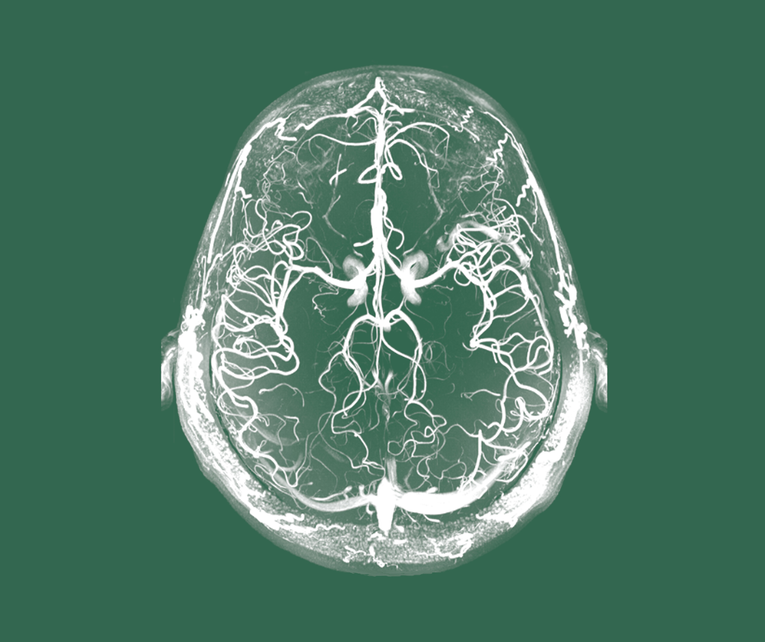
Schizophrenia
Course, natural history, and prognosis

Slide 2
Overview of the course and prognosis of schizophrenia

Slide 3
The course and prognosis of schizophrenia
Schizophrenia – Course, natural history, and prognosis
Risk factors, neurobiology, and course of schizophrenia^{1,2}
Schizophrenia is a highly heterogeneous disorder with variable onset, symptom patterns, and long-term outcomes^{1,3}
The onset of schizophrenia is thought to arise from the interaction between neurobiological vulnerability and environmental exposures during development^{3,4}
The disease course is often fluctuating, with episodic exacerbations and periods of remission³
Recent data show substantially better outcomes than historically assumed³
Genetic factors
Perinatal complications
Childhood adversity
Urban living
Ethnic minority status
Acute stress
Substance abuse
Treatment discontinuation
Substance abuse
Stress
Risk factors
Aberrant neurobiology
Altered synaptic pruning
Grey matter loss
Dopamine dysfunction
Excitatory/
inhibitory imbalance
Neurobiology
Course
Phase
Premorbid
Prodromal
FEP
Remission/
relapse
Chronic/
persistent
Time
Pre-/perinatal period
Childhood
Adolescence and early adulthood
Adulthood
Persistent from the start
Single episode
APS
BLIPS
Highly variable course
APS=attenuated psychotic symptoms; BLIPS=brief limited intermittent psychotic symptoms; FEP=first-episode psychosis
1. McCutcheon et al. JAMA Psychiatry 2020;77:201–210; 2. Leucht et al. Nat Rev Dis Primers 2025;11:83; 3. Jauhar et al. Lancet 2022;399:473–486; 4. Owen et al. Lancet 2016;388:86–97
Notes:
References:
McCutcheon RA, Reis Margques R, Howes OD. Schizophrenia-an overview. JAMA Psychiatry 2020; 77: 201–210.
Leucht S, Siafis S, McGrath JJ, et al. Schizophrenia. Nat Rev Dis Primers 2025; 11: 83.
Jauhar S, Johnstone M, McKenna PJ. Schizophrenia. Lancet 2022; 39910323: 473–486.
Owen MJ, Sawa A, Mortensen PB. Schizophrenia. Lancet 2016; 388: 86–97.

Slide 4
Symptom domains and early development in schizophrenia

Slide 5
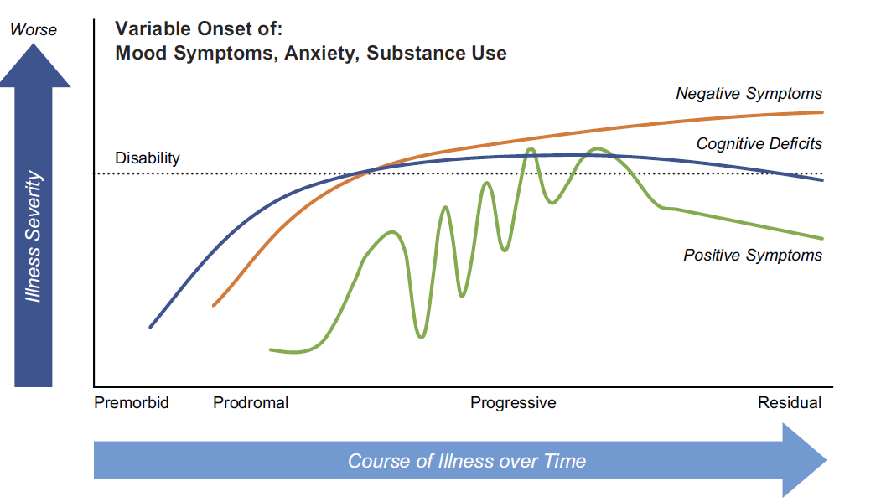
Symptom domains in schizophrenia
Schizophrenia – Course, natural history, and prognosis
Core symptom domains in schizophrenia include positive, negative, disorganization, cognitive, and affective¹
A domain-based approach is more clinically informative than using subtypes¹
The Liddle framework highlights persistent negative and disorganization symptoms in schizophrenia²
Symptom profiles help guide individualized clinical assessment and treatment³
Natural course of symptoms in schizophrenia⁴
Each symptom domain can follow distinct trajectories and may carry prognostic significance across stages of illness³
1. Tandon et al. Schizophr Res 2009;110:1–23; 2. Carpenter. Can J Psychiatry 2020;65:228–230;
3. Maj et al. World Psychiatry 2021;20:4–33; 4. Correll et al. Neuropsychiatr Dis Treat 2020:16; 519–534
This work is from ‘Clinical implications of negative symptoms in schizophrenia’ by Correll et al. Neuropsychiatr Dis Treat 2020, used under license CC-BY-4.0, This work is licensed under Creative Commons license CC-BY-SA by
The Lundbeck Foundation.
Notes:
The Liddle framework identifies psychomotor poverty (e.g., reduced speech and movement), disorganization (e.g., thought disorder and inappropriate affect), and reality distortion (e.g., delusions and hallucinations) as distinct but related syndromes.² This model expanded the earlier positive–negative symptom distinction by suggesting that schizophrenia symptoms group into three underlying syndromes rather than two.²
References:
Tandon R, Nasrallah HA, Keshavan MS. Schizophrenia, "just the facts" 4. Clinical features and conceptualization. Schizophr Res 2009; 110: 1–23.
Carpenter. Classical schizophrenia: Liddle and the core of schizophrenia. Can J Psychiatry 2020; 65: 228–230.
Maj M, van Os J, De Hert M, Wolfgang G, et al. The clinical characterization of the patient with primary psychosis aimed at personalization of management. World Psychiatry 2021; 20: 4–33.
Correll CU, Schooler NR & Kane JM, et al. Clinical implications of negative symptoms in schizophrenia. Neuropsychiatr Dis Treat 2020; 16: 519–534.

Slide 6
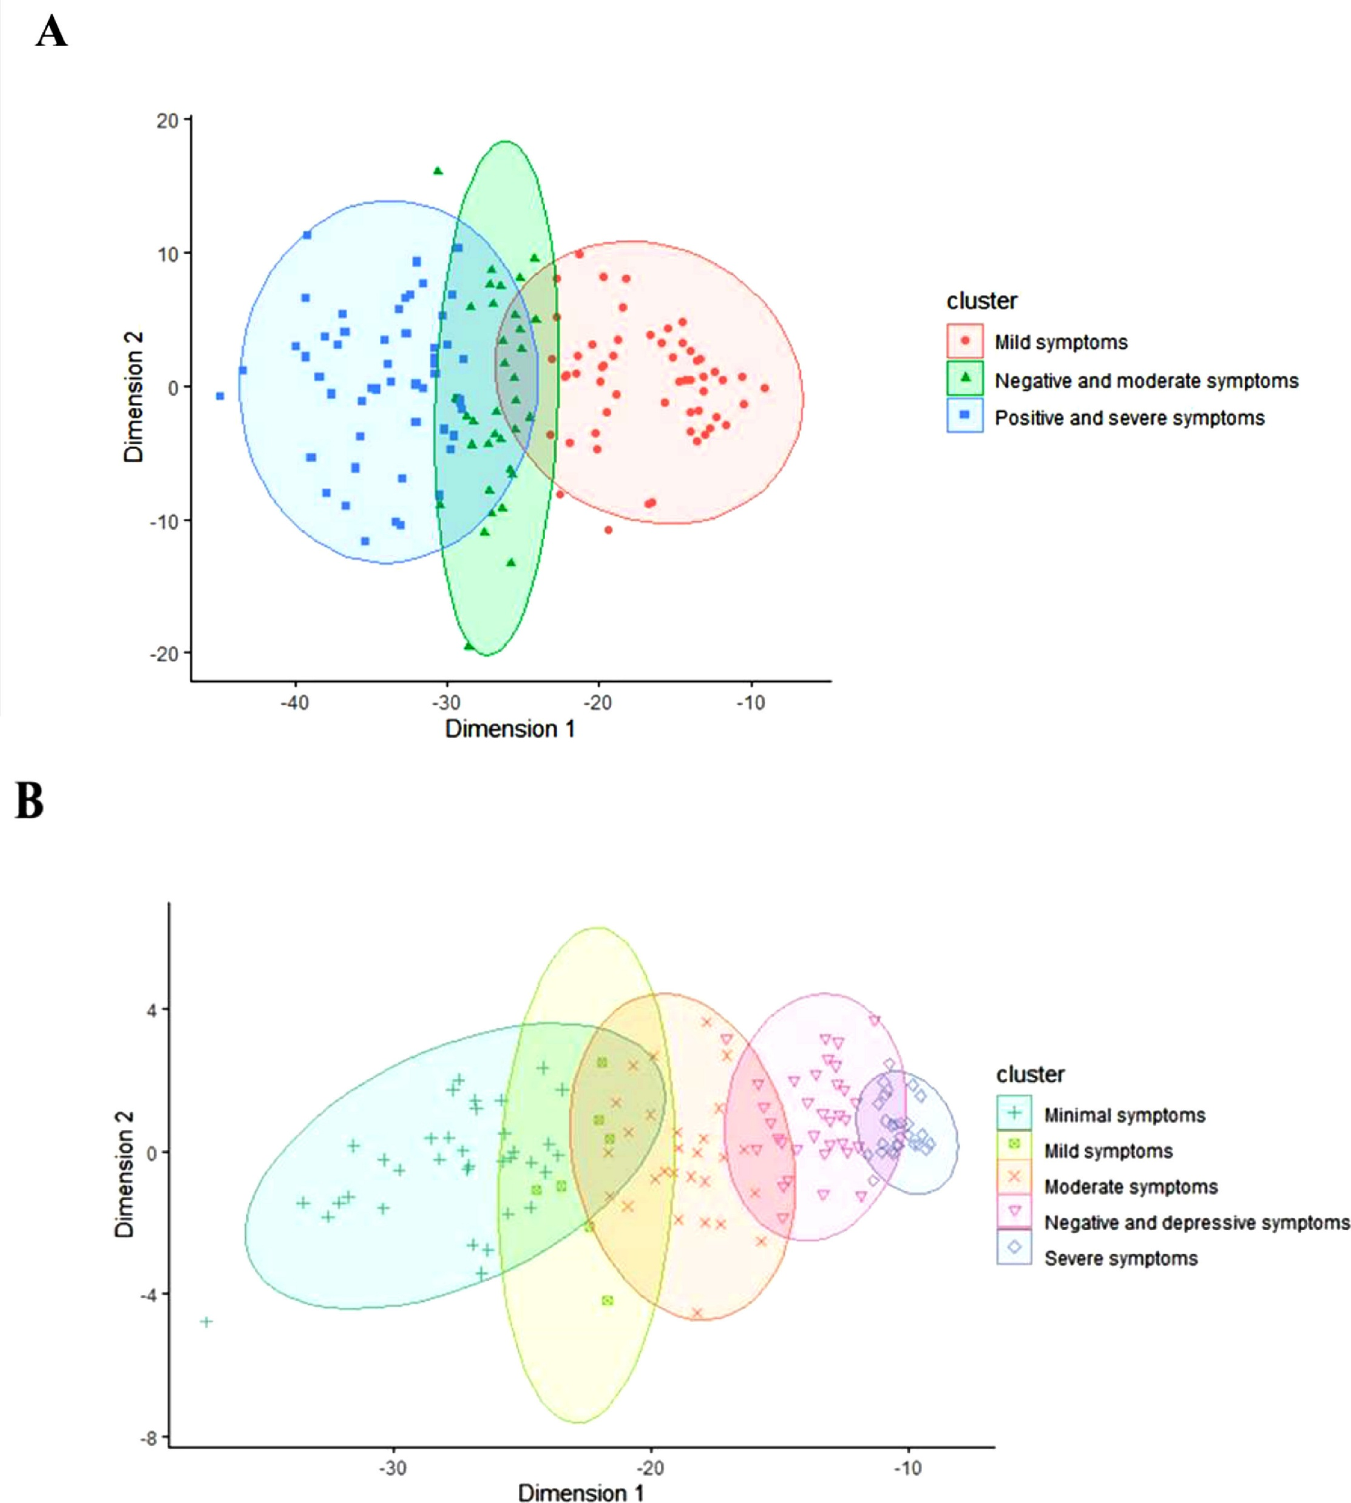
Premorbid functioning and prognosis
Schizophrenia – Course, natural history, and prognosis
Premorbid functioning in schizophrenia is heterogeneous, with studies identifying distinct latent or cluster-based profiles across patient populations¹
Cluster analyses have identified transdiagnostic premorbid trajectories, such as ‘normal overall’, ‘normal social/impaired declining academic’, and ‘impaired stable social/impaired declining academic’²
Poorer premorbid adjustment, particularly in social and academic domains, has consistently been associated with worse clinical and functional outcomes^{2,3}
Distribution of clinical subgroups in patients with FEP¹
Cluster distribution at baselineª
Cluster distribution at 2-year follow-upª
20
10
4
0
0
Dimension 2
Dimension 2
–10
–4
–20
–8
–40
–30
–20
–10
–30
–20
–10
Dimension 1
Dimension 1
Cluster
Cluster
●
Mild symptoms
+
Minimal symptoms
Negative and depressive symptoms
Negative and moderate symptoms
Mild symptoms
◊
Severe symptoms
■
Positive and severe symptoms
x
Moderate symptoms
Premorbid profiles may serve as early prognostic markers and could guide stratification efforts in early psychosis³
ªEach axis represents a reduction of a symptomatology domain, and each point is a subject
FEP=first-episode psychosis
1. Amoretti et al. Eur Neuropsychopharmacol 2021;47:112–129; 2. Chan et al. Psychiatry Res 2019;272:655–662;
3. Caqueo-Urízar et al. J Clin Med 2022;11:3840
This work is adapted from ‘Identifying clinical clusters with distinct trajectories in first-episode psychosis through an unsupervised machine learning technique’, by Amoretti et al. Eur Neuropsychopharmacol 2021, used under license CC-BY-4.0, This work is licensed under Creative Commons license CC-BY-SA by
The Lundbeck Foundation.
Notes:
References:
Amoretti S, Verdolini N, Mezquida G, et al. Identifying clinical clusters with distinct trajectories in first-episode psychosis through an unsupervised machine learning technique. Eur Neuropsychopharmacol 2021; 47: 112–129.
Chan CC, Shanahan M, Ospina LH, et al. Premorbid adjustment trajectories in schizophrenia and bipolar disorder: a transdiagnostic cluster analysis. Psychiatry Res 2019; 272: 655–662.
Caqueo-Urízar A, Ponce-Correa F, Semir-González C, Urzúa A. Latent profiles of premorbid adjustment in schizophrenia and their correlation with measures of recovery. J Clin Med 2022; 11: 3840.

Slide 7
Neurodevelopmental origins of schizophrenia
Schizophrenia – Course, natural history, and prognosis
Schizophrenia arises from early neurodevelopmental alterations, which contribute to early cognitive, social, and motor abnormalities and affect brain circuits before clinical onset^{1,2}
Genetic risk interacts with prenatal and perinatal complications, altering developmental trajectories and increasing vulnerability¹
The classical neurodevelopmental hypothesis has evolved into a broader developmental risk factor model integrating cumulative exposure across childhood
and adolescence²
Risk factors, neurobiology, and course of schizophrenia^{3,4}
Genetic factors
Perinatal complications
Childhood adversity
Urban living
Ethnic minority status
Acute stress
Substance abuse
Treatment discontinuation
Substance abuse
Stress
Risk factors
Aberrant neurobiology
Altered synaptic pruning
Grey matter loss
Dopamine dysfunction
Excitatory/
inhibitory imbalance
Neurobiology
Course
Phase
Premorbid
Prodromal
FEP
Remission/
relapse
Chronic/
persistent
Time
Pre-/perinatal period
Childhood
Adolescence and early adulthood
Adulthood
Persistent from the start
Single episode
APS
BLIPS
Highly variable course
APS=attenuated psychotic symptoms; BLIPS=brief limited intermittent psychotic symptoms; FEP=first-episode psychosis
1. Birnbaum & Weinberger. Am J Psychiatry 2024;181:482–492; 2. Murray et al. Schizophr Bull 2017;43:1190–1196; 3. McCutcheon et al. JAMA Psychiatry 2020;77:201–210;
4. Leucht et al. Nat Rev Dis Primers 2025;11:83
Notes:
References:
Birnbaum & Weinberger. The genesis of schizophrenia: an origin story. Am J Psychiatry 2024;181; 482–492.
Murray RM, Bhavsar V, Tripoli G, Howes DD. 30 Years on: how the neurodevelopmental hypothesis of schizophrenia morphed into the developmental risk factor model of psychosis. Schizophr Bull 2017; 43: 1190–1196.
McCutcheon RA, Reis Margques R, Howes OD. Schizophrenia-an overview. JAMA Psychiatry 2020; 77: 201–210.
Leucht S, Siafis S, McGrath JJ, et al. Schizophrenia. Nat Rev Dis Primers 2025; 11: 83.

Slide 8
Early course of schizophrenia

Slide 9
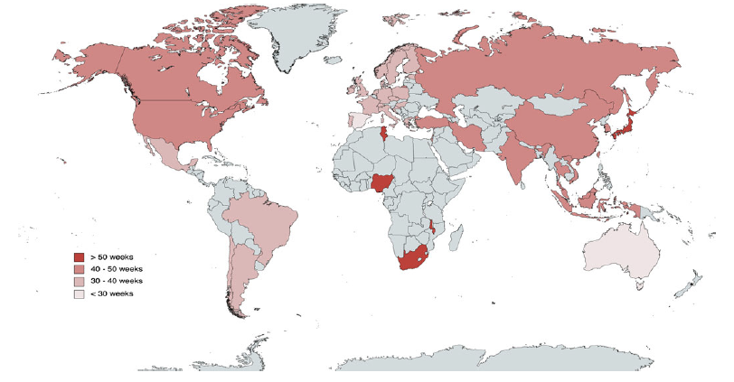
Global mean duration of untreated psychosis
Schizophrenia – Course, natural history, and prognosis
The duration of untreated psychosis varies worldwide, with a mean duration of
42.6 weeks across countries
Data suggest gaps in care exist between and within geographical regions, highlighting the need to address factors such as health literacy, stigma, and inequality
Countries and regions reporting mean duration of untreated psychosisª
48.7 weeks in North America
38.6 weeks in Europe
48.8 weeks in Asia
34.9 weeks in South America
>50 weeks
70.0 weeks in Africa
28.0 weeks
in Australasia
40–50 weeks
30–40 weeks
<30 weeks
ªThe duration of untreated psychosis for countries with at least 10 independent samples was individually calculated and the rest are represented according to the meta-analytical results in their continent
Salazar de Pablo et al. Psychol Med 2024;54:652–662
This work is adapted from ‘What is the duration of untreated psychosis worldwide? - A meta-analysis of pooled mean and median time and regional trends and other correlates across 369 studies’ by Salazar de Pablo et al. Psychol Med 2024, used under license CC-BY-4.0, This work is licensed under Creative Commons license CC-BY-SA by
The Lundbeck Foundation.
Notes:
References:
Salazar de Pablo G, Aymerich C, Guinart D. What is the duration of untreated psychosis worldwide? - A meta-analysis of pooled mean and median time and regional trends and other correlates across 369 studies. Psychol Med 2024; 54: 652–662.

Slide 10
Early-course critical period of psychosis
Schizophrenia – Course, natural history, and prognosis
Early improvements or deterioration during this critical phase can shape clinical trajectories¹
After this period, outcomes tend to stabilize, with a lower likelihood of major changes over time¹
Early intervention during this window improves remission rates and reduces relapse risk²
Mean global assessment of functioning
by duration of untreated illness in FEP^{1,a}
The first 2–5 years following illness onset are critical for long-term outcomes¹
ªA higher global assessment of functioning score indicates better overall functioning
DUI=duration of untreated illness; FEP=first-episode psychosis
1. Crumlish et al. World Psychiatry 2017;16:251–265; 2. Fusar-Poli et al. World Psychiatry 2017;16:251–265
Notes:
References:
Crumlish N, Whitty P, Clarke M, et al. Beyond the critical period: longitudinal study of 8-year outcome in first-episode non-affective psychosis. Br J Psychiatry 2009; 194:18–24.
Fusar-Poli McGorry PD, Kane JM. Improving outcomes of first-episode psychosis: an overview. World Psychiatry 2017; 16: 251–265.

Slide 11
Transdiagnostic clinical staging
Schizophrenia – Course, natural history, and prognosis
Transdiagnostic staging framework allows each clinical stage to be expanded and adapted¹
Transdiagnostic staging framework linking microphenotype progression to changes in symptoms functioning and neurocognition^{1,a}
Symptoms
Functioning
Neurocognition
Stage 0
asymptomatic
No current symptoms; increased risk of disorder
No histological change
Normal to mild deficits
Stage 1a
Mild/non-specific symptoms (QIDS 0–11)
Mild functional change or decline (GAF 70–100)
Mild neurocognitive deficits or relatively normal profile
Microphenotypes
Increasing symptom severity, specificity, and disability
Stage 1b
Sub-threshold symptoms
(QIDS 11–20, YMRS >9)
Functional decline to caseness (GAF <70)
Moderate neurocognitive changes
Stage 2
Moderate to severe symptoms (QIDS >20, YMRS >15)
Functional decline
(GAF <50)
Neurocognitive deficits
Macro-
phenotypes
Stage 3
Incomplete remission or relapse
Persistent functional decline (GAF <40)
Persistent decrement in neurocognition, including social cognition
Depressive
disorder
Substance
misuse
Stage 4
Severe, unremitting, or refractory illness
Poor treatment effectiveness despite intensive interventions
(GAF <30)
Poor treatment effectiveness despite intensive interventions
Bipolar
disorder
Personality
disorder
Primary
psychosis
Based on papers by Scott and colleagues² and Shah and colleagues.³ Selection of rating scales and score ranges can vary slightly between staging models
GAF=Global Assessment of Functioning; QIDS=Quick Inventory of Depressive Symptomatology; YMRS=Young Mania Rating Scale
1. Scott et al. Lancet Psychiatry 2024;11:461–471; 2. Scott et al. Early Interv Psychiatry 2021;15:306–313; 3. Shah et al. World Psychiatry 2020;19:233–242
Notes:
Traditional clinical staging is unidirectional and fails to account for the dynamic course of schizophrenia.¹ Dynamic models may enhance prognosis prediction and guide individualized treatment, within and across stages.¹
References:
Scott J, Iorfino F, Capon W, et al. Staging 2.0: refining transdiagnostic clinical staging frameworks to enhance reliability and utility for youth mental health. Lancet Psychiatry 2024; 11: 461–471.
Scott J, Martin N, Parker R, et al. Prevalence of self-reported subthreshold phenotypes of major mental disorders and their association with functional impairment, treatment, and full-threshold syndromes in a community-residing cohort of young adults. Early Interv Psychiatry 2020; 15: 306–313.
Shah JL, Scott J, McGorry PD, et al. Transdiagnostic clinical staging in youth mental health: a first international consensus statement. World Psychiatry 2020; 19: 233–242.

Slide 12
Clinical high-risk for psychosis
Schizophrenia – Course, natural history, and prognosis
Pathway from general population risk to psychosis: prognostic stratification in CHR‑P²
CHR-P criteria identify individuals with attenuated psychotic symptoms, brief limited psychotic episodes, or genetic risk accompanied by functional decline¹
This state is associated with an elevated risk of transition to psychosis, which increases with time¹
The CHR-P population is heterogeneous, with many individuals experiencing persistent symptoms or functional impairment^{1,2}
Advances in detection, prognosis, and stage-specific interventions aim to reduce transition risk and improve overall clinical outcomes²
Prognostic assessment
General
population
Help-seeking
Individuals
Individuals
at CHR-P
3-year
follow-up
General population:
0.43% psychosis risk
Psychosis risk pre-prognostic assessment: 15%
Prognostic tools (CAARMS/SIPS) increase identification accuracy
Outcomes at 3 years: 22% transition to psychosis
Key risk factors for psychosis
Childhood adversity
Substance abuse
Low education level
Unemployment
Male sex
Mental disorder comorbidity
Physical inactivity
Distribution of
CHR-P syndromes:
APS: 85%
BLIPS: 10%
GBD: 5%
Heterogenous
risk across
CHR-P subgroups
BLIP: 38%
APS: 24%
GRD: 8%
Healthy or in remission
With persistent nonpsychotic psychiatric disorders
With emerging psychosis
With persistent attenuated psychotic disorders
APS= attenuated psychosis syndrome; BLIPS=brief limited intermittent psychotic symptoms; CAARMS=Comprehensive Assessment of At-Risk Mental States;
CHR-P=clinical high-risk for psychosis; GRD=genetic risk and deterioration; SIPS=Structured Interview for Psychosis-Risk Syndromes
1. Fusar-Poli et al. JAMA Psychiatry 2013;70:107–120; 2. Fusar-Poli et al. JAMA Psychiatry 2020;77:755–765
Notes:
Several assessment tools have been developed to identify individuals at clinical high risk for psychosis, particularly in the early stages before a full psychotic disorder emerges. Three key assessment tools are described below.
The CAARMS is a semi-structured interview designed to assess subthreshold psychotic symptoms, functional decline, and other risk indicators to determine whether an individual meets criteria for an at-risk mental state.³
The SIPS evaluates attenuated psychotic syndromes, brief intermittent psychotic symptoms, and genetic risk combined with functional deterioration.⁴
The Mini-SIPS is a shorter screening version of SIPS developed to provide a more time-efficient method for identifying possible psychosis-risk syndromes in clinical settings while maintaining alignment with the SIPS criteria.⁴
Abbreviations: CAARMS=Comprehensive Assessment of At-Risk Mental States; SIPS=Structured Interview for Psychosis-Risk Syndromes
References:
Fusar-Poli P, Borgwardt S, Bechdolf A, et al. The psychosis high-risk state: a comprehensive state-of-the-art review. JAMA Psychiatry 2013; 70: 107–120.
Fusar-Poli P, Salazar de Pablo G, Correll CU, et al. Prevention of psychosis: advances in detection, prognosis, and intervention. JAMA Psychiatry 2020; 77: 755–765.
Orygen. Comprehensive Assessment of At-Risk Mental States (CAARMS 23) Toolkit. https://www.orygen.org.au/Training/Resources/Psychosis/CAARMS-Toolkit/CAARMS-23.
Woods S, Lympus C, McGlashan TH, et al. The Mini-SIPS: development of a brief clinical structured interview guide to diagnosing DSM-5 Attenuated Psychosis Syndrome and training outcomes. BMC Psychiatry 2022; 22: 784.

Slide 13
Transition risk for individuals at clinical high-risk for psychosis
Schizophrenia – Course, natural history, and prognosis
Transition risk varies across subgroups, with higher rates among individuals presenting with BLIPS/BIPS and lower rates in younger CHR-P populations¹⁻³
Updated meta-analytic evidence indicates that about a quarter of individuals are at risk of transition to psychosis at 3 years¹
Most individuals who do not transition still show ongoing psychopathology, poor functioning, or need for care at follow-up³
Compared to adults, adolescents at CHR-P display lower transition probabilities but significant persistence of symptoms and functional difficulties²
Cumulative risk of transition to psychosis in individuals at CHR-P¹
BLIPS/BIPS=brief-limited-intermittent psychotic symptoms; CHR-P=clinical high-risk for psychosis; CI=confidence interval
1. Salazar de Pablo et al. JAMA Psychiatry 2021;78:970–978; 2. Catalan et al. J Child Psychol Psychiatry 2021;62:657–673; 3. Salazar de Pablo et al. Epidemiol Psychiatr Sci 2022;31:e9
Notes:
References:
Salazar de Pablo G, Radua J, Pereira J, et al. Probability of transition to psychosis in individuals at clinical high risk: an updated meta-analysis. JAMA Psychiatry 2021; 78: 970–978.
Catalan et al. Annual research review: prevention of psychosis in adolescents - systematic review and meta-analysis of advances in detection, prognosis and intervention. J Child Psychol Psychiatry 2021; 62: 657–673.
Salazar de Pablo G, Soardo L, Cabras A, et al. Clinical outcomes in individuals at clinical high risk of psychosis who do not transition to psychosis: a meta-analysis. Epidemiol Psychiatr Sci 2022; 31: e9.

Slide 14
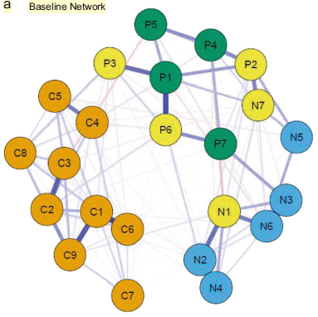
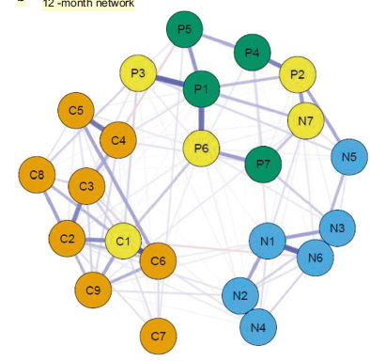
Initial presentation in first-episode psychosis
Schizophrenia – Course, natural history, and prognosis
FEP presentations are heterogeneous, with
analyses identifying distinct clinical clusters
at onset¹
These clusters differ in symptom severity and negative symptom burden from the earliest stages¹
Network-based longitudinal analyses show stable core symptom structures from onset, with strong interconnections among positive, negative, and affective symptoms²
Early symptom patterns and network properties predict subsequent course and
functional outcomes¹
Top scoring bridge nodes across baseline and
12-month networks²
Baseline network
12-month network
Calgary
PANSS negative
PANSS positive
Bridge
FEP=first-episode psychosis; PANSS=Positive and Negative Syndrome Scale
1. Amoretti et al. Eur Neuropsychopharmacol 2021;47:112–129; 2. Griffiths et al. Transl Psychiatry 2021;11:567
This work is adapted from ‘Structure and stability of symptoms in first episode psychosis: a longitudinal network approach’ by Griffiths et al. Transl Psychiatry 2021, used under license CC-BY-4.0, This work is licensed under Creative Commons license CC-BY-SA by
The Lundbeck Foundation.
Notes:
In the figure, each circle (node) represents a symptom, and the lines between nodes represent statistical associations between symptoms.² Symptoms are grouped by clinical scale: orange nodes represent depressive symptoms from the CDSS, blue nodes represent negative symptoms from the PANSS, and green nodes represent positive symptoms from the PANSS.² The yellow nodes highlight bridge symptoms.² These are symptoms that connect different symptom clusters and are important because they may help explain how symptoms from different domains influence each other and may represent potential targets for intervention to reduce overall symptom burden.² The figure suggests that relationships between symptom domains may evolve during the course of illness and treatment.² P1=Delusions; P2=Conceptual Organization; P3=Hallucinatory Behaviour; P4=Excitement; P5=Grandiosity; P6=Suspiciousness/Persecution; P7=Hostility; N1=Blunted Affect; N2=Emotional Withdrawal; N3=Poor Rapport; N4=Passive/Apathetic Social Withdrawal; N5=Difficulty in Abstract Thinking; N6=Lack of Spontaneity and Flow of Conversation; N7=Stereotyped Thinking; C1=Depression; C2=Hopelessness; C3=Self Depreciation; C4=Guilt Ideas of Reference; C5=Pathological Guilt; C6=Morning Depression; C7=Early Awakening; C8=Suicide; C9=Observed Depression.
Abbreviations: CDSS=Calgary Depression Scale for Schizophrenia; PANSS=Positive and Negative Syndrome Scale
References:
Amoretti S, Verdolini N, Mezquida G, et al. Identifying clinical clusters with distinct trajectories in first-episode psychosis through an unsupervised machine learning technique. Eur Neuropsychopharmacol 2021; 47: 112–129.
Griffiths SL, Leighton SP, Mallikarjun PK, et al. Structure and stability of symptoms in first episode psychosis: a longitudinal network approach. Transl Psychiatry 2021; 11: 567.

Slide 15
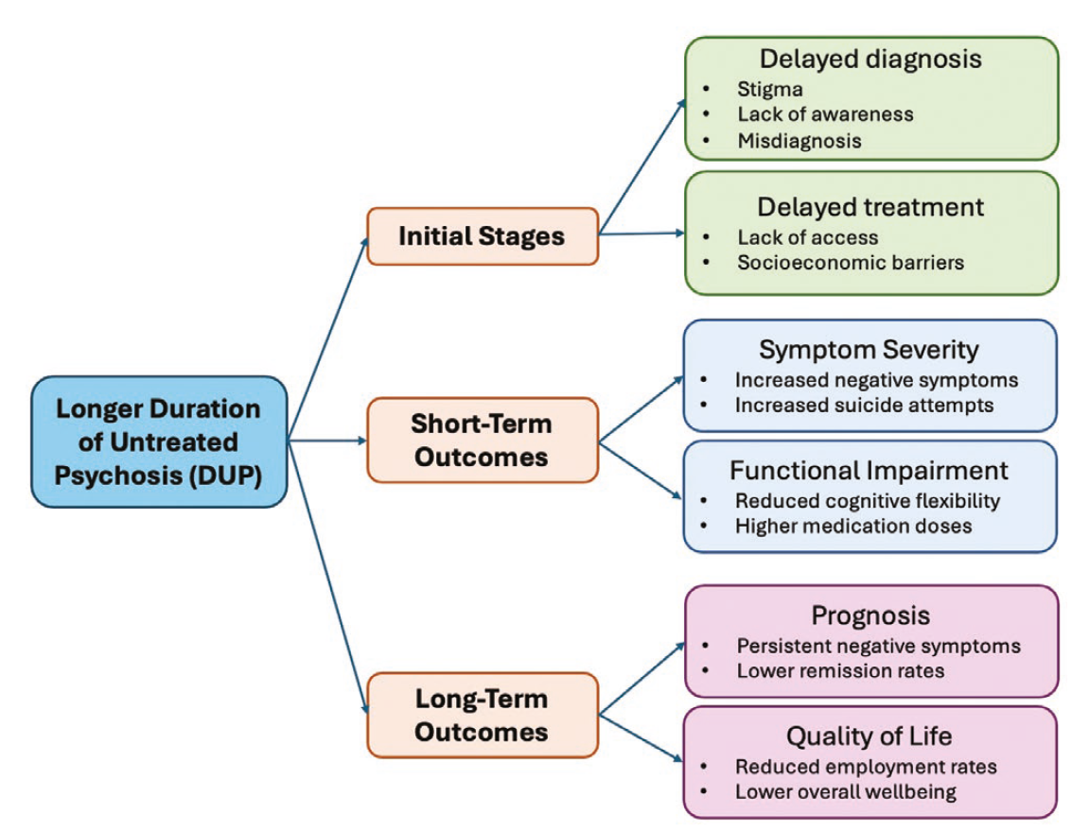
Duration of untreated psychosis and early treatment response
Schizophrenia – Course, natural history, and prognosis
A shorter DUP is consistently associated with better symptom reduction, functioning, and remission in FEP¹
Individuals with a longer DUP present with more severe baseline symptoms, poorer functioning, and reduced early treatment response²
Early detection and rapid initiation of antipsychotic treatment significantly improves both short- and long-term outcomes¹
Baseline differences linked to DUP persist over follow-up, with a long DUP predicting lower recovery rates and greater illness chronicity²
The role of DUP in determining outcomes²
DUP=duration of untreated psychosis; FEP=first-episode psychosis
1. Salazar de Pablo et al. Schizophr Bull 2024;50:771–783; 2. Catalan et al. Schizophr Bull 2025;51:1206–1230
This work is adapted from ‘"Short" versus "long" duration of untreated psychosis in people with first-episode psychosis: a systematic review and meta-analysis of baseline status and follow-up outcomes’ by Catalan, et al. Schizophr Bull 2025, used under license CC-NC-BY-4.0, This work is licensed under Creative Commons license CC-NC-BY-SA by The Lundbeck Foundation.
Notes:
References:
Salazar de Pablo G, Guinart D, Armendariz A, et al. Duration of untreated psychosis and outcomes in first-episode psychosis: systematic review and meta-analysis of early detection and intervention strategies. Schizophr Bull 2024; 50: 771–783.
Catalan A, Salazar de Pablo, Aymerich C, et al. "Short" versus “long" duration of untreated psychosis in people with first-episode psychosis: a systematic review and meta-analysis of baseline status and follow-up outcomes. Schizophr Bull 2025; 51: 1206–1230.

Slide 16
Long-term course and progression in schizophrenia

Slide 17
Long-term illness trajectories
Schizophrenia – Course, natural history, and prognosis
Long-term outcomes in psychotic disorders are highly variable, ranging from sustained remission to persistent impairment¹
Some patients achieve remission or recovery,² especially with early treatment response³
Outcomes often stabilize over time, although early illness patterns are important predictors¹
Better long-term outcomes are linked to a fewer negative symptoms and
male sex²
Meta-analytic symptomatic remission and recovery proportion in FEP over time²
Sample size, n
Remission
667 | 3,919 | 8,489 | 5,453
125 | 944 | 1,813 | 12,152
Recovery
FEP=first-episode psychosis
1. Tramazzo et al. Am J Psychiatry 2024;181:532–540; 2. Catalan et al. Eur Psychiatry 2021;64:e69;
3. Samara et al. Am J Psychiatry 2015;172:617–629
This work is adapted from ‘Proportion and predictors of remission and recovery in first-episode psychosis: systematic review and meta-analysis’ by Catalan et al. Eur Psychiatry 2021, used under license CC-BY-4.0, This work is licensed under Creative Commons license CC-BY-SA by The Lundbeck Foundation.
Notes:
References:
Tramazzo S, Lian W, Ajnakina O, et al. Long-term course of remission and recovery in psychotic disorders. Am J Psychiatry 2024; 181: 532–540.
Catalan A, Richter A, Salazar de Pablo G, et al. Proportion and predictors of remission and recovery in first-episode psychosis: systematic review and meta-analysis. Eur Psychiatry 2021; 64: e69.
Samara MT, Leucht C, Leeflang MM, et al. Early improvement as a predictor of later response to antipsychotics in schizophrenia: A diagnostic test review. Am J Psychiatry 2015; 172: 617–629.

Slide 18
The multi-episode course of schizophrenia
Schizophrenia – Course, natural history, and prognosis
A follow-up study of participants from the OPUS trial aimed to identify 20-year trajectories of positive and negative symptoms after FEP
in patients with a schizophrenia
spectrum diagnosis
Symptoms followed diverse and non-linear trajectories rather than a single
deteriorating course
  Some patients showed persistent positive symptoms, while others demonstrated improvement or fluctuating patterns
  Negative symptoms were generally more stable and persistent than positive symptoms
Early symptom severity and functional status were associated with lower cognition, poorer social functioning, higher antipsychotic use, and lower rates of recovery at 20 years
Symptom trajectories: Outcomes at 20 years’ follow-up
Positive symptoms:
~70% showed improvementª
~20% showed chronic or worsening symptoms
Stable improvement: 18%
Intermittent
symptoms: 10%
Relapse with
moderate symptoms: 12%
Early continuous remission: 51%
Continuous severe symptoms: 9%
Negative symptoms:
51% showed improvement
49% showed no improvement
Continuous
symptoms: 49%
Symptom remission:
51%
ªIncludes patients that experienced early continuous remission or stable improvement of symptoms
FEP=first-episode psychosis
Starzer et al. World Psychiatry 2023;22:424–432
Notes:
Symptoms were assessed using the Scale for the Assessment of Positive Symptoms and the Scale for the Assessment of Negative Symptoms; a composite score was calculated for each dimension, ranging from 0 to 5.¹ A score of 2 or less on all global ratings of symptoms was classed as clinical remission.¹
References:
Starzer M, Hansen HG, Hjorthøj C, et al. 20-year trajectories of positive and negative symptoms after the first psychotic episode in patients with schizophrenia spectrum disorder: results from the OPUS study. World Psychiatry 2023; 22: 424–432.

Slide 19
Chronic and persistent illness patterns
Schizophrenia – Course, natural history, and prognosis
Long-term symptom changes in psychotic disorders follow multiple distinct trajectories rather than a uniform pattern
Improvements in one domain (e.g., positive symptoms) does not directly translate into gains in functioning or improvements in negative symptoms
Symptom domains influence each other dynamically over time, with reciprocal effects across clinical and functional outcomes
Stable or worsening negative and cognitive dimensions are key drivers of poor
long-term functioning
Kotov et al. Am J Psychiatry 2017;174:1064–1074
Notes:
References:
Kotov R, Fochtmann L, Li L, et al. Declining clinical course of psychotic disorders over the two decades following first hospitalization: evidence from the Suffolk County Mental Health Project. Am J Psychiatry 2017; 174: 1064–1074.

Slide 20
Symptom domains across the course of schizophrenia

Slide 21
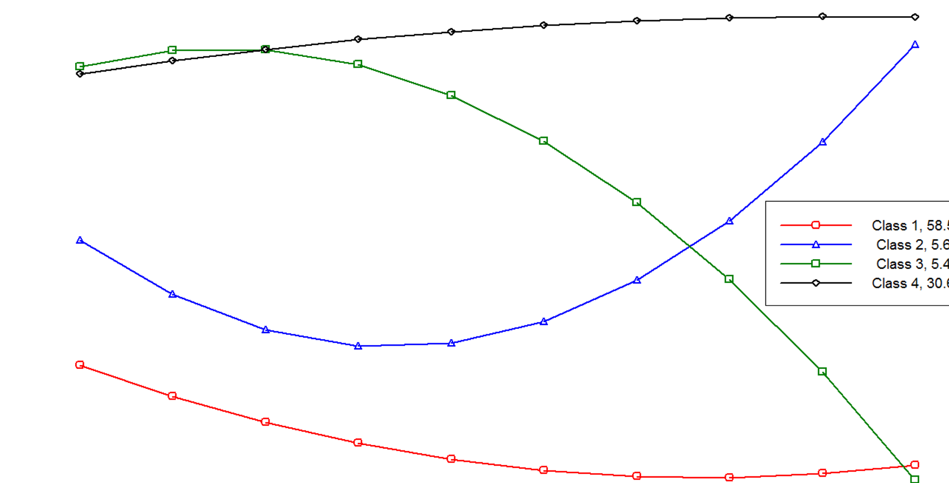
Heterogeneous long-term outcomes in schizophrenia
Schizophrenia – Course, natural history, and prognosis
Improvements in symptoms, functioning, and cognition
are related; however, personal recovery follows a
different trajectory¹
Better outcomes are linked to shorter DUP, targeted care, and baseline factors¹
Four main symptom trajectories include:²
  Remitting-improving
  Persistent
  Late improvement
  Late decline
Persistent trajectories are associated with poor long-term outcomes such as:²
  Longer DUP
  Social disadvantage
  Low premorbid IQ
Estimated latent trajectories of 4-class quadratic growth mixture models²
Class 1, 58.5%
Class 2, 5.6%
Class 3, 5.4%
Class 4, 30.6%
13
12
11
10
9
8
7
Number of months symptomatic (mean)
6
5
4
3
2
1
0
0
1
2
3
4
5
6
7
8
9
10
Follow-up (years)
Class 1: Remitting: course characterized by remitting periods of symptoms, which became shorter and less frequent over time
Class 2: Late decline: course characterized, initially, by remitting periods of symptoms, with more persistent symptoms over time
Class 3: Late improvement: course characterized, initially, by persistent symptoms, with remitting periods of symptoms later
Class 4: Persistent: a course characterized by persistent or long periods of symptoms throughout
DUP=duration of untreated psychosis; IQ=intelligence quotient
1. de Winter et al. Acta Psychiatr Scand 2025;152:6–26; 2. Morgan et al. Psychol Med 2022;52:2641–2650
This work is adapted from ‘Rethinking the course of psychotic disorders: modelling long-term symptom trajectories’ by Morgan et al. Psychol Med 2022, used under license CC-BY-4.0, This work is licensed under Creative Commons license CC-BY-SA by The Lundbeck Foundation.
Notes:
References:
de Winter L, Jelsma A, Vermeulen JM, et al. Interrelationships of changes in outcome domains in patients with schizophrenia spectrum disorders: a meta-analysis. Acta Psychiatr Scand 2025; 152: 6–26.
Morgan C, Dazzan P, Lappin J, et al. Rethinking the course of psychotic disorders: modelling long-term symptom trajectories. Psychol Med 2022; 52: 2641–2650.

Slide 22
Relapse and positive symptom persistence
Schizophrenia – Course, natural history, and prognosis
Positive symptoms typically follow a fluctuating course of relapse and remission^{1,2}
Relapse worsens outcomes, with poorer treatment response over time¹
Persistent symptoms show substantially higher relapse incidence²
Recurrent relapse is associated with a greater long-term risk of treatment resistance²
Risk of relapse associated with antipsychotic dose categories in comparison with standard dose^{3,a}
 | Dose | aHR (95% CI)^{b} |  | p value
1–2 relapses^{c} | <0.6 | 1.54 (1.06, 2.24) |  | 0.0243
 | 0.6 to <0.9 | 1.42 (0.97, 2.07) |  | 0.0719
 | 1.1 to <1.4 | 1.30 (0.86, 1.95) |  | 0.2094
 | 1.4 to <1.6 | 1.67 (1.05, 2.66) |  | 0.0310
 | 1.6 to <1.9 | 1.38 (0.88, 2.16) |  | 0.1579
 | 1.9 to <2.1 | 1.80 (1.02, 3.19) |  | 0.0442
 | 2.2 to <2.4 | 1.65 (0.96, 2.86) |  | 0.0721
 | ≥2.4 | 2.90 (1.92, 4.38) |  | <0.0001
3–5 relapses^{c} | <0.6 | 1.13 (0.79, 1.62) |  | 0.5125
 | 0.6 to <0.9 | 1.18 (0.82, 1.69) |  | 0.3771
 | 1.1 to <1.4 | 1.22 (0.84, 1.78) |  | 0.3013
 | 1.4 to <1.6 | 0.83 (0.53, 1.32) |  | 0.4304
 | 1.6 to <1.9 | 1.02 (0.67, 1.56) |  | 0.9351
 | 1.9 to <2.1 | 1.18 (0.72, 1.95) |  | 0.5135
 | 2.2 to <2.4 | 1.25 (0.78, 2.03) |  | 0.3546
 | ≥2.4 | 1.65 (1.13, 2.42) |  | 0.0100
aHR (95% CI)
ªA within-individual model was used in this analysis, meaning all comparisons were done within the same individual, i.e., each individual acted as his or her own control; ^{b}Adjusted for time since cohort entry; ^{c}Analysis was stratified by time before the second relapse (1–2 relapses) and after the second relapse until the fifth relapse or 5-year follow-up (3–5 relapses)
aHR=adjusted hazard ratio; CI=confidence interval
1. Takeuchi et al. Neuropsychopharmacology 2019;44:1036–1042; 2. Rubio et al. Lancet Psychiatry 2020;7:749–761;
3. Taipale et al. Lancet Psychiatry 2022;9:271–279
This work is adapted from ‘Real-world effectiveness of antipsychotic doses for relapse prevention in patients with first-episode schizophrenia in Finland: a nationwide, register-based cohort study’ by Taipale et al. Lancet Psychiatry 2022, used under license CC-BY-4.0, This work is licensed under Creative Commons license CC-BY-SA by The Lundbeck Foundation.
Notes:
References:
Takeuchi H, Siu C, Remington G, et al. Does relapse contribute to treatment resistance? Antipsychotic response in first- vs. second-episode schizophrenia. Neuropsychopharmacology 2019; 44: 1036–1042.
Rubio JM, Schoretsanitis G, John M, et al. Psychosis relapse during treatment with long-acting injectable antipsychotics in individuals with schizophrenia-spectrum disorders: an individual participant data meta-analysis. Lancet Psychiatry 2020; 7: 749–761.
Taipale H, Tanskanen A, Correll CU, Tiihonen J. Real-world effectiveness of antipsychotic doses for relapse prevention in patients with first-episode schizophrenia in Finland: a nationwide, register-based cohort study. Lancet Psychiatry 2022; 9: 271–279.

Slide 23
Negative symptoms over time
Schizophrenia – Course, natural history, and prognosis
The European Psychiatric Association guidance highlights that persistent negative symptoms represent a distinct longitudinal dimension, associated with poor functional outcomes and high treatment burden¹⁻³
Negative symptoms may persist over time, with periods of stability and fluctuation, and can show limited improvement^{1,3}
Negative symptoms often drive long-term functional impairment, with enduring effects on motivation, emotional expression, and social functioning¹⁻³
While positive symptoms can be managed with antipsychotic medications, primary negative symptoms lack effective treatment options and can remain prominent and contribute to long-term disability^{1,3}
1. Galderisi et al. Eur Psychiatry 2021;64:e23; 2. Fervaha et al. Eur Psych 2014;29:449–455; 3. Correll et al. Neuropsychiatr Dis Treat 2020:16:519–534
Notes:
Negative symptoms can be primary symptoms, which are intrinsic to the underlying pathophysiology of schizophrenia, or secondary symptoms that are related to psychiatric or medical comorbidities, adverse effects of treatment, or environmental factors.³
While secondary negative symptoms can improve with treatment to improve symptoms in other domains (i.e., positive symptoms, depressive symptoms) primary negative symptoms generally do not respond well to currently available antipsychotic treatment. Since some patients may lack insight about the presence of negative symptoms, these are generally not the reason that patients seek clinical care. Further symptoms may be underrecognized.³ These two factors combined with the limited number of effective treatment options contribute to overall disease burden, and poor functional outcomes.³
References:
Galderisi S, Mucca A, Dollfus S, et al. EPA guidance on assessment of negative symptoms in schizophrenia. Eur Psychiatry 2021; 64: e23.
Fervaha G, Foussias G, Agid O, Remington A. Impact of primary negative symptoms on functional outcomes in schizophrenia. Eur Psych 2014; 29: 449–455.
Correll CU, Schooler NR & Kane JM, et al. Clinical implications of negative symptoms in schizophrenia. Neuropsychiatr Dis Treat 2020; 16: 519–534.

Slide 24
Cognitive outcomes over time
Schizophrenia – Course, natural history, and prognosis
Cognitive deficits emerge early in the course of psychosis and are relatively stable¹
Cognitive outcome trajectory²
Clinical and functional outcomes²
Change from baseline NIH Toolbox Fluid Cognition Composite score at each timepoint in cognitive trajectory subgroups
Progressive decline group: Highest negative symptom scores over time (BNSS, PANNS negative), and lower GAF social and occupational scores
High-functioning group: Lowest negative symptoms, best social and occupational functioning at 8 and 16 months, and better subjective wellbeing
Change from baseline in Fluid Cognition score
Heterogeneous trajectories demonstrate stable impairment, progressive decline, or partial improvement in cognitive outcomes²
Cognitive trajectories strongly
predict long-term functioning independent of symptom severity²
BNSS=Brief Negative Symptom Scale; GAF=Mental Illness Research Education and Clinical Center (MIRECC) Global Assessment of Functioning; NIH=National Institutes of Health; PANNS=Positive and Negative Syndrome Scale
1. Watson et al. Br J Psychiatry 2022;221:714–721; 2. Lewandowski et al. World Psychiatry 2025;24:260–266
Notes:
Persons with schizophrenia-spectrum disorders or mood disorders with psychosis in the early course of illness (N=127) were assessed using clinical, functional, and cognitive measures at three timepoints: baseline, 8, and 16 months.² Group-based trajectory modelling, using the National Institutes of Health Toolbox Fluid Cognition Composite scores, identified three distinct cognitive trajectories (progressive decline, stable impairment, partial improvement,). The aim of the study was to determine whether early cognitive subgroups predicted clinical and functional outcomes over time.²
References:
Watson et al. Cognitive trajectories following onset of psychosis: a meta-analysis. Br J Psychiatry 2022; 221: 714–721.
Lewandowski KE, Blotner J, Yao B, et al. Distinct cognitive trajectories in the early course of psychosis are associated with clinical and functional outcomes longitudinally. World Psychiatry 2025; 24: 260–266.

Slide 25
Functional outcomes in schizophrenia

Slide 26
Functional outcomes in first-episode psychosis
Schizophrenia – Course, natural history, and prognosis
In FEP, approximately 54% of patients achieve symptomatic remission within 4 years, while only 32% achieve symptomatic and functional recovery¹
Among those with FEP, the most robust predictors of functional recovery include:²
In contrast, sociodemographic and some clinical variables appear to contribute relatively little to the prediction of functional recovery²
Functional recovery consistently trails behind clinical remission; many patients continue to experience impairment in social, educational, and vocational domains, even when early symptomatic improvement is achieved³
DUP as a predictor of functional recovery highlights the importance of early intervention
DUP
Cognitive
performance
Remission of both positive and negative symptoms
DUP=duration of untreated psychosis; FEP=first-episode psychosis
1. Catalan et al. Eur Psychiatry 2021;64:e69; 2. Santesteban-Echarri et al. Clin Psychol Rev 2017;58:59–75; 3. Peralta et al. Schizophr Bull 2022;48:631–642
Notes:
Functional impairment in schizophrenia-spectrum disorders affects multiple areas of everyday life.⁴ Improvements in symptoms alone may not adequately capture functional outcomes in daily life.⁵ Key domains of functioning, including activities of daily living, social functioning, and productive activities, may show differing patterns of impairment and recovery, highlighting the importance of assessing functional domains separately.⁴
Self-report measures show modest convergence with objective and informant-based measures of functioning, whereas high-contact informant ratings are more consistently associated with performance-based functional capacity measures.⁶
There is no single gold-standard instrument for functional assessment in schizophrenia. Several tools demonstrate adequate reliability and validity, including the Specific Level of Functioning scale and the Personal and Social Performance scale; the World Health Organization Disability Assessment Scale 2.0 may also be used, although schizophrenia-specific data are limited. More detailed instruments, such as the Social Functioning Scale, assess a broad range of domains but may be less feasible in routine clinical practice.⁷ Overall, outcome assessment in schizophrenia should integrate domain-specific functional measures with symptomatic outcomes and personal recovery perspectives, rather than relying on a single global outcome indicator.⁷
References:
Catalan A, Richter A, Salazar de Pablo G, et al. Proportion and predictors of remission and recovery in first-episode psychosis: Systematic review and meta-analysis. Eur Psychiatry 2021; 64: e69.
Santesteban-Echarri O, Paino M, Rice S, et al. Predictors of functional recovery in first-episode psychosis: a systematic review and meta-analysis of longitudinal studies. Clin Psychol Rev 2017; 58: 59–75.
Peralta V, García de Jalón E, Moreno-Izco L, et al. Long-term outcomes of first-admission psychosis: a naturalistic 21-year follow-up study of symptomatic, functional and personal recovery and their baseline predictors. Schizophr Bull 2022; 48: 631–642.
Tang SX, Hänsel K, Oliver LD, et al. Functional phenotypes in schizophrenia spectrum disorders: defining the constructs and identifying biopsychosocial correlates using data-driven methods. Schizophrenia (Heidelb). 2024; 10: 58.
Silva MA, Restrepo D. Functional recovery in schizophrenia. Rev Colomb Psiquiatr (Engl Ed). 2019; 48: 252–260.
Sabbag S, Twamley EM, Vella L, et al. Assessing everyday functioning in schizophrenia: not all informants seem equally informative. Schizophr Res. 2011; 131: 250–255.
Correll CU, Cortese S, Solmi M, et al. Beyond symptom improvement: transdiagnostic and disorder-specific ways to assess functional and quality of life outcomes across mental disorders in adults. World Psychiatry 2025; 24: 296–318.

Slide 27
Functional outcomes over the course of schizophrenia
Schizophrenia – Course, natural history, and prognosis
Functional recovery is non-linear and extends well beyond symptom remission, requiring rebuilding identity agency and meaningful goals¹
Functional outcomes remain poor, as employment rates among people with schizophrenia are very low:²
Higher education attainment is associated with better functional outcomes, later onset, absence of comorbid substance use disorder, and less severe psychotic symptoms³
Occupational status trends from 2 years before to
5 years after FEP (N=21,551)^{4,a,b}
100
90
80
3–4% employment rate
after diagnosis
80%
receiving disability pension
70
60
People (%)
50
40
30
20
10
0
Time point in relation to first diagnosis (years)
Employed
Long-term parental leave
Student
Not in work
Social welfare
ª‘Not in work’ includes long-term unemployment and long-term sick leave; ^{b}‘Social welfare’ includes social assistance and disability pension
FEP=first-episode psychosis
1. Fusar-Poli et al. World Psychiatry 2022;21:168–188; 2. Holm et al. Acta Psychiatr Scand 2021;143:61–71; 3. Ayesa-Arriola et al. Psychological Medicine 2023;53:66–77; 4. Solmi et al. Am J Psychiatry 2022;179:938–946
Notes:
Schizophrenia involves early disturbances in self-experience that evolve into broader alterations in identity and reality perception.¹
References:
Fusar-Poli P, Estrade A, Stanghellini G, et al. The lived experience of psychosis: a bottom-up review co-written by experts by experience and academics. World Psychiatry 2022; 21: 168–188.
Holm Mtaipale H, Tanskanen A, et al. Employment among people with schizophrenia or bipolar disorder: A population-based study using nationwide registers. Acta Psychiatr Scand 2021; 143: 61–71.
Ayesa-Arriola R, Miguel-Corredera M, Ortiz-García de la Foz V, et al. Education and long-term outcomes in first episode psychosis: 10-year follow-up study of the PAFIP cohort. Psychological Medicine 2023; 53: 66–77.
Solmi M, Taipale H, Holm M, et al. Effectiveness of antipsychotic use for reducing risk of work disability: results from a within-subject analysis of a Swedish national cohort of 21,551 patients with first-episode nonaffective psychosis. Am J Psychiatry 2022; 179: 938–946.

Slide 28
Prognostic factors in schizophrenia

Slide 29
Prognostic factors in mental disorders
Schizophrenia – Course, natural history, and prognosis
Broad transdiagnostic evidence shows that mental disorders share common environmental, developmental, and social determinants, from obstetric complications and early adversity to stress exposure, social isolation, and metabolic factors, many exerting cumulative effects across neurodevelopmental stages¹
Across psychotic disorders, the most robust and replicated risk factors for developing psychosis include childhood adversity, CHR-P status, and urbanicity, supported by high-credibility (Class I–II) evidence²
In schizophrenia-spectrum disorders:³
  Multivariable candidate predictors of remission include lower positive and negative symptom severity, shorter duration of untreated psychosis, higher functioning, better quality of life, and higher education
  Multivariable candidate predictors of relapse include greater global illness severity, higher positive symptom severity, and a greater number of previous episodes
  A trans-diagnosis pattern emerges for depressive symptoms:
  Lower depressive symptoms predict good outcomes across mental disorders but, for schizophrenia, lower depressive symptoms predict relapse³
CHR-P=clinical high-risk for psychosis
1. Arango et al. World Psychiatry 2021;20:417–436; 2. Radua et al. World Psychiatry 2018;17:49–66; 3. Solmi et al. Mol Psychiatry 2023;28:3671–3687
Notes:
References:
Arango C, Dragioti E, Solmi M, et al. Risk and protective factors for mental disorders beyond genetics: an evidence-based atlas. World Psychiatry 2021; 20: 417–436.
Radua J, Ramella-Cravaro V, Ioannidis JPA, al. What causes psychosis? An umbrella review of risk and protective factors. World Psychiatry 2018; 17: 49–66.
Solmi M, Cortese S, Vita G, et al. An umbrella review of candidate predictors of response, remission, recovery, and relapse across mental disorders. Mol Psychiatry 2023; 28: 3671–3687.

Slide 30
Early response predicts treatment outcomes in schizophrenia
Schizophrenia – Course, natural history, and prognosis
Early symptom improvement within the first
2 weeks of antipsychotic treatment is a strong predictor of subsequent clinical response in schizophrenia
A lack of early improvement in schizophrenia is associated with a low probability of achieving meaningful clinical response at later time points
Early response supports timely treatment adjustments where appropriate
Samara et al. Am J Psychiatry 2015;172:617–629
Notes:
References:
Samara MT, Leucht C, Leeflang MM, et al. Early improvement as a predictor of later response to antipsychotics in schizophrenia: a diagnostic test review. Am J Psychiatry 2015; 172: 617–629.

Slide 31
Treatment adherence and relapse risk
Schizophrenia – Course, natural history, and prognosis
In patients with FEP,
non-adherence to antipsychotic treatment is the strongest predictor of relapse¹
In a sample of 140 individuals, 94% of those who did not adhere to treatment relapsed within 3 years¹
In patients with remitted or stable FEP, discontinuation of antipsychotics increases risk of relapse²
In a meta-analysis of remitted/stable FEP (N=776), maintenance treatment reduced the 12-month relapse rate by ~50%²
In patients with chronic schizophrenia, discontinuation of antipsychotic treatment increases relapse risk³
In a meta-analysis of chronic schizophrenia (N=4,571), treatment discontinuation almost doubled the risk of relapse compared with dose reduction³
Across the course of illness, non-adherence to treatment consistently increases relapse risk
FEP=first-episode psychosis
1. Caseiro et al. J Psychiatr Res 2012;46:1099–1105; 2. Kishi et al. Psychol Med 2019;49:772–779; 3. Bogers et al. Schizophr Bull 2023;49:11–23
Notes:
References:
Caseiro O, Pérez-Iglesias R, Mata I, et al. Predicting relapse after a first episode of non-affective psychosis: a three-year follow-up study. J Psychiatr Res 2012; 46: 1099–1105.
Kishi T, Ikuta T, Matsui Y, et al. Effect of discontinuation v. maintenance of antipsychotic medication on relapse rates in patients with remitted/stable first-episode psychosis: a meta-analysis. Psychol Med 2019; 49: 772–779.
Bogers JPAM, Hambarian G, Schmidt N, et al. Risk factors for psychotic relapse after dose reduction or discontinuation of antipsychotics in patients with chronic schizophrenia. A meta-analysis of randomized controlled trials. Schizophr Bull 2023; 49: 11–23.

Slide 32
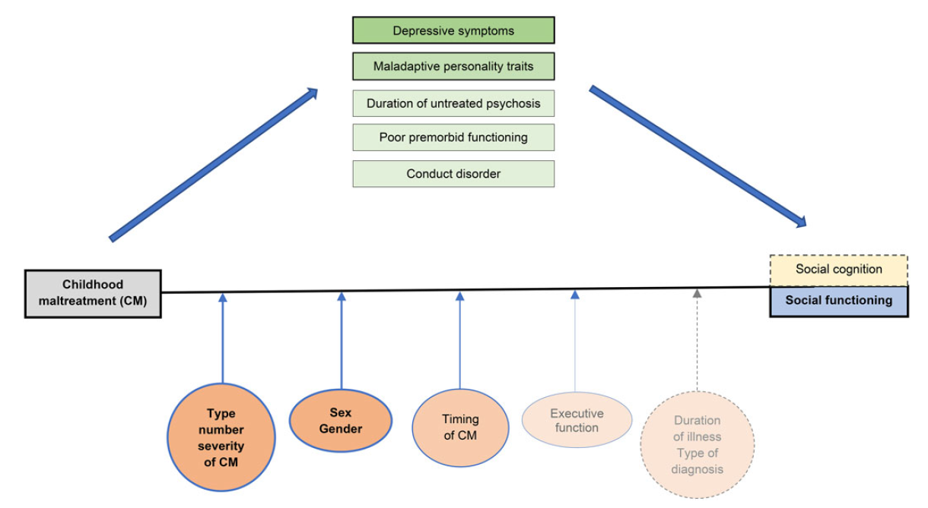
Trauma, social cognition, and functioning
Schizophrenia – Course, natural history, and prognosis
Childhood adversities, such as emotional abuse, neglect, and bullying, are associated with more severe positive, negative, and affective symptom dimensions in psychosis¹
Exposure to trauma is linked to reduced social functioning and impaired social cognition, which may partly contribute to poorer long-term functional outcomes²
Associations between maltreatment and symptoms are modulated by type of adversity, developmental timing and cumulative burden of traumatic events²
Childhood abuse or neglect may negatively affect neurocognitive and mentalizing abilities, which could contribute to psychotic symptoms, particularly in males³
Moderators and mediators between childhood maltreatment and social outcomes in psychotic disorders²
This work is from Fares-Otero, et al., ‘Examining associations, moderators and mediators between childhood maltreatment, social functioning, and social cognition in psychotic disorders: a systematic review and meta-analysis’ 2023, licensed under CC-BY-NC-ND-4.0. Published by Cambridge University Press on behalf of Psychological Medicine. The work cannot be changed in any way or used commercially without permission from the journal.
1. Alameda et al. Schizophr Bull 2021;47:975–985; 2. Fares-Otero et al. Psychol Med 2023;53:5909–5932; 3. Mansueto et al. Schizophrenia Research 2019;206:183–193
Notes:
The colour and thickness of the lines indicate the strength of the evidence: darker, thicker lines represent strong evidence (n ≥ 5), while lighter, thinner lines represent emerging evidence (n = 1).² Dotted lines and grey text indicate areas where evidence is lacking and further research is needed.²
References:
Alameda L, Christy A, Rodriguez V, et al. Association between specific childhood adversities and symptom dimensions in people with psychosis: systematic review and meta-analysis. Schizophr Bull 2021; 47: 975–985.
Fares-Otero N, Alameda L, Paltz, et al. Examining associations, moderators and mediators between childhood maltreatment, social functioning, and social cognition in psychotic disorders: a systematic review and meta-analysis. Psychol Med 2023; 53: 5909–5932.
Mansueto G, Schruers K, Cosci F, et al. Childhood adversities and psychotic symptoms: The potential mediating or moderating role of neurocognition and social cognition. Schizophrenia Research 2019; 206: 183–193.

Slide 33
The prognostic role of negative symptoms
Schizophrenia – Course, natural history, and prognosis
Even from the earliest stages of illness, persistent negative symptoms in
recent-onset psychosis are associated with:¹
Poorer treatment response
A lower likelihood of remission
Worse psychosocial functioning
In FEP, the persistence of negative symptoms is one of the most consistent predictors of long-term functional impairment, alongside longer DUP and
cognitive deficits²
High severity baseline negative symptoms indicate a higher risk of relapse vs mild severity, regardless of treatment strategy, and result in poorer social and
occupational functioning³
DUP=duration of untreated psychosis; FEP=first-episode psychosis
1. Bucci et al. Eur Neuropsychopharmacol 2020;34:76–86; 2. Santesteban-Echarri et al. Clin Psychol Rev 2017;58:59–75; 3. Wunderink et al. Schizophr Res 2020;216:192–199
Notes:
A post hoc analysis of a 7‑year follow‑up of a first‑episode psychosis cohort (n=103) from a dose‑reduction/discontinuation vs maintenance trial examined whether baseline negative symptoms predicted relapse and functional outcomes.³ After 7 years, baseline negative symptoms were demonstrated to be the highest predictor of relapse, as well as a predictor of functional outcome.³
References:
Bucci P, Mucci A, Winter van Rossum I, et al. Persistent negative symptoms in recent-onset psychosis: Relationship to treatment response and psychosocial functioning. Eur Neuropsychopharmacol 2020; 34: 76–86.
Santesteban-Echarri O, Paino M, Rice S, et al. Predictors of functional recovery in first-episode psychosis: a systematic review and meta-analysis of longitudinal studies. Clin Psychol Rev 2017; 58: 59–75.
Wunderink L, van Bebber J, Sytema S, et al. Negative symptoms predict high relapse rates and both predict less favorable functional outcome in first episode psychosis, independent of treatment strategy. Schizophr Res 2020; 216: 192–199.

Slide 34
Predictors of long-term outcomes
Schizophrenia – Course, natural history, and prognosis
Early identification of cognitive impairments may be useful for indicating
future treatment options:¹
Cannabis use as a predictor of outcomes in psychosis:^{4,5}
  Distinct cognitive profiles in FEP strongly predict social and functional outcomes¹
  Compared with discontinuation or non-use, continued cannabis use following the onset of psychosis increases relapse risk, hospital admissions, and symptom severity⁴
  Long-term cognitive decline is associated with poorer 25-year recovery and functioning²
  High-frequency and high-potency cannabis use is associated with poorer outcomes, including risk of
  non-remission and shorter time to relapse⁵
  Cognitive impairment appears early³ and varies substantially between individuals¹
  Discontinuation of cannabis after psychosis onset reduces relapse risk to levels comparable with those who have never used cannabis⁴
FEP=first-episode psychosis
1. Cowman et al. Br J Psychiatry 2025;1–8; 2. Yang et al. Schizophr Bull 2025;52:sbaf051; 3. Catalan et al. Transl Psychiatry 2024;14:15;
4. Schoeler et al. Lancet Psychiatry 2016;3:215–225; 5. Colizzi et al. Schizophr Res 2016;170:311–317
Notes:
References:
Cowman M, Hodgekins J, Griffiths SL, et al. Cognitive and clinical profiles in first-episode psychosis and their relationship with functional outcomes. Br J Psychiatry 2025; 1–8.
Yang Y, Clouston SAP, Reichenberg A, et al. Predictors and Outcomes Associated with 25-Year Cognitive Decline in Psychotic Disorders. Schizophr Bull 2025; 52: sbaf051.
Catalan A, McCutcheon RA, Aymerich C, et al. The magnitude and variability of neurocognitive performance in first-episode psychosis: a systematic review and meta-analysis of longitudinal studies. Transl Psychiatry 2024; 14: 15.
Schoeler T, Monk A, Sami MB, et al. Continued versus discontinued cannabis use in patients with psychosis: a systematic review and meta-analysis. Lancet Psychiatry 2016; 3: 215–225.
Colizzi M, Carra E, Fraietta S, et al. Substance use, medication adherence and outcome one year following a first episode of psychosis. Schizophr Res 2016; 170: 311–317.

Slide 35
Insight and illness awareness as a predictor of relapse
Schizophrenia – Course, natural history, and prognosis
In schizophrenia, illness insight refers to a patient’s awareness of their illness, understanding of the need for treatment, and capacity to acknowledge symptoms¹⁻³
Patients who relapse after 1 year show lower levels of insight at both 1 month and 1 year compared with patients who do not relapse¹
Patients who relapse show persistently worse insight and higher levels of positive symptoms⁴
Absence of insight at the first month is associated with relapse at 1 year, independent of diagnosis, social factors, or depression¹
1. Vlachos et al. J Clin Med 2023;12:4261; 2. Reddy. Indian J Psychol Med 2015;37:257–260; 3. Lysaker et al. BMC Psychiatry 2022;22:574; 4. O'Connor et al. BMC Psychiatry 2017;17:54
Notes:
There have been several efforts to describe the dimensions of and illness insight. The following five dimensions for insight in schizophrenia have previously been described:³
1. Awareness of having a mental illness.
2. Awareness of the consequences of mental illness.
3. Awareness of symptoms of mental disorder.
4. Attribution of symptoms to a mental disorder.
5. Awareness of the effects of medication.
References:
Vlachos II, Selakovic M, Ralli I, et al. Role of Clinical Insight at First Month in Predicting Relapse at the Year in First Episode of Psychosis (FEP) Patients. J Clin Med 2023; 12: 4261.
Reddy. Insight and Psychosis. Indian J Psychol Med 2015; 37: 257–260.
Lysaker P, Weiden PJ, O’Sullivan AK, et al. Impaired insight in schizophrenia: impact on patient-reported and physician-reported outcome measures in a randomized controlled trial. BMC Psychiatry 2022;22:574.
O'Connor JA, Ellet L, Ajnakina O, et al. Can cognitive insight predict symptom remission in a first episode psychosis cohort? BMC Psychiatry 2017; 17: 54.

Slide 36
Service-related factors as a predictor of outcomes in psychosis
Schizophrenia – Course, natural history, and prognosis
Early intervention services involve a multidisciplinary team of mental health professionals who deliver comprehensive care through a combination of psychosocial and pharmacological treatments tailored to each patient’s needs¹
In early intervention services programmes, care is coordinated and provided by a single team, rather than referring patients to multiple separate healthcare providers for different aspects of care¹
Early intervention services improve clinical and functional outcomes after a first episode of psychosis, with benefits maintained over 24 months of
continued treatment¹
Improvements in outcomes are not consistently maintained once patients transition to usual care, indicating the need for extended, intensive, and comprehensive interventions for individuals with
poorer trajectories²
Long-term outcomes following discontinuation of early intervention services for ≥1 years vs usual/modular care²
Outcome | RR (95% CI)
Suicide attempts | 0.739 (0.304, 1.798)
Antipsychotic use | 0.991 (0.905, 1.085)
Legal offences | 0.619 (0.222, 1.714)
Remission | 1.071 (0.901, 1.274)
Work involvement | 0.969 (0.695, 1.351)
Number of days hospitalized | 0.128 (0.019, 0.237)
% hospitalization | 0.900 (0.787, 1.029)
RR (95% CI)
CI=confidence interval; RR=risk ratio
1. Correll JAMA Psychiatry 2018;75:555–565; 2. Salazar de Pablo. World Psychiatry 2026;25:95–104
Notes:
References:
Correll C, Galling B, Pawar A, et al. Comparison of early intervention services vs treatment as usual for early-phase psychosis: a systematic review, meta-analysis, and meta-regression. JAMA Psychiatry 2018; 75: 555–565.
Salazar de Pablo G, Almeida J, Camacho J, et al. Do early intervention services for psychosis maintain their effects after transition to usual/modular care? A systematic review and meta-analysis. World Psychiatry 2026; 25: 95–104.

Slide 37
Mortality and physical outcomes in schizophrenia

Slide 38
Suicide risk in schizophrenia
Schizophrenia – Course, natural history, and prognosis
Suicidality affects a substantial proportion of patients with schizophrenia, with the highest risk observed during early stages of illness, especially during the untreated psychosis period¹
The strongest predictors of suicidality include previous suicide attempts, depressive symptoms, feelings of hopelessness, and younger age²
Higher premorbid functioning is also associated with increased
suicide risk²
Additional factors that elevate risk include substance use and
non-adherence to treatment²
1. Toll et al. Psychiatry Res 2023;325:115232; 2. Cassidy et al. Schizophr Bull 2018;44:787–797
Notes:
References:
Toll A, Pechuan E, Bergé D, et al. Factors associated with suicide attempts in first-episode psychosis during the first two years after onset. Psychiatry Res 2023; 325: 115232.
Cassidy RM, Yang F, Cavalcante Passos I. Risk factors for suicidality in patients with schizophrenia: a systematic review, meta-analysis, and meta-regression of 96 studies. Schizophr Bull 2018; 44: 787–797.

Slide 39
Increased mortality risk in schizophrenia
Schizophrenia – Course, natural history, and prognosis
Individuals with schizophrenia have a two to three times higher all-cause mortality compared with the general population
Cardiovascular disease, metabolic disorders, and respiratory disease are major contributors to
natural-cause mortality in schizophrenia
Several factors aggravate mortality risk, including:
  Smoking
  Obesity
  Sedentary lifestyle
  Metabolic side effects of antipsychotic treatment
  Comorbid substance use
  Limited access to healthcare
  Treatment non-adherence
Early detection and proactive management of health issues reduces excess mortality
Correll et al. World Psychiatry 2022;21:248–271
Notes:
References:
Correll CU, Solmi M, Croatto G, et al. Mortality in people with schizophrenia: a systematic review and meta-analysis of relative risk and aggravating or attenuating factors. World Psychiatry 2022; 21: 248–271.

Slide 40
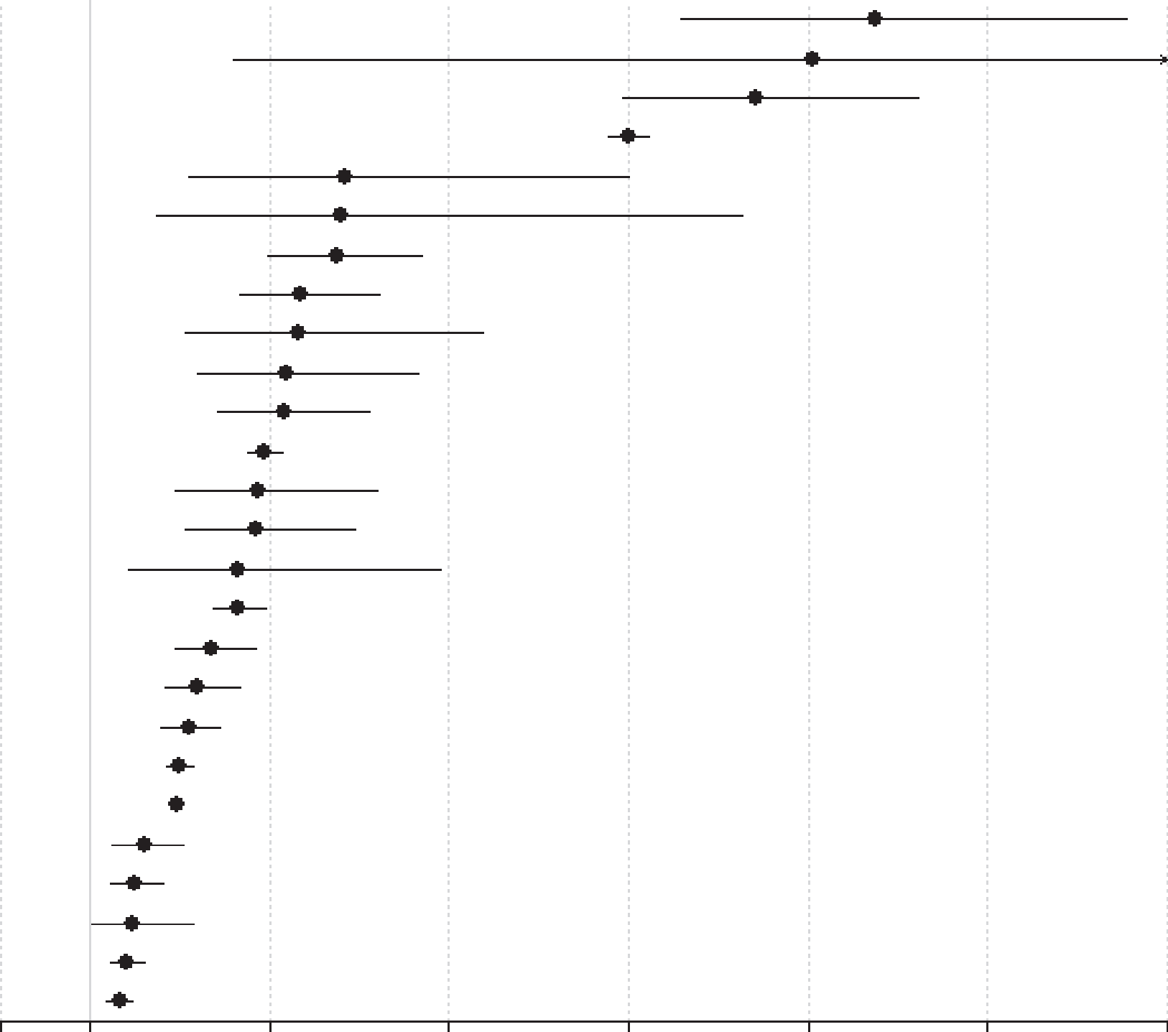
Physical health outcomes in schizophrenia
Schizophrenia – Course, natural history, and prognosis
People with schizophrenia face increased mortality risk from suicide and from multiple physical health conditions
All-cause and cause-specific mortality risk in schizophrenia versus the general population^{2a}
Patients with schizophrenia experience increased burden of physical multimorbidity compared with the general population, and are four times more likely to have at least two physical conditions¹
This excess is often evident at younger ages and highlights the need for early, integrated prevention and care¹
Outcome
Suicide (n=28)
Injury-poisoning (n=2) Undetermined non-natural (n=14)
Infectious-pneumonia (n=3)
Infectious-any (n=10)
Endocrine (n=9)
Respiratory-any (n=15)
Injury-accidents (n=9)
Urogenital-any (n=9)
Risk ratio (95% CI)
9.76 (7.60, 12.55)
9.06 (2.60, 31.50)
8.42 (6.94, 10.20)
7.00 (6.79, 7.23)
3.84 (2.10, 7.01)
3.80 (1.75, 8.26)
3.75 (2.99, 4.70)
3.35 (2.66, 4.22)
3.33 (2.06, 5.37)
Other not specified (n=7)
Diabetes (n=5)
All-cause (n=57)
Alcohol (n=2)
Gastrointestinal (n=12)
Urogenital-renal failure (n=2)
Natural (study-defined) (n=21)
3.19 (2.19, 4.64)
3.16 (2.42, 4.12)
2.94 (2.75, 3.13)
2.86 (1.95, 4.21)
2.86 (2.07, 3.95)
2.65 (1.43, 4.90)
2.65 (2.38, 2.95)
Nervous-any (n=8)
Cardiovascular (n=19)
Cardio-cerebrovascular (n=28)
Natural (n=59)
Liver (n=2)
Cerebrovascular (n=13)
Cancer-breast (n=2)
Cancer-colon (n=3)
Cancer-pancreas (n=2)
Cancer-any (n=25)
2.35 (1.94, 2.84)
2.21 (1.82, 2.67)
2.10 (1.80, 2.45)
2.00 (1.85, 2.15)
1.96 (1.90, 2.03)
1.60 (1.25, 2.04)
1.49 (1.22, 1.82)
1.48 (1.01, 2.16)
1.40 (1.21, 1.62)
1.33 (1.19, 1.48)
0
1
3
5
7
9
11
13
Risk ratio (95% CI)
ªIncident plus prevalent schizophrenia
CI=confidence interval
1. Stubbs et al. BMC Med 2016;14:189; 2. Correll et al. World Psychiatry 2022;21:248–271
This work is from ‘Mortality in people with schizophrenia: a systematic review and meta-analysis of relative risk and aggravating or attenuating factors’ by Correll et al. World Psychiatry 2022. Reproduced with permission from the authors; copyright © 2022 World Psychiatric Association.
Notes:
References:
Stubbs Koyanagi AI, Veronese N, et al. Physical multimorbidity and psychosis: comprehensive cross sectional analysis including 242,952 people across 48 low- and middle-income countries. BMC Med 2016; 14: 189.
Correll CU, Solmi M, Croatto G, et al. Mortality in people with schizophrenia: a systematic review and meta-analysis of relative risk and aggravating or attenuating factors. World Psychiatry 2022; 21: 248–271.

Slide 41
Modifiers and special topics in schizophrenia

Slide 42
Sex differences in course and prognosis
Schizophrenia – Course, natural history, and prognosis
 | Men | Women
Symptom profile at first episode¹ | More negative symptoms; poorer functioning | Less severe and better course of negative symptoms
Age at onset¹ | Earlier onset | Later onset
Early and mid‑life outcomes¹ | More heterogeneous and vulnerable trajectories | Better functional outcomes in early to mid‑life; advantage decreases after menopause
Premorbid functioning and early response^{1,2} | Predict outcomes; greater variability in trajectories | Predict outcomes; generally more favourable profiles
Hormonal influences³ | Not applicable | Pregnancy, postpartum, and perimenopause affect symptoms and relapse risk
Outcome pattern over 10 years¹ | Worse negative‑symptom course; other outcomes similar to women | Outcomes similar to men after ~10 years
Mortality risk⁴ | Higher all‑cause mortality; greater life‑years lost | Lower all‑cause mortality (hazard ratio ≈ 0.62)
Drivers of mortality⁴ | Higher impact of non‑use of antipsychotics, cardiovascular comorbidity, substance use | Lower relative risk, but still substantial premature mortality
Treatment effects on mortality⁴ | Benefits and risks of treatments similar to women | Similar treatment effect directions and magnitudes to men
1. Ayesa-Arriola et al. NPJ Schizophr 2020;6:33; 2. Grossman et al. Compr Psychiatry 2008;49:523–529; 3. Almeida et al. Curr Opin Psychiatry 2025;38:169–176;
4. Correll et al. Schizophr Res 2022;250:67–75
Notes:
References:
Ayesa-Arriola R, Ortíz-García de la Foz V, Setién-Suero E, et al. Understanding sex differences in long-term outcomes after a first episode of psychosis. NPJ Schizophr 2020; 6: 33.
Grossman L, Harrow M, Rosen C, et al. Sex differences in schizophrenia and other psychotic disorders: a 20-year longitudinal study of psychosis and recovery. Compr Psychiatry 2008; 49: 523–529.
Almeida M, Fletcher S, Granoff M. Schizophrenia in women: a review of unique aspects regarding course, management, and challenges across the lifespan. Curr Opin Psychiatry 2025; 38: 169–176.
Correll Bitter I, Hoti F, et al. Factors and their weight in reducing life expectancy in schizophrenia. Schizophr Res 2022; 250: 67–75.

Slide 43
Summary slide
Schizophrenia – Course, natural history, and prognosis
Schizophrenia is a highly heterogeneous disorder, with marked variability in onset, symptom profiles, and long‑term outcomes
The clinical course is typically episodic, with periods of relapse and remission, rather than uniformly progressive
The early phase (first 2–5 years) represents a critical period when early symptom change strongly influences long‑term outcomes, highlighting the importance of early intervention
Duration of untreated psychosis and early treatment response are key modifiable predictors of prognosis
Long‑term trajectories are diverse and non‑linear, ranging from remission or recovery to persistent symptoms and disability
Early, sustained, and individualized care can improve long‑term outcomes, but excess morbidity and mortality remain substantial

