Slide 1
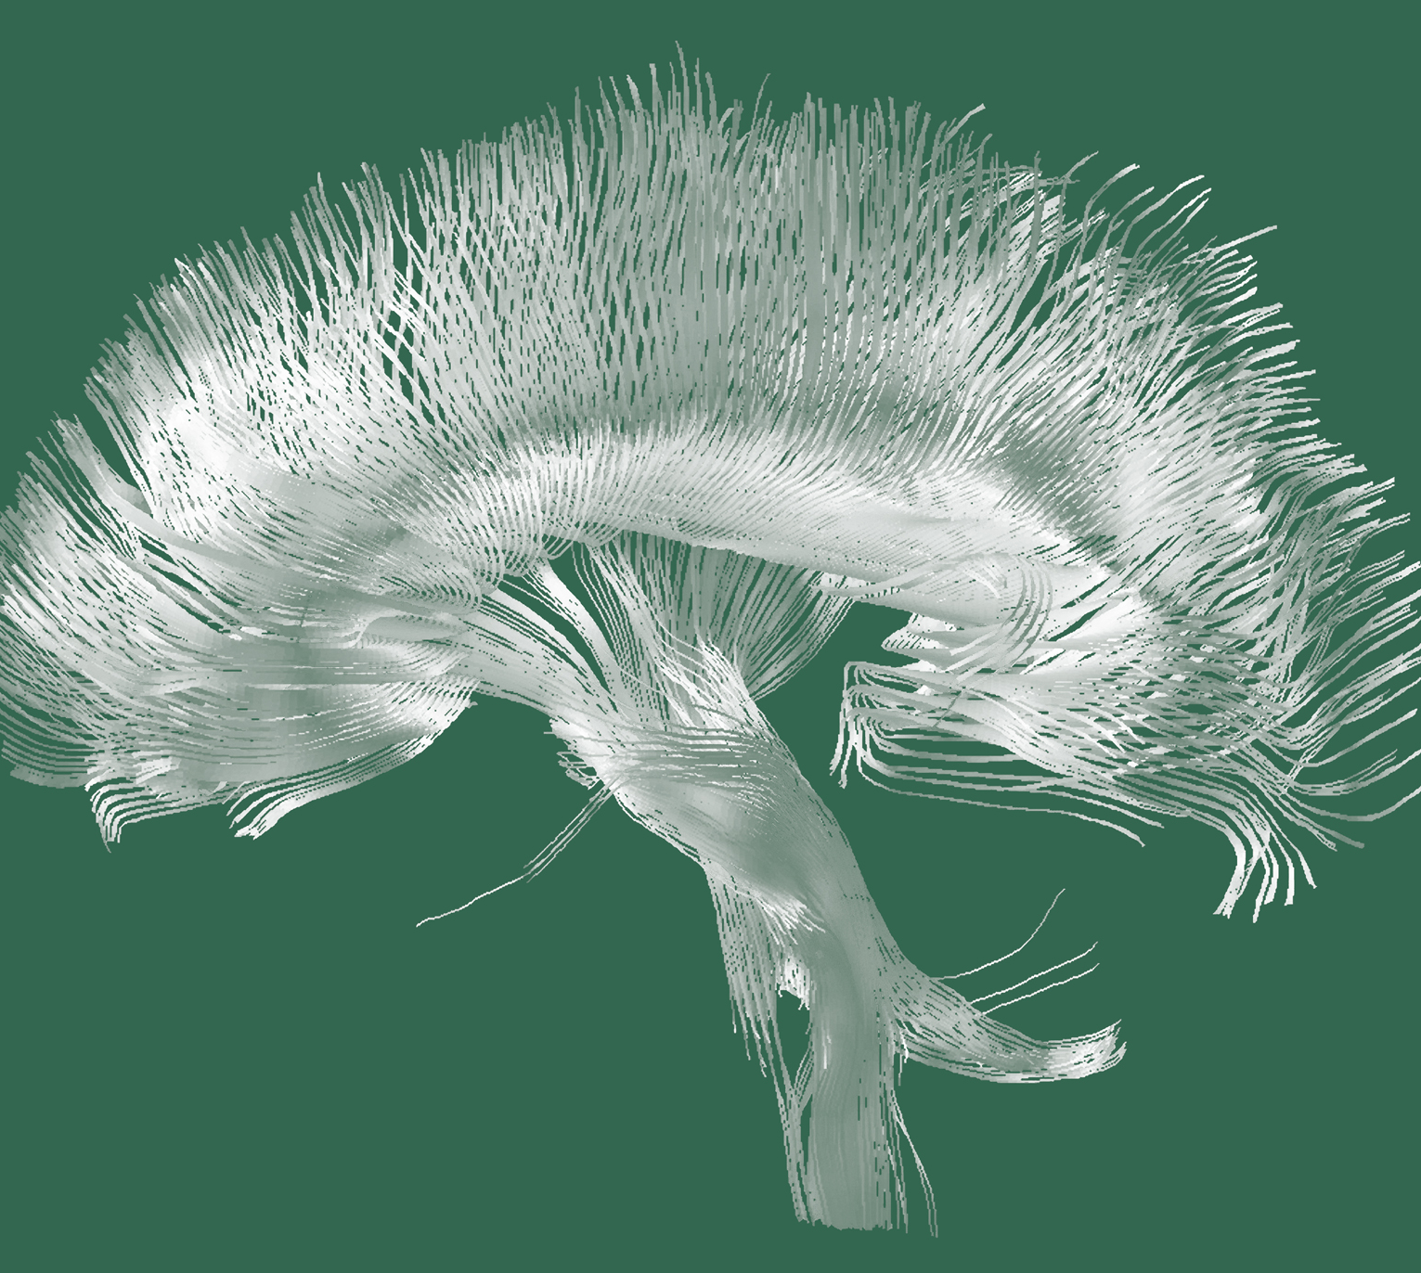
Schizophrenia
Epidemiology and burden

Slide 2
Global epidemiology of schizophrenia

Slide 3
Global prevalence and incidence of schizophrenia
Schizophrenia – Epidemiology and burden
Global estimates of prevalence, incidence, and overall disease burden for schizophrenia are largely derived from the Global Burden of Diseases, Injuries, and Risk Factors Study, which provides the most comprehensive and detailed global epidemiological dataset available^{1–3}
Schizophrenia incidence and prevalence in 2019 and 2021
 | GBD 2019^{1,2} | GBD 2021³
Incidence, count | 1.3 million | 1.2 million
ASIR, per 100,000 cases (95% UI) | 16.31 (13.8, 19.4) | 15.4 (12.7, 18.6)
Prevalence, count | 23.6 million | 23.2 million
ASPR, per 100,000 cases (95% UI) | 287.4 (246.2, 330.9) | 277.7 (229.8, 329.1)
The peak age of schizophrenia-spectrum disorder onset is 20.5 years, with a median (IQR) age of 25 (20–34) years⁴
In over half of cases, the first symptoms of schizophrenia present before the age of 25 years⁴:
  Before 14 years: 7.2%
  Before 18 years:18.0%
  Before 25 years: 54.8%
ASPR=age-standardized prevalence rate; ASIR=age-standardized incidence rate; GBD=Global Burden of Diseases; IQR=interquartile range; UI=uncertainty interval
1. GBD 2019 Mental Disorders Collaborators. Lancet Psychiatry 2022;9:137–150; 2. Solmi et al. Mol Psychiatry 2023;28:5319–5327; 3. GBD 2021 Diseases and Injuries Collaborators. Lancet 2024;403:2133–2161; 4. Solmi et al. Mol Psychiatry 2022;27:281–295
Notes:
The GBD study has quantified the burden of 371 diseases, including schizophrenia, across 204 countries and territories, using metrics such as ‘years lived with a disability’, ‘disability-adjusted life-years’, ‘years of life lost to premature mortality’, and ‘healthy life expectancy’, alongside prevalence and incidence.^{1,3}
GBD estimates are partially based on incomplete data and statistical modelling, so they must be interpreted with caution; however, it remains the most comprehensive source available, providing useful insights.^{1,3}
Abbreviation: GBD=Global Burden of Diseases
References:
GBD 2019 Mental Disorders Collaborators. Global, regional, and national burden of 12 mental disorders in 204 countries and territories, 1990-2019: a systematic analysis for the Global Burden of Disease Study 2019. Lancet Psychiatry 2022; 9: 137–150.
Solmi M, Seitidis G, Mavridis D, et al. Incidence, prevalence, and global burden of schizophrenia - data, with critical appraisal, from the Global Burden of Disease (GBD) 2019. Mol Psychiatry 2023; 28: 5319–5327.
GBD 2021 Diseases and Injuries Collaborators. Global incidence, prevalence, years lived with disability (YLDs), disability-adjusted life-years (DALYs), and healthy life expectancy (HALE) for 371 diseases and injuries in 204 countries and territories and 811 subnational locations, 1990-2021: a systematic analysis for the Global Burden of Disease Study 2021. Lancet 2024; 403: 2133–2161.
Solmi M, Radua J, Olivola M, et al. Age at onset of mental disorders worldwide: large-scale meta-analysis of 192 epidemiological studies. Mol Psychiatry 2022; 27 (1): 281–295.

Slide 4
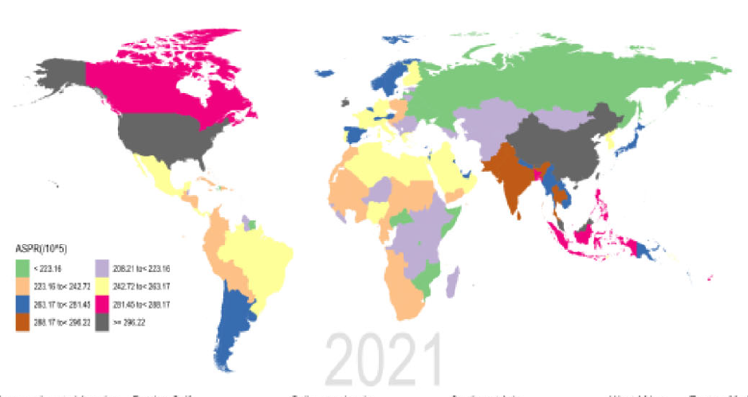
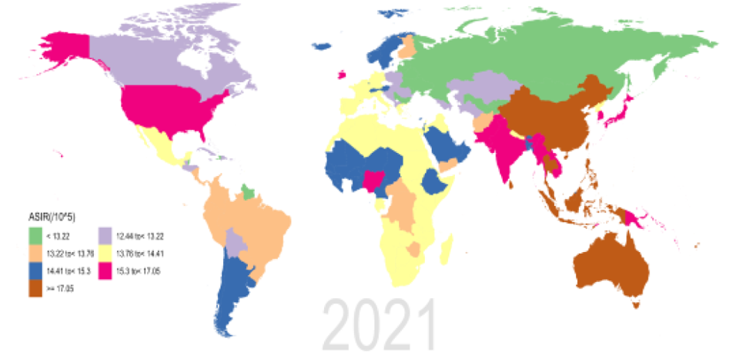
Prevalence and incidence of schizophrenia by region
Schizophrenia – Epidemiology and burden
ASPR for schizophrenia per 100,000 persons,
by region between 1990 and 2021
ASIR for schizophrenia per 100,000 persons,
by region between 1990 and 2021
ASPR
(per 100,000)
ASIR
(per 100,000)
208.21 to <223.16
12.44 to <13.22
<223.16
223.16 to <242.72
<13.22
242.72 to <263.17
13.22 to <13.75
263.17 to <261.45
13.76 to <14.41
261.45 to <288.17
14.41 to <15.30
288.17 to <296.22
15.30 to <17.05
≥296.22
≥17.05
This work is adapted from ‘Results of the global burden of disease study for schizophrenia: trends from 1990 to 2021 and projections to 2050’ by Zhan et al., used under CC-BY-4.0. This work is licensed under Creative Commons license CC-BY-SA by The Lundbeck Foundation.
Schizophrenia is associated with different prevalence and incidence rates across regions
ASIR=age-standardized incidence rate; ASPR=age-standardized prevalence rate
Zhan et al. Front Psychiatry 2025;16:1629032
Notes:
To describe the burden of schizophrenia regionally, the GBD study has grouped 204 countries into 21 GBD regions according to socioeconomic similarity and geographical proximity.²
Regions with the highest ASIRs include Australasia (20.2 per 100,000) and East Asia (18.3 per 100,000).¹ Regions with the lowest ASIRs include Eastern Europe (11.7 per 100,000), followed by the Caribbean (12.4 per 100,000) and Central Asia (12.43 per 100,000).¹ Regions with the highest ASPRs include Australasia (387.1 per 100,000), followed by North America (347.7 per 100,000) and East Asia (311.4 per 100,000).¹ Regions with the lowest ASPRs include Eastern Europe (205.8 per 100,000), followed by the Central Sub-Saharan Africa (212.7 per 100,000) and Central Asia (215.6 per 100,000).¹
The observed differences across regions are hypothesized to be a result of differences in data quality. The high ASPRs reported in high-income countries likely reflect better mental health data systems, where health systems routinely collect and store epidemiologic data on mental health, while low-income countries might still be developing sustainable systematic data collection infrastructure, rather than reflecting a true higher schizophrenia risk in high-income countries.³
Abbreviations: ASIR=age-standardized incidence rate; ASPR=age-standardized prevalence rate; GBD=Global Burden of Diseases
References:
Zhan Z, Wang J, Shen T, et al. Results of the global burden of disease study for schizophrenia: trends from 1990 to 2021 and projections to 2050. Front Psychiatry 2025; 16: 1629032.
Li X, Wei N, Song J, et al. The global burden of schizophrenia and the impact of urbanization during 1990-2019: an analysis of the global burden of disease study 2019. Environ Res 2023; 232:116305.
Solmi M, Seitidis G, Mavridis D, et al. Incidence, prevalence, and global burden of schizophrenia - data, with critical appraisal, from the Global Burden of Disease (GBD) 2019. Mol Psychiatry 2023; 28: 5319–5327.

Slide 5
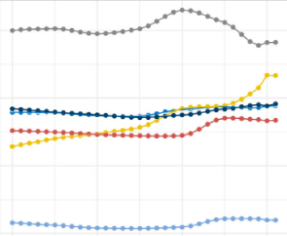
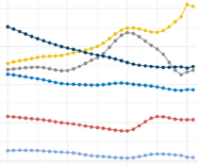
Prevalence and incidence of schizophrenia over time and by sociodemographic index
Schizophrenia – Epidemiology and burden
ASPR for schizophrenia from 1990 to 2021, globally and in the five SDI regions
ASIR for schizophrenia from 1990 to 2021, globally and in the five SDI regions
Globally, the ASIR of schizophrenia has declined between 1990 and 2021, while ASPR increased slightly
Consistently lower prevalence and incidence rates are reported in lower SDI quintiles, likely reflecting differences in mental health care structures
16.5
300
16.0
280
ASPR per 100,000
ASIR per 100,000
15.5
260
15.0
240
14.5
1990
2000
2010
2020
1990
2000
2010
2020
Year
Year
Global
High-middle SDI
High SDI
Low-middle SDI
Low SDI
Middle SDI
This work is adapted from ‘Results of the global burden of disease study for schizophrenia: trends from 1990 to 2021 and projections to 2050’ by Zhan et al., used under CC-BY-4.0. This work is licensed under Creative Commons license CC-BY-SA by The Lundbeck Foundation.
The SDI is a composite measure that incorporates the total fertility rate, the average educational attainment of individuals aged 15 years and older, and the per capita income ranking; it indicates a nation’s overall social development, with values ranging from zero to one, and is classified as low, low-middle, medium, medium-high, and high
ASPR=age-standardized prevalence rate; ASIR=age-standardized incidence rate; SDI=sociodemographic index
Zhan et al. Front Psychiatry 2025;16:1629032
Notes:
Reference:
Zhan Z, Wang J, Shen T, et al. Results of the global burden of disease study for schizophrenia: trends from 1990 to 2021 and projections to 2050. Front Psychiatry 2025; 16: 1629032.

Slide 6
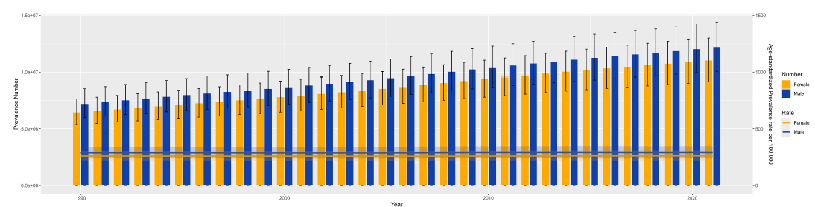
Prevalence and incidence of schizophrenia by sex
Schizophrenia – Epidemiology and burden
The GBD 2021 analysis showed a higher prevalence of schizophrenia in males¹
  Male ASPR:
  291.6 per 100,000
  (95% UI: 241.6, 345.0)
  Female ASPR:
  263.6 per 100,000
  (95% UI: 217.7, 311.9)
  A similar pattern is observed with incidence¹
Various GBD analyses show mostly similar sex patterns across countries and SDI regions^{2–4}
Global trends in schizophrenia prevalence by sex (1990–2021)⁴
1.5x10⁷
1,500
Number
Rate
Female
Female
Male
Male
1.0x10⁷
1,000
Prevalence number
ASPR per 100,0000
5.0x10⁶
500
0
0
1990
2000
2010
2020
Year
This work is adapted from ‘Results of the global burden of disease study for schizophrenia: trends from 1990 to 2021 and projections to 2050’ by Zhan et al., used under CC-BY-4.0. This work is licensed under Creative Commons license CC-BY-SA by The Lundbeck Foundation.
The male-to-female prevalence ratio has remained stable over the past three decades, with a consistently higher global risk of schizophrenia observed in males^{2,5}
ASPR=age-standardized prevalence rates; GBD=Global Burden of Disease; SDI=sociodemographic index; UI=uncertainty interval
1. GBD 2021 Diseases and Injuries Collaborators. Lancet 2024;403:2133–2161; 2. Peng et al. Front Psychiatry 2025;16:1682955; 3. Liao et al. BMC Psychiatry 2025;25:1101;
4. Zhan et al. Front Psychiatry 2025;16:1629032; 5. Solmi et al. Mol Psychiatry 2023;28:5319–5327
Notes:
GBD data for 2021 reported 659,000 (95% UI: 545,000, 791,000) incident cases of schizophrenia in males and 564,000 (95% UI: 464,000, 681,000) in females; this translated into an ASIR of 16.4 per 100,000 (95% UI: 13.6, 19.7) for males and 14.4 per 100,000 (95% UI: 11.8, 17.4), for females.¹
A GBD 2021 analysis revealed that the estimated annual percentage change in schizophrenia prevalence rates varied across SDI regions. In high SDI regions, the increasing trend of schizophrenia was higher in females than males, while in high-middle SDI regions, higher increasing trends were observed in males than females.⁴
Abbreviations: ASIR=age-standardized incidence rate; GBD=Global Burden of Diseases; SDI=sociodemographic index; UI=uncertainty interval
References:
GBD 2021 Diseases and Injuries Collaborators. Global incidence, prevalence, years lived with disability (YLDs), disability-adjusted life-years (DALYs), and healthy life expectancy (HALE) for 371 diseases and injuries in 204 countries and territories and 811 subnational locations, 1990-2021: a systematic analysis for the Global Burden of Disease Study 2021. Lancet 2024; 403: 2133–2161.
Peng B, Hu F, He Q, et al. Global, regional, and national burden and trends of schizophrenia among adolescents and young adults aged 15-39 years from 1990 to 2021: an analysis of the global burden of disease study 2021. Front Psychiatry 2025; 16: 1682955.
Liao W, Chen Z, Wu W, et al. Trends and future burden of schizophrenia in youth across G20 countries: a systematic analysis of the global burden of disease 2021 study. BMC Psychiatry 2025; 25: 1101.
Zhan Z, Wang J, Shen T, et al. Results of the global burden of disease study for schizophrenia: trends from 1990 to 2021 and projections to 2050. Front Psychiatry 2025; 16: 1629032.
Solmi M, Seitidis G, Mavridis D, et al. Incidence, prevalence, and global burden of schizophrenia - data, with critical appraisal, from the Global Burden of Disease (GBD) 2019. Mol Psychiatry 2023; 28: 5319–5327.

Slide 7
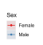
Prevalence and incidence of schizophrenia by age
Schizophrenia – Epidemiology and burden
Schizophrenia and other psychotic disorders typically emerge in early adulthood¹
Prevalence of schizophrenia,
by age and sex (1990–2021)²
Incidence of schizophrenia,
by age and sex (1990–2021)²
Sex
Female
600
60
Male
400
40
Rate of prevalence
Rate of incidence
200
20
0
0
<5
5–9
10–14
15–19
20–24
25–29
30–34
35–39
40–44
45–49
50–54
55–59
60–64
65–69
70–74
75–79
80–84
85–89
90–94
95+
<5
5–9
10–14
15–19
20–24
25–29
30–34
35–39
40–44
45–49
50–54
55–59
60–64
65–69
70–74
75–79
80–84
85–89
90–94
95+
Age
Age
This work is adapted from ‘Results of the global burden of disease study for schizophrenia: trends from 1990 to 2021 and projections to 2050’, by Zhan et al., used under CC-BY-4.0. This work is licensed under Creative Commons license CC-BY-SA by The Lundbeck Foundation.
The incidence of schizophrenia is highest among individuals aged 20–24 years,
while prevalence peaks in those aged 35–39 years²
ASIR=age-standardized incidence rate; ASPR=age-standardized prevalence rate
1. Solmi et al. Mol Psychiatry 2022;27:281–295; 2. Zhan et al. Front Psychiatry 2025;16:1629032
Notes:
A GBD 2021 analysis among young people (aged 10–24 years) across the G20 countries revealed schizophrenia incidence was generally higher in males, although prevalence showed more variable sex differences across countries.³
In an analysis of people aged 15–39 years, the GBD 2021 study reported higher ASPR estimates in males: 384.6 per 100,000 males (95% UI: 295.4, 483.1) and 344.0 (95% UI: 264.1, 434.0) per 100,000 females, with prevalence consistently ~1.2-fold higher in males than in females.⁴
The male-to-female ratio for schizophrenia prevalence inverts from more males in younger age groups to more females in older age groups, reflecting earlier age at onset in males and longer life expectancy in females.⁵
Abbreviations: ASPR=age-standardized prevalence rate; G20=Group of 20; GBD=Global Burden of Diseases; UI=uncertainty interval
References:
Solmi M, Radua J, Olivola M. et al. Age at onset of mental disorders worldwide: large-scale meta-analysis of 192 epidemiological studies. Mol Psychiatry 2022; 27: 281–295.
Zhan Z, Wang J, Shen T, et al. Results of the global burden of disease study for schizophrenia: trends from 1990 to 2021 and projections to 2050. Front Psychiatry 2025; 16: 1629032.
Liao W, Chen Z, Wu W, et al. Trends and future burden of schizophrenia in youth across G20 countries: a systematic analysis of the global burden of disease 2021 study. BMC Psychiatry 2025; 25: 1101.
Peng B, Hu F, He Q, et al. Global, regional, and national burden and trends of schizophrenia among adolescents and young adults aged 15-39 years from 1990 to 2021: an analysis of the global burden of disease study 2021. Front Psychiatry 2025; 16: 1682955.
Solmi M, Seitidis G, Mavridis D, et al. Incidence, prevalence, and global burden of schizophrenia - data, with critical appraisal, from the Global Burden of Disease (GBD) 2019. Mol Psychiatry 2023; 28: 5319–5327.

Slide 8
Global burden of schizophrenia

Slide 9
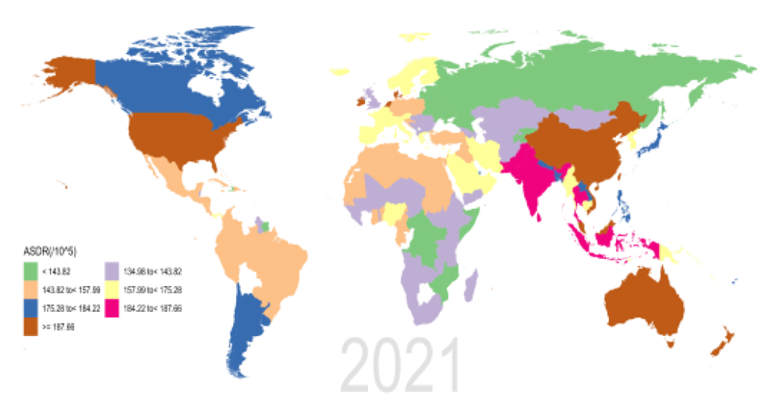
Global burden of disability due to schizophrenia
Schizophrenia – Epidemiology and burden
Schizophrenia is ranked among the top 20 mental disorders resulting in disability globally¹
  This burden is attributed to early onset in late adolescence/early adulthood, with low remission rates, which leads to a cumulative burden^{2–4}
ASDRs for schizophrenia per 100,000 persons,
by region in 2021⁵
DALYs due to schizophrenia in 2019 and 2021
 | GBD 2019² | GBD 2021⁵
DALYs, count | 15.1 million | 14.8 million
ASDR, per 100,000 cases (95% UI) | 184.15 (134.32, 234.54) | 177.8 (131.5, 228.8)
ASDR
(per 100,000)
134.96 to <143.82
<143.82
143.82 to <157.99
157.99 to <175.28
175.28 to <184.22
184.22 to <187.66
≥187.66
This work is adapted from ‘Results of the global burden of disease study for schizophrenia: trends from 1990 to 2021 and projections to 2050’ by Zhan et al., used under CC-BY-4.0. This work is licensed under Creative Commons license CC-BY-SA by The Lundbeck Foundation.
ASDR=age-standardized disability rate; DALY=disability-adjusted life year; GBD=Global Burden of Disease; UI=uncertainly interval
1. GBD 2019 Mental Disorders Collaborators. Lancet Psychiatry 2022;9:137–150; 2. Solmi et al. Mol Psychiatry 2023;28:5319–5327; 3. Weye et al. Lancet Psychiatry 2021;8:310–319;
4. Peng et al. Front Psychiatry 2025;16:1682955; 5. Zhan et al Front Psychiatry 2025;16:1629032
Notes:
In the GBD study, each death can only be assigned one cause. Schizophrenia is not listed as a cause of death; deaths in people with schizophrenia are recorded due to causes such as suicide or other physical illness. Consequently, the GBD study assigns zero deaths to schizophrenia, so zero years of life are lost. This means that DALYs due to schizophrenia (total burden) may be underestimated because DALYs = years of life lost (YLL; burden related to death) + years living with a disability (YLD; non-fatal burden). One DALY equals loss of one healthy year of life.²
Abbreviations: DALY=disability-adjusted life year; GBD=Global Burden of Disease; YLD=years lived with a disability; YLL=years of life lost
References:
GBD 2019 Mental Disorders Collaborators. Global, regional, and national burden of 12 mental disorders in 204 countries and territories, 1990-2019: a systematic analysis for the Global Burden of Disease Study 2019. Lancet Psychiatry 2022; 9: 137–150.
Solmi M, Seitidis G, Mavridis D, et al. Incidence, prevalence, and global burden of schizophrenia - data, with critical appraisal, from the Global Burden of Disease (GBD) 2019. Mol Psychiatry 2023; 28: 5319–5327.
Weye N, Santomauro DF, Agerbo E, et al. Register-based metrics of years lived with disability associated with mental and substance use disorders: a register-based cohort study in Denmark. Lancet Psychiatry 2021; 8: 310–319.
Peng B, Hu F, He Q, et al. Global, regional, and national burden and trends of schizophrenia among adolescents and young adults aged 15-39 years from 1990 to 2021: an analysis of the global burden of disease study 2021. Front Psychiatry 2025; 16: 1682955.
Zhan Z, Wang J, Shen T, et al. Results of the global burden of disease study for schizophrenia: trends from 1990 to 2021 and projections to 2050. Front Psychiatry 2025; 16: 1629032.

Slide 10
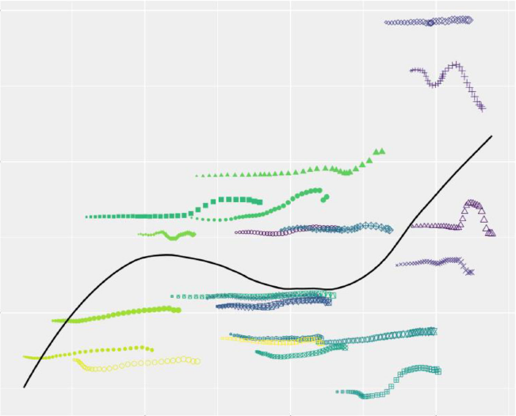
Schizophrenia burden by region
Schizophrenia – Epidemiology and burden
ASDR (95% UI) for schizophrenia per 100,000 people,
by SDI region in 2019 and 2021
ASDR and SDI for schizophrenia across 22 GBD regions (1990–2021)²
SDI regions | GBD 2019¹ | GBD 2021²
High | 213.4 (155.5, 271.9) | 188.6 (140.8, 241.8)
High-middle | 194.5 (142.6, 244.5) | 185.4 (138.4, 233.1)
Middle | 182.4 (133.4, 232.5) | 179.0 (132.6, 229.9)
Low-middle | 174.3 (125.2, 222.2) | 173.7 (128.0, 227.8)
Low | 150.6 (108.1 193.9) | 154.5 (112.4, 202.6)
Location
250
Global
High-income Asia Pacific
High-income North America
Western Europe
Australasia
Andean Latin America
Tropical Latin America
Central Latin America
200
Southern Latin America
Caribbean
Central Europe
ASDR per 100,000
Eastern Europe
Central Asia
North Africa and Middle East
South Asia
Southeast Asia
150
East Asia
Oceania
Western Sub-Saharan Africa
Eastern Sub-Saharan Africa
Central Sub-Saharan Africa
Year
Southern Sub-Saharan Africa
0.4
0.6
0.8
1990
2010
SDI
1995
2015
2000
2020
2005
There is a positive correlation between ASDR for schizophrenia and SDI,
with the highest ASDR rates reported in high SDI countries^{1,3}
ASDR=age-standardized disability rate; DALY=disability-adjusted life year; GBD=Global Burden of Disease; SDI=sociodemographic index; UI=uncertainly interval
1. Solmi et al. Mol Psychiatry 2023;28:5319–5327; 2. Zhan et al Front Psychiatry 2025;16:1629032; 3. Li et al. Environ Res 2023;232:116305
This work is adapted from ‘Results of the global burden of disease study for schizophrenia: trends from 1990 to 2021 and projections to 2050’
by Zhan et al., used under CC-BY-4.0. This work is licensed under
Creative Commons license CC-BY-SA by The Lundbeck Foundation.
Notes:
References:
Solmi M, Seitidis G, Mavridis D, et al. Incidence, prevalence, and global burden of schizophrenia - data, with critical appraisal, from the Global Burden of Disease (GBD) 2019. Mol Psychiatry 2023; 28: 5319–5327.
Zhan Z, Wang J, Shen T, et al. Results of the global burden of disease study for schizophrenia: trends from 1990 to 2021 and projections to 2050. Front Psychiatry 2025; 16: 1629032.
Li X, Wei N, Song J, et al. The global burden of schizophrenia and the impact of urbanization during 1990-2019: an analysis of the global burden of disease study 2019. Environ Res 2023; 232:116305.

Slide 11

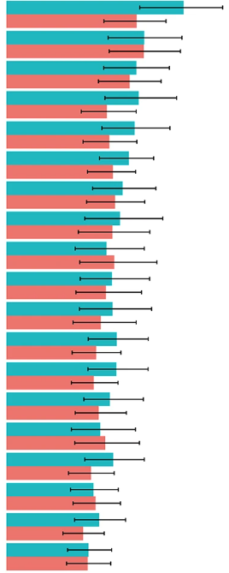
Schizophrenia burden by sex
Schizophrenia – Epidemiology and burden
Consistently higher ASDRs have been observed for males with schizophrenia than for females
across age groups and regions^{1–3}
Global DALYS for schizophrenia,
by sex and age group in 2019^{a,4}
Sex-stratified ASDR for schizophrenia among youth populations (aged 10–24 years), in G20 countries in 2021¹
Age (years)
≥95
90–94
85–89
80–84
75–79
70–74
65–69
60–64
55–59
50–54
45–49
40–44
35–39
30–34
25–29
20–24
15–19
10–14
Australia
United States of America
China
India
Indonesia
Canada
Japan
Argentina
Republic of Korea
France
Saudi Arabia
Italy
Mexico
Turkey
Germany
Brazil
South Africa
United Kingdom
Russian Federation
Male
Males
Females
Female
2
1
0
1
2
DALYs (millions)
This work is adapted from ‘Global, regional, and national burden of 12 mental disorders in 204 countries and territories, 1990-2019: a systematic analysis for the Global Burden of Disease Study 2019’ by GBD 2019 Mental Disorders Collaborators, used under CC-BY-4.0. This work is licensed under Creative Commons license CC-BY-SA by The Lundbeck Foundation.
0
100
200
300
Age-standardized DALYs
(per 100,000 person-years)
ªSince the GBD 2019 estimate of YLL is zero in schizophrenia, YLD and DALY values were identical in the analysis
ASDR=age-standardized disability rate; CI=confidence interval; DALY=disability-adjusted life year; G20=Group of 20;
GBD=Global Burden of Diseases; YLD=years lived with disability; YLL=years of life lost; UI=uncertainty interval
1.Liao et al. BMC Psychiatry 2025;25:1101; 2. Solmi et al. Mol Psychiatry 2023;28:5319–5327; 3. Peng et al. Front Psychiatry 2025;16:1682955; 4. GBD 2019 Mental Disorders Collaborators. Lancet Psychiatry 2022;9:137–150
Notes:
Similar to 2019 estimates, the GBD study reported higher ASDRs for males (189.0 per 100,000 [95% UI: 139.9, 243.7]) with schizophrenia than females (166.4 per 100,000 [95% UI: 122.8, 213.9]) in 2021, suggesting consistent temporal trends.⁵
A GBD analysis of 2021 data for individuals aged 15–39 years showed an ASDR of 255.52 per 100,000 (95% UI: 180.97, 345.67) for males with schizophrenia versus 222.77 per 100,000 (157.48, 301.86) for females.³
Abbreviations: ASDR=age-standardized disability rate; GBD=Global Burden of Diseases; UI=uncertainty interval
References:
Liao W, Chen Z, Wu W, et al. Trends and future burden of schizophrenia in youth across G20 countries: a systematic analysis of the global burden of disease 2021 study. BMC Psychiatry 2025; 25: 1101.
Solmi M, Seitidis G, Mavridis D, et al. Incidence, prevalence, and global burden of schizophrenia - data, with critical appraisal, from the Global Burden of Disease (GBD) 2019. Mol Psychiatry 2023; 28: 5319–5327.
Peng B, Hu F, He Q, et al. Global, regional, and national burden and trends of schizophrenia among adolescents and young adults aged 15-39 years from 1990 to 2021: an analysis of the global burden of disease study 2021. Front Psychiatry 2025; 16: 1682955.
GBD 2019 Mental Disorders Collaborators. Global, regional, and national burden of 12 mental disorders in 204 countries and territories, 1990-2019: a systematic analysis for the Global Burden of Disease Study 2019. Lancet Psychiatry 2022; 9: 137–150.
Zhan Z, Wang J, Shen T, et al. Results of the global burden of disease study for schizophrenia: trends from 1990 to 2021 and projections to 2050. Front Psychiatry 2025; 16: 1629032.

Slide 12
Age patterns in the disability burden of schizophrenia
Schizophrenia – Epidemiology and burden
DALYs and YLD due to schizophrenia increase rapidly after age 15–19 years in both sexes, peaking at around 30–39 years but remaining high throughout lifetime^{1–3}
Danish registry data show that YLD due to schizophrenia remain consistently high throughout adulthood in both sexes²
  Among mental and substance use disorders, schizophrenia was the leading cause of YLD, accounting for 42% of all YLD in males and
  30% in females²
The rapid rise in schizophrenia burden during early adulthood, which persists over lifetime has consistently been observed over time³
Age- and sex-specific YLD rates for schizophrenia in Denmark (2000–2015)²
800
Females
Males
600
Rate of years lived with disability
(per 100,000 person-year)
400
200
0
0–4
5–9
≥75
0–4
5–9
≥75
10–14
15–19
20–24
25–29
30–34
35–39
40–44
45–49
50–54
55–59
60–64
65–69
70–74
10–14
15–19
20–24
25–29
30–34
35–39
40–44
45–49
50–54
55–59
60–64
65–69
70–74
Age group (years)
Age group (years)
DALY=disability-adjusted life year; GBD=Global Burden of Disease; YLD=years lived with disability
1. GBD 2019 Mental Disorders Collaborators. Lancet Psychiatry 2022;9:137–150; 2. Weye et al. Lancet Psychiatry 2021;8:310–319;
3. Institute for Health Metrics and Evaluation 2025 https://vizhub.healthdata.org/gbd-compare
This work is adapted from ‘Register-based metrics of years lived with disability associated with mental and substance use disorders: a register-based cohort study in Denmark’ by Weye et al., used under CC-BY-4.0. This work is licensed under Creative Commons license CC-BY-SA by The Lundbeck Foundation.
Notes:
A Danish study of over 6.9 million residents aimed to calculate YLD for 18 mental and substance use disorders.² Schizophrenia was associated with 225.0 (95% CI: 190.0, 258.0) YLD per 100,000 person-years in females and 322.6 (274.1, 370.7) YLD per 100,000 person-years in males.² When analyzed by subgroup (i.e., individuals with a specific mental or substance use disorder), schizophrenia was associated with the highest estimated YLD, at 65,872 (55,791–75,533) per 100,000 person-years across both sexes.²
Abbreviations: CI=confidence interval; YLD=years lived with disability
References:
GBD 2019 Mental Disorders Collaborators. Global, regional, and national burden of 12 mental disorders in 204 countries and territories, 1990-2019: a systematic analysis for the Global Burden of Disease Study 2019. Lancet Psychiatry 2022; 9: 137–150.
Weye N, Santomauro DF, Agerbo E, et al. Register-based metrics of years lived with disability associated with mental and substance use disorders: a register-based cohort study in Denmark. Lancet Psychiatry 2021; 8: 310–319.
Institute for Health Metrics and Evaluation (IHME). GBD Compare Data Visualization. Seattle, WA: IHME, University of Washington, 2025. Available from https://vizhub.healthdata.org/gbd-compare.

Slide 13
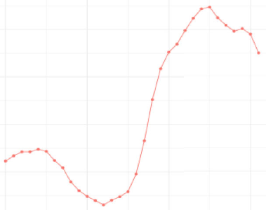
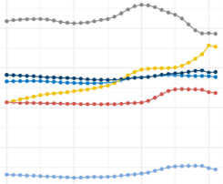
Disability burden due to schizophrenia over time and by SDI
Schizophrenia – Epidemiology and burden
Global ASDR for schizophrenia
(1990–2021)¹
ASDR for schizophrenia
across SDI regions (1990–2021)¹
178.0
190
Global
177.5
180
High-middle SDI
High SDI
ASDR per 100,000
ASDR per 100,000
Low-middle SDI
177.0
170
Low SDI
Middle SDI
176.5
160
1990
2000
2010
2020
1990
2000
2010
2020
Year
Year
Generally, ASDR rates have increased over time since 2002; high SDI regions consistently have higher DALY rates^{1,2}
ASDR=age-standardized disability rate; DALY=disability-adjusted life year; SDI=sociodemographic index
1. Zhan et al Front Psychiatry 2025;16:1629032; 2. Solmi et al. Mol Psychiatry 2023;28:5319–5327
This work is adapted from ‘Results of the global burden of disease study for schizophrenia: trends from 1990 to 2021 and projections to 2050’ by Zhan et al., used under CC-BY-4.0. This work is licensed under Creative Commons license CC-BY-SA by
The Lundbeck Foundation.
Notes:
The calculation of GBD data is based on the data available for each country, which means the accuracy of GBD data depends heavily on the quality and quantity of data used in the algorithm.³ The lowest epidemiological data coverage was found in data from countries with low levels of development, leading to greater uncertainty in the estimates.³
Abbreviations: GBD=Global Burden of Diseases
References:
Zhan Z, Wang J, Shen T, et al. Results of the global burden of disease study for schizophrenia: trends from 1990 to 2021 and projections to 2050. Front Psychiatry 2025; 16: 1629032.
Solmi M, Seitidis G, Mavridis D, et al. Incidence, prevalence, and global burden of schizophrenia - data, with critical appraisal, from the Global Burden of Disease (GBD) 2019. Mol Psychiatry 2023; 28: 5319–5327.
Li X, Wei N, Song J, et al. The global burden of schizophrenia and the impact of urbanization during 1990-2019: an analysis of the global burden of disease study 2019. Environ Res 2023; 232: 116305.

Slide 14
Mortality in schizophrenia

Slide 15
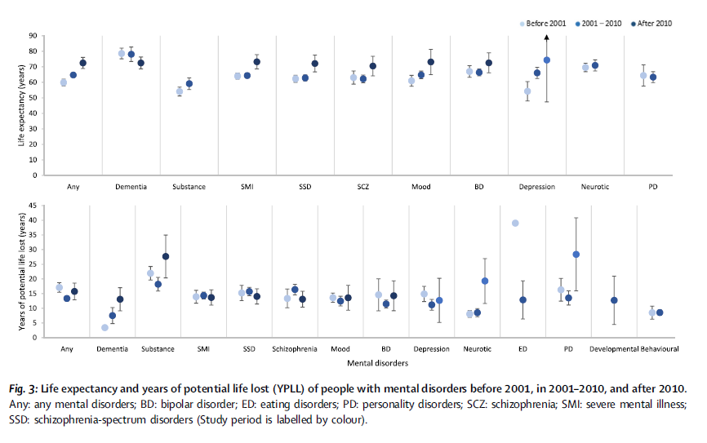
Life expectancy in schizophrenia
Schizophrenia – Epidemiology and burden
Life expectancy and YPLL in
people with schizophrenia
Life expectancy of people with mental disorders
before 2001, in 2001–2010, and after 2010
90
Before 2001
2001–2010
After 2010
Years (95% CI) | Male | Female | Overall
Life expectancy | 61.7 (59.3, 64.1) | 69.2 (66.8, 71.6) | 63.7 (61.5, 65.8)
YPLL | 15.0 (13.3, 16.6) | 13.1 (11.3, 14.9) | 15.2 (13.8, 16.7)
80
70
60
50
Life expectancy (years)
40
30
20
10
0
Any
Dementia
Substance
SMI
SSD
SCZ
Mood
BD
Depression
Neurotic
PD
YPPL in people with mental disorders
before 2001, in 2001–2010, and after 2010
45
40
35
30
25
YPLL
20
15
10
5
0
Any
Dementia
Substance
SMI
SSD
SCZ
Mood
BD
Depression
Neurotic
ED
PD
Develop-mental
Behavioural
The shortest life expectancy was reported for people with substance use disorders,
followed by depressive disorders, personality disorders, and schizophrenia; YPLL was highest for people with substance use disorders, eating disorders, schizophrenia-spectrum disorders, and personality disorders.
BD=bipolar disorder; CI=confidence interval; ED=eating disorder; PD=personality disorder; SCZ=schizophrenia; SMI=severe mental illness; SSD=schizophrenia-spectrum disorder; YPLL=years of potential life lost
Chan et al. EClinicalMedicine 2023;65:102294
This work is from Chan et al. eClinicalMedicine 2023. ‘Life expectancy and years of potential life lost in people with mental disorders: a systematic review and meta-analysis’, licensed under CC-BY-NC-ND-4.0. Published by Elsevier on behalf of eClinicalMedicine. The work cannot be changed in any way or used commercially without permission
from the journal.
Notes:
Reference:
Chan JKN, Correll CU, Wong CSM, et al. Life expectancy and years of potential life lost in people with mental disorders: a systematic review and meta-analysis. EClinicalMedicine 2023; 65: 102294.

Slide 16
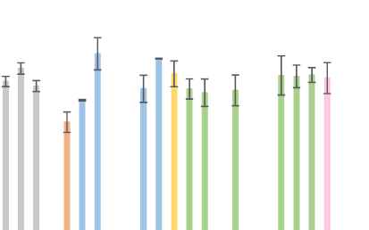
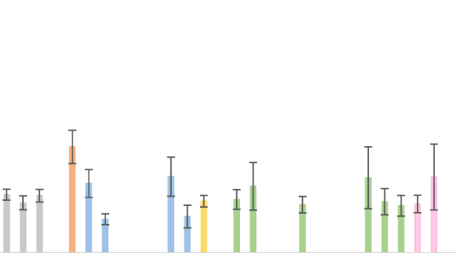
Life expectancy in schizophrenia, by region
Schizophrenia – Epidemiology and burden
Overall life expectancy of people with schizophrenia by region
YPLL for people with
schizophrenia by region
90
60
80
50
70
60
40
50
30
Life expectancy (years)
YPLL (years)
40
30
20
20
10
10
0
0
Overall
Female
Male
Ethiopia
China
Hong Kong
Israel
Japan
Taiwan
Türkiye
Australia
Denmark
Finland
Germany
Hungary
Italy
Norway
Spain
Sweden
UK
Canada
USA
Brazil
Overall
Female
Male
Ethiopia
China
Hong Kong
India
Israel
Japan
Taiwan
Türkiye
Australia
Czech Republic
Denmark
Finland
France
Germany
Hungary
Ireland
Italy
Norway
Spain
Sweden
UK
Canada
USA
Brazil
Differences in lifestyle factors as well as access to, and quality of, healthcare services may contribute
to the variations in life expectancy across countries
UK=United Kingdom; USA=United States of America; YPLL=years of potential life lost
Chan et al. EClinicalMedicine 2023;65:102294
This work is from Chan et al. eClinicalMedicine 2023. ‘Life expectancy and years of potential life lost in people with mental disorders: a systematic review and meta-analysis’, licensed under
CC-BY-NC-ND-4.0. Published by Elsevier on behalf of eClinicalMedicine. The work cannot
be changed in any way or used commercially without permission from the journal.
Notes:
The study had limitations, including the fact that data from continents other than Europe and North America were represented by fewer studies; therefore, results on regional differences should be interpreted with caution.¹
Reference:
Chan JKN, Correll CU, Wong CSM, et al. Life expectancy and years of potential life lost in people with mental disorders: a systematic review and meta-analysis. EClinicalMedicine 2023; 65: 102294.

Slide 17
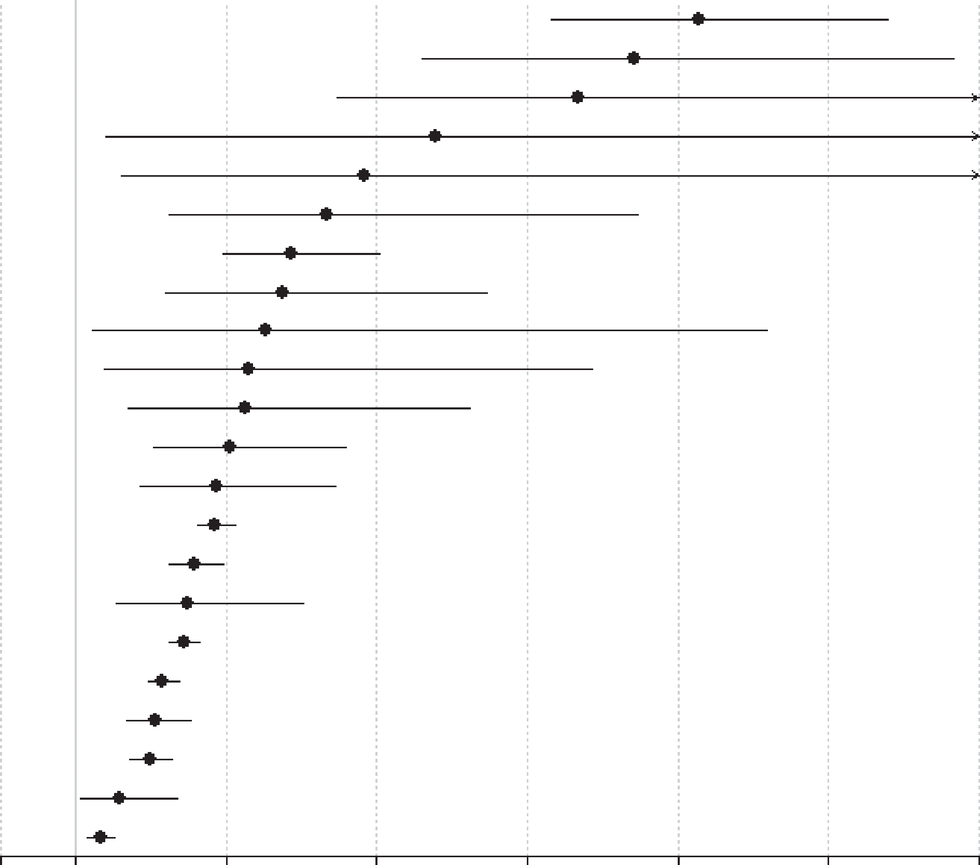
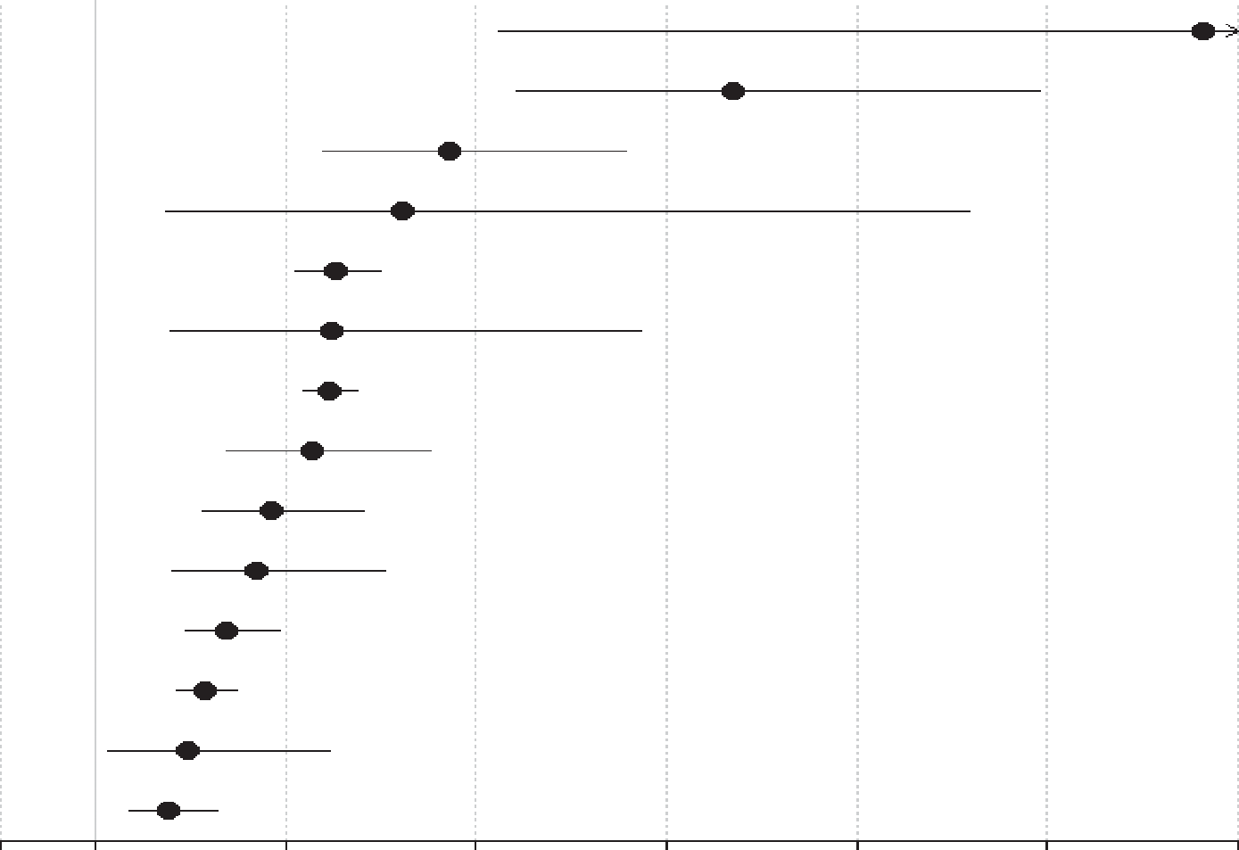
Mortality in prevalent and incident schizophrenia
Schizophrenia – Epidemiology and burden
All-cause and cause-specific mortality risk in prevalent schizophrenia versus the general population
All-cause and cause-specific mortality risk in incident schizophrenia versus the general population
Outcome
Risk ratio (95% CI)
Suicide (n=23)
Undetermined non-natural (n=9)
Infectious-pneumonia (n=2)
Skin/subcutaneous (n=2)
Musculoskeletal/connective (n=2)
Infectious-any (n=8)
Respiratory-any (n=11)
Urogenital-any (n=7)
Endocrine (n=6)
Injury-accidents (n=4)
Injury-any (n=5)
Gastrointestinal (n=8)
Diabetes (n=4)
All-cause (n=50)
Natural (study-defined) (n=16)
Other not specified (n=4)
Nervous-any (n=4)
Natural (n=38)
Cardiovascular (n=14)
Cardio-cerebrovascular (n=24)
Cerebrovascular (n=8)
Cancer-any (n=20)
9.28 (7.31, 11.78)
8.42 (5.60, 12.70)
7.67 (4.48, 13.10)
5.79 (1.40, 23.90)
4.83 (1.60, 14.60)
4.34 (2.23, 8.47)
3.86 (2.96, 5.03)
3.75 (2.18, 6.45)
3.52 (1.22, 10.18)
3.31 (1.39, 7.87)
3.26 (1.70, 6.23)
3.06 (2.05, 4.58)
2.88 (1.86, 4.46)
2.86 (2.62, 3.12)
2.58 (2.25, 2.96)
2.49 (1.53, 4.02)
2.43 (2.24, 2.64)
2.15 (1.96, 2.37)
2.06 (1.68, 2.52)
1.98 (1.73, 2.28)
1.58 (1.06, 2.36)
1.33 (1.16, 1.52)
Outcome
Risk ratio (95% CI)
Suicide (n=5)
Undetermined non-natural (n=5)
Other not specified (n=3)
Endocrine (n=3)
All-cause (n=7)
Cardio-cerebrovascular (n=4)
Injury-accidents (n=5)
Respiratory-any (n=4)
Natural (study-defined) (n=5)
Cardiovascular (n=5)
Gastrointestinal (n=4)
Natural (n=6)
Nervous-any (n=4)
Cerebrovascular (n=5)
12.7 (5.25, 30.53)
7.69 (5.42, 10.90)
4.72 (3.39, 6.56)
4.22 (1.75, 10.18)
3.52 (3.09, 4.00)
3.47 (1.79, 6.72)
3.45 (3.18, 3.75)
3.27 (2.36, 4.51)
2.85 (2.14, 3.81)
2.70 (1.80, 4.05)
2.38 (1.94, 2.93)
2.15 (1.86, 2.48)
1.97 (1.13, 3.45)
1.76 (1.36, 2.29)
0
1
3
5
7
9
11
13
0
1
3
5
7
9
11
13
Risk ratio (95% CI)
Risk ratio (95% CI)
Suicide is the leading specific cause of death in prevalent and incident schizophrenia
CI=confidence interval
Correll et al. World Psychiatry. 2022;21:248–271
This work is from World Psychiatry, Vol 21, Correll et al., ‘Mortality in people with schizophrenia: a systematic review and meta-analysis of relative risk and aggravating or attenuating factors’, 248–271; Copyright © 2022, with permission from the authors.
Notes:
Based on a systematic review and random-effects meta-analysis of 135 studies (1957–2021), including 4.5 million people with schizophrenia and over 1.1 billion general population controls, all-cause mortality was higher in people with schizophrenia than in the general population (incident schizophrenia risk ratio: 3.516 [95% CI: 3.09, 3.998]; prevalent schizophrenia risk ratio: 2.859 [95% CI: 2.622, 3.117]).¹
Abbreviations: CI=confidence interval
References
Correll CU, Solmi M, Croatto G, et al. Mortality in people with schizophrenia: a systematic review and meta-analysis of relative risk and aggravating or attenuating factors. World Psychiatry 2022; 21: 248–271.

Slide 18
Other factors affecting mortality in schizophrenia
Schizophrenia – Epidemiology and burden
Regional variations in
mortality risk in schizophrenia¹:
Substance use and
mortality in schizophrenia:
Comorbid substance use disorder in people with schizophrenia is associated with increased
all-cause mortality²
There is a need to screen for and address substance use disorders as early as possible²
Healthcare access in
people with mental illness including schizophrenia:
People with schizophrenia have lower rates of cardiovascular and cancer screening,^{3,4} and reduced access to diabetes monitoring and treatment⁵
These disparities in healthcare may contribute to the high mortality risk in schizophrenia^{3–5}
Regions with highest and lowest mortality riskª
Risk ratio (95% CI) | Region with lowest risk | Region with highest risk
All-cause mortality | North America: 2.7 (2.5, 3.0) | Africa: 6.0 (4.1, 8.7)
Suicide | North America: 4.4 (4.1, 4.8) | Oceania: 13.5 (10.1, 18.1)
Natural causes | North America: 1.9 (1.6, 2.2) | Asia: 2.3 (1.9, 2.7)
ªData shown are for incident plus prevalent schizophrenia and represent comparative risk of mortality in those with schizophrenia versus the general population across 23 countries
and six continents
CI=confidence interval
1. Solmi et al. Eur Neuropsychopharmacol 2024;80:55–69; 2. Correll et al. World Psychiatry 2022;21:248–271; 3. Solmi et al. Lancet Psych 2020;7:52–63; 4. Solmi et al. Am J Psychiatry 2021;78:793–803; 5. Wagner et al. Lancet Psychiatry 2026;13:112–124
Notes:
Notable differences in all-cause, suicide-related, and specific-cause mortality risk have been observed across different regions.¹ While mortality risk varies across regions, it is important to note that most data comes from North America, and Western and Northern Europe. Limited data are available for Central and South America, Eastern Europe, the Middle East and South Eastern Asia,¹ meaning the mortality risk is not accurately captured for these regions.
References:
Solmi M, Croatto G, Fornaro M, et al. Regional differences in mortality risk and in attenuating or aggravating factors in schizophrenia: a systematic review and meta-analysis. Eur Neuropsychopharmacol 2024; 80: 55–69.
Correll CU, Solmi M, Croatto G, et al. Mortality in people with schizophrenia: a systematic review and meta-analysis of relative risk and aggravating or attenuating factors. World Psychiatry 2022; 21: 248–271.
Solmi M, Firth J, Miola A, et al. Disparities in cancer screening in people with mental illness across the world versus the general population: prevalence and comparative meta-analysis including 4 717 839 people. Lancet Psych 2020; 7: 52–63.
Solmi M, Fiedorowicz J, Poddighe L, et al. Disparities in screening and treatment of cardiovascular diseases in patients with mental disorders across the world: systematic review and meta-analysis of 47 observational studies. Am J Psychiatry 2021; 78: 793–803.
Wagner E, Højlund M, Fiedorowicz JG, et al. Lancet Psych 2026; 13: 112–124.

Slide 19
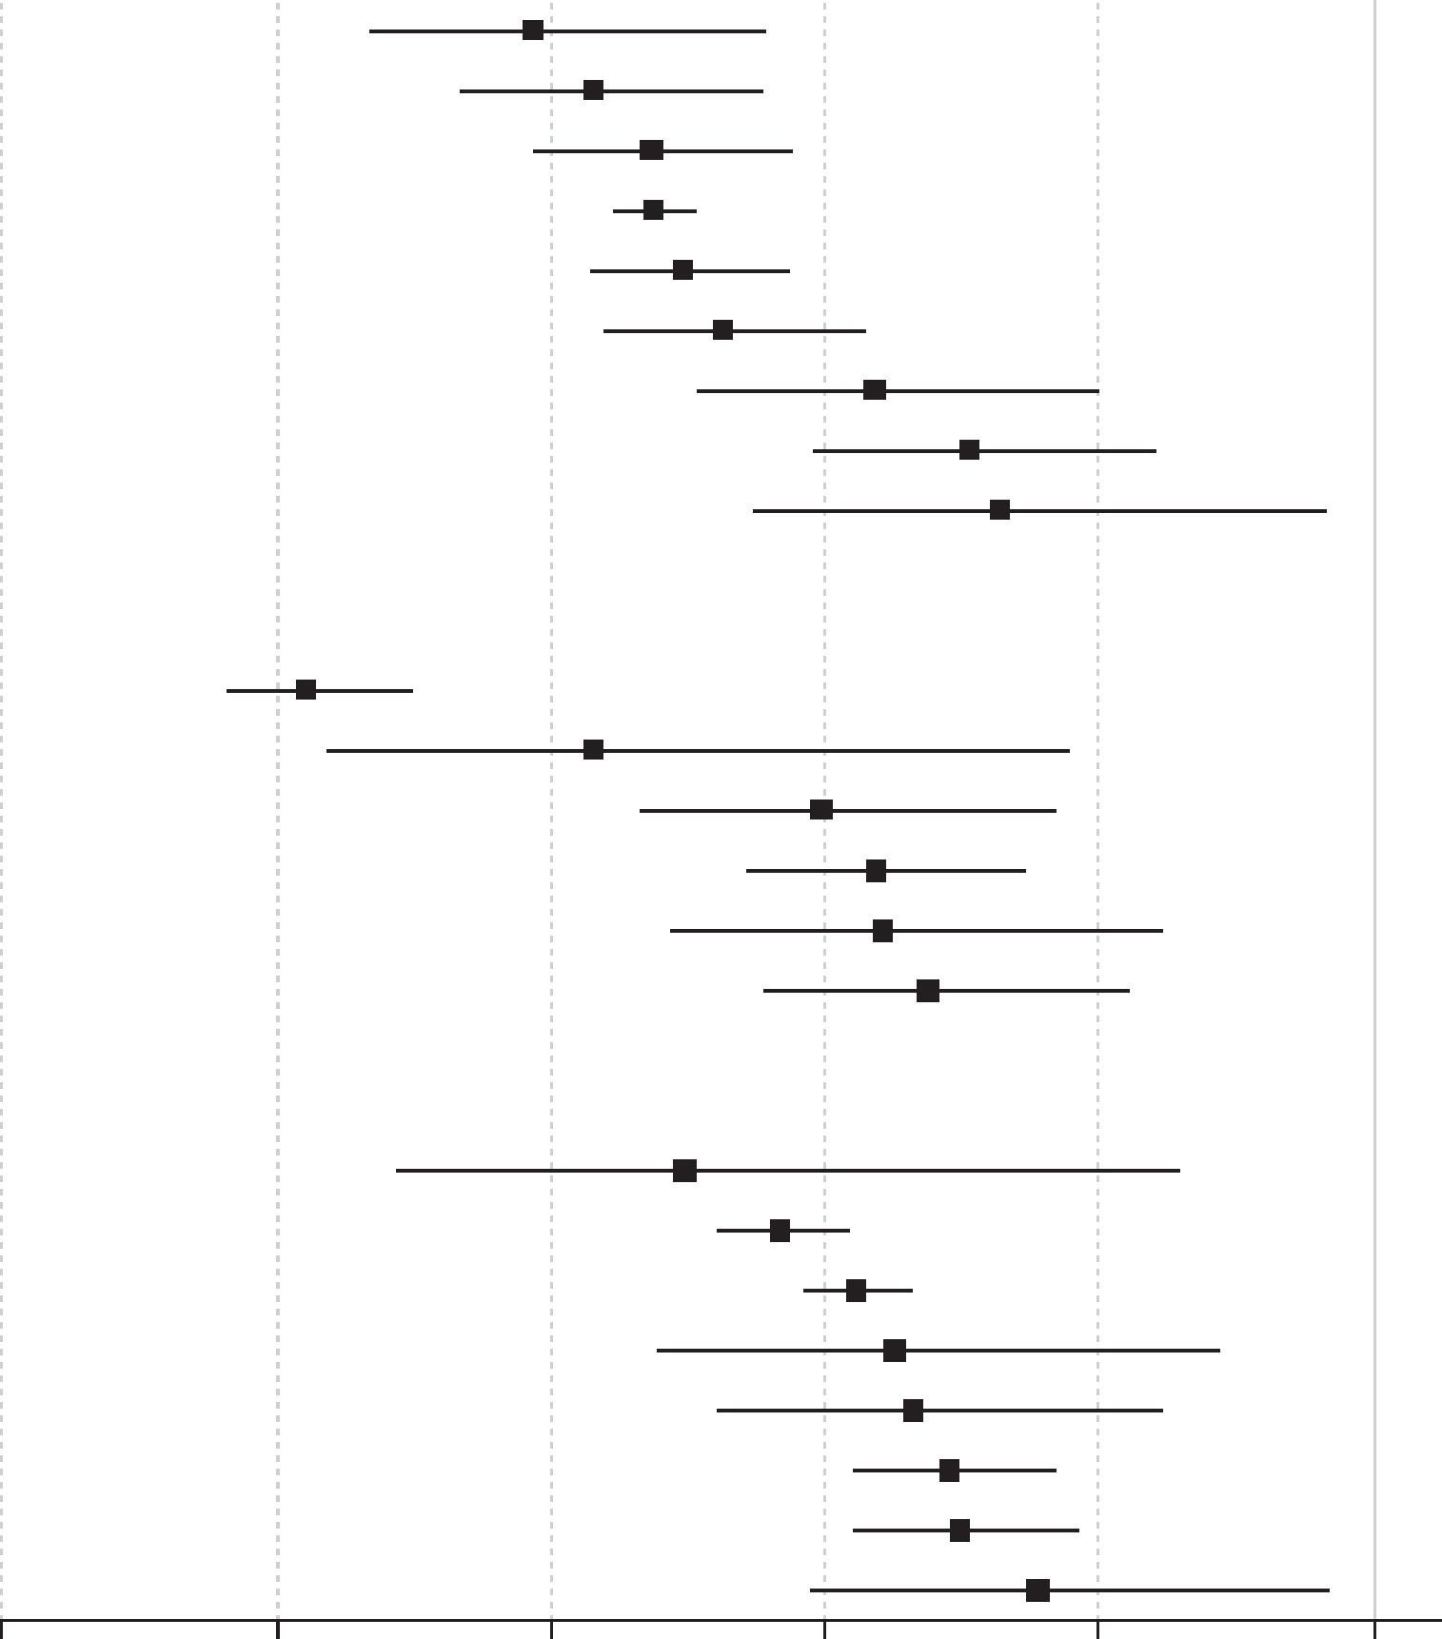
The antipsychotic paradox and mortality risk in schizophrenia
Schizophrenia – Epidemiology and burden
What is the antipsychotic paradox?
Antipsychotics are associated with several AEs, particularly cardiometabolic events, which are known risk factors for premature cardiovascular mortality; however, antipsychotics have consistently been associated with decreased mortality risk in people with schizophrenia, due to improved lifestyle and increased access to care when on treatment^{1,2}
All-cause mortality risk and mortality risk due to suicide or natural death
in schizophrenia, by antipsychotic type¹
Outcome
Risk ratio (95% CI)
All-cause mortality
Any SGA LAI (n=3)
Clozapine (n=3)
Any LAI (n=2)
Any SGA oral (n=4)
Any FGA LAI (n=3)
Any SGA (n=4)
Any oral (n=4)
Any antipsychotic (n=11)
Any FGA (n=5)
0.39 (0.27, 0.56)
0.43 (0.34, 0.55)
0.47 (0.39, 0.58)
0.47 (0.45, 0.50)
0.50 (0.43, 0.57)
0.53 (0.44, 0.63)
0.64 (0.51, 0.80)
0.71 (0.59, 0.84)
0.73 (0.55, 0.97)
CVM risk with antipsychotics
Compared with FGAs, SGAs and clozapine demonstrate a reduced risk of CVM³
Mortality from suicide
Clozapine (n=2)
Any SGA LAI (n=1)
Any LAI (n=1)
Any SGA oral (n=2)
Any FGA LAI (n=1)
Any SGA (n=2)
0.22 (0.16, 0.30)
0.43 (0.24, 0.78)
0.60 (0.47, 0.77)
0.64 (0.54, 0.74)
0.64 (0.49, 0.85)
0.68 (0.56, 0.82)
The protective effects of antipsychotics¹
Antipsychotics are protective against all‑cause mortality, with clozapine and SGA LAIs showing the strongest risk reductions compared with FGA LAIs and any oral antipsychotic
Mortality from natural cause
Clozapine (n=2)
Any SGA oral (n=2)
Any oral antipsychotic (n=1)
Any SGA (n=2)
Any SGA LAI (n=1)
Any LAI (n=1)
Any FGA LAI (n=1)
Any antipsychotic (n=3)
0.50 (0.29, 0.86)
0.57 (0.52, 0.62)
0.62 (0.59, 0.66)
0.65 (0.48, 0.89)
0.66 (0.52, 0.84)
0.69 (0.62, 0.77)
0.70 (0.62, 0.78)
0.76 (0.59, 0.97)
0
0.2
0.4
0.6
0.8
1
Risk ratio (95% CI)
AE=adverse event; CI=confidence interval; CVM=cardio-cerebrovascular mortality; FGA=first-generation antipsychotic; LAI=long-acting injectable; SGA=second-generation antipsychotic
1. Correll et al. World Psychiatry 2022;21:248–271; 2. Solmi & Correll. Eur Neuropsychopharmacol 2022;62:1–3; 3. Solmi et al. Eur Neuropsychopharmacol 2024;88:6–20
This work is from World Psychiatry, Vol 21, Correll et al., ‘Mortality in people with schizophrenia: a systematic review and meta-analysis of relative risk and aggravating or attenuating factors’, 248–271; Copyright © 2022, with permission from the authors.
Notes:
Potential explanations for the “antipsychotic paradox” include antipsychotic-related reductions of stress-linked cortisol levels and inflammation, improved healthy lifestyle behaviours, and a reduction in healthcare disparities between patients with and without schizophrenia.² Further, antipsychotics are associated with increased adherence to medical and psychiatric care, which may override cardiometabolic risk associated with these treatments.² This increased access to medical care may allow signs and symptoms to be identified sooner, resulting in timely diagnosis and treatment. In schizophrenia, there is a reduced substance abuse and suicide risk in individuals using antipsychotics vs those who are not.²
Evidence for the protective effects of antipsychotics is not consistently available across regions, with limited data available from South America, Eastern Europe, the Middle East and South-East Asia, highlighting a need for further research in these regions.^{1,4}
References:
Correll CU, Solmi M, Croatto G, et al. Mortality in people with schizophrenia: a systematic review and meta-analysis of relative risk and aggravating or attenuating factors. World Psychiatry 2022; 21: 248–271.
Solmi M & Correll CU. The antipsychotic paradox: Lessons regarding determinants of premature mortality. Eur Neuropsychopharmacol 2022; 62: 1–3.
Solmi M, Croatto G, Gupta A, et al. Effects of antipsychotic treatment on cardio-cerebrovascular related mortality in schizophrenia: A subanalysis of a systematic review and meta-analysis with meta-regression of moderators. Eur Neuropsychopharmacol 2024; 88: 6–20.
Solmi M, Croatto G, Fornaro M, et al. Regional differences in mortality risk and in attenuating or aggravating factors in schizophrenia: a systematic review and meta-analysis. Eur Neuropsychopharmacol 2024; 80: 55–69.

Slide 20
Economic burden of schizophrenia

Slide 21
Direct and indirect costs associated with schizophrenia
Schizophrenia – Epidemiology and burden
A broad spectrum of cost drivers contributes to the overall economic burden of schizophrenia
The costs of schizophrenia can be evaluated from the perspective of the healthcare system, patients (including caregivers and family members), or society
Characterization of the economic burden of schizophrenia
Total costs
Direct costs
Indirect costs
Intangible costs#
Direct HC*
Direct non-HC
Lost productivity
Caregiver cost
Others
Pain & suffering
Outpatient/
HCPS
Travel, food & lodging
Stress & anxiety
Due to mortality (suicide)***
Due to morbidity
Lost productivity
Leisure time forgone
Disability compensation
Hospitalization
Law enforcement**
Presenteeism
Pension costs
Emergency room & day care
Shelters for homeless
Absenteeism
Tax forgone
Pharmacy
Research & training
Tests & procedures
Permanent disability
Social service cost
Long-term care, nursing home & rehabilitation
Administration of benefits
Unemployment
Equipment
Private expenditure
Early retirement
Stakeholder perspective
Healthcare
Societal
Patient
*Includes costs of adverse events; **Incarceration, judicial & legal services, police protection; some studies consider these components under indirect costs; ***Some studies consider suicide under direct costs; #Includes costs for both people with schizophrenia and caregivers
HC=healthcare; HCP=healthcare professional
Kotzeva et al. J Med Econ 2023;26:70–83
This work is from Kotzeva et al. J Med Econ 2023, ‘Socioeconomic burden of schizophrenia: a targeted literature review of types of costs and associated drivers across 10 countries’, licensed under CC-BY-NC-ND-4.0. Published by Taylor and Francis on behalf of Journal of Medical Economics. The work cannot be changed in any way or used commercially without permission from the journal.
Notes:
A targeted literature review aimed to summarize the different costs/cost drivers associated with schizophrenia in 10 countries, including all cost types and stakeholder perspectives, and to identify disease aspects associated with the greatest costs, as shown in the figure.¹
Reference:
Kotzeva A, Mittal D, Desai S, et al. Socioeconomic burden of schizophrenia: a targeted literature review of types of costs and associated drivers across 10 countries. J Med Econ 2023; 26: 70–83.

Slide 22
Distribution of direct and indirect costs of schizophrenia
Schizophrenia – Epidemiology and burden
The economic burden of schizophrenia is mostly attributable to indirect costs (caregiving, unemployment, productivity loss, etc.)
Inpatient care is the main driver of direct costs; followed by outpatient care
Distribution of direct and indirect costs of schizophrenia in the USA in 2019
Indirect costs:
73.4%
of total costs
Direct HC costs:
18.2%
of total costs
Direct
non-HC costs:
10.2%ª
of total costs
The estimated excess economic burden of schizophrenia in the USA in 2019 was $343.2 billion
Percentages are rounded to one decimal place and may not total 100%
ªCost offsets, representing $6.0 billion (1.7%) and included to account for individuals who were homeless or institutionalized and therefore not incurring basic living costs, were subtracted from direct non-HC costs
HC=healthcare; SSDI=Social Security Disability Income; SSI=Supplemental Security Income
Kadakia et al. J Clin Psychiatry 2022;83:22m14458
Notes:
A US-based study aimed to assess the direct and indirect costs associated with schizophrenia using a prevalence-based approach.¹ Direct healthcare costs were assessed retrospectively using an exact-matched cohort design using MarketScan databases.¹ Direct non-healthcare costs were estimated using published literature and government data, and indirect costs were estimated using a human capital approach and the value of quality-adjusted life-years lost.¹
Reference:
Kadakia A, Catillon M, Fan Q, et al. The economic burden of schizophrenia in the United States. J Clin Psychiatry 2022; 83: 22m14458.

Slide 23
Regional differences in the costs of schizophrenia
Schizophrenia – Epidemiology and burden
Indirect costs have been consistently identified as the main driver of economic burden across countries^{1–3}
In studies that have examined the economic burden of schizophrenia, there is considerable variation between countries, reflecting differences in study methods, healthcare systems, and population characteristics³
Proportion of economic burden attributed to direct and indirect costs in schizophrenia across countries³
⁵
Country
UK=United Kingdom; USA=United States of America
1. Kadakia et al. J Clin Psychiatry 2022;83:22m14458; 2. Chong et al. Neuropsychiatr Dis Treat 2016;12:357–73; 3. Kotzeva et al. J Med Econ 2023;26:70–83
Notes:
References:
Kadakia A, Catillon M, Fan Q, et al. The economic burden of schizophrenia in the United States. J Clin Psychiatry 2022; 83: 22m14458.
Chong HY, Teoh SL, Wu DB, et al. Global economic burden of schizophrenia: a systematic review. Neuropsychiatr Dis Treat 2016; 12: 357–373.
Kotzeva A, Mittal D, Desai S, et al. Socioeconomic burden of schizophrenia: a targeted literature review of types of costs and associated drivers across 10 countries. J Med Econ 2023; 26: 70–83.

Slide 24
Humanistic burden of schizophrenia

Slide 25
The humanistic burden of schizophrenia
Schizophrenia – Epidemiology and burden
Schizophrenia causes a high degree of disability, affecting the health and well-being of those living with the illness, caregivers, relatives, neighbours, and others in their
daily lives^{1,2}
People living with schizophrenia often experience challenges across several connected areas
of life^{1,3}
The humanistic burden of schizophrenia^{1–3}
Crime
Occupational¹
Housing
Burden of schizophrenia
Health
and QoL
Stigma
Emotional
experiences
Social
Family/
caregivers
QoL=quality of life
1. Millier et al. J Psychiatr Res 2014;54:85–93; 2. Leucht et al. Nat Rev Dis Primers 2025;11:83; 3. Fusar-Poli et al. World Psychiatry 2022;21:168–188
Notes:
The humanistic burden of schizophrenia involves several dimensions of life, as shown on the slide. Most of these dimensions overlap, and all are linked.¹ For example, schizophrenia’s positive and negative symptoms, along with cognitive impairment, and physical and mental comorbidities, can directly impair quality of life and contribute to occupational difficulties, unemployment, and social isolation, which also contribute to diminished quality of life.^{1,3}
References:
Millier A, Schmidt U, Angermeyer MC, et al. Humanistic burden in schizophrenia: a literature review. J Psychiatr Res 2014; 54: 85–93.
Fusar-Poli P, Estradé A, Stanghellini G, et al. The lived experience of psychosis: a bottom-up review co-written by experts by experience and academics. World Psychiatry 2022; 21: 168–188.
Leucht S, Siafis S, McGrath JJ, et al. Schizophrenia. Nat Rev Dis Primers 2025; 11: 83.

Slide 26
Health, family, social, and stigma-related burden in schizophrenia
Schizophrenia – Epidemiology and burden
Poor health and QoL^{1–3}
Reduced overall health and QoL
High rates of comorbid mental disorders, particularly depression
Increased physical health problems (e.g., cardiovascular disease, diabetes, and dental problems)
Contributing factors include unhealthy lifestyle behaviours, medication side effects, and barriers to accessing care
Stigma^{1,3,5}
Public stigma creates barriers to employment, relationships, and care
Internalized stereotypes contribute to shame, low self-esteem, and withdrawal
Stigma in healthcare can delay diagnosis and treatment of physical illness
Family^{1,4}
Emotional, physical, social, and
financial burden
Increased risk of mental health problems among family members
Stigma may isolate the whole family
Social^{1,5}
Social withdrawal from family and friends
Loneliness, exacerbated by potential bullying
Reduced participation in the community
Social deprivation and isolation within the local community
QoL=quality of life
1. Millier et al. J Psychiatr Res 2014;54:85–93; 2. Leucht et al. Nat Rev Dis Primers 2025;11:83; 3. Liberati et al. EClin Med 2025;80:103026; 4. Mittendorfer-Rutz et al. Schizophr Bull 2019;45:794–803; 5. Fusar-Poli et al. World Psychiatry 2022;21:168–188
Notes:
References:
Millier A, Schmidt U, Angermeyer MC, et al. Humanistic burden in schizophrenia: a literature review. J Psychiatr Res 2014; 54: 85–93.
Leucht S, Siafis S, McGrath JJ, et al. Schizophrenia. Nat Rev Dis Primers 2025; 11: 83.
Liberati E, Kelly S, Price A, et al. Diagnostic inequalities relating to physical healthcare among people with mental health conditions: a systematic review. EClinicalMedicine 2025; 80: 103026.
Mittendorfer-Rutz E, Rahman S, Tanskanen A, et al. Burden for parents of patients with schizophrenia-a nationwide comparative study of parents of offspring with rheumatoid arthritis, multiple sclerosis, epilepsy, and healthy controls. Schizophr Bull 2019; 45: 794–803.
Fusar-Poli P, Estradé A, Stanghellini G, et al. The lived experience of psychosis: a bottom-up review co-written by experts by experience and academics. World Psychiatry 2022; 21: 168–188.

Slide 27
Occupation, justice, and housing burden, and emotional experiences
Schizophrenia – Epidemiology and burden
Occupational^{1,2}
Cognitive impairment affecting learning and work performance
Reduced ability to gain and
maintain employment
Cognitive impairment reduces independence and can worsen QoL
Justice system^{1,4–9}
Increased risk of committing violent crimes, especially if comorbid with substance use disorder
Some evidence that people with schizophrenia are also often victims
of violent crime
Increased risk of incarceration
Emotional experiences³
Feelings of isolation, disconnection, and difficulties understanding social interactions
Loss of trust in others and society
Uncertainty about the future
Feelings of helplessness
Housing^{1,10,11}
Increased risk of homelessness
Homelessness impacts QoL
Homelessness itself is highly stigmatized, and can create barriers to accessing treatment and support
QoL=quality of life
1. Millier et al. J Psychiatr Res 2014;54:85–93; 2. Leucht et al. Nat Rev Dis Primers 2025;11:83; 3. Fusar-Poli et al. World Psychiatry 2022;21:168–188;
4. Das et al. Schizophr Res 2026;287:73–81; 5. Whiting et al. JAMA Psychiatry 2022;79:120–132; 6. Fazel et al. PLoS Med 2009;6:e1000120; 7. Fortugno et al. PLoS One 2013;8:e58142; 8. Wehring & Carpenter. Schizophr Bull 2011;37:877–878; 9. Uslu & Mavíş, J Forensic Psych Res Pract 2024;24:269–279;
10. Reilly et al. Health Soc Care Community 2022;30:2128–2141; 11. Rea J. J Soc Issues 2023;79:465–493
Notes:
References:
Millier A, Schmidt U, Angermeyer MC, et al. Humanistic burden in schizophrenia: a literature review. J Psychiatr Res 2014; 54: 85–93.
Leucht S, Siafis S, McGrath JJ, et al. Schizophrenia. Nat Rev Dis Primers 2025; 11: 83.
Fusar-Poli P, Estradé A, Stanghellini G, et al. The lived experience of psychosis: a bottom-up review co-written by experts by experience and academics. World Psychiatry 2022; 21: 168–188.
Das N, Dhamija R, Mistak D Koyanagi A, Oh H, DeVylder J. Epidemiological analysis of schizophrenia and incarceration: A multi-center exploration of the criminalization of mental illness in the United States. Schizophr Res 2026; 287: 73–81.
Whiting D, Gulati G, Geddes JR, Fazel S. Association of schizophrenia spectrum disorders and violence perpetration in adults and adolescents from 15 countries: a systematic review and meta-analysis. JAMA Psychiatry 2022; 79: 120–132.
Fazel S, Gulati G, Linsell L, et al. Schizophrenia and violence: systematic review and meta-analysis. PLoS Med 2009; 6: e1000120.
Fortugno F, Katsakou C, Bremner S, et al. Symptoms associated with victimization in patients with schizophrenia and related disorders. PLoS One 2013; 8: e58142.
Wehring HJ & WT Carpenter. Violence and Schizophrenia. Schizophr Bull 2011; 37: 877–878.
Uslu E & Mavíş V. The other side of the coin: Individuals diagnosed with schizophrenia as victims of crime and violence. J Forensic Psych Res Pract 2024; 24: 269–279.
Reilly J, Ho I & Williamson A. A systematic review of the effect of stigma on the health of people experiencing homelessness. Health Soc Care Community 2022; 30: 2128–2141.
Rea J. Social relationships, stigma, and wellbeing through experiences of homelessness in the United Kingdom. J Soc Issues 2023; 79: 465–493.

Slide 28
Employment status in schizophrenia

Slide 29
Employment status rates before and after first-episode psychosis
Schizophrenia – Epidemiology and burden
Employment status trends from 2 years before
to 5 years after FEP (N=21,551)¹
Employment decreases over time from before FEP,¹ suggesting occupational difficulties may reflect prodromal symptoms preceding psychosis
As employment decreases, dependence on social welfare increases, indicating an inability to work¹
  Occupational impairment may result in homelessness when social welfare is
  not available
The proportion of people with schizophrenia in education decreases
over time¹
  Consistent with previous findings of lower educational attainment in schizophrenia
  versus the general population,^{2,3} reflecting early functional impairment due to the illness
100
90
80
70
60
50
Percent
40
30
20
10
0
Time point in relation to first diagnosis (years)
Employed
Long-term parental leave
Student
Not in work
Social welfare
ª‘Not in work’ includes long-term unemployment and long-term sick leave
^{b}‘Social welfare’ includes social assistance and disability pension
FEP=first-episode psychosis
1. Solmi et al. Am J Psychiatry 2022;179:938–946 ; 2. Dickson et al. Psychol Med 2020;50:1949–1965; 3. Crossley et al. Lancet Psychiatry 2022;9:565–573
Notes:
In this study, the main outcome measure was any sickness absence or disability pension.¹ In Sweden, individuals aged ≥16 years in employment can claim sickness absence benefits from the Social Insurance Agency if they have been absent from work due to sickness for more than 14 days; individuals aged 19–29 years can claim a temporary disability pension. All individuals aged 30–64 years can receive a permanent disability pension if their work capacity is permanently reduced due to morbidity. The secondary outcome was long-term sickness absence (>90 days), encompassing both sickness absence benefits and disability pension. People were categorized yearly based on their main activity or source of income from 2 years before to 5 years after the date of first diagnosis and were initially designated as employed or not employed based on income. Alternative activities and sources of income were evaluated by the number of days of receipt of social security benefits (including sickness absence, parental leave, and disability pension), and the number of days registered as unemployed.¹
References:
Solmi M, Taipale H, Holm M, et al. Effectiveness of antipsychotic use for reducing risk of work disability: results from a within-subject analysis of a Swedish national cohort of 21,551 patients with first-episode nonaffective psychosis. Am J Psychiatry 2022; 179: 938–946.
Dickson H, Hedges EP, Ma SY, et al. Academic achievement and schizophrenia: a systematic meta-analysis. Psychol Med 2020; 50: 1949–1965.
Crossley NA, Alliende LM, Czepielewski LS, et al. The enduring gap in educational attainment in schizophrenia according to the past 50 years of published research: a systematic review and meta-analysis. Lancet Psychiatry 2022; 9: 565–573.

Slide 30
Employment rates across regions, decades, follow-up, settings, and other factors
Schizophrenia – Epidemiology and burden
Meta-analysis (70 studies) of employment status at the end of follow-up after first contact with mental health services for psychosis, in individuals with FEP disordersª (average follow-up: 8.3 years)
Analysis | N studies | Pooled prevalence (%) | 95% CI
Employment at the end of follow-up | 70 | 32.5 | 28.5, 36.9
Study-year group
1968–1998 | 16 | 34.8 | 25.4, 45.5
1999–2007 | 17 | 29.2 | 21.3, 38.5
2008–2011 | 16 | 35.1 | 26.8, 44.3
2012–2021 | 20 | 31.1 | 24.2, 38.9
Study region
Asia | 9 | 30.7 | 20.8, 42.8
Australia and New Zealand | 4 | 35.5 | 25.7, 46.7
Europe | 43 | 32.6 | 27.3, 38.0
Multicentre | 1 | 14.3 | 11.5, 17.7
North America | 13 | 36.9 | 25.9, 49.4
Assessment type
Case notes | 12 | 32.5 | 24.0, 42.5
Interview | 49 | 34.0 | 29.1, 38.9
Combination | 7 | 29.2 | 17.9, 43.8
Analysis | N studies | Pooled prevalence (%) | 95% CI
Setting
Adult psychiatric hospitals | 34 | 29.2 | 23.9, 35.2
Community and early intervention services | 3 | 31.2 | 24.7, 38.6
In-/outpatient psychiatric services | 27 | 33.8 | 28.1, 40.0
Follow-up categories
1–2 years | 15 | 43.0 | 36.5, 44.3
3–5 years | 22 | 32.6 | 24.6, 41.8
>6 years | 30 | 26.8 | 22.5, 31.5
Societal status
High income | 62 | 33.4 | 29.7, 37.9
Middle income | 7 | 28.1 | 15.4, 45.6
Diagnosis
Affective | 3 | 58.4 | 26.6, 84.5
FEP | 24 | 25.9 | 29.4, 42.3
FES | 41 | 29.9 | 24.6, 35.8
Ater an average follow-up of 8.3 years, 32.5% of people with FEP disorders were in work, and consistently low employment rates were reported across the decades, highlighting substantial functional recovery challenges for people with FEP disorders
ªFEP disorders includes: FEP and first-episode affective psychosis
CI=confidence interval; FEP=first-episode psychosis; FES=first-episode schizophrenia
Ajnakina et al. Schizophr Res 2021:231:122–133
Notes:
As employment is an important indicator of long-term functional recovery in individuals with FEP disorders, there is a need to elucidate more accurately how frequently the employment status of people with FEP disorders are affected by their disorder.¹ As employment status is complex, it is important to identify moderating factors, which may help to identify those individuals who may be at higher risk for unemployment and poor long-term outcomes.¹
This meta-analysis of 70 longitudinal studies (N=14,828) evaluated the proportion of people with an FEP disorder who were employed (defined as having either a full-/part-time job, being a student at school or university, or being involved in a study/training programme) at the end of follow-up after first contact with mental health services for psychosis.¹ To increase the generalizability of findings, a wide range of studies were captured, including in the in- and outpatient settings, which used different assessment methods, such as case notes and face-to-face interviews. The analysis stratified employment based on FEP disorder type and variables related to demographic factors, such as country and country income status. Study design factors, such as length of follow-up and study year publication, were also included.¹
The pooled proportion of people with FEP disorders in employment was 32.5% after an average follow-up of 8.3 years, highlighting substantial functional recovery challenges for people with FEP disorders. There was significant heterogeneity across stratification factors:
People with schizophrenia had a higher risk of unemployment than those with affective psychoses
Middle-income countries reported lower employment rates than high-income countries
Studies with longer follow-up reported lower employment, indicating progressive functional impairment over time
Abbreviations: FEP=first episode psychosis
Reference:
Ajnakina O, Stubbs B, Francis E, et al. Employment and relationship outcomes in first-episode psychosis: a systematic review and meta-analysis of longitudinal studies. Schizophr Res 2021; 231: 122–133.

Slide 31
Risk and protective factors for schizophrenia onset and disease course

Slide 32
Risk factors and population attributable fraction for schizophrenia
Schizophrenia – Epidemiology and burden
Genetic and environmental factors, and their interactions contribute to the risk of developing schizophrenia, and several environmental risk factors have been identified¹⁻³
The PAF estimates the proportion of disease cases that could theoretically be prevented in a population if an individual risk factor was eliminated^{4,5}
Relationships between risk factors and genetics in the development of schizophrenia³
Global meta-analytic PAF for the most robust, potentially modifiable risk factors of schizophrenia spectrum disorders¹
Genetic factors e.g. SNPs, CNVs, rare variants
Birth
Childhood adversity was a modifiable factor in 38% of cases
Environment
Perinatal complications
Childhood infections
Maternal infections
Winter/spring birth
Migration
Urbanicity
Cannabis use was a modifiable factor in 10% of cases
Childhood adversity
Cannabis
Disease onset
This work is adapted from ‘Environmental Risk Factors for Schizophrenia and Bipolar Disorder and Their Relationship to Genetic Risk: Current Knowledge and Future Directions’ by Robinson & Bergen., used under
CC-BY-4.0. This work is licensed under Creative Commons license CC-BY-SA by The Lundbeck Foundation.
Risk factor
Further research into interaction of risk factors in schizophrenia onset is needed and may identify prevention strategies and therapeutic targets³
Identifying modifiable risk factors can
potentially reduce the global
incidence of an illness^{4,5}
CNV=copy number variants; SNP=single nucleotide polymorphism; PAF=population attributable fraction
1. McCutcheon et al. JAMA Psychiatry 2020;77:201‒210; 2. Jauhar et al. Lancet 2022;399:473‒486; 3. Robinson & Bergen. Front Genet 2021;12:686666;
4. Dragioti et al. Mol Psychiatry 2022;27:3510–3519; 5. Mukadam et al. Lancet Glob Health. 2019;7:e596–e603
Notes:
PAF estimates the epidemiologic contribution of a risk factor to a certain disease. It is calculated using the relative risk of a disease associated with a risk factor and the prevalence of that risk factor.^{1,2}
Abbreviation: PAF=population attributable fraction
References:
McCutcheon RA, Reis Marques T, Howes, OD. Schizophrenia-an overview. JAMA Psychiatry 2020; 77: 201–210.
Jauhar S, Johnstone M, McKenna PJ. Schizophrenia. Lancet 2022; 399: 473–486.
Robinson N & Bergen SE. Environmental Risk Factors for Schizophrenia and Bipolar Disorder and Their Relationship to Genetic Risk: Current Knowledge and Future Directions. Front Genet 2021; 12: 686666.
Dragioti E, Radua J, Solmi M, et al. Global population attributable fraction of potentially modifiable risk factors for mental disorders: a meta-umbrella systematic review. Mol Psychiatry 2022; 27: 3510–3519.
Mukadam N, Sommerlad A, Huntley J, Livingston G. Population attributable fractions for risk factors for dementia in low-income and middle-income countries: an analysis using cross-sectional survey data. Lancet Glob Health 2019; 7: e596–e603.

Slide 33
Costs associated with the negative symptoms of schizophrenia
Schizophrenia – Epidemiology and burden
A retrospective analysis of EHR data from 25 US providers of mental health care compared HCRU in individuals with schizophrenia with predominant negative symptoms (n=360) versus those without (n=4,084)¹
Compared with those without predominant negative symptoms, those with predominant negative symptoms:
  were younger (36.4 vs 39.7 years)
  had more psychiatric comorbidities
  had fewer days on antipsychotics (111.8 vs 140.9 days) during follow-up¹
HCRU in people with schizophrenia with predominant negative symptoms
versus those without predominant negative symptoms¹:
Negative symptoms of schizophrenia can be associated with increased healthcare costs and HCRU,^{1–3} specifically due to more frequent, longer, and more expensive
inpatient visits
There is an additional economic burden from lost caregiver productivity and higher rates of unemployment in people with negative symptoms³
Psychiatric inpatient hospitalization
76.1% vs 59.7%
Patients with
inpatient visits ≥20 days
30.3% vs 22.8%
Total
inpatient costs (USD)
$16,893 vs $13,732
EHR=electronic health record; HCRU=healthcare resource utilization; USD= United States Dollars
1. Patel et al. BMJ Open 2024;14:e084613; 2. Weber et al. Schizophr Res 2022;241:251–259; 3. Correll et al. J Clin Psychiatry 2024;85:24r15316
Notes:
A systematic literature review of six studies describing the economic burden of the negative symptoms of schizophrenia reported a positive association between negative symptoms and increased healthcare resource use and costs, owing to higher inpatient costs, more frequent primary care visits, and lost caregiver workdays.² However, the authors noted that evidence regarding healthcare costs and resource use associated with negative symptoms is limited because only six eligible studies were identified, and considerable heterogeneity was observed across findings, influenced by differences in patient characteristics, cost components analyzed, and differences in health systems and costs across the countries.²
References:
Patel R, Dembek C, Won Y, et al. A real-world data analysis of electronic health records to investigate the associations of predominant negative symptoms with healthcare resource utilisation, costs and treatment patterns among patients with schizophrenia. BMJ Open 2024; 14: e084613.
Weber S, Scott JG, Chatterton ML. Healthcare costs and resource use associated with negative symptoms of schizophrenia: a systematic literature review. Schizophr Res 2022; 241: 251–259.
Correll CU, Xiang P, Sarikonda K, et al. The economic impact of cognitive impairment and negative symptoms in schizophrenia: a targeted literature review with a focus on outcomes relevant to health care decision-makers in the United States. J Clin Psychiatry 2024; 85: 24r15316.

Slide 34
Costs associated with the cognitive symptoms of schizophrenia
Schizophrenia – Epidemiology and burden
Mean annual costs of people with schizophrenia with cognitive difficulties versus those without (USD)
Compared with individuals with no cognitive symptoms, people with cognitive
difficulties experience:
  greater limitations in activities of daily living
  greater limitations in social and recreational activities
  greater limitations in work, school, and home activities
  lower perceived overall health status
  higher unemployment due to illness (48.8 vs 26.6%)
Cost category | With cognitive difficulties | Without cognitive difficulties
Direct costs
Mean total direct costsª | $19,733 | $14,723
Hospitalizations | $16,188 | $2,932
Home health visits | $12,556 | $8,149
Outpatient visits | $5,834 | $3,627
Emergency department visits | $1,914 | $1,503
Pharmacy | $6,966 | $5,143
Dental, vision visits | $806 | $941
Indirect costs
Wage loss due to unemployment | $16,188 | $2,932
Wage loss due to missed work | $12,556 | $8,149
Cognitive symptoms in schizophrenia are associated with functional impairment, unemployment, and notable economic burden through higher
healthcare use and wage loss
ªMean total costs are not additive of each category of HCRU
HCRU=healthcare resource utilization; USD= United States Dollars
Choi et al. J Clin Psychiatry 2025;86:25m15794
Notes:
Reference:
1. Choi BM, Singh T, Nili M, et al. Understanding the characteristics and burden of cognitive impairments in schizophrenia in the US: medical expenditure panel survey. J Clin Psychiatry 2025; 86: 25m15794.

Slide 35
Comorbidities and other factors are associated with a higher burden
Schizophrenia – Epidemiology and burden
  Physical and mental comorbidities in schizophrenia
  substantially contribute to the economic burden of schizophrenia
Elevated healthcare use
Individuals with schizophrenia have more frequent HCRU for comorbidities versus individuals without schizophrenia, including hospitalizations and
long-term care¹
Comorbid substance abuse is associated with more frequent medical treatment, particularly psychiatric treatment versus
schizophrenia alone²
Increased healthcare costs
Comorbidity-related costs in people with schizophrenia versus those without schizophrenia have been shown to be 99%, 293%, and 105% higher in hypertension, substance abuse, and diabetes, respectively¹
Comorbid substance use disorder is associated with 75% higher mental health treatment costs versus schizophrenia alone²
Physical comorbidities are associated with a 36% excess in non–mental health hospital costs versus the general population³
More comorbidities
increases burden
Increased risk of hospitalization with more physical or mental comorbidities^{4,5}
First-hospitalization costs increase by 8% per additional physical (cardiometabolic) comorbidity⁴
Individuals with schizophrenia who are younger (18–29 years), male, living in unstable housing, receiving care from ≥3 medical specialties, or presenting with comorbidities, have higher medical costs⁶
HCRU=healthcare resource utilization
1. Lafeuille et al. Expert Rev Pharmacoecon Outcomes Res 2014;14:259-67; 2. Dickey et al. J Ment Health Policy Econ 2000;3:27–33; 3. Wienand. Eur J Public Health 2025;35:ckaf161.1936; 4. Correll et al. Ann Gen Psychiatry 2017;16:9; 5. Kessler et al. Compr Psychiatry 2019;89:7–15; 6. Stewart et al. Health Promot Chronic Dis Prev Can 2022;4210:431–439
Notes:
Individuals living with schizophrenia tend to have high rates of medical comorbidities and mortality. Multiple behavioural and treatment-related factors contribute to medical comorbidities including overeating, sedentary lifestyle, high smoking rates, inadequate medical care, and medication side effects (such as cardiovascular risk associated with antipsychotics).¹ Comorbidities commonly identified include alcohol and substance abuse, diabetes, chronic obstructive pulmonary disease, cardiovascular disease (hypertension, congestive heart failure), hyperlipidaemia, obesity, HIV, and hepatitis C.¹ In a US cohort of 57,506 patients with schizophrenia, 66.1% had ≥1 cardiometabolic comorbidity; over one-third had ≥2.⁴ Another US-based study (1997–2003) of 2,327 patients with schizophrenia found that 39.4% of people were depressed at enrolment, with poor mental and physical health.⁷
Comorbid substance abuse is associated with increased treatment for asthma, GI diseases, skin infections, and acute respiratory disease; and increased risk of hospitalization for diabetes, GI disorders, skin infections, and injury/poisoning,² which may further contribute to the overall economic burden of schizophrenia.
Abbreviations: GI=gastrointestinal; HIV=human immunodeficiency virus; US=United States
References:
Lafeuille MH, Dean J, Fastenau J, et al. Burden of schizophrenia on selected comorbidity costs. Expert Rev Pharmacoecon Outcomes Res 2014; 14: 259-67.
Dickey B, Azeni H, Weiss R, Sederer L. Schizophrenia, substance use disorders and medical co-morbidity. J Ment Health Policy Econ 2000; 3: 27–33.
Wienand D, Goodwin GM, Simon J. Non-mental health hospital costs associated with selected serious mental health conditions in Europe. Eur J Public Health 2025; 35(Suppl 4): ckaf161.1936.
Correll CU, Ng-Mak DS, Stafkey-Mailey D, et al. Cardiometabolic comorbidities, readmission, and costs in schizophrenia and bipolar disorder: a real-world analysis. Ann Gen Psychiatry 2017; 16: 9.
Kessler T & Lev-Ran S. The association between comorbid psychiatric diagnoses and hospitalization-related factors among individuals with schizophrenia. Compr Psychiatry 2019; 89: 7–15.
Stewart AJ, Patten SB, Fiest KM, et al. Factors associated with high health care spending among patients with schizophrenia. Health Promot Chronic Dis Prev Can 2022; 4210: 431–439.
Conley RR, Ascher-Svanum H, Zhu B, et al. The burden of depressive symptoms in the long-term treatment of patients with schizophrenia. Schizophr Res 2007; 90: 186–97.

Slide 36
Comorbidities and other factors are associated with a higher burden
Schizophrenia – Epidemiology and burden
  Comorbid mental disorders in schizophrenia have been linked with lower QoL, and increased morbidity and mortality,¹ contributing substantially to overall disease burden
Unemployment and homelessness risk
Depression and substance use disorder are associated with increased risk of unemployment^{2,3}
Substance abuse and antisocial behaviour disorder have been frequently reported in individuals with schizophrenia who
are homeless^{4–6}
QoL and functioning
Comorbid depression is associated with diminished QoL, and substance abuse disorder with poor clinical and functional outcomes^{7,8}
Physical health in individuals with schizophrenia and comorbid substance abuse is often poorly managed due to limited access to appropriate care,⁹ which may further impair functioning
Caregiver burden
Caregivers of individuals with schizophrenia with comorbidities that can rapidly exacerbate symptoms and illness severity, experience lower QoL¹⁰
Caregiver burden is particularly high for carers of individuals with schizophrenia and comorbid substance use disorder¹¹
Mortality
Suicide risk increases with comorbid depression and substance use disorder^{7–9}
Mortality in schizophrenia, and especially suicide, are major features of the humanistic burden of the disease. Prevention programmes addressing substance abuse and depression are needed⁸
QoL= quality of life
1. Kessler et al. Compr Psychiatry 2019;89:7–15; 2. Chilman et al. SPPE 2024;59:1709–1719; 3. Marwaha et al. Br J Psychiatry 2007;191:30–37; 4. Handest et al. SPPE 2025;60:2747–2757; 5. Caton et al. Am J Public Health 1994;84:265–270; 6. Caton et al. Am J Public Health 1995;85:1153–1156; 7. Abdullah et al. Focus 2020;18:386–390; 8. Millier et al. J Psychiatr Res 2014;54:85–93; 9. Neyra et al. Behav Sci 2024;23:40; 10. Gagiu et al. Behav Sci 2025;15:684; 11. Krasa et al. Psychiatr Res Clin Pract 2025;7:244–253
Notes:
References:
Kessler T & Lev-Ran S. The association between comorbid psychiatric diagnoses and hospitalization-related factors among individuals with schizophrenia. Compr Psychiatry 2019; 89: 7–15.
Chilman N, Laporte D, Dorrington S et al. Understanding social and clinical associations with unemployment for people with schizophrenia and bipolar disorders: large‑scale health records study. SPPE 2024; 59: 1709–1719.
Marwaha S, Johnson S, Bebbington P et al. Rates and correlates of employment in people with schizophrenia in the UK, France and Germany. Br J Psychiatry 2007; 191: 30–37.
Handest R, Mølstrøm I-M, Henriksen MG, Nordgaard J. Duration of untreated psychosis and diagnostic delay in homeless patients with schizophrenia– a Copenhagen based clinical study. SPPE 2025; 60: 2747–2757.
Caton CL, Shrout PE, Eagle PF et al. Risk factors for homelessness among schizophrenic men: a case-control study. Am J Public Health 1994; 84: 265–270.
Caton CL, Shrout PE, Dominguez B et al. Risk factors for homelessness among women with schizophrenia. Am J Public Health 1995; 85: 1153–1156.
Abdullah HM, Shahul HA, Hwang MY, Ferrando S. Comorbidity in schizophrenia: conceptual issues and Clinical management. Focus 2020; 18: 386–390.
Millier A, Schmidt U, Angermeyer MC, et al. Humanistic burden in schizophrenia: a literature review. J Psychiatr Res 2014; 54: 85–93.
Neyra RG, Hernández-Calle D, García-Mieres H, et al. Management of schizophrenia and comorbid substance use disorders: expert review and guidance. Behav Sci 2024; 23: 40.
Gagiu C, Dionisie V, Manea MC, et al. Quality of life in caregivers of patients with schizophrenia: a systematic review of the impact of sociodemographic, clinical, and psychological factors. Behav Sci 2025; 15: 684.
Krasa H, Birch K, Eskew F, et al. Quantifying the societal impacts of schizophrenia: a survey of caregivers. Psychiatr Res Clin Pract 2025; 7: 244–253.

Slide 37
Evidence-based treatments reduce costs and burden in schizophrenia
Schizophrenia – Epidemiology and burden
Medical costs
Compared with oral antipsychotics, LAIs are associated with fewer hospitalizations and ER admissions, and elevated pharmacy costs are offset by lower medical costs¹
Risk of sickness absence or disability pension in patients with FEP with antipsychotic treatment versus no treatment²
Indirect costs
Compared with no treatment, antipsychotics reduce the risk of work disability (most pronounced with LAIs), which can reduce indirect costs associated with unemployment,² including caregiver costs and loss of productivity³
Outcome improvement
Individuals who receive early psychosocial interventions, such as CBT, cognitive remediation therapy, family intervention, and supported employment have improved symptoms, functioning, QoL, and employment-related outcomes compared with those who do not receive such interventions⁴
16
16
28
23
32
32
54
Treatment- resistant schizophrenia
Clozapine (alone or in combination with other drugs or ECT) is the guideline-recommended approach in treatment-resistant schizophrenia^{5,6} and lowers hospitalization costs, despite high medication costs⁷
CBT=cognitive behavioural therapy; ECT=electroconvulsive therapy; ER=emergency room; FEP=first-episode psychosis; LAI=long-acting injectable; QoL=quality of life
1. Lin et al. CNS Drugs 2021;35:469–481; 2. Solmi et al. Am J Psychiatry 2022;179:938–946; 3. Kadakia et al. J Clin Psychiatry 2022;83:22m14458; 4. Solmi et al. Mol Psychiatry 2022;28:354–368; 5. Wagner et al. Schizophr Bull 2020;46:1459–1470; 6. McCutcheon et al. Lancet Psychiatry 2025; 12:384–394; 7. Oh et al. Can J Clin Pharmacol 2001;8:199–206
Notes:
The concept of cost offset in schizophrenia evaluates whether pharmacological treatment costs are balanced by reductions in non-pharmacological direct and indirect costs, such as reduced hospitalizations and reduced caregiver burden, as a result of treatment efficacy. When these costs are similar, there is no net change in overall healthcare costs.¹ There is strong evidence of treatment efficacy and cost offset with evidence-based schizophrenia interventions, including in overall and treatment-resistant populations, as shown on the slide.
A meta-analysis of 25 real-world studies demonstrated that, compared with oral antipsychotics, patients initiated on a LAI had lower odds of hospitalization, fewer hospitalizations, and fewer emergency room admissions. The initiation of a LAI was associated with higher per-patient-per-year pharmacy costs (mean difference: $5,603), which was offset by lower per-patient-per-year medical costs (mean difference: −$5,404), resulting in no significant net difference in per-patient-per-year total all-cause healthcare costs between patients treated with LAIs and those treated with oral antipsychotics (mean difference: $327).¹
Abbreviations: LAI=long-acting injectable
References:
Lin D, Thompson-Leduc P, Ghelerter I, et al. Real-World evidence of the clinical and economic impact of long-acting injectable versus oral antipsychotics among patients with schizophrenia in the United States: a systematic review and meta-analysis. CNS Drugs 2021; 35: 469–481.
Solmi M, Taipale H, Holm M, et al. Effectiveness of antipsychotic use for reducing risk of work disability: results from a within-subject analysis of a Swedish national cohort of 21,551 patients with first-episode nonaffective psychosis. Am J Psychiatry. 2022; 179: 938–946.
Solmi M, Croatto G, Piva G, et al. Efficacy and acceptability of psychosocial interventions in schizophrenia: systematic overview and quality appraisal of the meta-analytic evidence. Mol Psychiatry 2023; 28: 354–368.
Kadakia A, Catillon M, Fan Q, et al. The economic burden of schizophrenia in the United States. J Clin Psychiatry 2022; 83 : 22m14458.
Wagner E, Kane JM, Correll CU, et al. Clozapine combination and augmentation strategies in patients with schizophrenia - recommendations from an international expert survey among the Treatment Response and Resistance in Psychosis (TRRIP) Working Group. Schizophr Bull 2020; 46: 1459–1470.
McCutcheon RA, Pillinger T, Varvari I, et al. INTEGRATE: international guidelines for the algorithmic treatment of schizophrenia. Lancet Psychiatry 2025; 12: 384–394.
Oh PI, Iskedjian M, Addis A, et al. Pharmacoeconomic evaluation of clozapine in treatment-resistant schizophrenia: a cost-utility analysis. Can J Clin Pharmacol 2001; 8: 199–206.

Slide 38
Summary slide
Schizophrenia – Epidemiology and burden
Schizophrenia affects 23.2 million people globally, with onset typically emerging in early adulthood
ASIRs have declined between 1990 and 2021, while prevalence has increased slightly
Schizophrenia is ranked among the top 20 mental disorders resulting in disability globally, due to accumulating disability over lifetime, early onset, and low remission rates
Schizophrenia is associated with high mortality and reduced life expectancy, with a large proportion of risk attributed to suicide
There are notable regional, sex, age, and sociodemographic differences in prevalence, incidence, disability, and mortality rates
There is a substantial humanistic burden associated with schizophrenia, affecting several connected areas of life for those living with the illness, their caregivers and family members, and others in their daily life
The economic burden of schizophrenia is primarily driven by indirect costs, such as unemployment and caregiving, reflecting functional impairment and lost productivity of individuals affected by the illness
Negative and cognitive symptoms, along with mental and physical comorbidities, increase healthcare use and costs, as well as increasing the overall burden of the illness
Evidence‑based pharmacological and psychosocial interventions can improve functioning, lower mortality risk, and reduce the overall burden of schizophrenia
ASIR=age-standardized incidence rate

