Slide 1
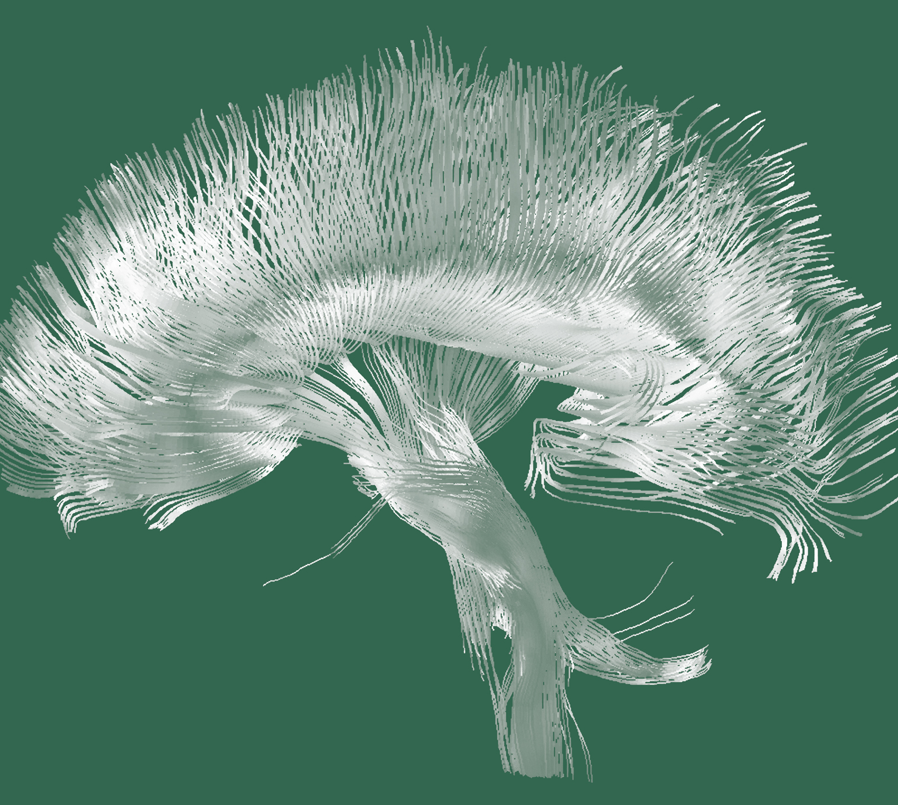
Schizophrenia
Epidemiology and burden

