Slide 1
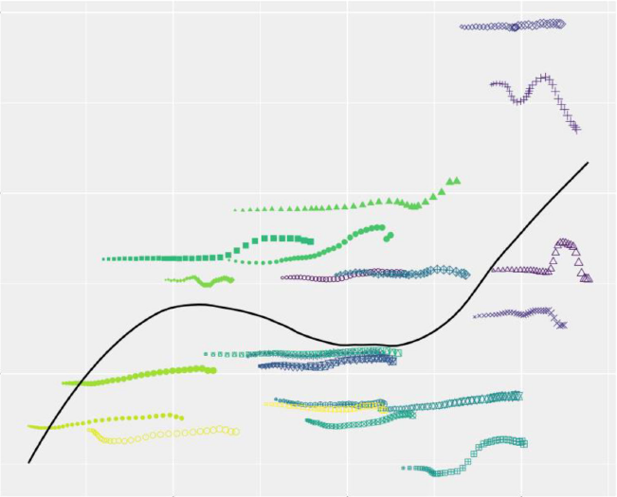
Schizophrenia burden by region
Schizophrenia – Epidemiology and burden
ASDR (95% UI) for schizophrenia per 100,000 people,
by SDI region in 2019 and 2021
ASDR and SDI for schizophrenia across 22 GBD regions (1990–2021)²
SDI regions | GBD 2019¹ | GBD 2021²
High | 213.4 (155.5, 271.9) | 188.6 (140.8, 241.8)
High-middle | 194.5 (142.6, 244.5) | 185.4 (138.4, 233.1)
Middle | 182.4 (133.4, 232.5) | 179.0 (132.6, 229.9)
Low-middle | 174.3 (125.2, 222.2) | 173.7 (128.0, 227.8)
Low | 150.6 (108.1 193.9) | 154.5 (112.4, 202.6)
Location
250
Global
High-income Asia Pacific
High-income North America
Western Europe
Australasia
Andean Latin America
Tropical Latin America
Central Latin America
200
Southern Latin America
Caribbean
Central Europe
ASDR per 100,000
Eastern Europe
Central Asia
North Africa and Middle East
South Asia
Southeast Asia
150
East Asia
Oceania
Western Sub-Saharan Africa
Eastern Sub-Saharan Africa
Central Sub-Saharan Africa
Year
Southern Sub-Saharan Africa
0.4
0.6
0.8
1990
2010
SDI
1995
2015
2000
2020
2005
There is a positive correlation between ASDR for schizophrenia and SDI,
with the highest ASDR rates reported in high SDI countries^{1,3}
ASDR=age-standardized disability rate; DALY=disability-adjusted life year; GBD=Global Burden of Disease; SDI=sociodemographic index; UI=uncertainly interval
1. Solmi et al. Mol Psychiatry 2023;28:5319–5327; 2. Zhan et al Front Psychiatry 2025;16:1629032; 3. Li et al. Environ Res 2023;232:116305
This work is adapted from ‘Results of the global burden of disease study for schizophrenia: trends from 1990 to 2021 and projections to 2050’
by Zhan et al., used under CC-BY-4.0. This work is licensed under
Creative Commons license CC-BY-SA by The Lundbeck Foundation.
Notes:
References:
Solmi M, Seitidis G, Mavridis D, et al. Incidence, prevalence, and global burden of schizophrenia - data, with critical appraisal, from the Global Burden of Disease (GBD) 2019. Mol Psychiatry 2023; 28: 5319–5327.
Zhan Z, Wang J, Shen T, et al. Results of the global burden of disease study for schizophrenia: trends from 1990 to 2021 and projections to 2050. Front Psychiatry 2025; 16: 1629032.
Li X, Wei N, Song J, et al. The global burden of schizophrenia and the impact of urbanization during 1990-2019: an analysis of the global burden of disease study 2019. Environ Res 2023; 232:116305.

