Slide 1

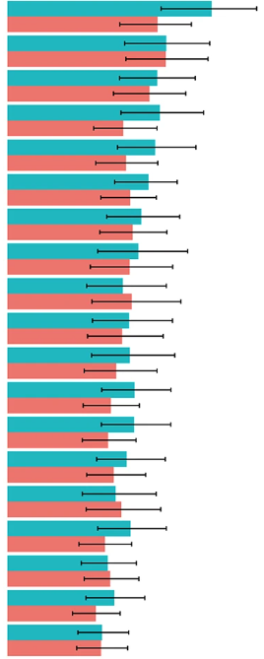
Schizophrenia burden by sex
Schizophrenia – Epidemiology and burden
Consistently higher ASDRs have been observed for males with schizophrenia than for females
across age groups and regions^{1–3}
Global DALYS for schizophrenia,
by sex and age group in 2019^{a,4}
Sex-stratified ASDR for schizophrenia among youth populations (aged 10–24 years), in G20 countries in 2021¹
Age (years)
≥95
90–94
85–89
80–84
75–79
70–74
65–69
60–64
55–59
50–54
45–49
40–44
35–39
30–34
25–29
20–24
15–19
10–14
Australia
United States of America
China
India
Indonesia
Canada
Japan
Argentina
Republic of Korea
France
Saudi Arabia
Italy
Mexico
Turkey
Germany
Brazil
South Africa
United Kingdom
Russian Federation
Male
Males
Females
Female
2
1
0
1
2
This work is from Liao et al. BMC Psychiatry 2025, ‘Trends and future burden of schizophrenia in youth across G20 countries: a systematic analysis of the global burden of disease 2021 study’, licensed under CC‑BY-NC-ND-4.0. Published by Springer Nature on behalf of BMC Psychiatry. The work cannot be changed in any way or used commercially without permission from the journal.
DALYs (millions)
This work is adapted from ‘Global, regional, and national burden of 12 mental disorders in 204 countries and territories, 1990-2019: a systematic analysis for the Global Burden of Disease Study 2019’ by GBD 2019 Mental Disorders Collaborators, used under CC-BY-4.0. This work is licensed under Creative Commons license CC-BY-SA by The Lundbeck Foundation.
0
100
200
300
Age-standardized DALYs
(per 100,000 person-years)
ªSince the GBD 2019 estimate of YLL is zero in schizophrenia, YLD and DALY values were identical in the analysis
ASDR=age-standardized disability rate; CI=confidence interval; DALY=disability-adjusted life year; G20=Group of 20;
GBD=Global Burden of Diseases; YLD=years lived with disability; YLL=years of life lost; UI=uncertainty interval
1.Liao et al. BMC Psychiatry 2025;25:1101; 2. Solmi et al. Mol Psychiatry 2023;28:5319–5327; 3. Peng et al. Front Psychiatry 2025;16:1682955; 4. GBD 2019 Mental Disorders Collaborators. Lancet Psychiatry 2022;9:137–150
Notes:
Similar to 2019 estimates, the GBD study reported higher ASDRs for males (189.0 per 100,000 [95% UI: 139.9, 243.7]) with schizophrenia than females (166.4 per 100,000 [95% UI: 122.8, 213.9]) in 2021, suggesting consistent temporal trends.⁵
A GBD analysis of 2021 data for individuals aged 15–39 years showed an ASDR of 255.52 per 100,000 (95% UI: 180.97, 345.67) for males with schizophrenia versus 222.77 per 100,000 (157.48, 301.86) for females.³
Abbreviations: ASDR=age-standardized disability rate; GBD=Global Burden of Diseases; UI=uncertainty interval
References:
Liao W, Chen Z, Wu W, et al. Trends and future burden of schizophrenia in youth across G20 countries: a systematic analysis of the global burden of disease 2021 study. BMC Psychiatry 2025; 25: 1101.
Solmi M, Seitidis G, Mavridis D, et al. Incidence, prevalence, and global burden of schizophrenia - data, with critical appraisal, from the Global Burden of Disease (GBD) 2019. Mol Psychiatry 2023; 28: 5319–5327.
Peng B, Hu F, He Q, et al. Global, regional, and national burden and trends of schizophrenia among adolescents and young adults aged 15-39 years from 1990 to 2021: an analysis of the global burden of disease study 2021. Front Psychiatry 2025; 16: 1682955.
GBD 2019 Mental Disorders Collaborators. Global, regional, and national burden of 12 mental disorders in 204 countries and territories, 1990-2019: a systematic analysis for the Global Burden of Disease Study 2019. Lancet Psychiatry 2022; 9: 137–150.
Zhan Z, Wang J, Shen T, et al. Results of the global burden of disease study for schizophrenia: trends from 1990 to 2021 and projections to 2050. Front Psychiatry 2025; 16: 1629032.

