Slide 1
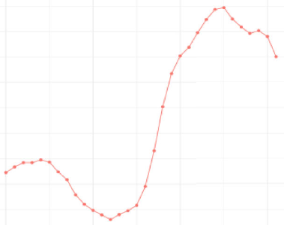
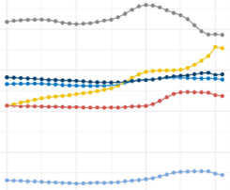
Disability burden due to schizophrenia over time and by SDI
Schizophrenia – Epidemiology and burden
Global ASDR for schizophrenia
(1990–2021)¹
ASDR for schizophrenia
across SDI regions (1990–2021)¹
178.0
190
Global
177.5
180
High-middle SDI
High SDI
ASDR per 100,000
ASDR per 100,000
Low-middle SDI
177.0
170
Low SDI
Middle SDI
176.5
160
1990
2000
2010
2020
1990
2000
2010
2020
Year
Year
Generally, ASDR rates have increased over time since 2002; high SDI regions consistently have higher DALY rates^{1,2}
ASDR=age-standardized disability rate; DALY=disability-adjusted life year; SDI=sociodemographic index
1. Zhan et al Front Psychiatry 2025;16:1629032; 2. Solmi et al. Mol Psychiatry 2023;28:5319–5327
This work is adapted from ‘Results of the global burden of disease study for schizophrenia: trends from 1990 to 2021 and projections to 2050’ by Zhan et al., used under CC-BY-4.0. This work is licensed under Creative Commons license CC-BY-SA by
The Lundbeck Foundation.
Notes:
The calculation of GBD data is based on the data available for each country, which means the accuracy of GBD data depends heavily on the quality and quantity of data used in the algorithm.³ The lowest epidemiological data coverage was found in data from countries with low levels of development, leading to greater uncertainty in the estimates.³
Abbreviations: GBD=Global Burden of Diseases
References:
Zhan Z, Wang J, Shen T, et al. Results of the global burden of disease study for schizophrenia: trends from 1990 to 2021 and projections to 2050. Front Psychiatry 2025; 16: 1629032.
Solmi M, Seitidis G, Mavridis D, et al. Incidence, prevalence, and global burden of schizophrenia - data, with critical appraisal, from the Global Burden of Disease (GBD) 2019. Mol Psychiatry 2023; 28: 5319–5327.
Li X, Wei N, Song J, et al. The global burden of schizophrenia and the impact of urbanization during 1990-2019: an analysis of the global burden of disease study 2019. Environ Res 2023; 232: 116305.

