Slide 1
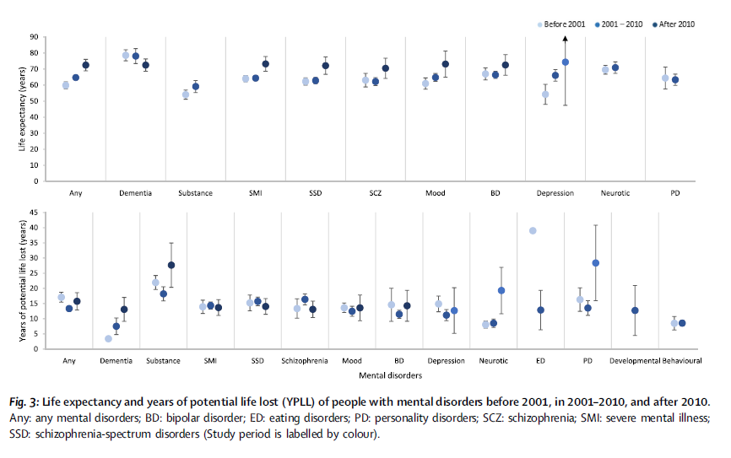
Life expectancy in schizophrenia
Schizophrenia – Epidemiology and burden
Life expectancy and YPLL in
people with schizophrenia
Life expectancy of people with mental disorders
before 2001, in 2001–2010, and after 2010
90
Before 2001
2001–2010
After 2010
Years (95% CI) | Male | Female | Overall
Life expectancy | 61.7 (59.3, 64.1) | 69.2 (66.8, 71.6) | 63.7 (61.5, 65.8)
YPLL | 15.0 (13.3, 16.6) | 13.1 (11.3, 14.9) | 15.2 (13.8, 16.7)
80
70
60
50
Life expectancy (years)
40
30
20
10
0
Any
Dementia
Substance
SMI
SSD
SCZ
Mood
BD
Depression
Neurotic
PD
YPPL in people with mental disorders
before 2001, in 2001–2010, and after 2010
45
40
35
30
25
YPLL
20
15
10
5
0
Any
Dementia
Substance
SMI
SSD
SCZ
Mood
BD
Depression
Neurotic
ED
PD
Develop-mental
Behavioural
The shortest life expectancy was reported for people with substance use disorders,
followed by depressive disorders, personality disorders, and schizophrenia; YPLL was highest for people with substance use disorders, eating disorders, schizophrenia-spectrum disorders, and personality disorders.
BD=bipolar disorder; CI=confidence interval; ED=eating disorder; PD=personality disorder; SCZ=schizophrenia; SMI=severe mental illness; SSD=schizophrenia-spectrum disorder; YPLL=years of potential life lost
Chan et al. EClinicalMedicine 2023;65:102294
This work is from Chan et al. eClinicalMedicine 2023. ‘Life expectancy and years of potential life lost in people with mental disorders: a systematic review and meta-analysis’, licensed under CC-BY-NC-ND-4.0. Published by Elsevier on behalf of eClinicalMedicine. The work cannot be changed in any way or used commercially without permission
from the journal.
Notes:
Reference:
Chan JKN, Correll CU, Wong CSM, et al. Life expectancy and years of potential life lost in people with mental disorders: a systematic review and meta-analysis. EClinicalMedicine 2023; 65: 102294.

