Slide 1
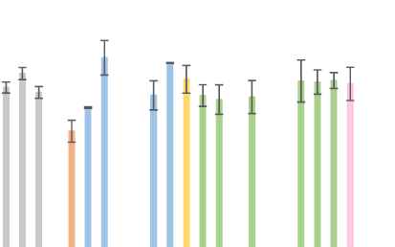
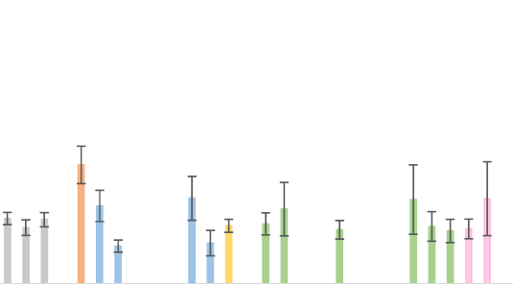
Life expectancy in schizophrenia, by region
Schizophrenia – Epidemiology and burden
Overall life expectancy of people with schizophrenia by region
YPLL for people with
schizophrenia by region
90
60
80
50
70
60
40
50
30
Life expectancy (years)
YPLL (years)
40
30
20
20
10
10
0
0
Overall
Female
Male
Ethiopia
China
Hong Kong
Israel
Japan
Taiwan
Türkiye
Australia
Denmark
Finland
Germany
Hungary
Italy
Norway
Spain
Sweden
UK
Canada
USA
Brazil
Overall
Female
Male
Ethiopia
China
Hong Kong
India
Israel
Japan
Taiwan
Türkiye
Australia
Czech Republic
Denmark
Finland
France
Germany
Hungary
Ireland
Italy
Norway
Spain
Sweden
UK
Canada
USA
Brazil
Differences in lifestyle factors as well as access to, and quality of, healthcare services may contribute
to the variations in life expectancy across countries
UK=United Kingdom; USA=United States of America; YPLL=years of potential life lost
Chan et al. EClinicalMedicine 2023;65:102294
This work is from Chan et al. eClinicalMedicine 2023. ‘Life expectancy and years of potential life lost in people with mental disorders: a systematic review and meta-analysis’, licensed under
CC-BY-NC-ND-4.0. Published by Elsevier on behalf of eClinicalMedicine. The work cannot
be changed in any way or used commercially without permission from the journal.
Notes:
The study had limitations, including the fact that data from continents other than Europe and North America were represented by fewer studies; therefore, results on regional differences should be interpreted with caution.¹
Reference:
Chan JKN, Correll CU, Wong CSM, et al. Life expectancy and years of potential life lost in people with mental disorders: a systematic review and meta-analysis. EClinicalMedicine 2023; 65: 102294.

