Slide 1
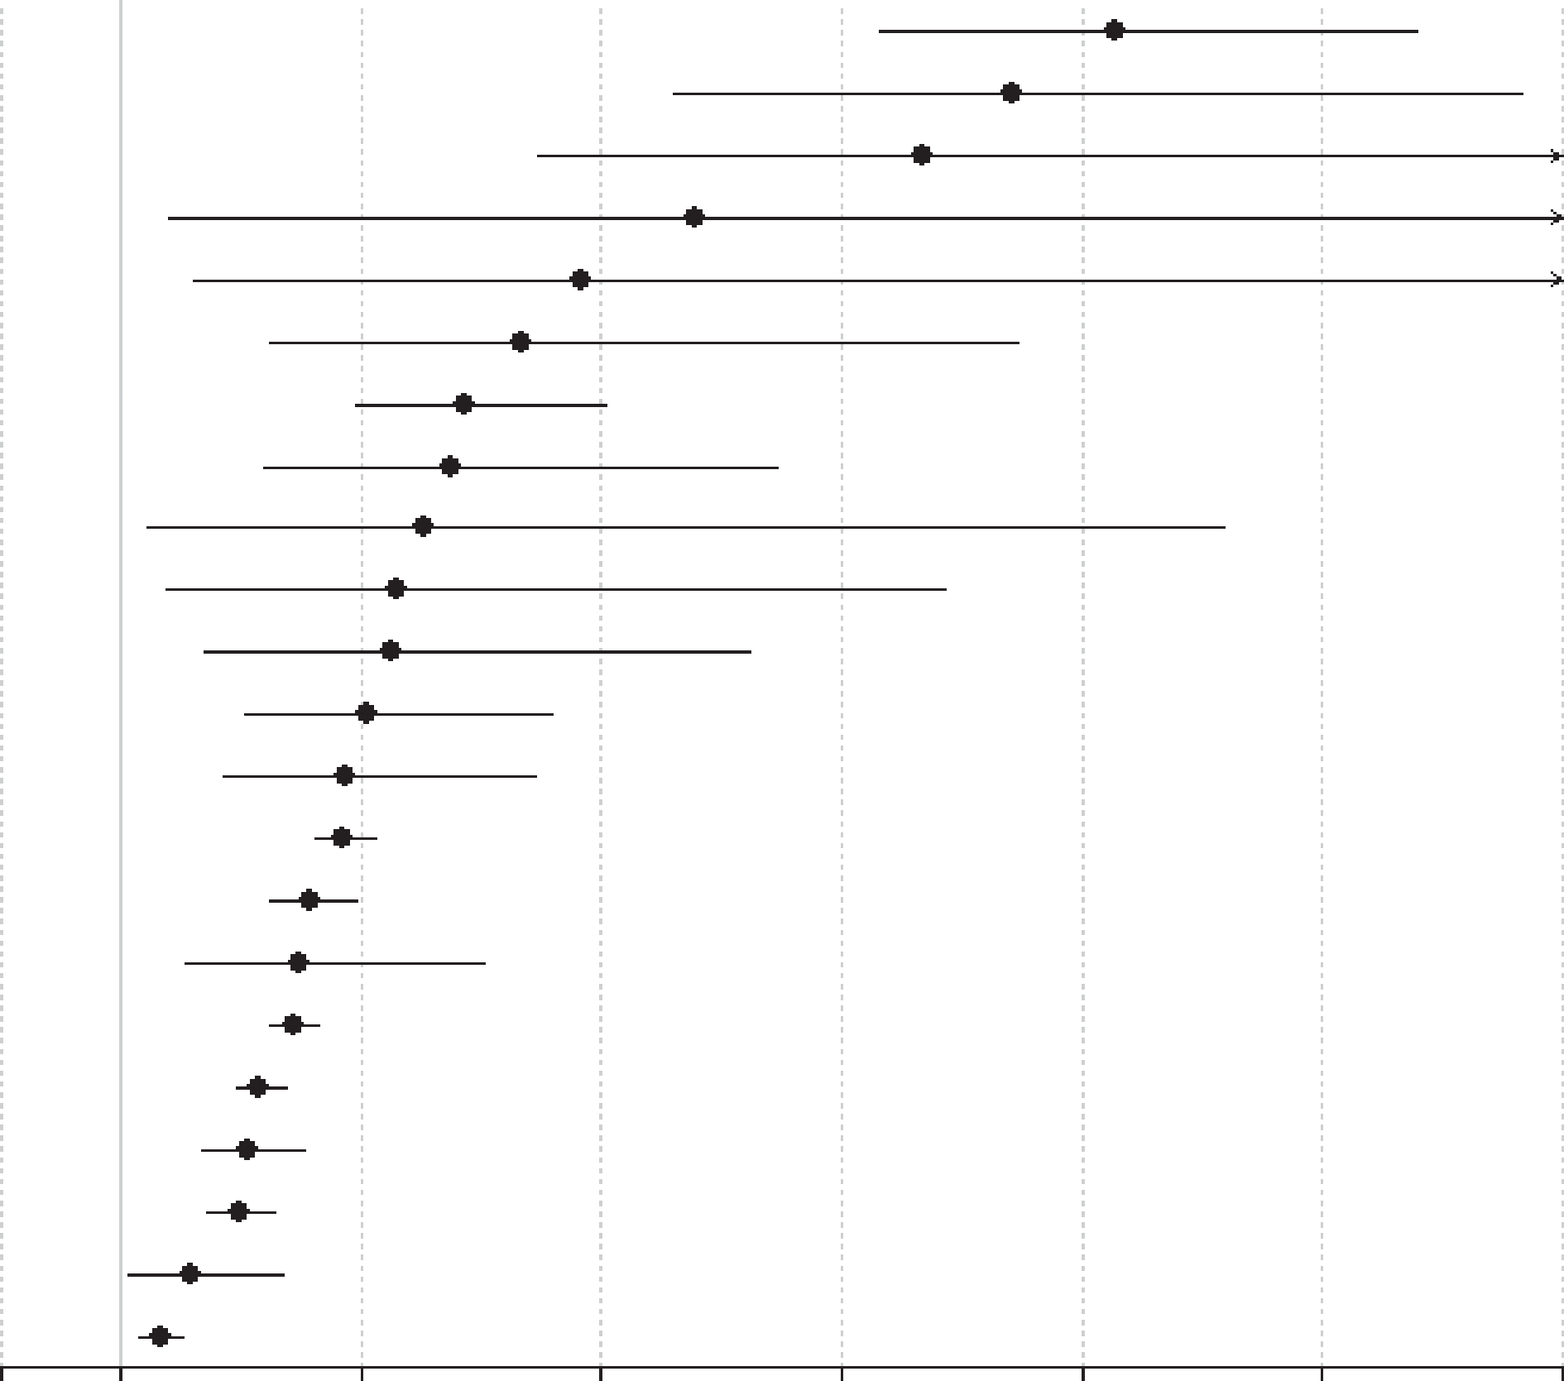
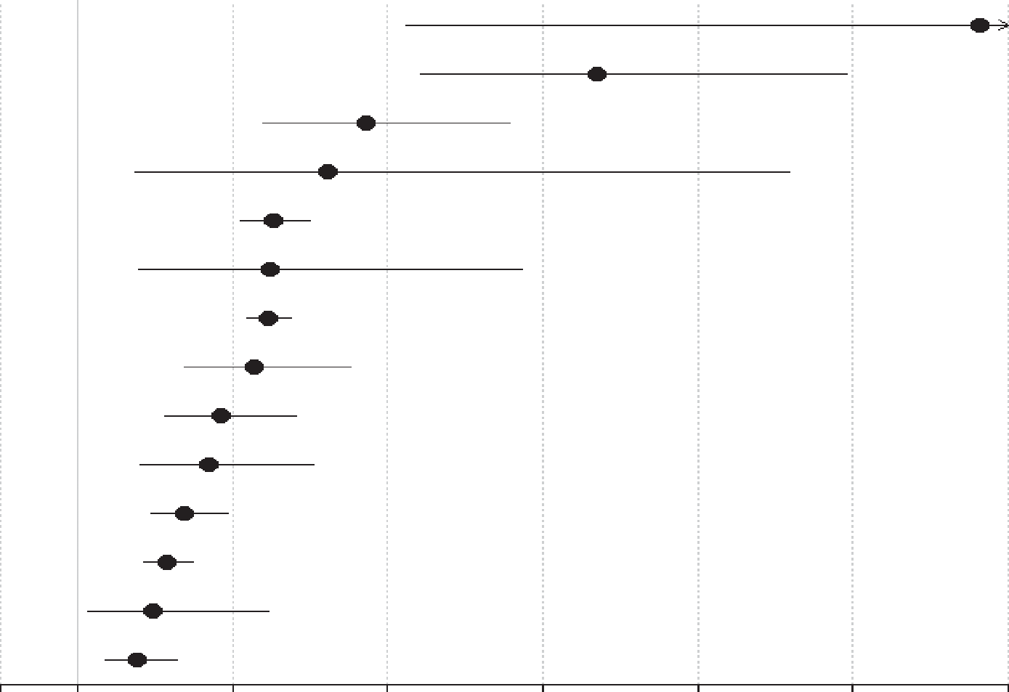
Mortality in prevalent and incident schizophrenia
Schizophrenia – Epidemiology and burden
All-cause and cause-specific mortality risk in prevalent schizophrenia versus the general population
All-cause and cause-specific mortality risk in incident schizophrenia versus the general population
Outcome
Risk ratio (95% CI)
Suicide (n=23)
Undetermined non-natural (n=9)
Infectious-pneumonia (n=2)
Skin/subcutaneous (n=2)
Musculoskeletal/connective (n=2)
Infectious-any (n=8)
Respiratory-any (n=11)
Urogenital-any (n=7)
Endocrine (n=6)
Injury-accidents (n=4)
Injury-any (n=5)
Gastrointestinal (n=8)
Diabetes (n=4)
All-cause (n=50)
Natural (study-defined) (n=16)
Other not specified (n=4)
Nervous-any (n=4)
Natural (n=38)
Cardiovascular (n=14)
Cardio-cerebrovascular (n=24)
Cerebrovascular (n=8)
Cancer-any (n=20)
9.28 (7.31, 11.78)
8.42 (5.60, 12.70)
7.67 (4.48, 13.10)
5.79 (1.40, 23.90)
4.83 (1.60, 14.60)
4.34 (2.23, 8.47)
3.86 (2.96, 5.03)
3.75 (2.18, 6.45)
3.52 (1.22, 10.18)
3.31 (1.39, 7.87)
3.26 (1.70, 6.23)
3.06 (2.05, 4.58)
2.88 (1.86, 4.46)
2.86 (2.62, 3.12)
2.58 (2.25, 2.96)
2.49 (1.53, 4.02)
2.43 (2.24, 2.64)
2.15 (1.96, 2.37)
2.06 (1.68, 2.52)
1.98 (1.73, 2.28)
1.58 (1.06, 2.36)
1.33 (1.16, 1.52)
Outcome
Risk ratio (95% CI)
Suicide (n=5)
Undetermined non-natural (n=5)
Other not specified (n=3)
Endocrine (n=3)
All-cause (n=7)
Cardio-cerebrovascular (n=4)
Injury-accidents (n=5)
Respiratory-any (n=4)
Natural (study-defined) (n=5)
Cardiovascular (n=5)
Gastrointestinal (n=4)
Natural (n=6)
Nervous-any (n=4)
Cerebrovascular (n=5)
12.7 (5.25, 30.53)
7.69 (5.42, 10.90)
4.72 (3.39, 6.56)
4.22 (1.75, 10.18)
3.52 (3.09, 4.00)
3.47 (1.79, 6.72)
3.45 (3.18, 3.75)
3.27 (2.36, 4.51)
2.85 (2.14, 3.81)
2.70 (1.80, 4.05)
2.38 (1.94, 2.93)
2.15 (1.86, 2.48)
1.97 (1.13, 3.45)
1.76 (1.36, 2.29)
0
1
3
5
7
9
11
13
0
1
3
5
7
9
11
13
Risk ratio (95% CI)
Risk ratio (95% CI)
Suicide is the leading specific cause of death in prevalent and incident schizophrenia
CI=confidence interval
Correll et al. World Psychiatry. 2022;21:248–271
This work is from World Psychiatry, Vol 21, Correll et al., ‘Mortality in people with schizophrenia: a systematic review and meta-analysis of relative risk and aggravating or attenuating factors’, 248–271; Copyright © 2022, with permission from the authors.
Notes:
Based on a systematic review and random-effects meta-analysis of 135 studies (1957–2021), including 4.5 million people with schizophrenia and over 1.1 billion general population controls, all-cause mortality was higher in people with schizophrenia than in the general population (incident schizophrenia risk ratio: 3.516 [95% CI: 3.09, 3.998]; prevalent schizophrenia risk ratio: 2.859 [95% CI: 2.622, 3.117]).¹
Abbreviations: CI=confidence interval
References
Correll CU, Solmi M, Croatto G, et al. Mortality in people with schizophrenia: a systematic review and meta-analysis of relative risk and aggravating or attenuating factors. World Psychiatry 2022; 21: 248–271.

