Slide 1
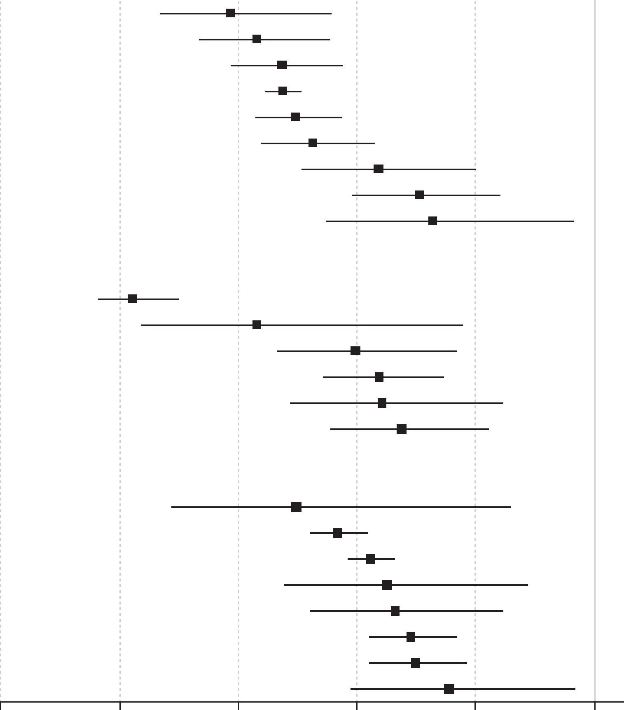
The antipsychotic paradox and mortality risk in schizophrenia
Schizophrenia – Epidemiology and burden
What is the antipsychotic paradox?
Antipsychotics are associated with several AEs, particularly cardiometabolic events, which are known risk factors for premature cardiovascular mortality; however, antipsychotics have consistently been associated with decreased mortality risk in people with schizophrenia, due to improved lifestyle and increased access to care when on treatment^{1,2}
All-cause mortality risk and mortality risk due to suicide or natural death
in schizophrenia, by antipsychotic type¹
Outcome
Risk ratio (95% CI)
All-cause mortality
Any SGA LAI (n=3)
Clozapine (n=3)
Any LAI (n=2)
Any SGA oral (n=4)
Any FGA LAI (n=3)
Any SGA (n=4)
Any oral (n=4)
Any antipsychotic (n=11)
Any FGA (n=5)
0.39 (0.27, 0.56)
0.43 (0.34, 0.55)
0.47 (0.39, 0.58)
0.47 (0.45, 0.50)
0.50 (0.43, 0.57)
0.53 (0.44, 0.63)
0.64 (0.51, 0.80)
0.71 (0.59, 0.84)
0.73 (0.55, 0.97)
CVM risk with antipsychotics
Compared with FGAs, SGAs and clozapine demonstrate a reduced risk of CVM³
Mortality from suicide
Clozapine (n=2)
Any SGA LAI (n=1)
Any LAI (n=1)
Any SGA oral (n=2)
Any FGA LAI (n=1)
Any SGA (n=2)
0.22 (0.16, 0.30)
0.43 (0.24, 0.78)
0.60 (0.47, 0.77)
0.64 (0.54, 0.74)
0.64 (0.49, 0.85)
0.68 (0.56, 0.82)
The protective effects of antipsychotics¹
Antipsychotics are protective against all‑cause mortality, with clozapine and SGA LAIs showing the strongest risk reductions compared with FGA LAIs and any oral antipsychotic
Mortality from natural cause
Clozapine (n=2)
Any SGA oral (n=2)
Any oral antipsychotic (n=1)
Any SGA (n=2)
Any SGA LAI (n=1)
Any LAI (n=1)
Any FGA LAI (n=1)
Any antipsychotic (n=3)
0.50 (0.29, 0.86)
0.57 (0.52, 0.62)
0.62 (0.59, 0.66)
0.65 (0.48, 0.89)
0.66 (0.52, 0.84)
0.69 (0.62, 0.77)
0.70 (0.62, 0.78)
0.76 (0.59, 0.97)
0
0.2
0.4
0.6
0.8
1
Risk ratio (95% CI)
AE=adverse event; CI=confidence interval; CVM=cardio-cerebrovascular mortality; FGA=first-generation antipsychotic; LAI=long-acting injectable; SGA=second-generation antipsychotic
1. Correll et al. World Psychiatry 2022;21:248–271; 2. Solmi & Correll. Eur Neuropsychopharmacol 2022;62:1–3; 3. Solmi et al. Eur Neuropsychopharmacol 2024;88:6–20
This work is from World Psychiatry, Vol 21, Correll et al., ‘Mortality in people with schizophrenia: a systematic review and meta-analysis of relative risk and aggravating or attenuating factors’, 248–271; Copyright © 2022, with permission from the authors.
Notes:
Potential explanations for the “antipsychotic paradox” include antipsychotic-related reductions of stress-linked cortisol levels and inflammation, improved healthy lifestyle behaviours, and a reduction in healthcare disparities between patients with and without schizophrenia.² Further, antipsychotics are associated with increased adherence to medical and psychiatric care, which may override cardiometabolic risk associated with these treatments.² This increased access to medical care may allow signs and symptoms to be identified sooner, resulting in timely diagnosis and treatment. In schizophrenia, there is a reduced substance abuse and suicide risk in individuals using antipsychotics vs those who are not.²
Evidence for the protective effects of antipsychotics is not consistently available across regions, with limited data available from South America, Eastern Europe, the Middle East and South-East Asia, highlighting a need for further research in these regions.^{1,4}
References:
Correll CU, Solmi M, Croatto G, et al. Mortality in people with schizophrenia: a systematic review and meta-analysis of relative risk and aggravating or attenuating factors. World Psychiatry 2022; 21: 248–271.
Solmi M & Correll CU. The antipsychotic paradox: Lessons regarding determinants of premature mortality. Eur Neuropsychopharmacol 2022; 62: 1–3.
Solmi M, Croatto G, Gupta A, et al. Effects of antipsychotic treatment on cardio-cerebrovascular related mortality in schizophrenia: A subanalysis of a systematic review and meta-analysis with meta-regression of moderators. Eur Neuropsychopharmacol 2024; 88: 6–20.
Solmi M, Croatto G, Fornaro M, et al. Regional differences in mortality risk and in attenuating or aggravating factors in schizophrenia: a systematic review and meta-analysis. Eur Neuropsychopharmacol 2024; 80: 55–69.

