Slide 1
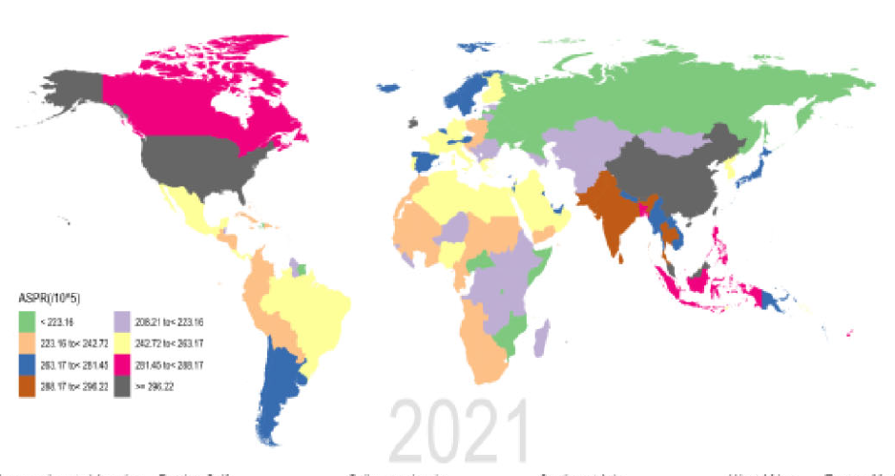
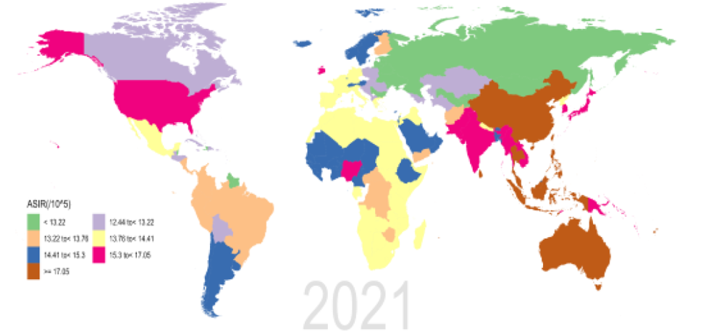
Prevalence and incidence of schizophrenia by region
Schizophrenia – Epidemiology and burden
ASPR for schizophrenia per 100,000 persons,
by region between 1990 and 2021
ASIR for schizophrenia per 100,000 persons,
by region between 1990 and 2021
ASPR
(per 100,000)
ASIR
(per 100,000)
208.21 to <223.16
12.44 to <13.22
<223.16
223.16 to <242.72
<13.22
242.72 to <263.17
13.22 to <13.75
263.17 to <261.45
13.76 to <14.41
261.45 to <288.17
14.41 to <15.30
288.17 to <296.22
15.30 to <17.05
≥296.22
≥17.05
This work is adapted from ‘Results of the global burden of disease study for schizophrenia: trends from 1990 to 2021 and projections to 2050’ by Zhan et al., used under CC-BY-4.0. This work is licensed under Creative Commons license CC-BY-SA by The Lundbeck Foundation.
Schizophrenia is associated with different prevalence and incidence rates across regions
ASIR=age-standardized incidence rate; ASPR=age-standardized prevalence rate
Zhan et al. Front Psychiatry 2025;16:1629032
Notes:
To describe the burden of schizophrenia regionally, the GBD study has grouped 204 countries into 21 GBD regions according to socioeconomic similarity and geographical proximity.²
Regions with the highest ASIRs include Australasia (20.2 per 100,000) and East Asia (18.3 per 100,000).¹ Regions with the lowest ASIRs include Eastern Europe (11.7 per 100,000), followed by the Caribbean (12.4 per 100,000) and Central Asia (12.43 per 100,000).¹ Regions with the highest ASPRs include Australasia (387.1 per 100,000), followed by North America (347.7 per 100,000) and East Asia (311.4 per 100,000).¹ Regions with the lowest ASPRs include Eastern Europe (205.8 per 100,000), followed by the Central Sub-Saharan Africa (212.7 per 100,000) and Central Asia (215.6 per 100,000).¹
The observed differences across regions are hypothesized to be a result of differences in data quality. The high ASPRs reported in high-income countries likely reflect better mental health data systems, where health systems routinely collect and store epidemiologic data on mental health, while low-income countries might still be developing sustainable systematic data collection infrastructure, rather than reflecting a true higher schizophrenia risk in high-income countries.³
Abbreviations: ASIR=age-standardized incidence rate; ASPR=age-standardized prevalence rate; GBD=Global Burden of Diseases
References:
Zhan Z, Wang J, Shen T, et al. Results of the global burden of disease study for schizophrenia: trends from 1990 to 2021 and projections to 2050. Front Psychiatry 2025; 16: 1629032.
Li X, Wei N, Song J, et al. The global burden of schizophrenia and the impact of urbanization during 1990-2019: an analysis of the global burden of disease study 2019. Environ Res 2023; 232:116305.
Solmi M, Seitidis G, Mavridis D, et al. Incidence, prevalence, and global burden of schizophrenia - data, with critical appraisal, from the Global Burden of Disease (GBD) 2019. Mol Psychiatry 2023; 28: 5319–5327.

