Slide 1
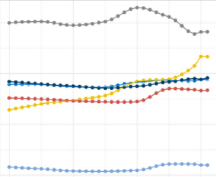
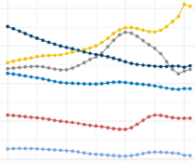
Prevalence and incidence of schizophrenia over time and by sociodemographic index
Schizophrenia – Epidemiology and burden
ASPR for schizophrenia from 1990 to 2021, globally and in the five SDI regions
ASIR for schizophrenia from 1990 to 2021, globally and in the five SDI regions
Globally, the ASIR of schizophrenia has declined between 1990 and 2021, while ASPR increased slightly
Consistently lower prevalence and incidence rates are reported in lower SDI quintiles, likely reflecting differences in mental health care structures
16.5
300
16.0
280
ASPR per 100,000
ASIR per 100,000
15.5
260
15.0
240
14.5
1990
2000
2010
2020
1990
2000
2010
2020
Year
Year
Global
High-middle SDI
High SDI
Low-middle SDI
Low SDI
Middle SDI
This work is adapted from ‘Results of the global burden of disease study for schizophrenia: trends from 1990 to 2021 and projections to 2050’ by Zhan et al., used under CC-BY-4.0. This work is licensed under Creative Commons license CC-BY-SA by The Lundbeck Foundation.
The SDI is a composite measure that incorporates the total fertility rate, the average educational attainment of individuals aged 15 years and older, and the per capita income ranking; it indicates a nation’s overall social development, with values ranging from zero to one, and is classified as low, low-middle, medium, medium-high, and high
ASPR=age-standardized prevalence rate; ASIR=age-standardized incidence rate; SDI=sociodemographic index
Zhan et al. Front Psychiatry 2025;16:1629032
Notes:
Reference:
Zhan Z, Wang J, Shen T, et al. Results of the global burden of disease study for schizophrenia: trends from 1990 to 2021 and projections to 2050. Front Psychiatry 2025; 16: 1629032.

