Slide 1
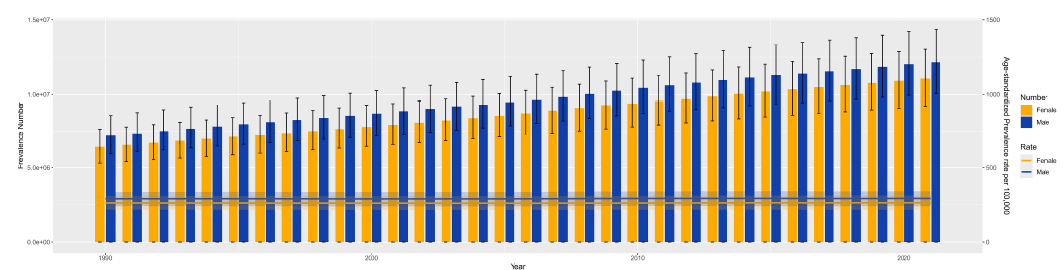
Prevalence and incidence of schizophrenia by sex
Schizophrenia – Epidemiology and burden
The GBD 2021 analysis showed a higher prevalence of schizophrenia in males¹
  Male ASPR:
  291.6 per 100,000
  (95% UI: 241.6, 345.0)
  Female ASPR:
  263.6 per 100,000
  (95% UI: 217.7, 311.9)
  A similar pattern is observed with incidence¹
Various GBD analyses show mostly similar sex patterns across countries and SDI regions^{2–4}
Global trends in schizophrenia prevalence by sex (1990–2021)⁴
1.5x10⁷
1,500
Number
Rate
Female
Female
Male
Male
1.0x10⁷
1,000
Prevalence number
ASPR per 100,0000
5.0x10⁶
500
0
0
1990
2000
2010
2020
Year
This work is adapted from ‘Results of the global burden of disease study for schizophrenia: trends from 1990 to 2021 and projections to 2050’ by Zhan et al., used under CC-BY-4.0. This work is licensed under Creative Commons license CC-BY-SA by The Lundbeck Foundation.
The male-to-female prevalence ratio has remained stable over the past three decades, with a consistently higher global risk of schizophrenia observed in males^{2,5}
ASPR=age-standardized prevalence rates; GBD=Global Burden of Disease; SDI=sociodemographic index; UI=uncertainty interval
1. GBD 2021 Diseases and Injuries Collaborators. Lancet 2024;403:2133–2161; 2. Peng et al. Front Psychiatry 2025;16:1682955; 3. Liao et al. BMC Psychiatry 2025;25:1101;
4. Zhan et al. Front Psychiatry 2025;16:1629032; 5. Solmi et al. Mol Psychiatry 2023;28:5319–5327
Notes:
GBD data for 2021 reported 659,000 (95% UI: 545,000, 791,000) incident cases of schizophrenia in males and 564,000 (95% UI: 464,000, 681,000) in females; this translated into an ASIR of 16.4 per 100,000 (95% UI: 13.6, 19.7) for males and 14.4 per 100,000 (95% UI: 11.8, 17.4), for females.¹
A GBD 2021 analysis revealed that the estimated annual percentage change in schizophrenia prevalence rates varied across SDI regions. In high SDI regions, the increasing trend of schizophrenia was higher in females than males, while in high-middle SDI regions, higher increasing trends were observed in males than females.⁴
Abbreviations: ASIR=age-standardized incidence rate; GBD=Global Burden of Diseases; SDI=sociodemographic index; UI=uncertainty interval
References:
GBD 2021 Diseases and Injuries Collaborators. Global incidence, prevalence, years lived with disability (YLDs), disability-adjusted life-years (DALYs), and healthy life expectancy (HALE) for 371 diseases and injuries in 204 countries and territories and 811 subnational locations, 1990-2021: a systematic analysis for the Global Burden of Disease Study 2021. Lancet 2024; 403: 2133–2161.
Peng B, Hu F, He Q, et al. Global, regional, and national burden and trends of schizophrenia among adolescents and young adults aged 15-39 years from 1990 to 2021: an analysis of the global burden of disease study 2021. Front Psychiatry 2025; 16: 1682955.
Liao W, Chen Z, Wu W, et al. Trends and future burden of schizophrenia in youth across G20 countries: a systematic analysis of the global burden of disease 2021 study. BMC Psychiatry 2025; 25: 1101.
Zhan Z, Wang J, Shen T, et al. Results of the global burden of disease study for schizophrenia: trends from 1990 to 2021 and projections to 2050. Front Psychiatry 2025; 16: 1629032.
Solmi M, Seitidis G, Mavridis D, et al. Incidence, prevalence, and global burden of schizophrenia - data, with critical appraisal, from the Global Burden of Disease (GBD) 2019. Mol Psychiatry 2023; 28: 5319–5327.

