Slide 1
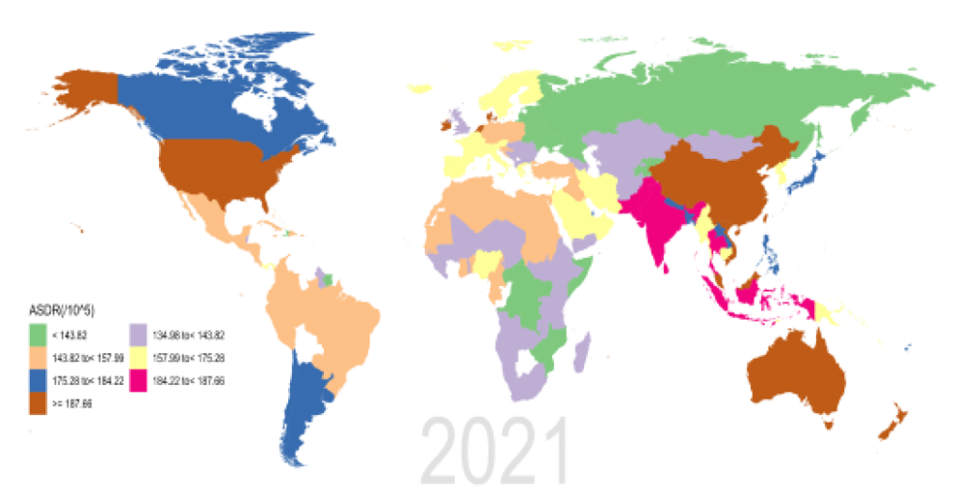
Global burden of disability due to schizophrenia
Schizophrenia – Epidemiology and burden
Schizophrenia is ranked among the top 20 mental disorders resulting in disability globally¹
  This burden is attributed to early onset in late adolescence/early adulthood, with low remission rates, which leads to a cumulative burden^{2–4}
ASDRs for schizophrenia per 100,000 persons,
by region in 2021⁵
DALYs due to schizophrenia in 2019 and 2021
 | GBD 2019² | GBD 2021⁵
DALYs, count | 15.1 million | 14.8 million
ASDR, per 100,000 cases (95% UI) | 184.15 (134.32, 234.54) | 177.8 (131.5, 228.8)
ASDR
(per 100,000)
134.96 to <143.82
<143.82
143.82 to <157.99
157.99 to <175.28
175.28 to <184.22
184.22 to <187.66
≥187.66
This work is adapted from ‘Results of the global burden of disease study for schizophrenia: trends from 1990 to 2021 and projections to 2050’ by Zhan et al., used under CC-BY-4.0. This work is licensed under Creative Commons license CC-BY-SA by The Lundbeck Foundation.
ASDR=age-standardized disability rate; DALY=disability-adjusted life year; GBD=Global Burden of Disease; UI=uncertainly interval
1. GBD 2019 Mental Disorders Collaborators. Lancet Psychiatry 2022;9:137–150; 2. Solmi et al. Mol Psychiatry 2023;28:5319–5327; 3. Weye et al. Lancet Psychiatry 2021;8:310–319;
4. Peng et al. Front Psychiatry 2025;16:1682955; 5. Zhan et al Front Psychiatry 2025;16:1629032
Notes:
In the GBD study, each death can only be assigned one cause. Schizophrenia is not listed as a cause of death; deaths in people with schizophrenia are recorded due to causes such as suicide or other physical illness. Consequently, the GBD study assigns zero deaths to schizophrenia, so zero years of life are lost. This means that DALYs due to schizophrenia (total burden) may be underestimated because DALYs = years of life lost (YLL; burden related to death) + years living with a disability (YLD; non-fatal burden). One DALY equals loss of one healthy year of life.²
Abbreviations: DALY=disability-adjusted life year; GBD=Global Burden of Disease; YLD=years lived with a disability; YLL=years of life lost
References:
GBD 2019 Mental Disorders Collaborators. Global, regional, and national burden of 12 mental disorders in 204 countries and territories, 1990-2019: a systematic analysis for the Global Burden of Disease Study 2019. Lancet Psychiatry 2022; 9: 137–150.
Solmi M, Seitidis G, Mavridis D, et al. Incidence, prevalence, and global burden of schizophrenia - data, with critical appraisal, from the Global Burden of Disease (GBD) 2019. Mol Psychiatry 2023; 28: 5319–5327.
Weye N, Santomauro DF, Agerbo E, et al. Register-based metrics of years lived with disability associated with mental and substance use disorders: a register-based cohort study in Denmark. Lancet Psychiatry 2021; 8: 310–319.
Peng B, Hu F, He Q, et al. Global, regional, and national burden and trends of schizophrenia among adolescents and young adults aged 15-39 years from 1990 to 2021: an analysis of the global burden of disease study 2021. Front Psychiatry 2025; 16: 1682955.
Zhan Z, Wang J, Shen T, et al. Results of the global burden of disease study for schizophrenia: trends from 1990 to 2021 and projections to 2050. Front Psychiatry 2025; 16: 1629032.

