Slide 1
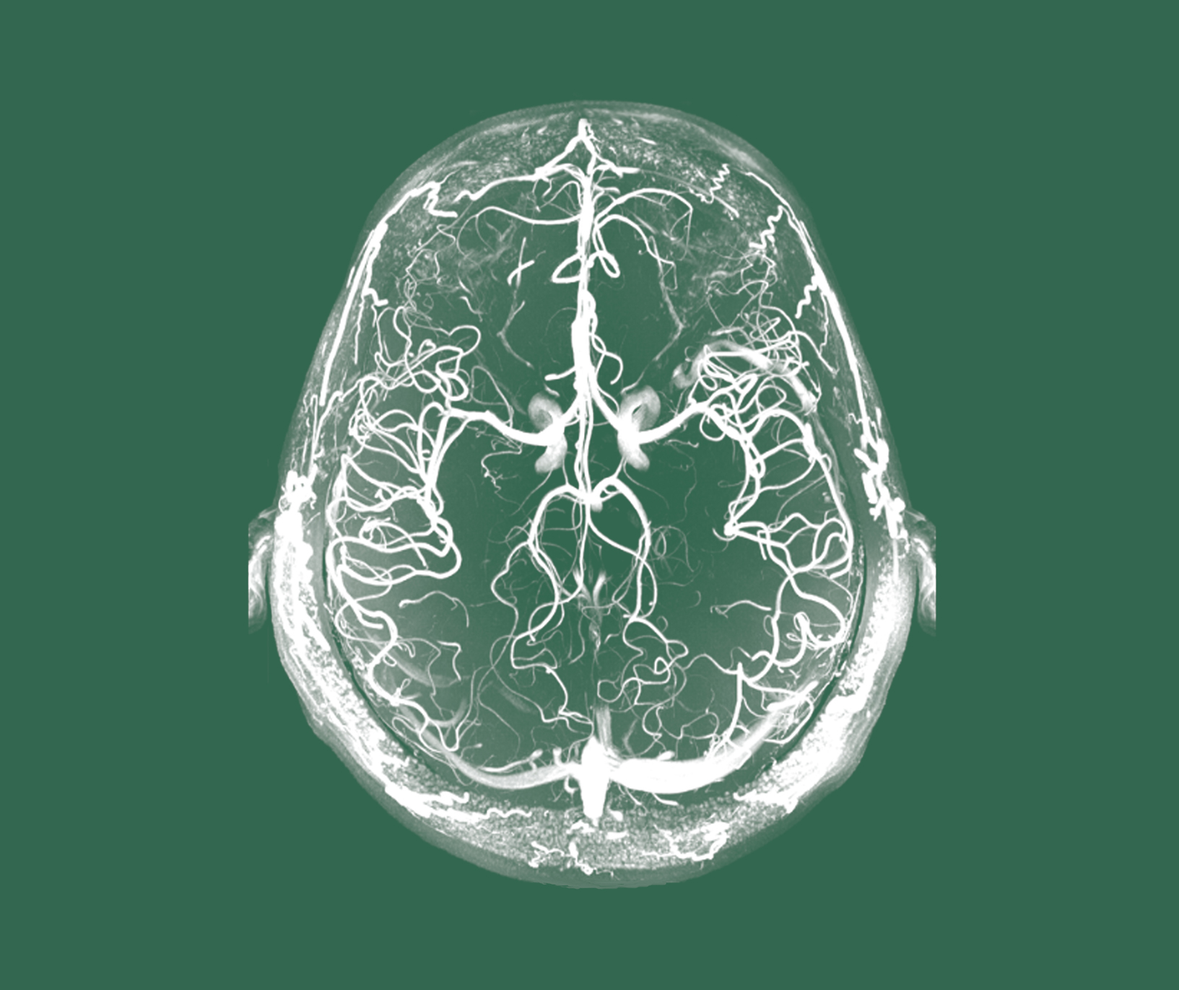
Schizophrenia
History, definitions, and diagnosis

