Slide 1
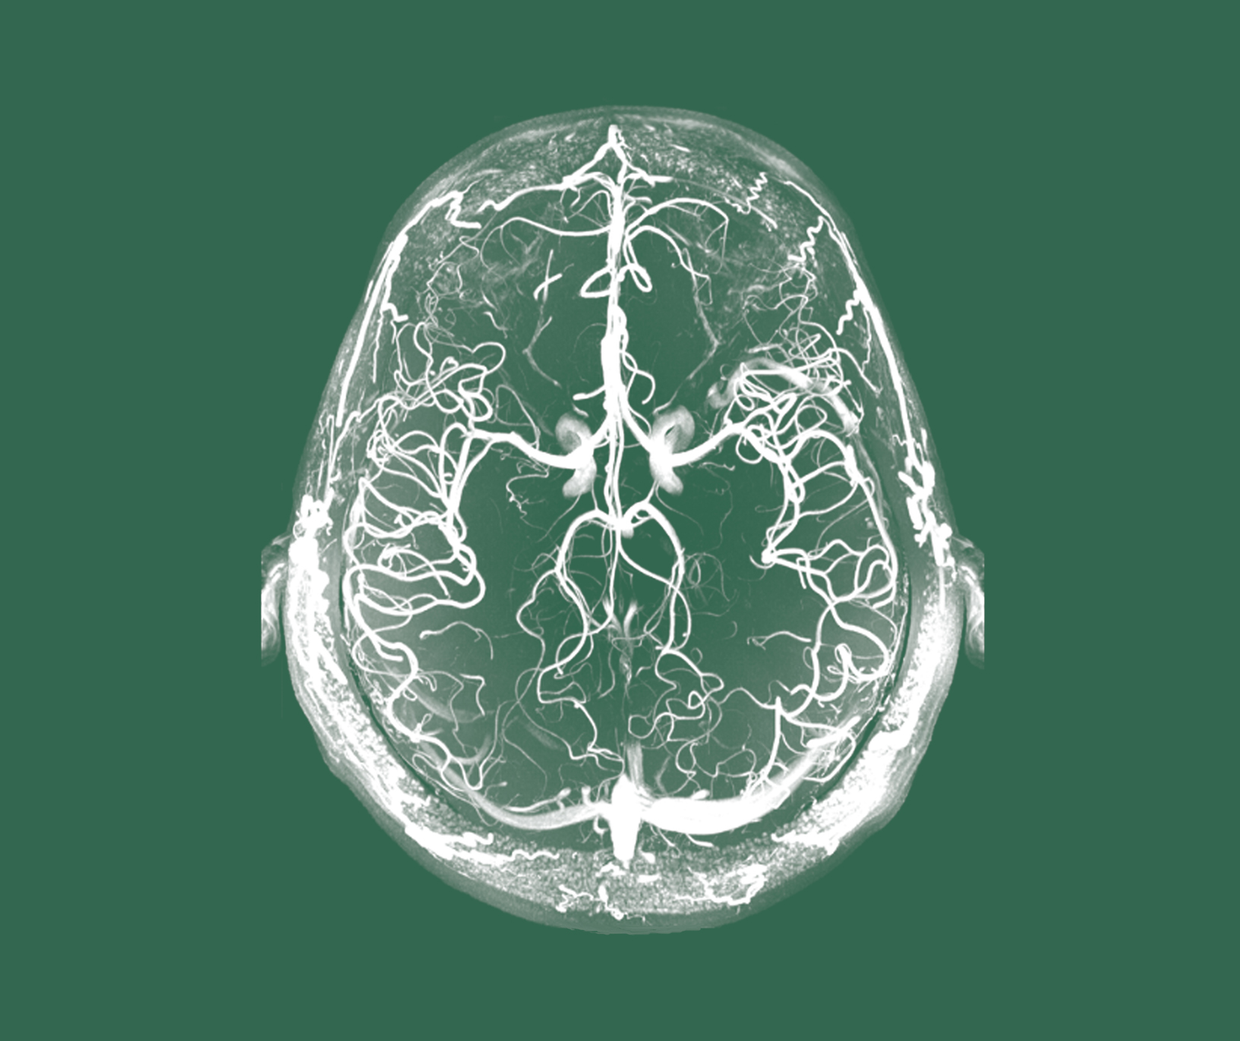
Schizophrenia
Treatment principles

