Slide 1
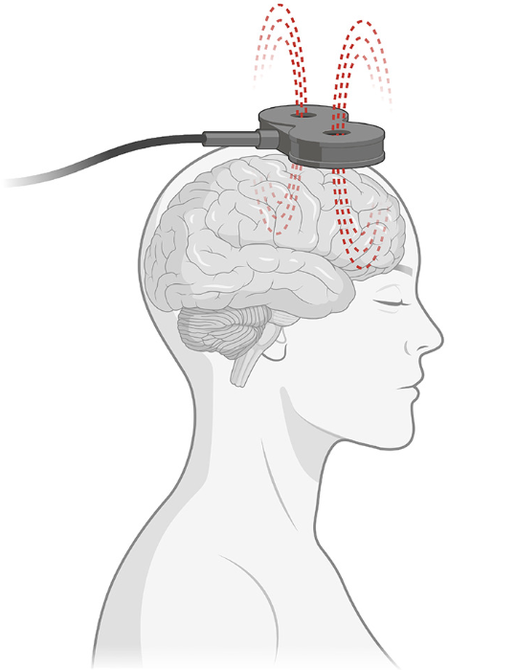
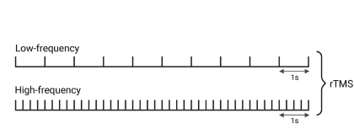
Non-pharmacological treatment for psychosis and treatment-resistant schizophrenia
Schizophrenia – Treatment principles
Cognitive behavioural therapy for psychosis (CBTp)¹
Guidelines such the American Psychiatric Association recommend CBTp for all people with schizophrenia (including those with treatment-resistant schizophrenia), and suggest that engaging family members and persons of support may be helpful
CBTp can be initiated during any phase of illness and in any treatment setting, including inpatient settings
Non-invasive brain stimulation²
A meta-analysis suggests that rTMS may alleviate overall symptoms of treatment-resistant schizophrenia, with a small effect size
Guidelines recommend ECT as an adjunct to standard treatment for treatment-resistant schizophrenia, although there is no clear superiority over sham controls
  rTMS therapy³
This work is adapted from ‘Brain stimulation treatment for bipolar disorder' by Mutz, used under CC-BY-4.0. This work is licensed under Creative Commons license CC-BY-SA by The Lundbeck Foundation.
CBTp=cognitive behavioural therapy for psychosis; ECT=electroconvulsive therapy; rTMS=repetitive transcranial magnetic stimulation
1. American Psychiatric Association. The American Psychiatric Association Practice Guideline for the Treatment of Patients with Schizophrenia 2020;
2. Wei et al. EClinicalMedicine 2025;89:103583; 3. Mutz. Bipolar Disord 2023;25:9–24
Notes:
References:
1. American Psychiatric Association. The American Psychiatric Association Practice Guideline for the Treatment of Patients with Schizophrenia. Third Edition. American Psychiatric Association Publishing; 2020.
2. Wei Y, Lorenz C, Siafis S, et al. Non-invasive brain stimulation augmentation therapy for treatment-resistant schizophrenia: a systematic review and network meta-analysis. EClinicalMedicine 2025; 89: 103583.
3. Mutz J. Brain stimulation treatment for bipolar disorder. Bipolar Disord 2023; 25: 9–24.

